Slide 1
Diseased Samples Show Biased Usage Of V-J Genes
Prateek Arora
Assignment for AlloyTx

Slide 2
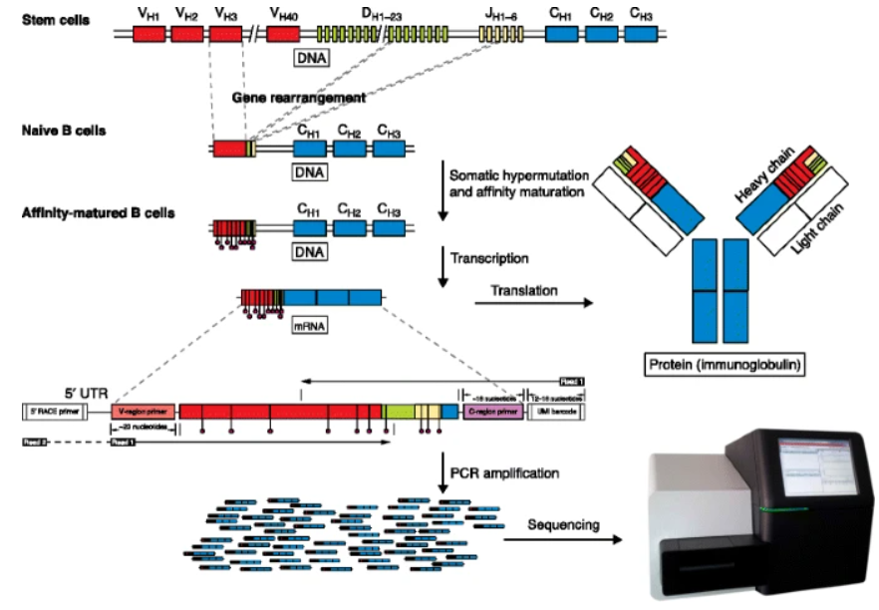
Overview of Rep-Seq

Slide 3
Processing steps
Pre Processing
Alignment and VDJ assignment-- abstar
Post processing

Slide 4
Clean up removes 25-35 % data
Remove incomplete rows
Remove fragments containing * (presumably stop codon or non determinant amino acids)
Removed smaller than 4 amino acid long chains
Remove duplicates
Start with Aligned data
Dataset A
(Healthy)
983
955
950
636
1000
Dataset B
(Disease)
991
975
968
755
1000

Slide 5
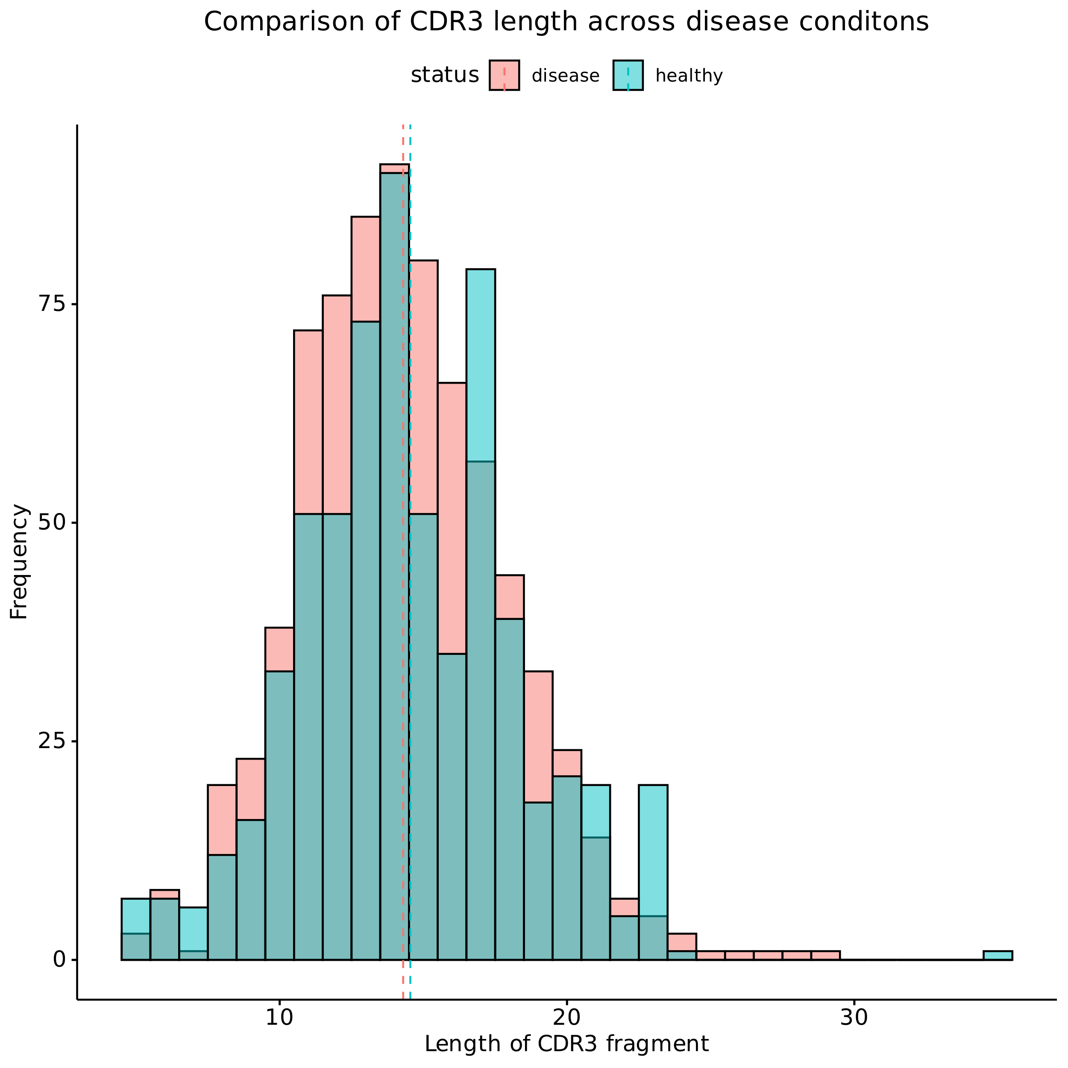
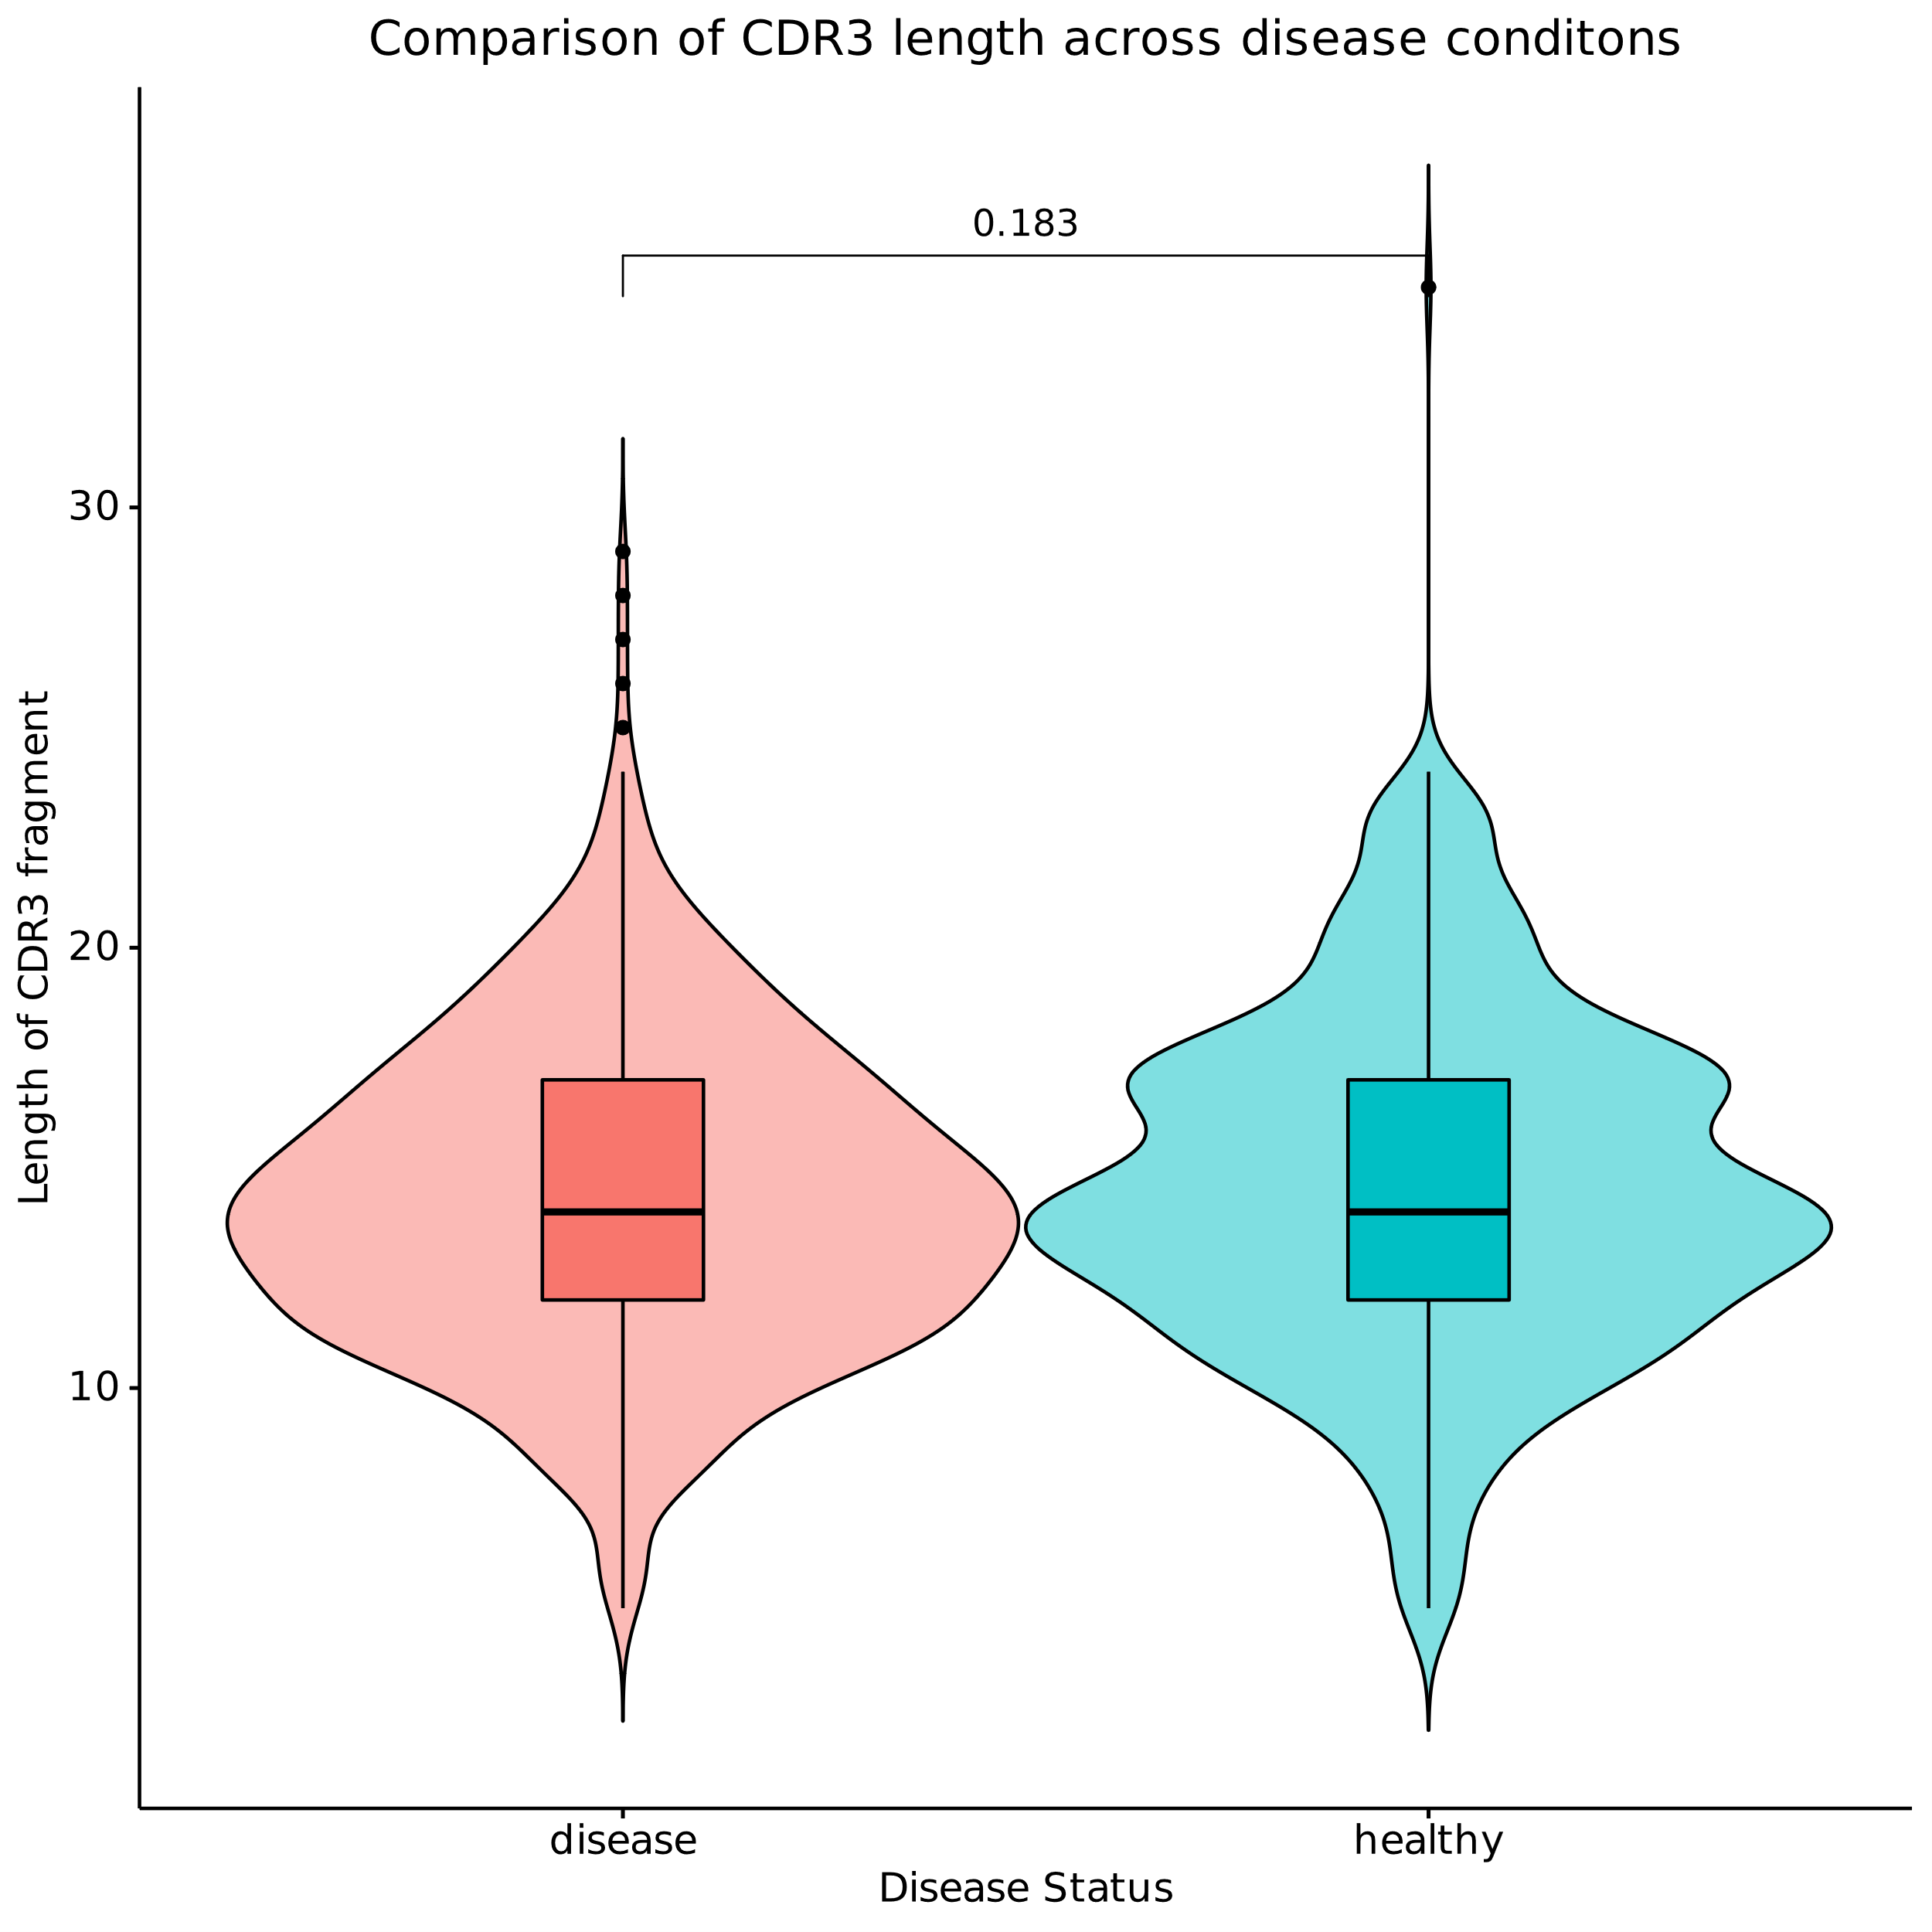
Both groups seem to use similar length CDR3 fragments
Need more biological replicates for conclusive analysis

Slide 6
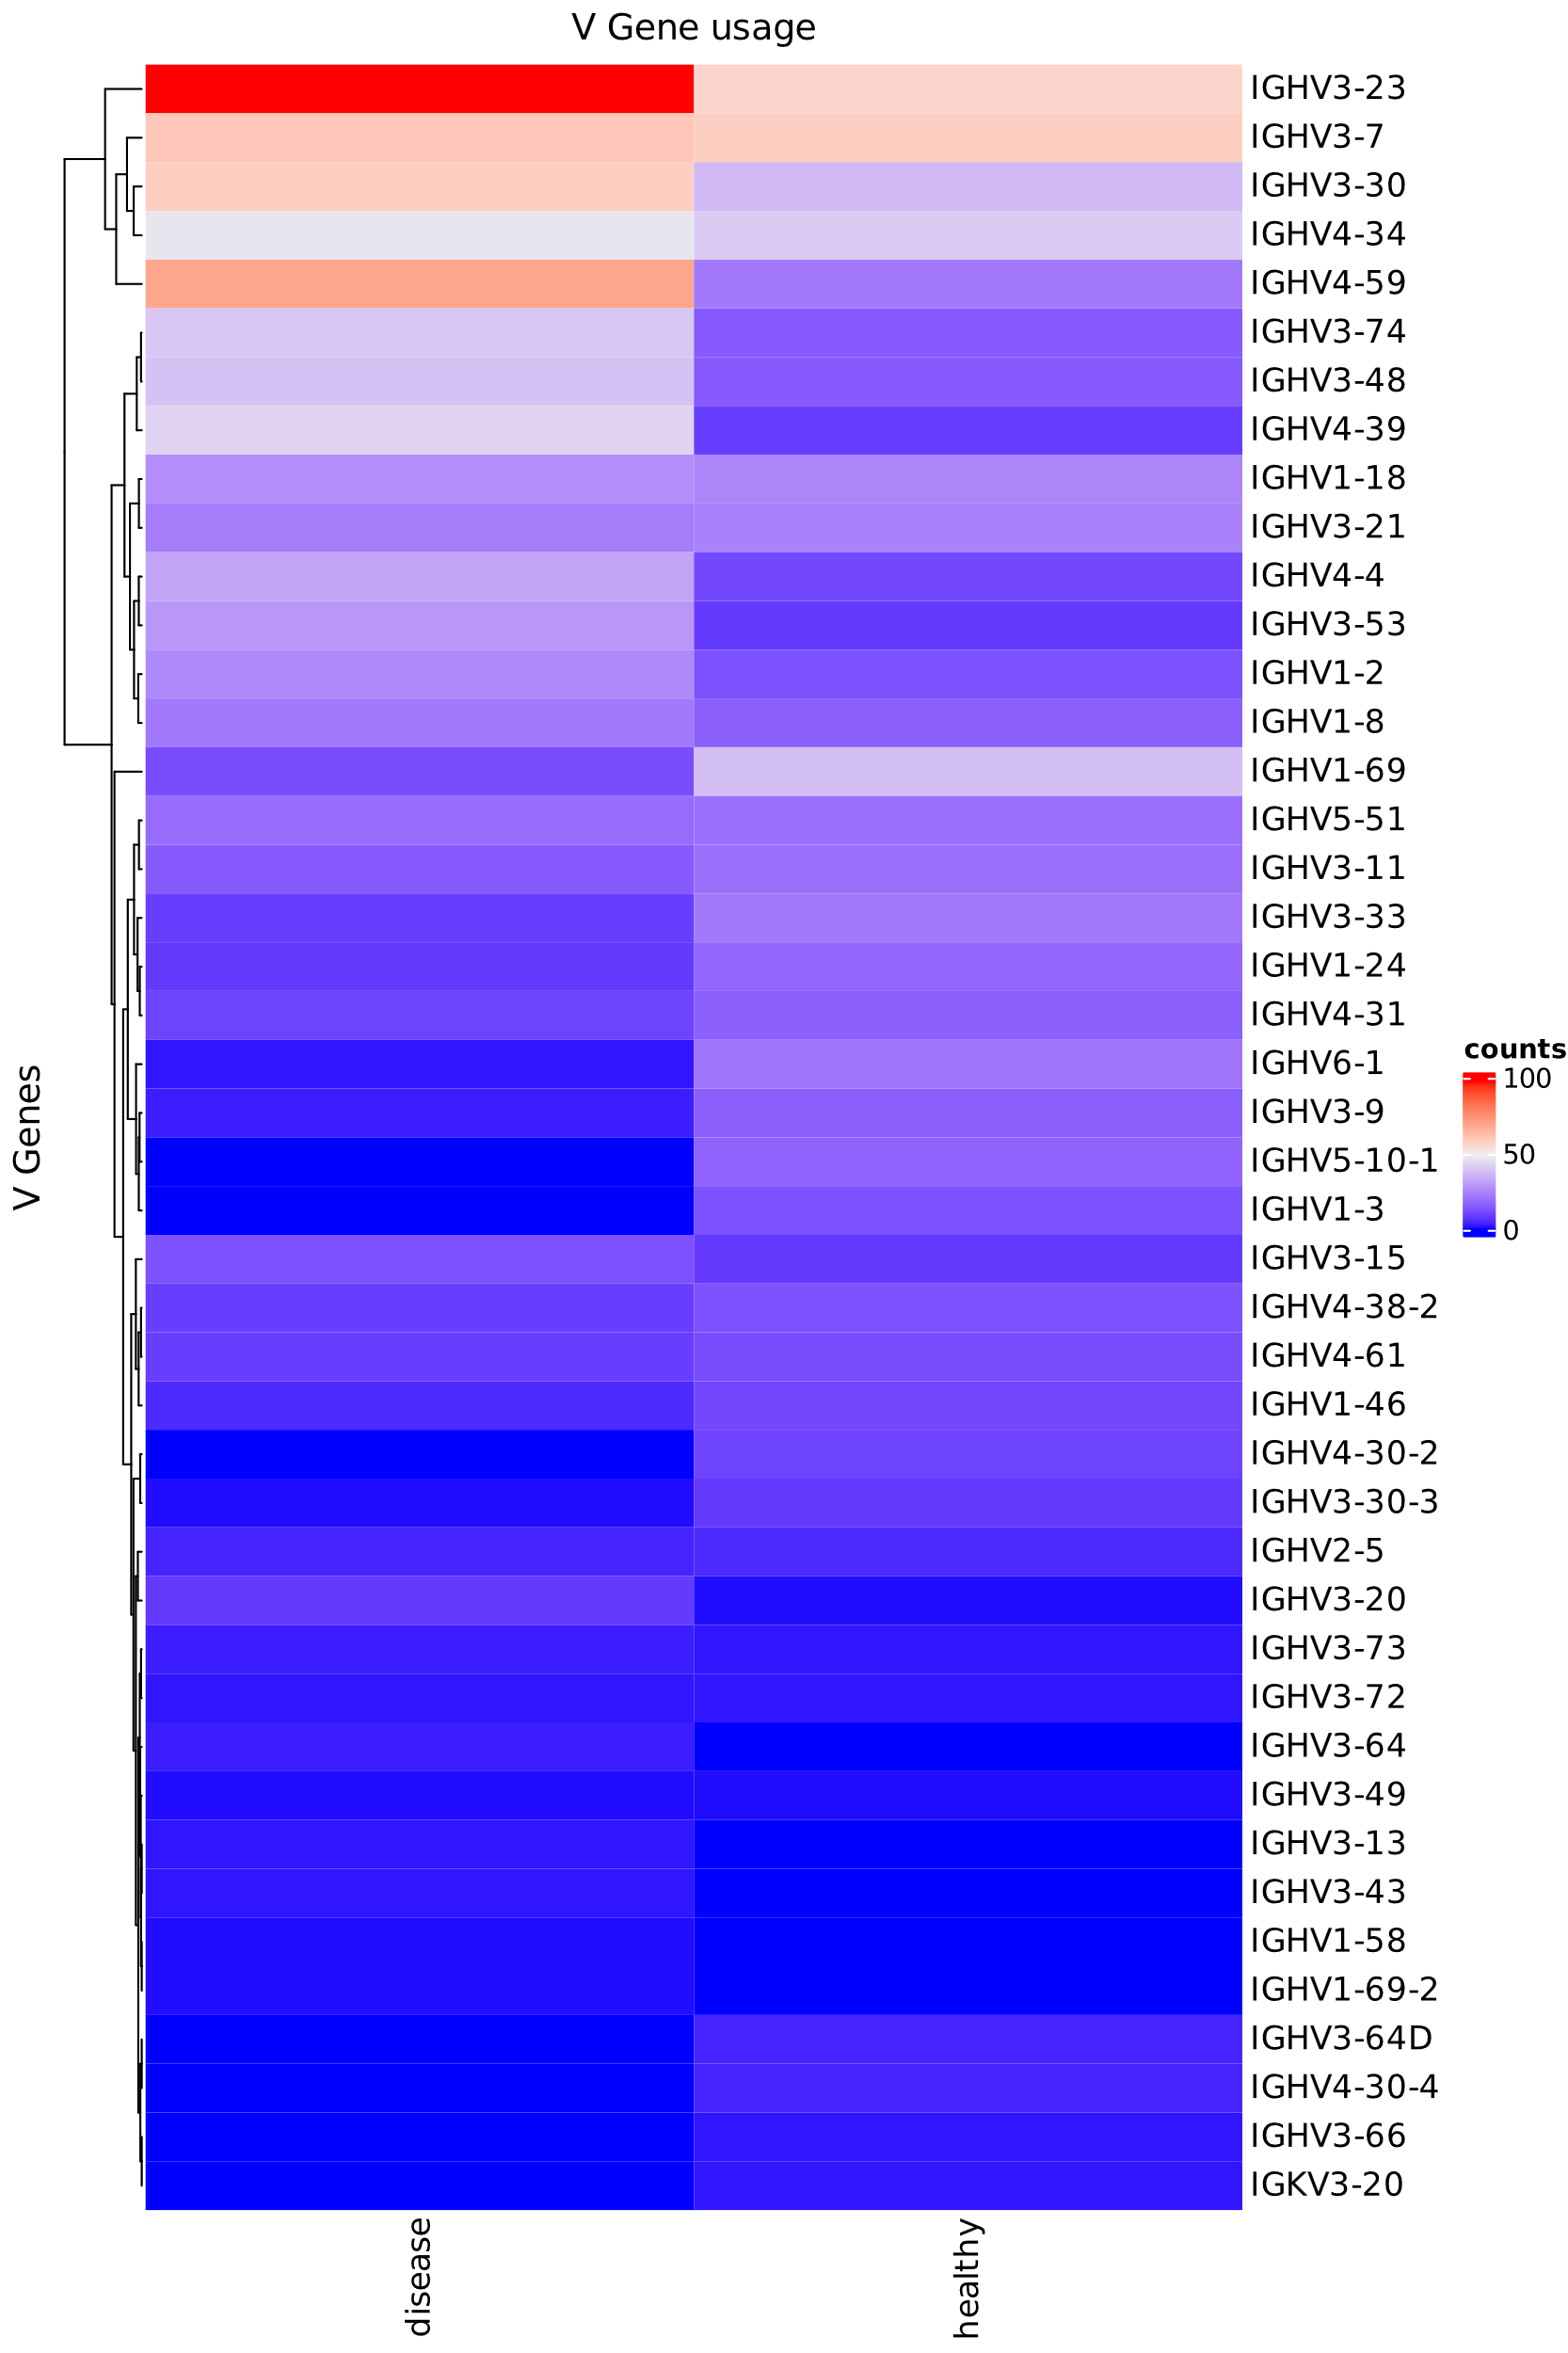
Few V-chain genes seem preferentially used in diseased samples
IGHV3-23, IGHV3-7, IGHV4-34, IGHV4-59 seem preferentially used in diseased conditions
Need more biological replicates for conclusive analysis

Slide 7
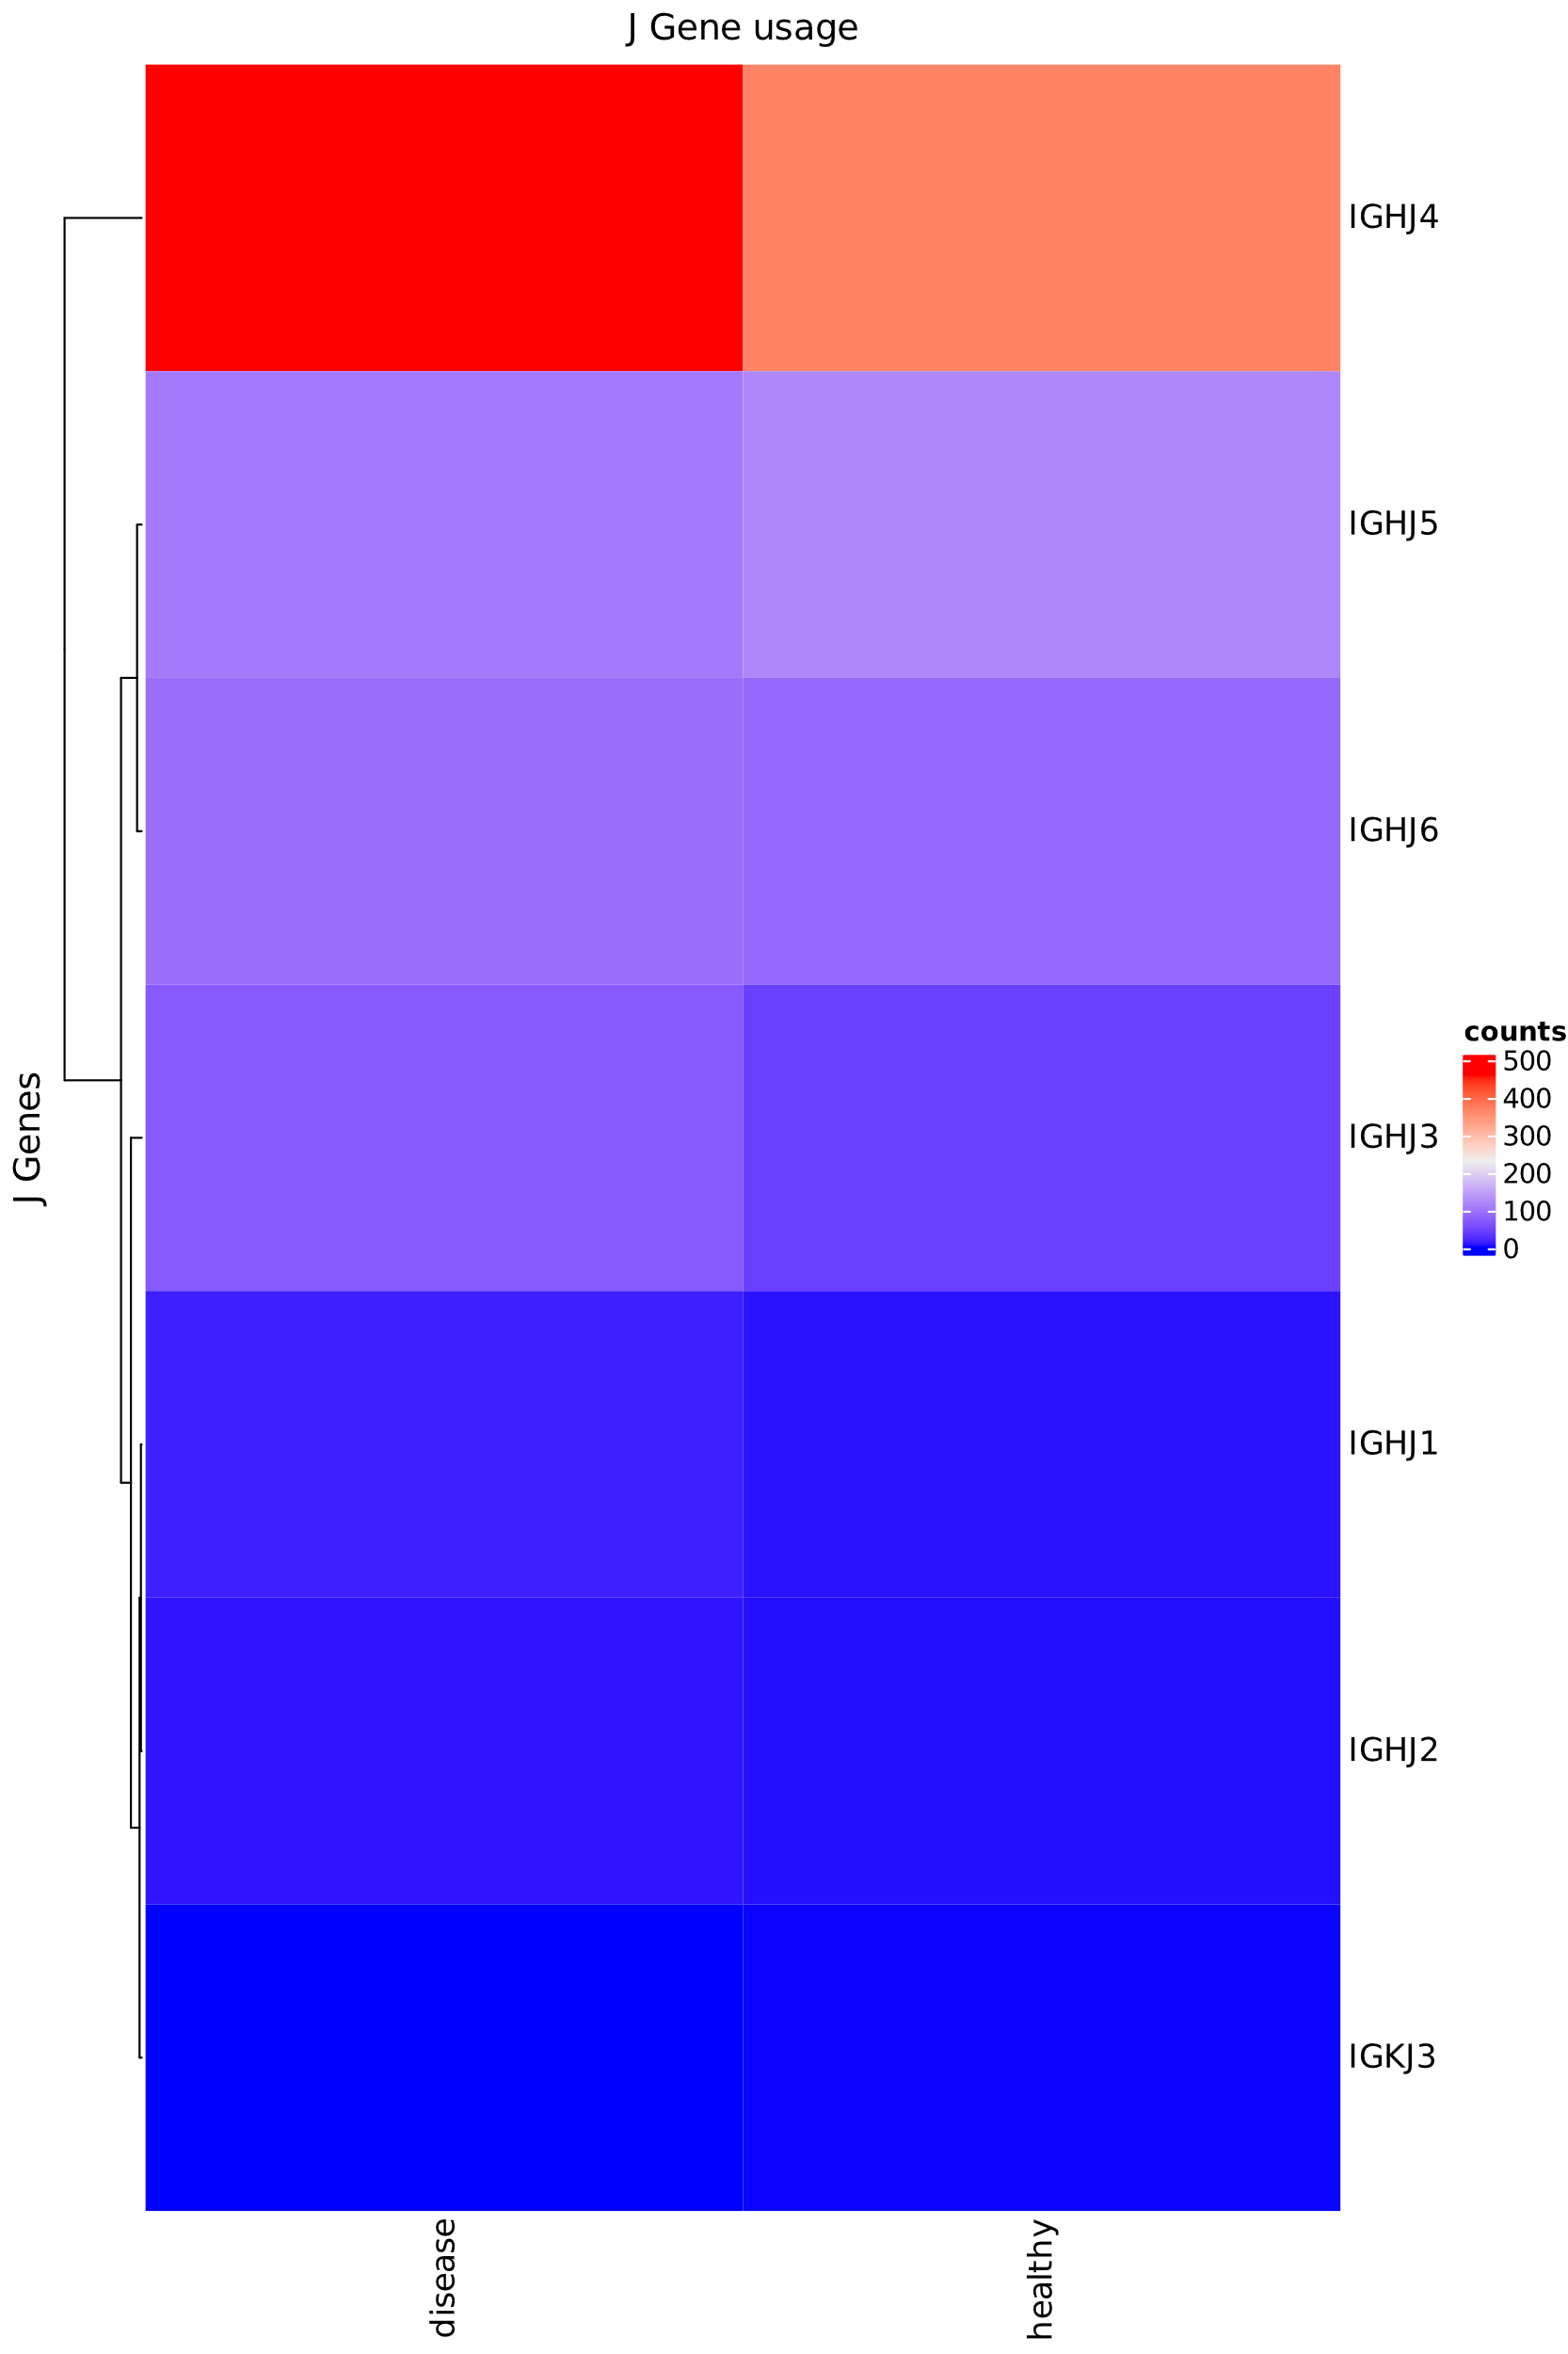
IGHJ4 seems to used more used in diseased conditions
Need more biological replicates for conclusive analysis

Slide 8
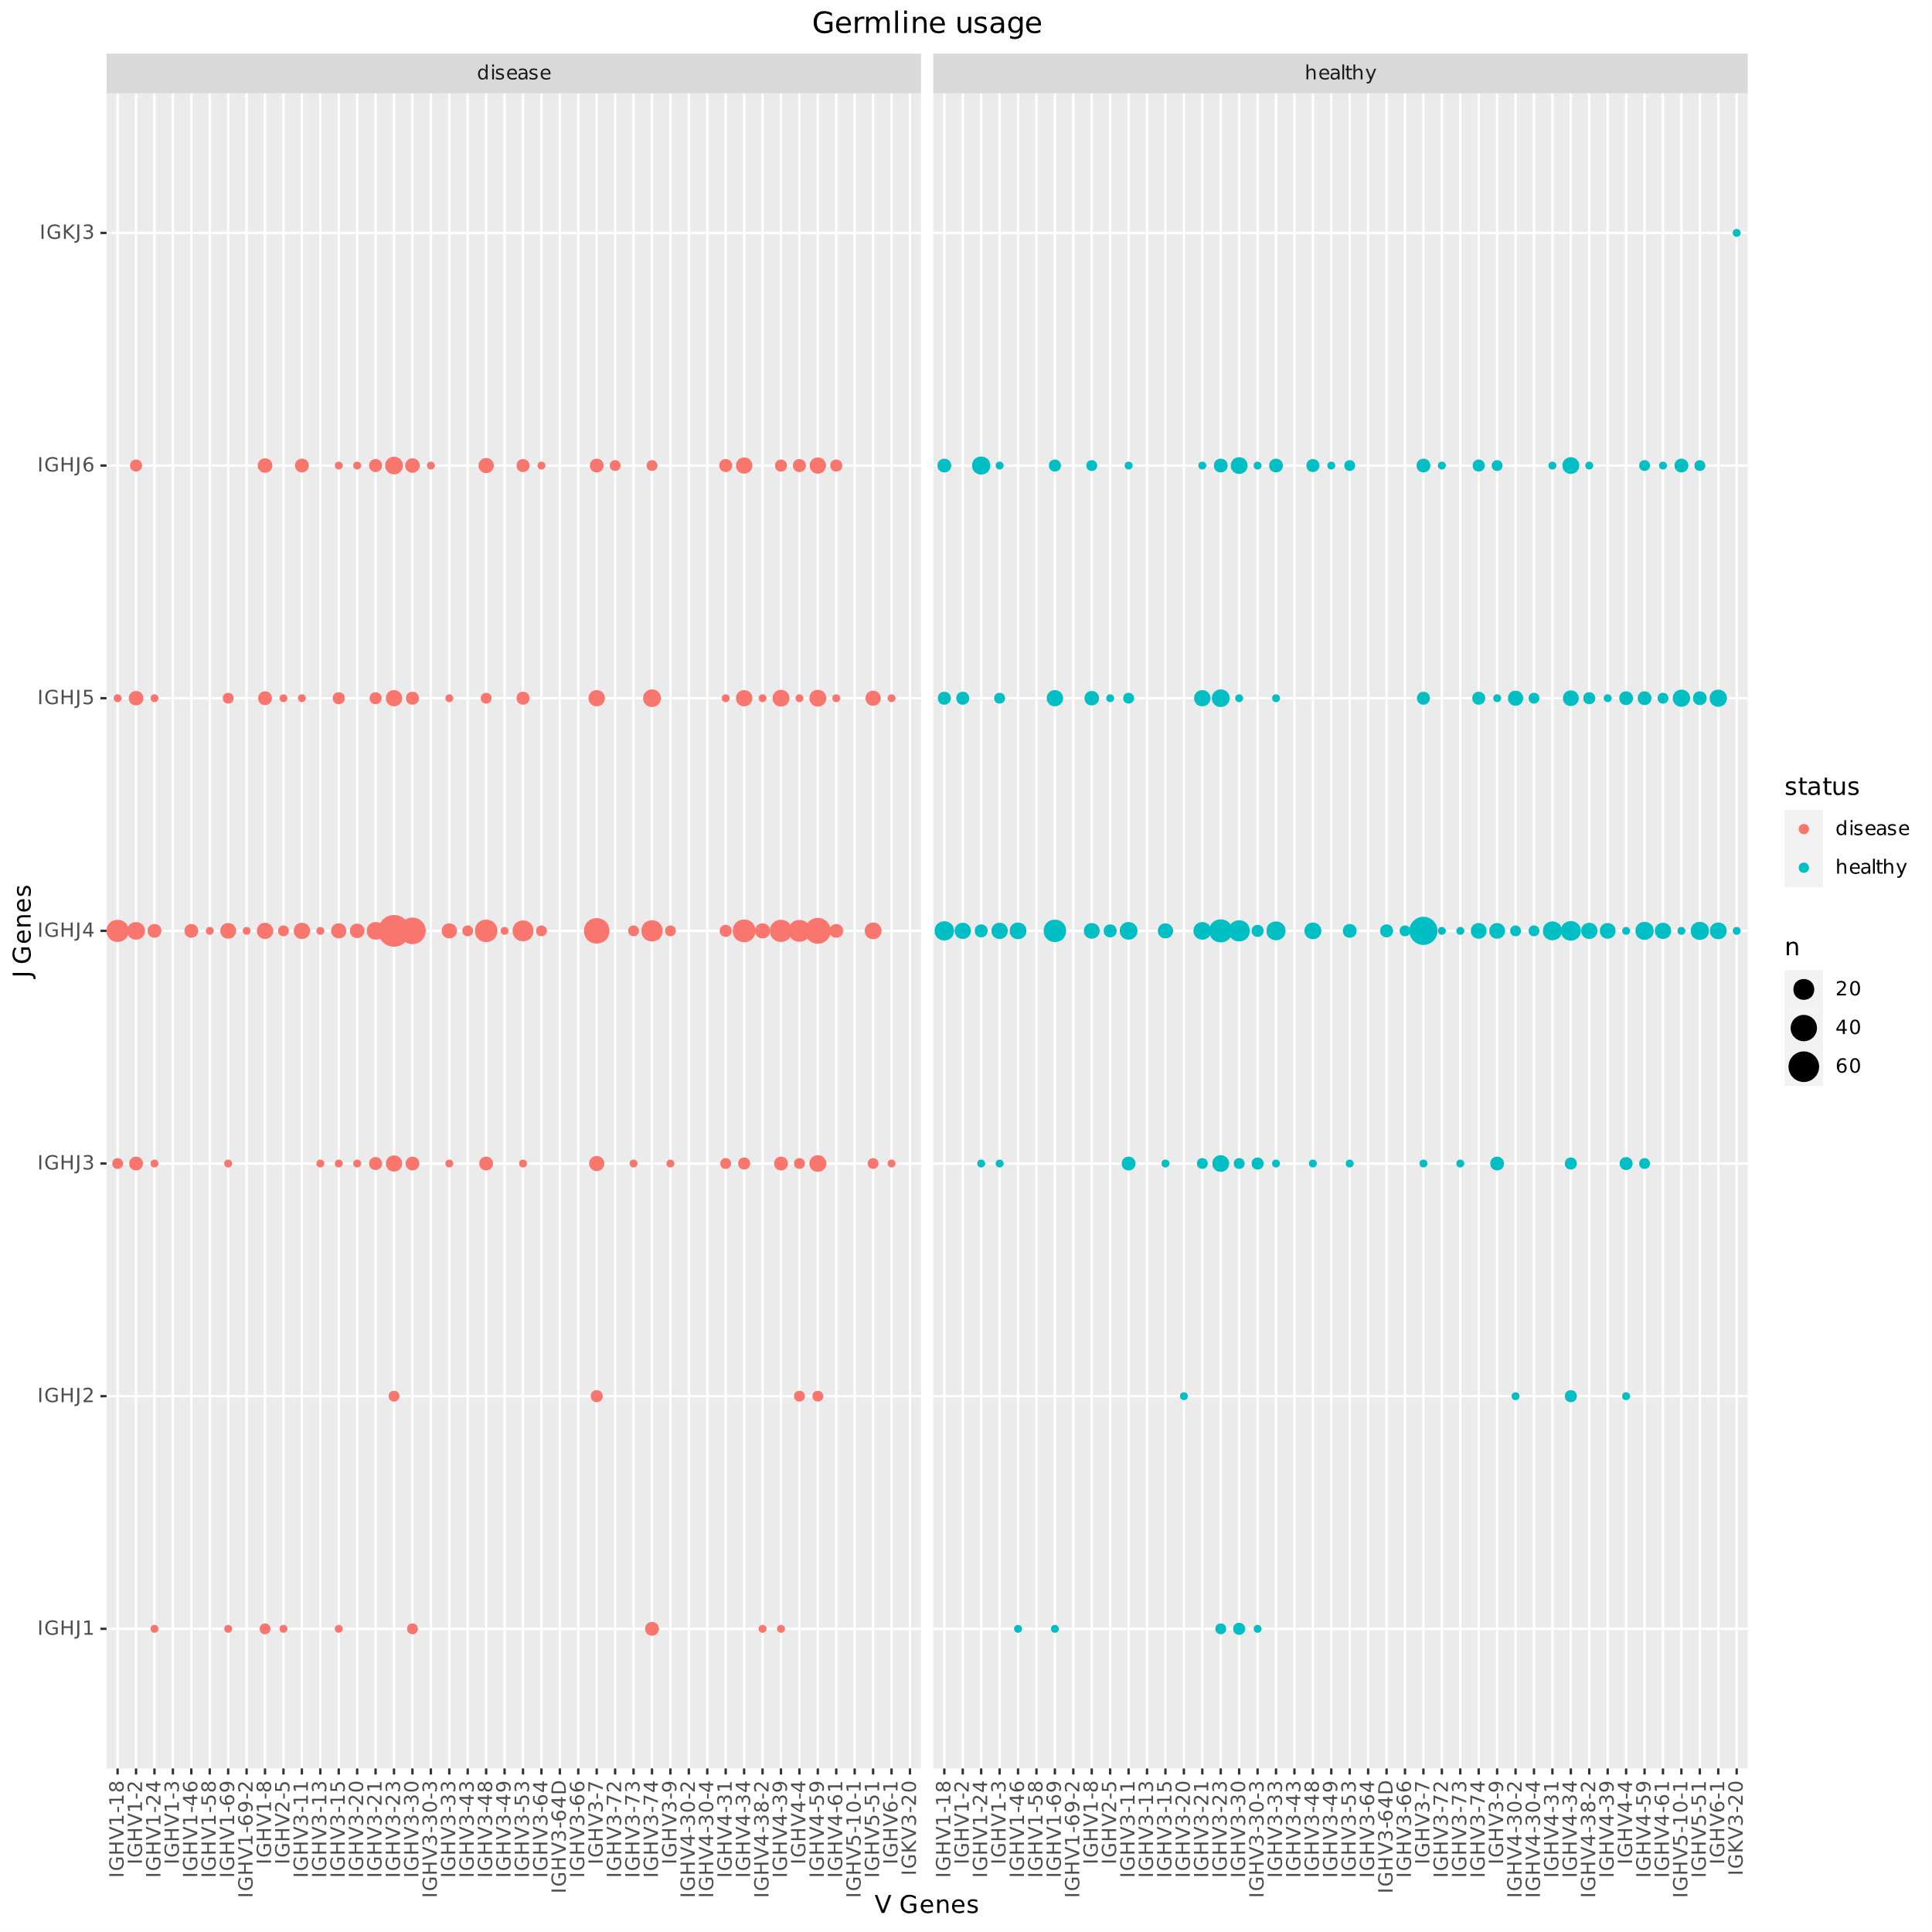
Some combinations of VJ are more used in disease
Need more biological replicates for conclusive analysis

Slide 9
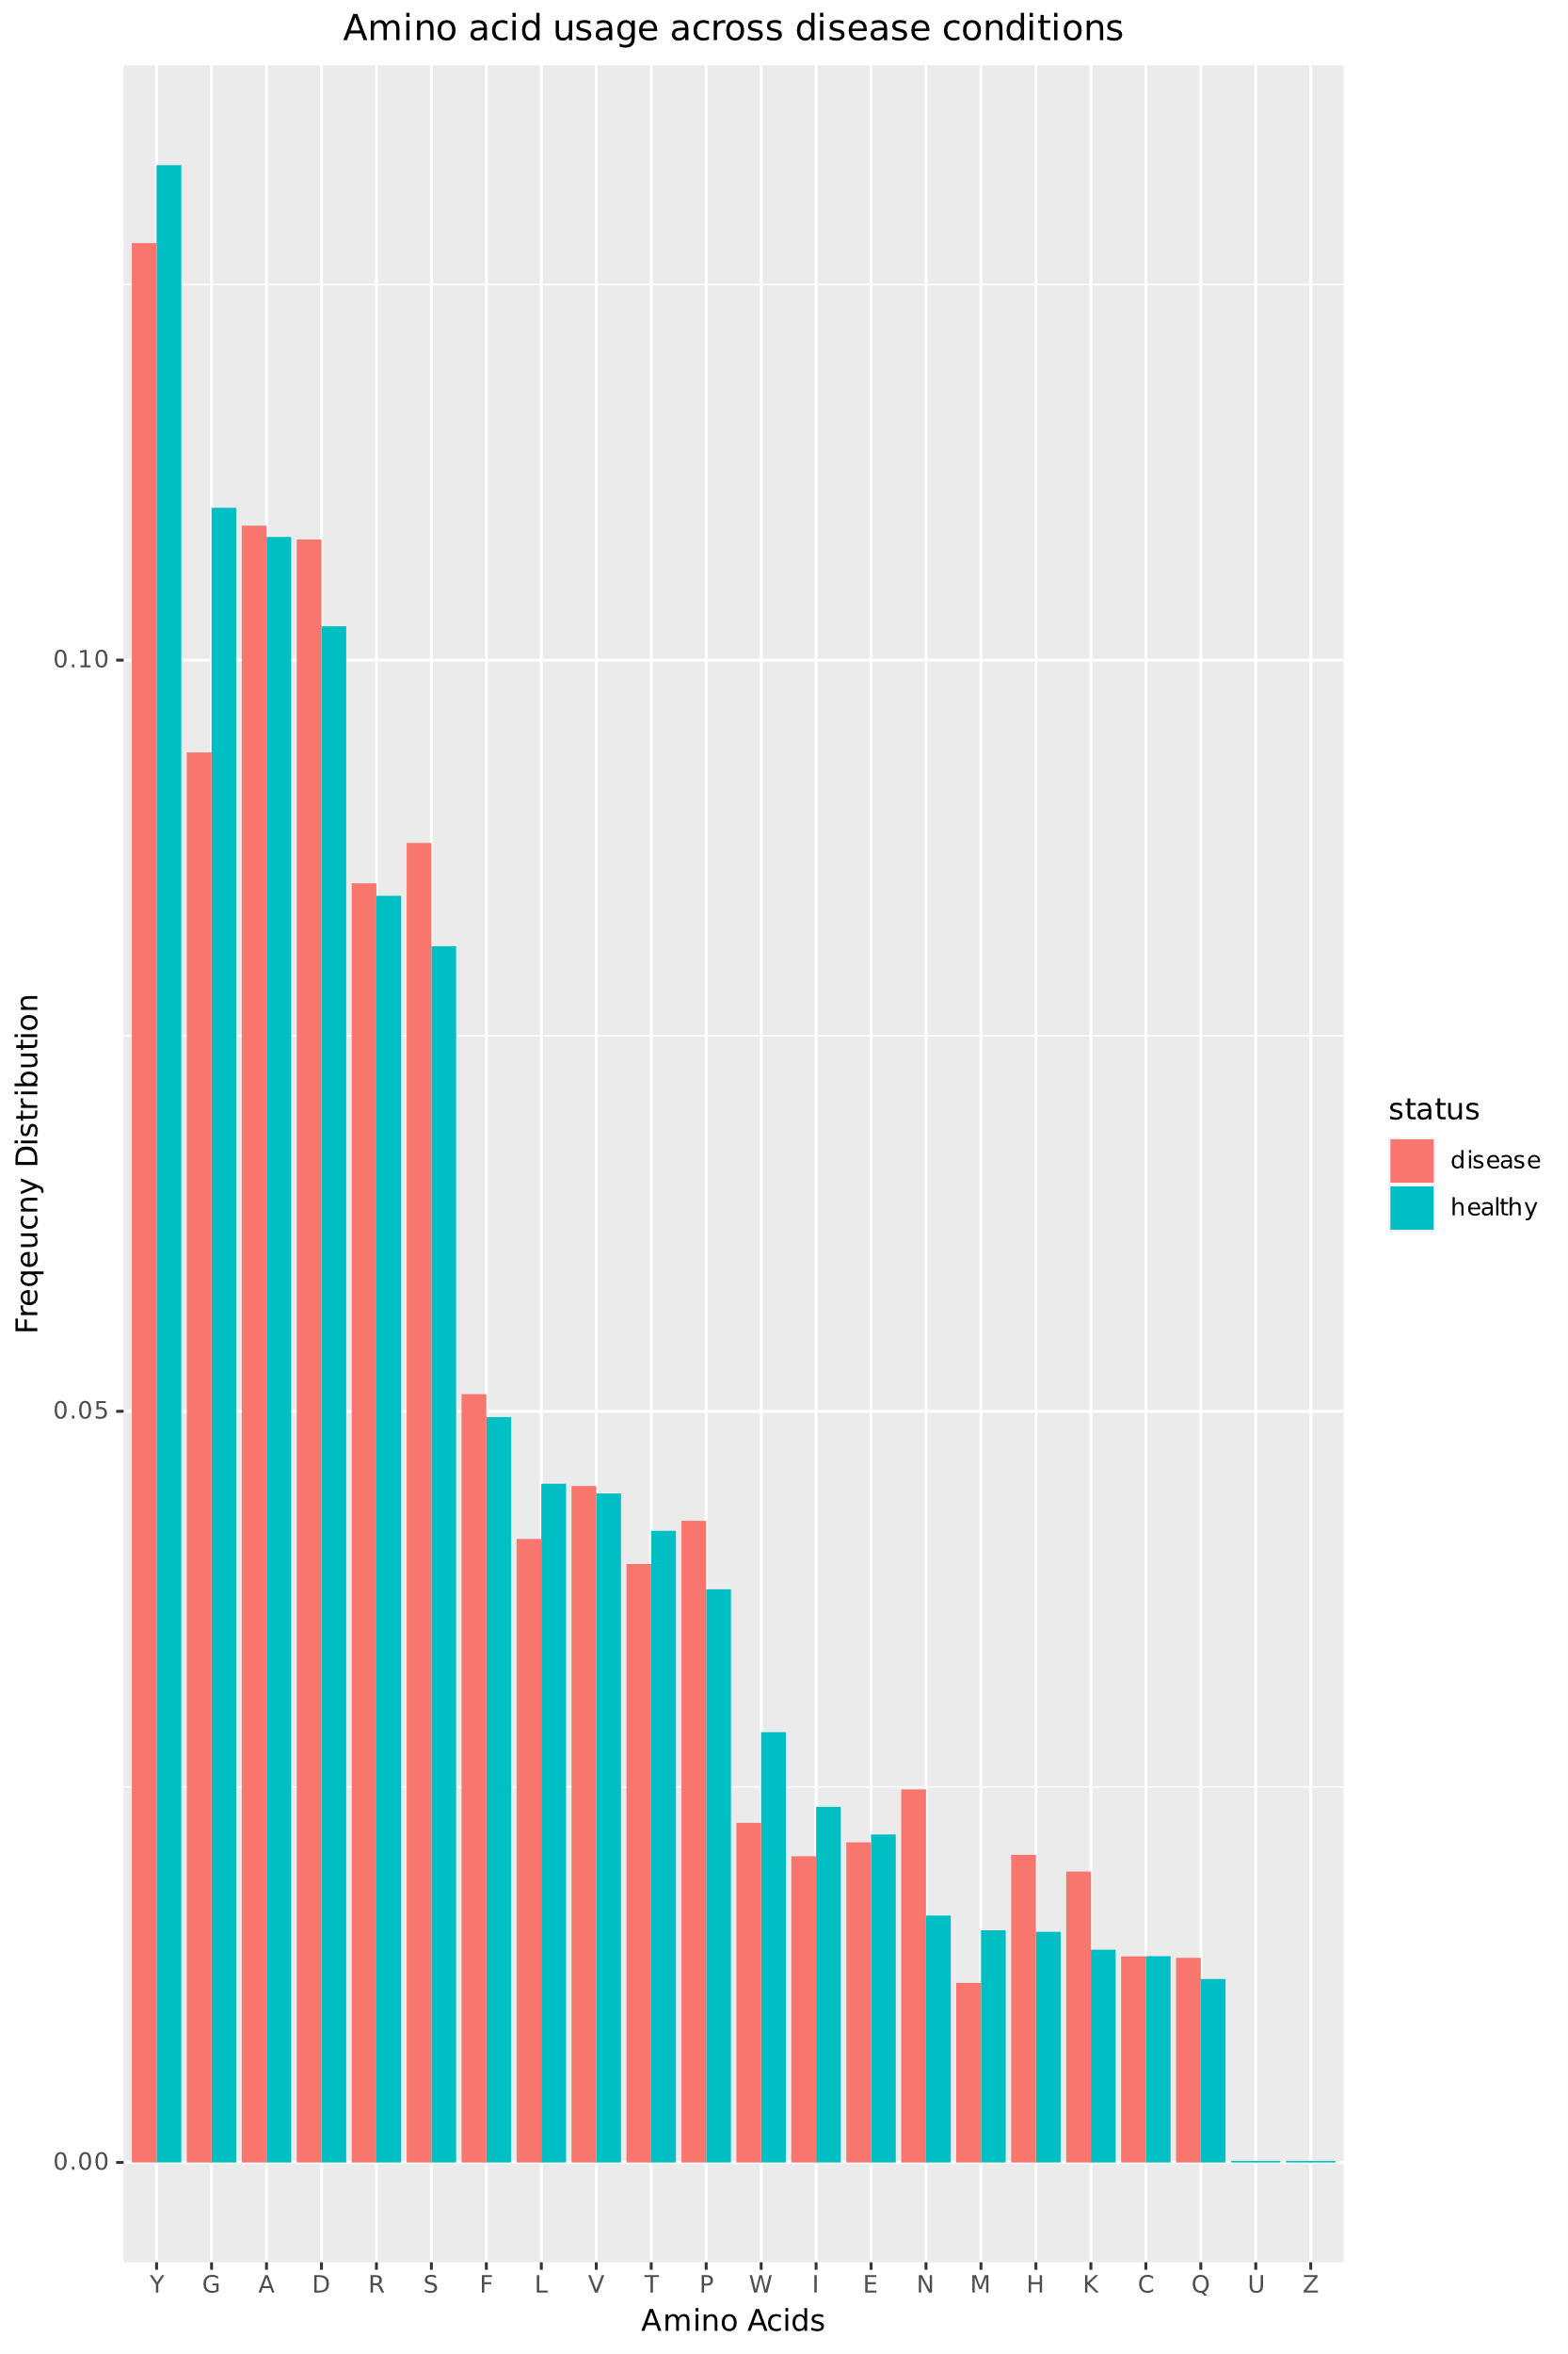
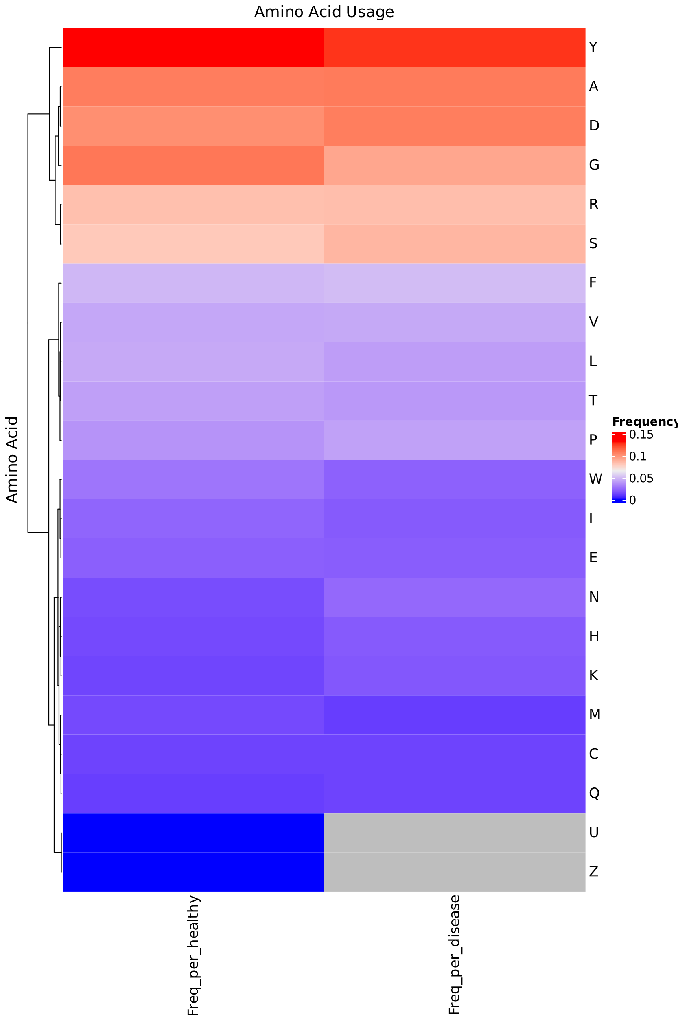
More amino acids are used in diseased conditions
Need more biological replicates for conclusive analysis

Slide 10
Thank You

