Slide 1
Rumour Mimimization
Under the supervision of –
Dr. Shikha Mehta
Made by -
Piyush Vashishtha (9915103265)
Prataya Amrit (9915103267)
Sparsh Majhe (9915103276)

Slide 2
A rumour is a piece of information or a story that has not been verified meaning that the person telling it doesn’t know if it’s true or false.
Why RUMOURS ?
To feel superior
For attention
For control
Out of boredom

Slide 3
People in the network are categorized into three groups :
Ignorant : People who are ignorant of rumours.
Spreaders : People who actively spread the rumours.
Stiflers : People who have heard the rumour but no longer interested in spreading the rumour.

Slide 4
Diffusion Model :
There are two types of diffusion models, namely :
Independent Cascade (IC)
Linear Threshold (LT)
Independent Cascade :
When node v becomes active, it has a single chance of activating each currently inactive neighbor w.
The activation attempt succeeds with probability p_{vw} .
The deterministic model is a special case of IC model. In this case, p_{vw} =1 for all (v,w).

Slide 5
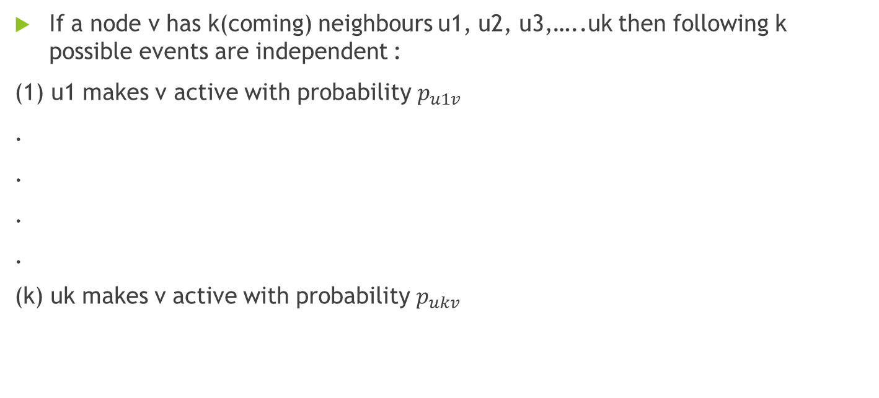
If a node v has k(coming) neighbours u1, u2, u3,…..uk then following k possible events are independent :
(1) u1 makes v active with probability $p_{u1v}$
.
.
.
.
(k) uk makes v active with probability $p_{ukv}$

Slide 6


Linear Threshold :
A node v has random threshold ~ U[0,1]
A node v is influenced by each neighbor w according to a weight b_{w,v} such that
A node v becomes active when at least (weighted) fraction of its neighbors are active

Slide 7
Improved Shuffled Frog Leaping Algorithm Using Memetic Reconfiguration

Slide 8
Nature Inspired Algorithms
Biological processes, biological structures and organizational principles found in nature.
Provides us with various problem solving methodologies which can be used to optimize complex real world scenarios.
Various types of Nature inspired algorithms include-
Genetic Algorithm
Memetic Algorithm
Particle Swarm Optimisation
Evolutionary Algorithm
Shuffled Frog Leaping Algorithm

Slide 9
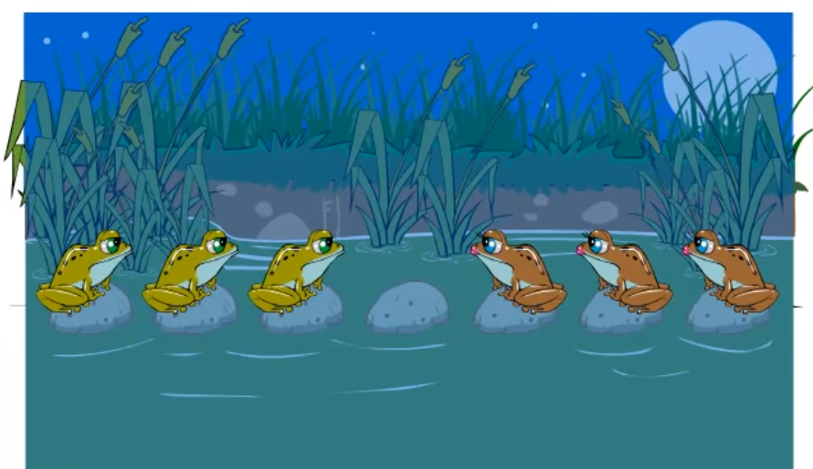
Shuffled Frog Leaping Algorithm

Slide 10
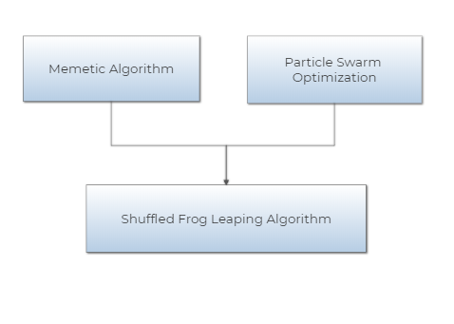
Developed by Muzaffar Eusuff, Kevin Lansey and Fayzul Pasha in 2003.
Integrates the merits of both the evolutionary approach based memetic algorithm and particle swarm optimisation algorithm.

Slide 11
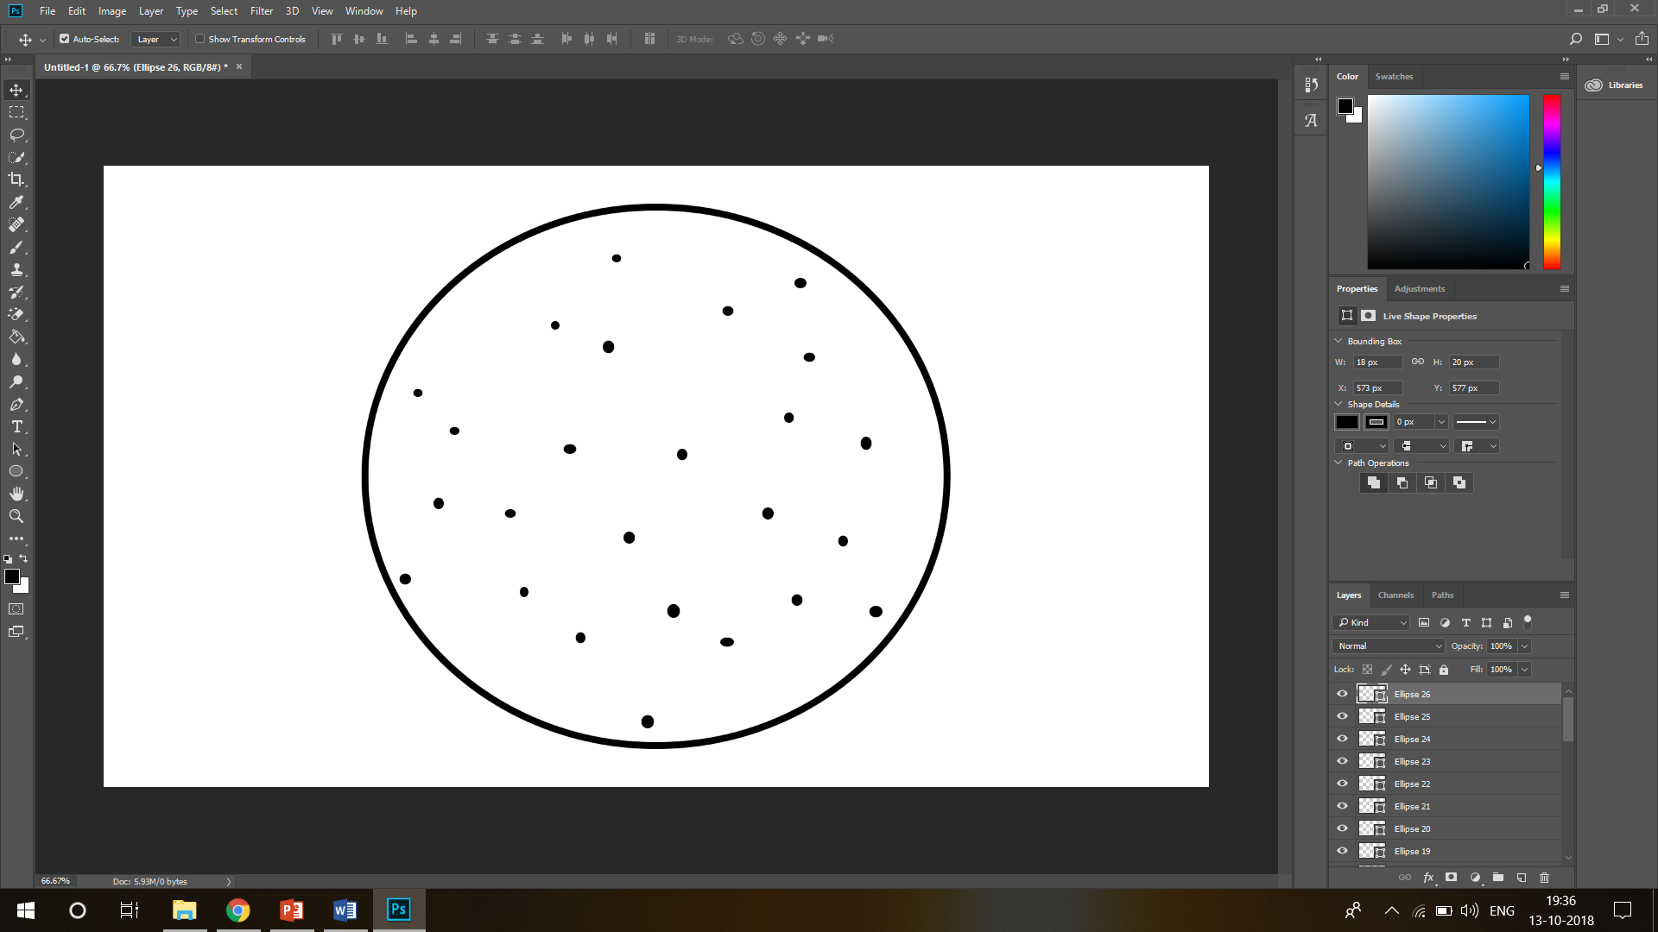
Composed of a set of frogs that are organized into diverse clusters, called the memeplexes.
Space containing set of frogs.

Slide 12


Slide 13
Composed of a set of frogs that are organized into diverse clusters, called the memeplexes.
Each frog in the memeplex denotes a potential solution to a given optimization problem.
Within every memeplex, each of the constituent frogs holds beliefs that they are influenced by the beliefs of other frogs and cultivated through a process of memetic evolution, called the local search.

Slide 14
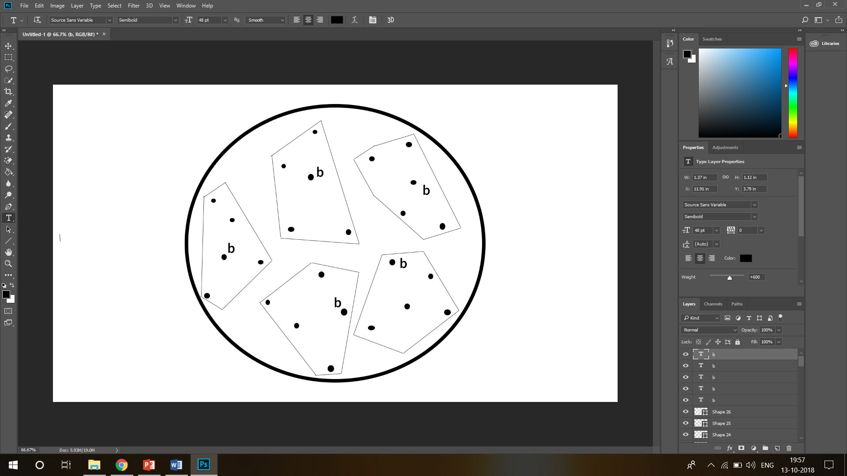
Local best frog in each memeplex.

Slide 15

Subsequent to a number of memetic evolutionary steps, the memeplexes are shuffled which leads to a global evolution.
These processes of local search and shuffling continue till the pre-defined convergence criteria are not met.

Slide 16
SFLA algorithm :
Firstly generate random population of P solutions (frogs)
For each individual i in P :- Calculate fitness f(i)
Sort the population P in ascending order of their fitness
Divide P into m memeplexes
For each memeplex m
Determine the fitness of local best ( X_{lb} ) frog as f_{lb}
Determine the fitness of local worst ( X_{w} ) frogs as f_{w}
For each iteration k
For each dimension d in individual i
Change in frog position (D_{d}) = rand () x (X_{lb}- X_{w}) (1) (D_{max} >= D_{d} >= -D_{max})
New Position X_{w} = X_{w} + D_{d}
Compute fitness of X_{w}

Slide 17
If fitness improves
New Position X_{w} = X_{w} + D_{d} ;
Else
Change in frog position (D_{d} ) = rand () x (X_{gb} - X_{w}) (2) (D_{max} >= D_{d} >= -D_{max})
New Position X_{w} = X_{w} + D_{d} ;
Compute fitness of X_{w} ;
If fitness improves
New Position X_{w} = X_{w} + D_{d} ;
Else
New Position X_{w} = rand() * D_{max} + rand() *(- D_{max} );
End
End
End
Combine the evolved memeplexes
Sort the population P in descending order of their fitness
Check if termination is true
End
End

Slide 18
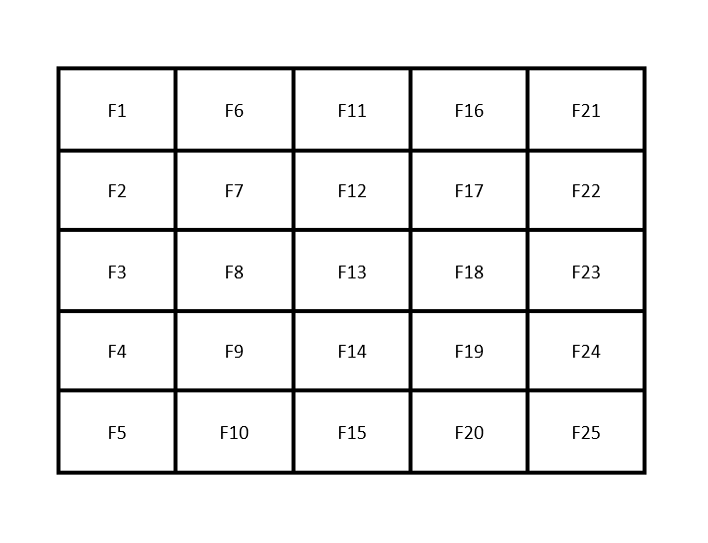
SFLA frog distribution in memeplex :

Slide 19
Memeplex matrix of each nodes in network: (passing values of fitness fumction)
Node | Out node 1 | Out node 2 | Out node 3 | Out node 4 | Out node 5 | Out node 6 | Out node 7 | Out node 8 | Out node 9 | Out node n
0 | 806 | 1268 | 1571 | 1907 | 4179 | 7339 | 7647 | 9195 | 9850 | .
1 | 1756 | 2723 | 3203 | 3278 | 3899 | 4093 | 4476 | 6022 | 8846 | .
2 | 130 | 1231 | 2936 | 4358 | 4546 | 5677 | 5875 | 6991 | 7347 | .
3 | 2251 | 2800 | 3240 | 5156 | 5336 | 8252 | 8955 | - | - | .
4 | 2046 | 5153 | 6437 | 7390 | 9247 | 9841 | - | - | - | .
5 | 1024 | 2213 | 4455 | 4723 | 5268 | 5795 | 7100 | 7303 | 8701 | .
6 | 11 | 952 | 1029 | 2367 | 3411 | 5734 | 6382 | 8573 | 9718 | .
7 | 319 | 1893 | 2261 | 3577 | 3907 | 4017 | 5337 | 6756 | 9120 | .
8 | 1320 | 4659 | 5197 | 5369 | 6663 | 7411 | 7441 | 7777 | 8743 | .
9 | 4291 | 4462 | 6721 | 7567 | - | - | - | - | - | .
10 | 65 | 416 | 1087 | 1392 | 6288 | 6530 | 7066 | 8803 | 9938 | .
11 | 2115 | 4391 | 6301 | 6542 | 724 | 7427 | - | - | - | .
12 | 29 | 445 | 1034 | 3146 | 4665 | 6062 | 8179 | 8393 | 9229 | .
13 | 984 | 994 | 1599 | 1743 | 2091 | 2936 | 4995 | 5164 | 7379 | .
14 | 309 | 415 | 3833 | 4114 | 4913 | 5445 | 9300 | - | - | .
15 | 657 | 1311 | 1922 | 2188 | 2850 | 2959 | 377 | 5560 | 8253 | .
16 | 157 | 688 | 1709 | 2348 | 2974 | 3474 | 5741 | 6944 | 8258 | .
And | . | . | . | . | . | . | . | . | . | .
So | . | . | . | . | . | . | . | . | . | .
On… | . | . | . | . | . | . | . | . | . | .

Slide 20
We got the activated neighbouring nodes of each nodes in the network after certain defined timestamp.
We chose the node having highest probability value (from fitness function).
The chosen node would be the node which is activating in current time stamp. So we block that node.
We then again sort the matrix in descending order and the highest value node would be again blocked in next time stamp.
Similarly the process continues till each and every activated nodes in the network got blocked.

Slide 21
Results :
SNo. | Time Stamp | Activated Nodes | Inactive Nodes | Blocked Nodes
1. | T0 | 512 | 9488 | 0
2. | T1 | 512 | 9232 | 256
3. | T2 | 510 | 8978 | 512
4. | T3 | 510 | 8723 | 767
5. | T4 | 504 | 8468 | 1022
6. | T5 | 500 | 8226 | 1274

