Slide 1
Improved Shuffled Frog Leaping Algorithm Using Memetic Reconfiguration

Slide 2
Under the supervision of- Dr. Shikha Mehta
Made by-
Piyush Vashishtha (9915103265)
Prataya Amrit (9915103267)
Sparsh Majhe (9915103276)

Slide 3
Nature Inspired Algorithms
Biological processes, biological structures and organizational principles found in nature.
Provides us with various problem solving methodologies which can be used to optimize complex real world scenarios.
Various types of Nature inspired algorithms include-
Genetic Algorithm
Memetic Algorithm
Particle Swarm Optimisation
Evolutionary Algorithm
Shuffled Frog Leaping Algorithm

Slide 4

Shuffled Frog Leaping Algorithm

Slide 5
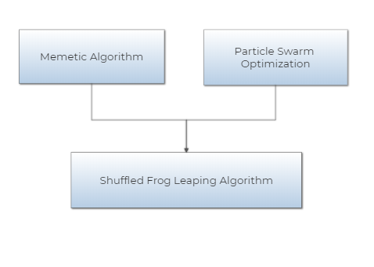
Developed by Muzaffar Eusuff, Kevin Lansey and Fayzul Pasha in 2003.
Integrates the merits of both the evolutionary approach based memetic algorithm and particle swarm optimisation algorithm.

Slide 6
Composed of a set of frogs that are organized into diverse clusters, called the memeplexes.

Slide 7
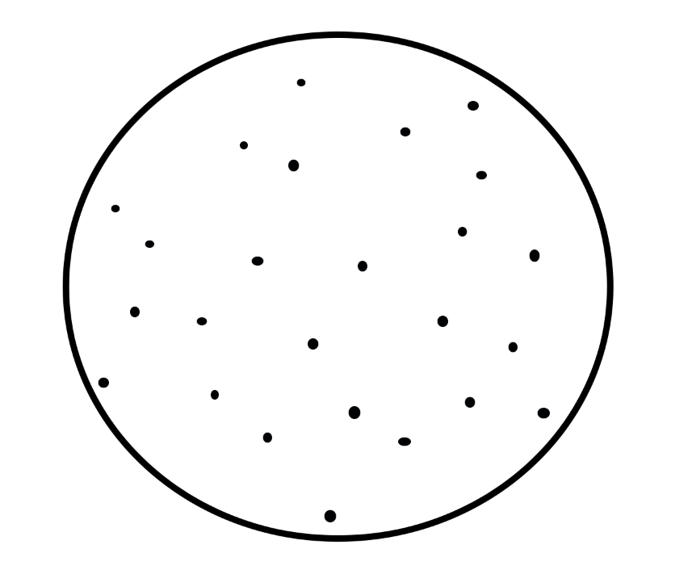
Space containing set of frogs

Slide 8

Frogs divided into memeplexes

Slide 9
Composed of a set of frogs that are organized into diverse clusters, called the memeplexes.
Each frog in the memeplex denotes a potential solution to a given optimization problem.
Within every memeplex, each of the constituent frogs holds beliefs that they are influenced by the beliefs of other frogs and cultivated through a process of memetic evolution, called the local search.

Slide 10
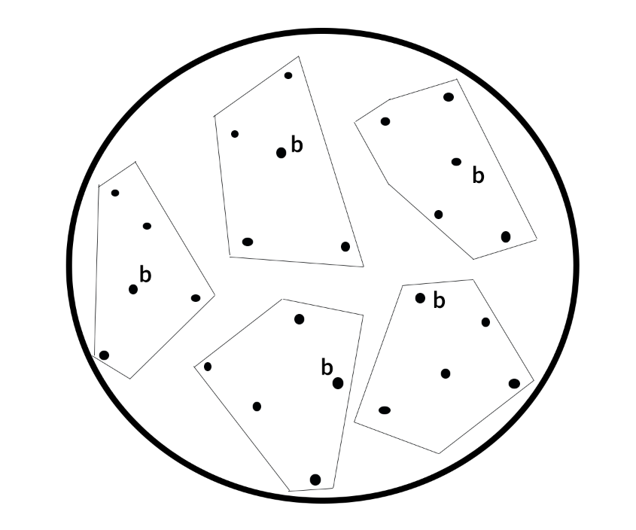
Local best frogs in each memeplex

Slide 11
Composed of a set of frogs that are organized into diverse clusters, called the memeplexes.
Each frog in the memeplex denotes a potential solution to a given optimization problem.
Within every memeplex, each of the constituent frogs holds beliefs that are influenced by the beliefs of other frogs and cultivated through a process of memetic evolution, called the local search.
Subsequent to a number of memetic evolutionary steps, the memeplexes are shuffled which leads to a global evolution.

Slide 12

Global best frog

Slide 13
Composed of a set of frogs that are organized into diverse clusters, called the memeplexes.
Each frog in the memeplex denotes a potential solution to a given optimization problem.
Within every memeplex, each of the constituent frogs holds beliefs that are influenced by the beliefs of other frogs and cultivated through a process of memetic evolution, called the local search.
Subsequent to a number of memetic evolutionary steps, the memeplexes are shuffled which leads to a global evolution.
These processes of local search and shuffling continue till the pre-defined convergence criteria are not met.

Slide 14
SFLA algorithm-
Firstly generate random population of P solutions (frogs)
For each individual i in P :- Calculate fitness f(i)
Sort the population P in ascending order of their fitness
Divide P into m memeplexes
For each memeplex m
Determine the fitness of local best ( X_{lb} ) frog as f_{lb}
Determine the fitness of local worst ( X_{w} ) frogs as f_{w}
For each iteration k
For each dimension d in individual i
Change in frog position (D_{d}) = rand () x (X_{lb}- X_{w}) (1) (D_{max} >= D_{d} >= -D_{max})
New Position X_{w} = X_{w} + D_{d}
Compute fitness of X_{w}

Slide 15
If fitness improves
New Position X_{w} = X_{w} + D_{d} ;
Else
Change in frog position (D_{d} ) = rand () x (X_{gb} - X_{w}) (2) (D_{max} >= D_{d} >= -D_{max})
New Position X_{w} = X_{w} + D_{d} ;
Compute fitness of X_{w} ;
If fitness improves
New Position X_{w} = X_{w} + D_{d} ;
Else
New Position X_{w} = rand() * D_{max} + rand() *(- D_{max} );
End
End
End
Combine the evolved memeplexes
Sort the population P in descending order of their fitness
Check if termination is true
End
End

Slide 16
Previous work on SFLA
Memetic Evolution using Interactive Learning Method which leads to faster convergence rate.
Improving SFLA by Orthogonal Learning in which a guidance vector is generated by combination of efficient dimensions of frogs.
Modification by convergence of update process in local search.

Slide 17
Proposed Algorithms
SFLA Version 1
SFLA Version 2
SFLA Version 3

Slide 18
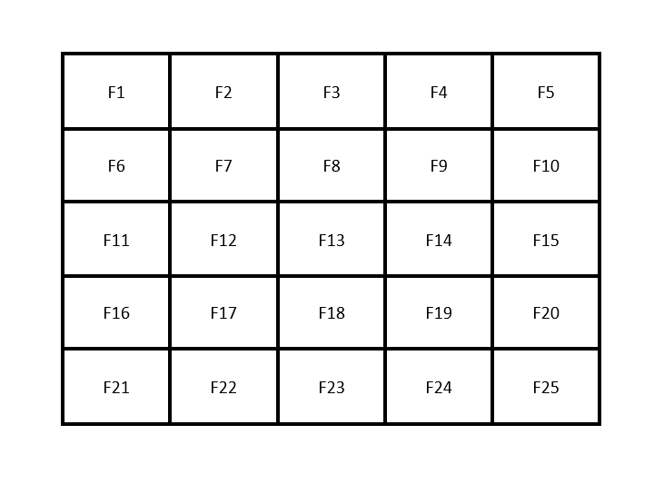
SFLA Version 1
Row-wise Distribution

Slide 19

SFLA Version 2
Column-wise Distribution

Slide 20
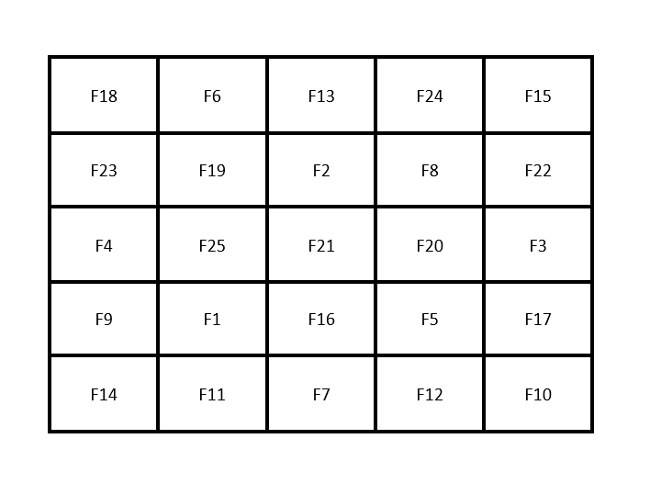
SFLA Version 3
Random Distribution

