Slide 1
Part 1: Preprocessing
Filter-bank CSP + band power in short time windows
ML Frontiers, VISTEC · BCIC IV-2a, left vs right hand MI

Slide 2
Why not just use CSP, or MixNet’s input?
MI shows up as ERD/ERS in Mu and beta, around C3/C4 [lecture p.51]
Classic CSP keeps one log-variance per trial, so it throws away the timing inside the trial [lecture p.62]
MixNet keeps the whole CSP time series [lecture p.63]: 7,200 numbers per trial, learned from only ∼115 training trials
 | Classic FBCSP | MixNet | Ours
Keeps timing | no | all 400 samples | 15 windows
Shape per trial | 36 | 18 × 400 | 36 × 15
Numbers per trial | 36 | 7,200 | 540
Hypothesis
Band power in short time windows keeps the timing of ERD/ERS, at a size a small model can learn from ∼115 trials.
1/5

Slide 3
Pipeline: four steps, two of them learned
same as MixNet
our change
Raw EEG
20 channels
4 s at 100 Hz
Filter bank
9 bands, 4-40 Hz
Butterworth
CSP per band
4 filters
per band
Log-variance
0.5 s windows
0.25 s step
Standardize
each feature
20 × 400
9 × 20 × 400
36 × 400
36 × 15
36 × 15
Teal boxes: fit on the training fold only
Output per trial
“Fit CSP: training data only” [lecture p.60]
“Training-set per-channel standardization” [lecture p.31]
Validation and session E only reuse the saved filters and mean/SD. A self-check in the code tests this.
36 features (9 bands × 4 CSP filters) × 15 time windows, standardized
2/5

Slide 4
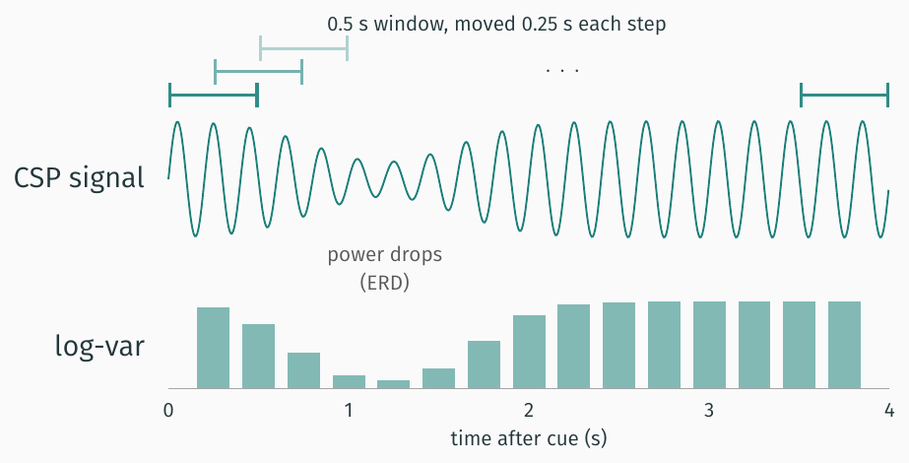
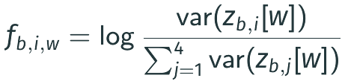
Our change: one log-variance per short window
Normalized log-variance
For band b, CSP filter i, window w:
[lecture p.59]
(400 − 50)/25 + 1 = 15 windows in 4 s
This step learns nothing, so it cannot leak
Then each feature is standardized with the training-fold mean and SD [lecture p.31]
3/5

Slide 5
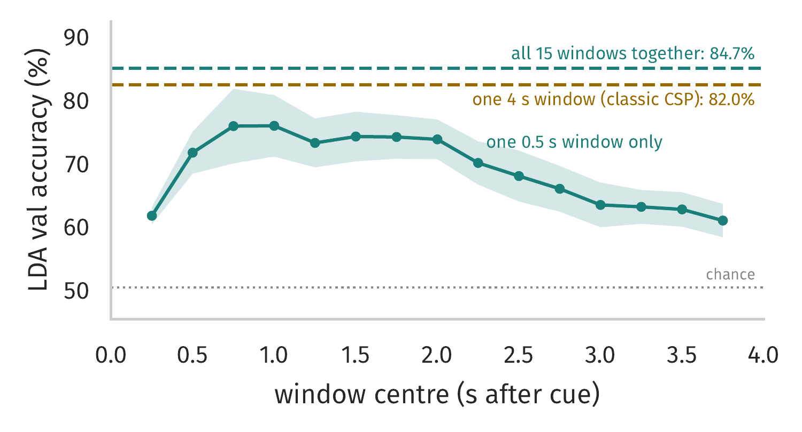
Quick LDA test: class information is not spread evenly in time
One 0.5 s window (36 numbers, one LDA per window): peaks at 0.75-1 s (75.5%), near 61% at both ends
One 4 s window = whole trial, classic CSP (36 numbers): 82.0%
All 15 windows together = our features (540 numbers): 84.7%, better in 8 of 9 subjects
How we got these numbers
A simple shrinkage LDA, the classic classifier after CSP [lecture p.60], trained on our features before building HWNet. Same 5 folds as the real pipeline: fit on the training fold, score on the validation fold of session T, mean of 9 subjects (band = ±1 SE). Session E not used: not test results, not comparable with MixNet.
4/5

Slide 6
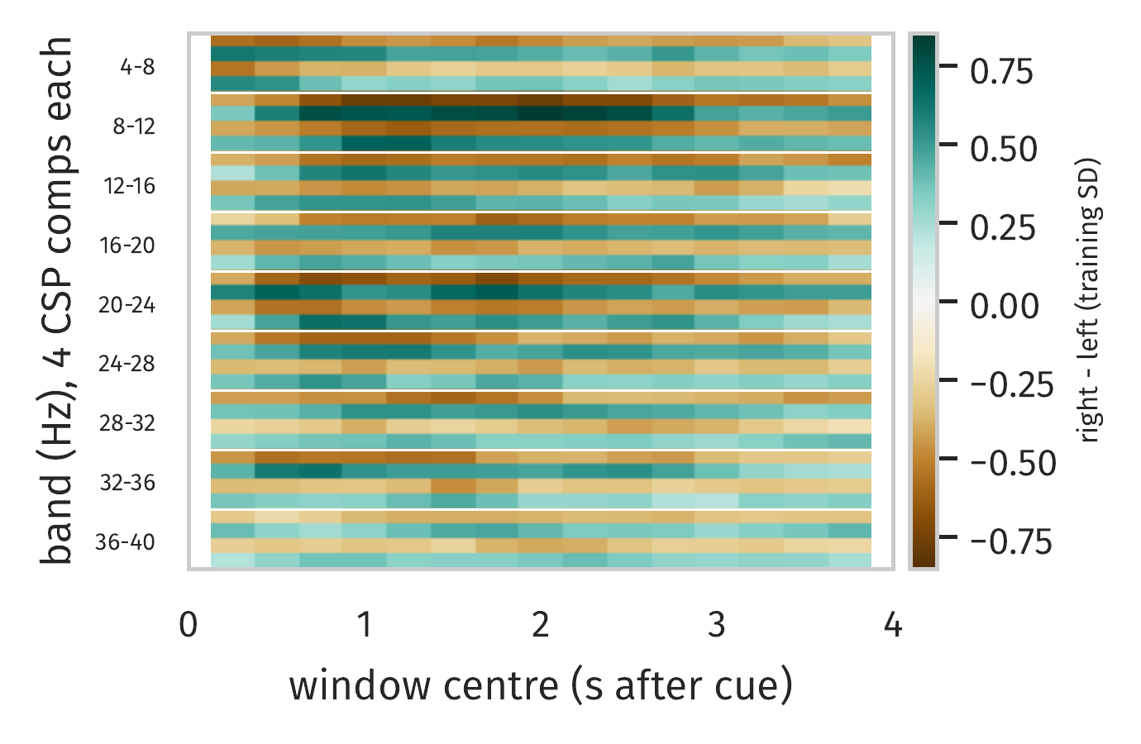
What the model sees: 36 features × 15 windows
Each cell: right minus left class mean, in training SD units
Strongest in 8-12 Hz (Mu) and 20-24 Hz (beta), from about 0.5 to 2.5 s, the bands where ERD/ERS shows up [lecture p.51]
Rows alternate in sign because CSP takes filters from both ends: one end has more power for left hand, the other for right [lecture p.57]
Takeaway
Each trial becomes which band, which spatial filter and when, in 540 numbers.
All 144 session T trials per subject, averaged over 9 subjects. Session E not used.
5/5

Slide 7
Part 2: Model Development
HWNet: a compact temporal CNN on the 36 × 15 features
ML Frontiers, VISTEC · architecture, hyperparameter tuning, benchmark against MixNet

Slide 8
HWNet: two small temporal conv blocks, 5,362 parameters
kernels slide over time only: 3 windows = 1.0 s
Input
36 features
× 15 windows
(from Part 1)
Block 1
Conv 1×3, 32 filters
BatchNorm + ELU
Dropout 0.5
Block 2
Conv 1×3, 16 filters
BatchNorm + ELU
AvgPool 2, Dropout 0.5
Classifier
Flatten (112)
Dense 2, max-norm 0.5
Softmax
15 × 36
15 × 32
7 × 16
left / right
Key design choices
Training setup
Matched receptive field: a 1×3 kernel spans 3 windows, 0.5 s + 2 × 0.25 s = 1.0 s, about one ERD burst
Heavy regularization: two 50% dropouts, batch norm, max-norm(0.5) on the output layer
Single-task training: cross-entropy only, no reconstruction or triplet loss to weight
Adam, lr 0.001, batch 32
lr halved on plateau (patience 5)
Early stop on val loss (patience 20)
5-fold CV on session T, test on session E
1/7
Notes:
Part 1 hands over a 36 x 15 map per trial. Spatial and spectral work is done, so HWNet only has to learn timing across the 15 windows. Two conv blocks with 1x3 kernels, heavy dropout, and a max-norm dense layer. 5,362 trainable parameters.

Slide 9
HWNet vs MixNet: ~8× fewer parameters, one loss
 | MixNet (baseline) | HWNet (ours) | Why it matters
Input per trial | CSP time series, 18 × 400 | band power, 36 × 15 | 540 vs 7,200 numbers
Trainable parameters | 44,777 | 5,362 | less room to overfit
Loss | MSE + triplet + cross-entropy | cross-entropy only | no loss weights to tune
Temporal kernels | 64 and 32 samples | 3 windows (1.0 s) | matches ERD timing
Training time, 9 subjects | ~18 min | ~4.5 min | ~4× faster to iterate
Why MixNet needs more
Takeaway
Starts from long time series, so it needs big kernels and many filters
Uses an autoencoder and a triplet loss to keep that capacity from overfitting
Part 1 already does the spatial and spectral work, so a small regularized CNN is enough.
Training time: all 9 subjects × 5 folds on one GPU (RTX 4090).
2/7
Notes:
Side-by-side with MixNet. The key difference is the input: MixNet learns from 7,200 numbers per trial, we learn from 540. That lets us drop the autoencoder and triplet loss and use about 8x fewer parameters.

Slide 10
Tuning, stage 1: 11 configs, one change at a time
Started from the first HWNet and changed one setting at a time: kernel length k, dropout, learning rate, batch size, filter counts
Screened on 3 subjects (S01, S05, S08) × 5 folds, session T validation only
Lower lr, smaller batch and 16/8 filters: all worse. 48/24 filters: close, but least stable across folds (SD 8.6 pp)
Sent to stage 2 (teal)
k = 2, 3, 5 and dropout 0.5, 0.6: all within 0.7 pp of the baseline
Mean validation accuracy over 15 folds (S01, S05, S08), session T. Session E not used.
3/7
Notes:
Stage 1 is a cheap screen: 11 configs on 3 subjects. Optimizer settings were already best. Only kernel length and dropout were close enough to the baseline to be worth a full run.

Slide 11
Tuning, stage 2: top 5 on all 9 subjects, picked on validation
Kernel k (span) | Dropout | Params | Val acc | Val F1
3 (1.0 s) ← selected | 0.5 | 5,362 | 83.87% | 0.836
3 (1.0 s) | 0.6 | 5,362 | 83.79% | 0.835
5 (1.5 s) | 0.5 | 8,690 | 83.50% | 0.833
2 (0.75 s) | 0.6 | 4,210 | 82.85% | 0.826
2 (0.75 s) | 0.5 | 4,210 | 82.85% | 0.825
Selection rule
Highest mean validation macro-F1 over 9 subjects × 5 folds of session T, with accuracy as a check. Session E is not used to choose.
Takeaway
Time span of one kernel: 0.5 s + (k − 1) × 0.25 s
k = 2 (0.75 s) is last on both metrics: too little context
The top 3 are within 0.4 pp. Tuning confirms the first design (k = 3, dropout 0.5) rather than replacing it.
Validation = session T folds, mean over 45 folds (9 subjects × 5). F1 = macro-F1.
4/7
Notes:
Stage 2 runs the 5 candidates on all 9 subjects. The baseline k=3, dropout 0.5 wins on both validation metrics, so it is the final model. Differences among the top 3 are tiny.

Slide 12
Session E test: 78.3% vs MixNet's 76.5%, gap not significant
Model | Chosen by | Test accuracy | Macro-F1 | Trainable params
MixNet (baseline) | paper setup | 76.53 ± 15.10% | 0.753 | 44,777
HWNet, first run (k = 3) | first design | 77.13 ± 15.02% | 0.757 | 5,362
HWNet, selected (k = 3) | stage 2 validation | 78.33 ± 14.52% | 0.771 | 5,362
HWNet, k = 5 (ablation) | not selected | 78.64 ± 14.78% | 0.776 | 8,690
Is the gap real? (selected HWNet vs MixNet)
Run-to-run noise
+1.8 pp accuracy, +1.8 pp macro-F1
Paired t-test p = 0.43, Wilcoxon p = 0.91
Higher on 4 subjects, tied on 1, lower on 4
Not significant with 9 subjects
The same k = 3 setup, trained twice: 77.13% then 78.33% (+1.2 pp).
So gaps under ~1 pp, like k = 5 vs k = 3 (+0.3 pp), are within noise.
± = SD over 9 subjects. Session E is the held-out test session; it is used only here and on the next slide.
5/7
Notes:
Final test on session E. The selected model reaches 78.3% vs 76.5% for MixNet, with about 8x fewer parameters. The paired tests across 9 subjects are far from significant, so we claim parity at much lower cost, not a better model. The k=5 row is shown only as an ablation: it scored slightly higher on test but lower on validation, and the gap is within run-to-run noise.

Slide 13
Per subject: one big win (S05), the rest within ±5 pp
S05: 78.6% vs 60.8% (+17.8 pp). Hypothesis: a short ERD burst that the 0.5 s windows keep not tested yet
S02: near chance for both (50.6% vs 55.1%). Likely BCI inefficiency: no clear mu/beta ERD, seen in 15-30% of users
Without S02: HWNet 81.8%, MixNet 79.2%
Takeaway
The mean gain comes from S05. Without S05, HWNet is 0.2 pp below MixNet.
Session E test accuracy, selected HWNet (k = 3) minus MixNet. Teal: HWNet higher, gold: MixNet higher.
6/7
Notes:
Per-subject differences. S05 alone accounts for the mean gain; on the other 8 subjects the two models are essentially tied. S02 is near chance for both models.

Slide 14
Takeaways: MixNet-level accuracy at ~8× fewer parameters
Preprocessing does most of the work: 36 × 15 windowed band power keeps ERD/ERS timing in 540 numbers per trial
A 5,362-parameter CNN is enough: 78.3% on session E vs 76.5% for MixNet (44,777 params), not significantly different (p = 0.43)
Tuning confirmed the first design: 11 configs screened, 5 run on all subjects; k = 3 and dropout 0.5 stayed on top in validation
Cheap to train: ~4.5 min for all 9 subjects, one cross-entropy loss
Takeaway
HWNet matches MixNet with ~8× fewer parameters and one loss. The accuracy gain is not significant, so the claim is efficiency, not better accuracy.
Next
Multi-scale kernels (1×2, 1×3, 1×5)
Attention over the 36 features
Small GRU over the 15 windows
More seeds, to measure run-to-run noise
7/7
Notes:
Summary: the features from Part 1 let a very small CNN reach MixNet-level accuracy. Tuning did not find anything better than the first design. Next steps are multi-scale kernels, feature attention, a recurrent head, and more seeds.

Slide 15
Backup: settings and data notes
All settings live in experiments/prep_HW.py
Data notes
50 Hz line noise: removed. After resampling to 100 Hz it sits at the top edge, where every band filter blocks it
Drift and eye movement below 4 Hz: removed by the lowest band edge
Not removed: blinks in 4-8 Hz, muscle noise in beta, and trials marked as artifacts (2 to 36 of 144 per subject)
Setting | Ours | Ablation
win_len, win_step | 0.5 s, 0.25 s | 4.0 s, 4.0 s (classic)
n_components | 4 | 2 (MixNet size)
norm_logvar | True | False
bands | 9 bands, 4-40 Hz
order | 5
Quick LDA check (validation, session T): ours 84.7%, classic 82.0%, norm_logvar=False 85.0%, n_components=2 not run yet.

Slide 16
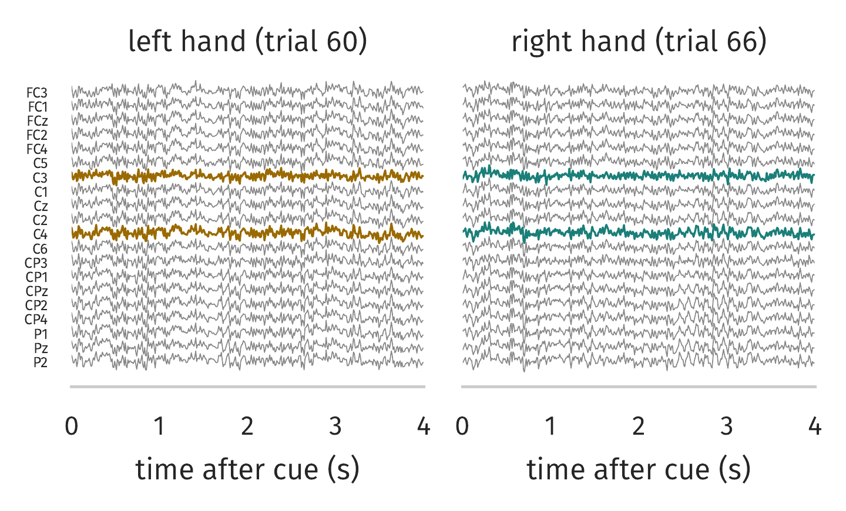
S3 walkthrough (1/5): raw EEG, 20 × 400
One left hand and one right hand trial: 20 channels, 4 s at 100 Hz
C3 and C4 (over the hand areas) in colour
By eye the two classes look the same: the difference is hidden in band power
Subject 3, session T only (144 trials, 72 per class). Example trials = the trial closest to its class mean. CSP and scaler fit on all session T trials of S3 for this picture; no accuracy is computed here.

Slide 17
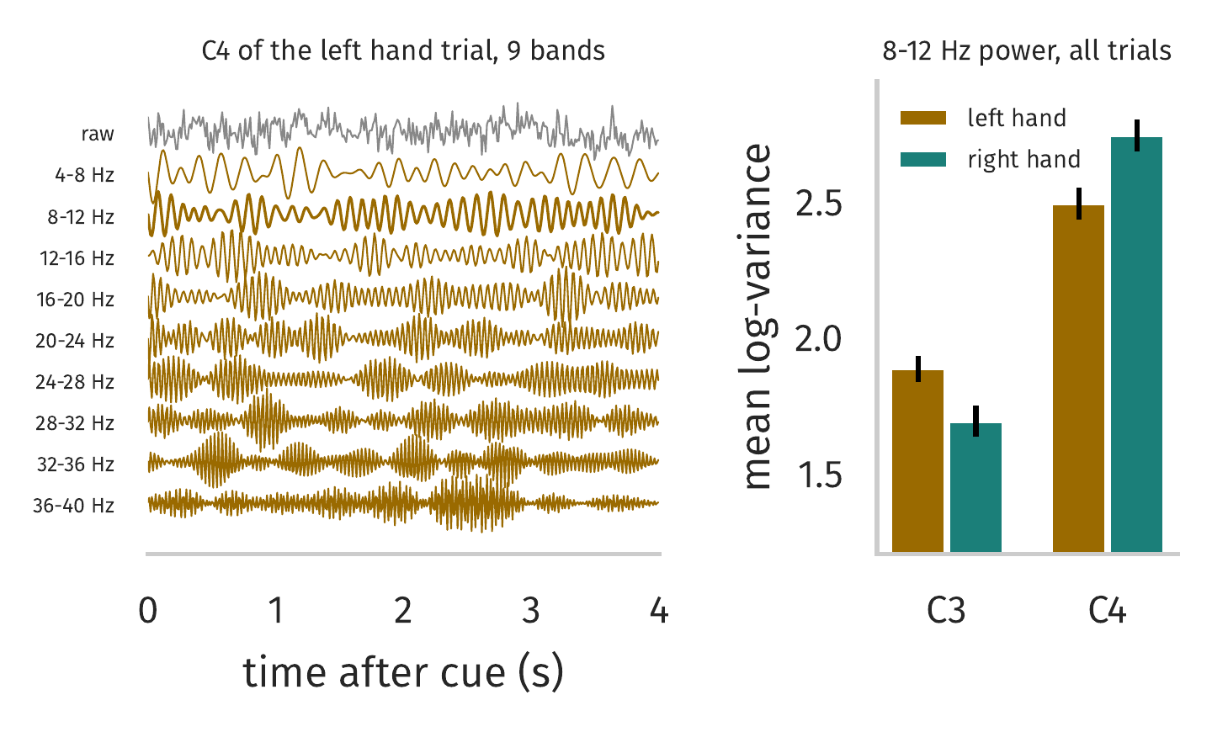
S3 walkthrough (2/5): filter bank, 9 × 20 × 400
Left: C4 of the left hand trial split into 9 bands (each trace scaled on its own)
Right: 8-12 Hz power is lower at C4 for left hand and lower at C3 for right hand
That is contralateral ERD [lecture p.51]
Subject 3, session T only (144 trials, 72 per class). Example trials = the trial closest to its class mean. CSP and scaler fit on all session T trials of S3 for this picture; no accuracy is computed here.

Slide 18
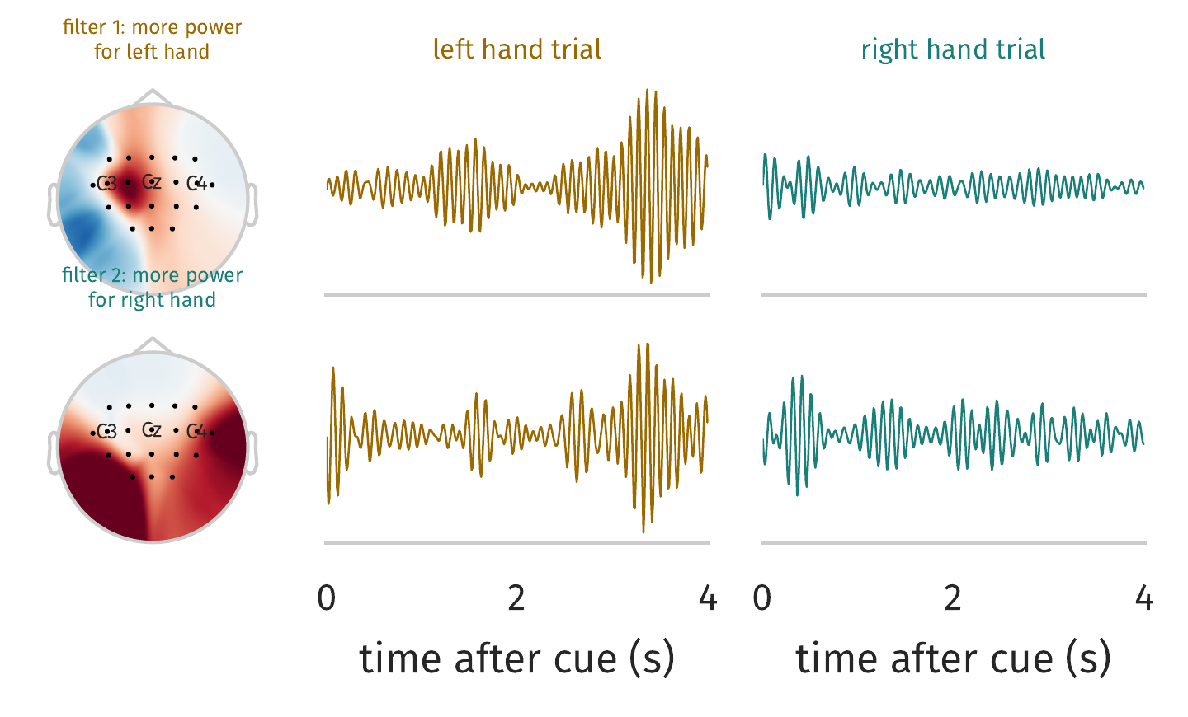
S3 walkthrough (3/5): CSP per band, 36 × 400 (8-12 Hz shown)
Maps: spatial pattern of each filter, i.e. where it looks [lecture p.58]
Filter 1 gives more power for left hand, filter 2 for right hand
Filter 1 shows the gap clearly in these two trials; filter 2 less so, single trials are noisy
20 channels become 4 signals per band; time is untouched
Subject 3, session T only (144 trials, 72 per class). Example trials = the trial closest to its class mean. CSP and scaler fit on all session T trials of S3 for this picture; no accuracy is computed here.

Slide 19
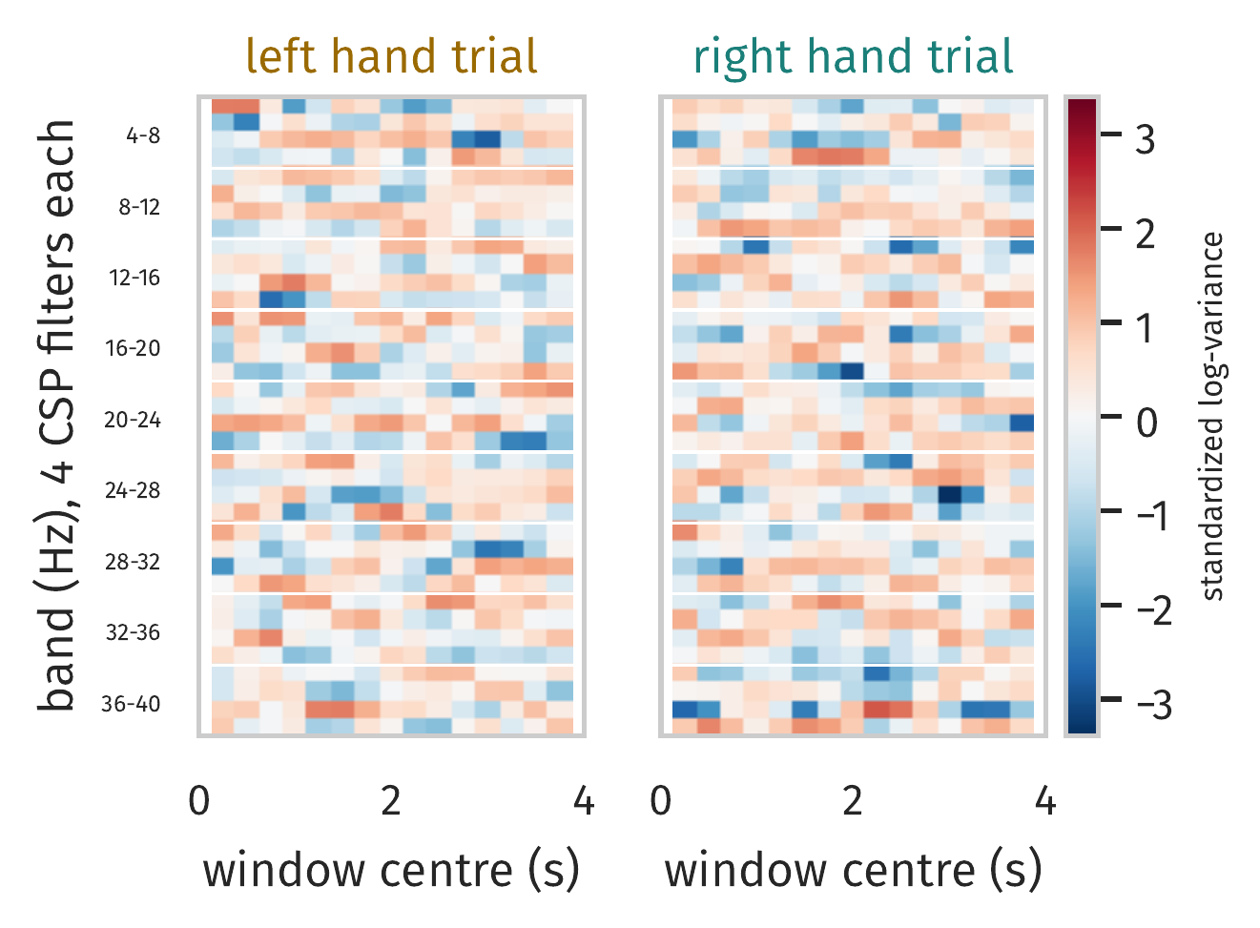
S3 walkthrough (4/5): windowed log-variance, 36 × 15
The same two trials as the model sees them: 36 rows (9 bands × 4 filters) × 15 windows, standardized
One trial alone is noisy; the class difference shows up only across many trials (next slide)
Subject 3, session T only (144 trials, 72 per class). Example trials = the trial closest to its class mean. CSP and scaler fit on all session T trials of S3 for this picture; no accuracy is computed here.

Slide 20
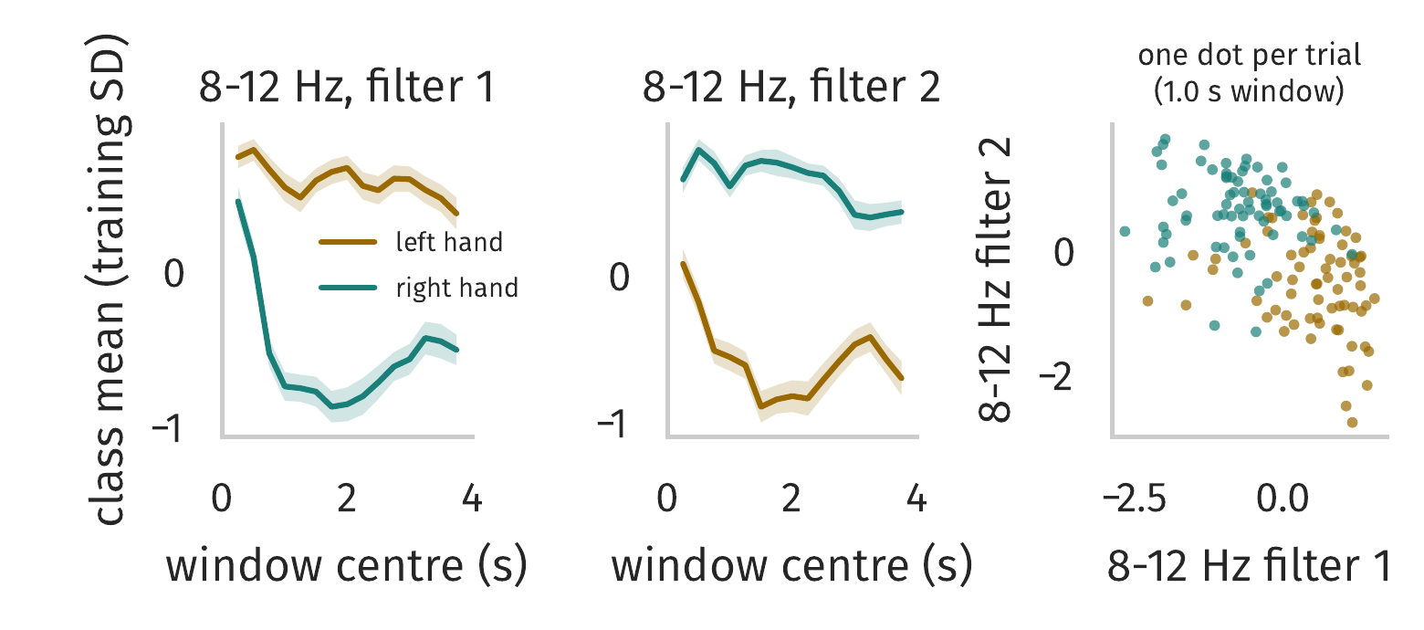
S3 walkthrough (5/5): do the features separate the classes?
Class means of the two 8-12 Hz filters: the gap is small right after the cue and grows within about 1 s, the timing our windows keep
Right: every trial at the 1.0 s window, using only 2 of the 540 numbers, already mostly separable
S3 is one of the easier subjects (quick LDA check: 95.8%), so other subjects look less clean
Subject 3, session T only (144 trials, 72 per class). Example trials = the trial closest to its class mean. CSP and scaler fit on all session T trials of S3 for this picture; no accuracy is computed here.

Slide 21
Backup: HWNet layers and parameter count
Layer | Operation | Output | Params
Input | 36 × 15 feature map | (1, 15, 36) | 0
Conv 1 | Conv2D 32, kernel (1, 3), same padding, ELU | (1, 15, 32) | 3,488
BN 1 / Drop 1 | BatchNorm, Dropout 0.5 | (1, 15, 32) | 128
Conv 2 | Conv2D 16, kernel (1, 3), same padding, ELU | (1, 15, 16) | 1,552
BN 2 | BatchNorm | (1, 15, 16) | 64
Pool 2 / Drop 2 | AvgPool (1, 2), Dropout 0.5 | (1, 7, 16) | 0
Flatten |  | 112 | 0
Dense + softmax | Dense 2, max-norm 0.5 | 2 | 226
Total | 5,362 trainable (+96 BatchNorm statistics) |  | 5,458
k = 5 variant: same layers with (1, 5) kernels, 8,690 trainable parameters. k = 2: 4,210.
Code: MixNet-homework/mixnet/models/HWNet.py, configs in MixNet-homework/experiments/configs/HWNet.py.

Slide 22
Backup: per-subject results
Subject | Val acc (sel.) | MixNet | HWNet first | HWNet sel. | HWNet k = 5 | Sel. − MixNet
S01 | 90.27 | 85.56 | 82.92 | 86.11 | 87.78 | +0.56
S02 | 61.80 | 55.14 | 49.44 | 50.56 | 51.94 | −4.58
S03 | 95.17 | 91.94 | 92.22 | 90.42 | 90.00 | −1.53
S04 | 72.29 | 68.47 | 65.14 | 66.81 | 64.17 | −1.67
S05 | 88.20 | 60.83 | 76.81 | 78.61 | 78.06 | +17.78
S06 | 68.60 | 60.14 | 62.78 | 64.58 | 65.14 | +4.44
S07 | 91.67 | 89.72 | 88.33 | 88.06 | 88.61 | −1.67
S08 | 96.53 | 90.42 | 93.47 | 93.33 | 94.44 | +2.92
S09 | 90.30 | 86.53 | 83.06 | 86.53 | 87.64 | 0.00
Mean | 83.87 | 76.53 | 77.13 | 78.33 | 78.64 | +1.81
Session E test accuracy (%) except "Val acc", which is the session T validation mean over 5 folds for the selected model.

