Slide 1
Part 1: Preprocessing
Filter-bank CSP + band power in short time windows
ML Frontiers, VISTEC · BCIC IV-2a, left vs right hand MI

Slide 2
Why not just use CSP, or MixNet’s input?
MI shows up as ERD/ERS in Mu and beta, around C3/C4 [lecture p.51]
Classic CSP keeps one log-variance per trial, so it throws away the timing inside the trial [lecture p.62]
MixNet keeps the whole CSP time series [lecture p.63]: 7,200 numbers per trial, learned from only ∼115 training trials
 | Classic FBCSP | MixNet | Ours
Keeps timing | no | all 400 samples | 15 windows
Shape per trial | 36 | 18 × 400 | 36 × 15
Numbers per trial | 36 | 7,200 | 540
Hypothesis
Band power in short time windows keeps the timing of ERD/ERS, at a size a small model can learn from ∼115 trials.
1/5

Slide 3
Pipeline: four steps, two of them learned
same as MixNet
our change
Raw EEG
20 channels
4 s at 100 Hz
Filter bank
9 bands, 4-40 Hz
Butterworth
CSP per band
4 filters
per band
Log-variance
0.5 s windows
0.25 s step
Standardize
each feature
20 × 400
9 × 20 × 400
36 × 400
36 × 15
36 × 15
Teal boxes: fit on the training fold only
Output per trial
“Fit CSP: training data only” [lecture p.60]
“Training-set per-channel standardization” [lecture p.31]
Validation and session E only reuse the saved filters and mean/SD. A self-check in the code tests this.
36 features (9 bands × 4 CSP filters) × 15 time windows, standardized
2/5

Slide 4
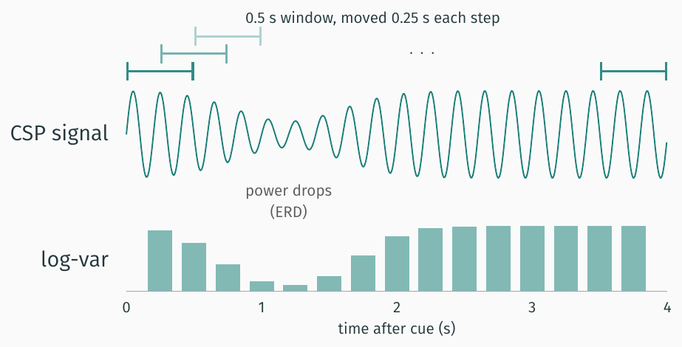
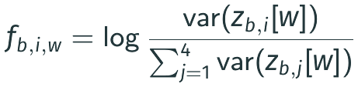
Our change: one log-variance per short window
Normalized log-variance
For band b, CSP filter i, window w:
[lecture p.59]
(400 − 50)/25 + 1 = 15 windows in 4 s
This step learns nothing, so it cannot leak
Then each feature is standardized with the training-fold mean and SD [lecture p.31]
3/5

Slide 5
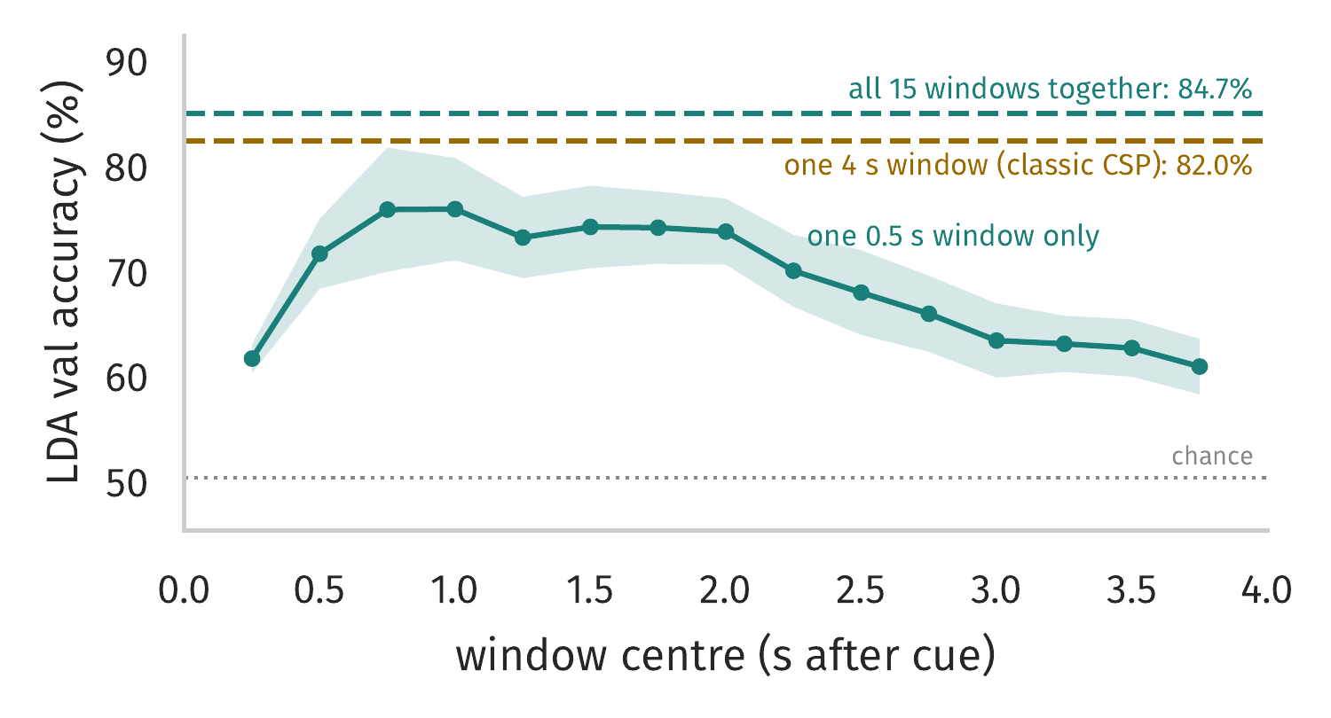
Quick LDA test: class information is not spread evenly in time
One 0.5 s window (36 numbers, one LDA per window): peaks at 0.75-1 s (75.5%), near 61% at both ends
One 4 s window = whole trial, classic CSP (36 numbers): 82.0%
All 15 windows together = our features (540 numbers): 84.7%, better in 8 of 9 subjects
How we got these numbers
A simple shrinkage LDA, the classic classifier after CSP [lecture p.60], trained on our features before building HWNet. Same 5 folds as the real pipeline: fit on the training fold, score on the validation fold of session T, mean of 9 subjects (band = ±1 SE). Session E not used: not test results, not comparable with MixNet.
4/5

Slide 6
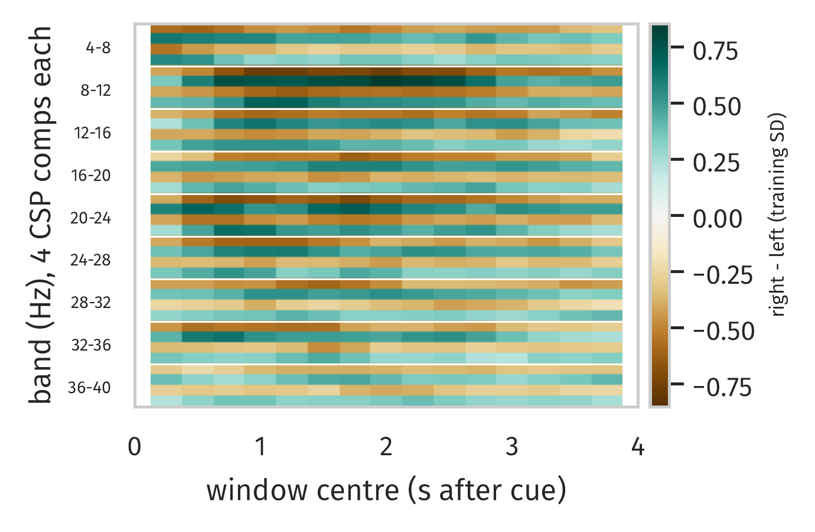
What the model sees: 36 features × 15 windows
Each cell: right minus left class mean, in training SD units
Strongest in 8-12 Hz (Mu) and 20-24 Hz (beta), from about 0.5 to 2.5 s, the bands where ERD/ERS shows up [lecture p.51]
Rows alternate in sign because CSP takes filters from both ends: one end has more power for left hand, the other for right [lecture p.57]
Takeaway
Each trial becomes which band, which spatial filter and when, in 540 numbers.
All 144 session T trials per subject, averaged over 9 subjects. Session E not used.
5/5

Slide 7
Backup: settings and data notes
All settings live in experiments/prep_HW.py
Data notes
50 Hz line noise: removed. After resampling to 100 Hz it sits at the top edge, where every band filter blocks it
Drift and eye movement below 4 Hz: removed by the lowest band edge
Not removed: blinks in 4-8 Hz, muscle noise in beta, and trials marked as artifacts (2 to 36 of 144 per subject)
Setting | Ours | Ablation
win_len, win_step | 0.5 s, 0.25 s | 4.0 s, 4.0 s (classic)
n_components | 4 | 2 (MixNet size)
norm_logvar | True | False
bands | 9 bands, 4-40 Hz
order | 5
Quick LDA check (validation, session T): ours 84.7%, classic 82.0%, norm_logvar=False 85.0%, n_components=2 not run yet.

Slide 8
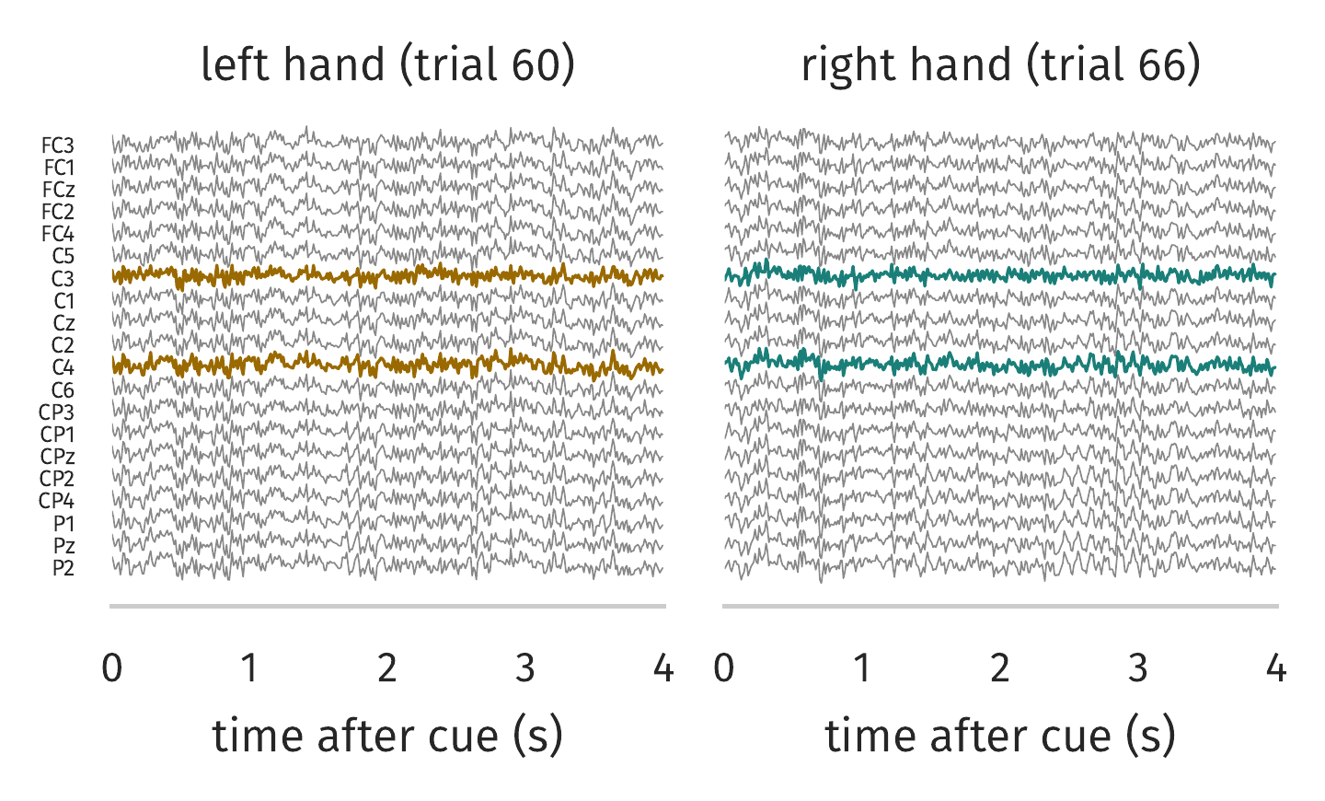
S3 walkthrough (1/5): raw EEG, 20 × 400
One left hand and one right hand trial: 20 channels, 4 s at 100 Hz
C3 and C4 (over the hand areas) in colour
By eye the two classes look the same: the difference is hidden in band power
Subject 3, session T only (144 trials, 72 per class). Example trials = the trial closest to its class mean. CSP and scaler fit on all session T trials of S3 for this picture; no accuracy is computed here.

Slide 9
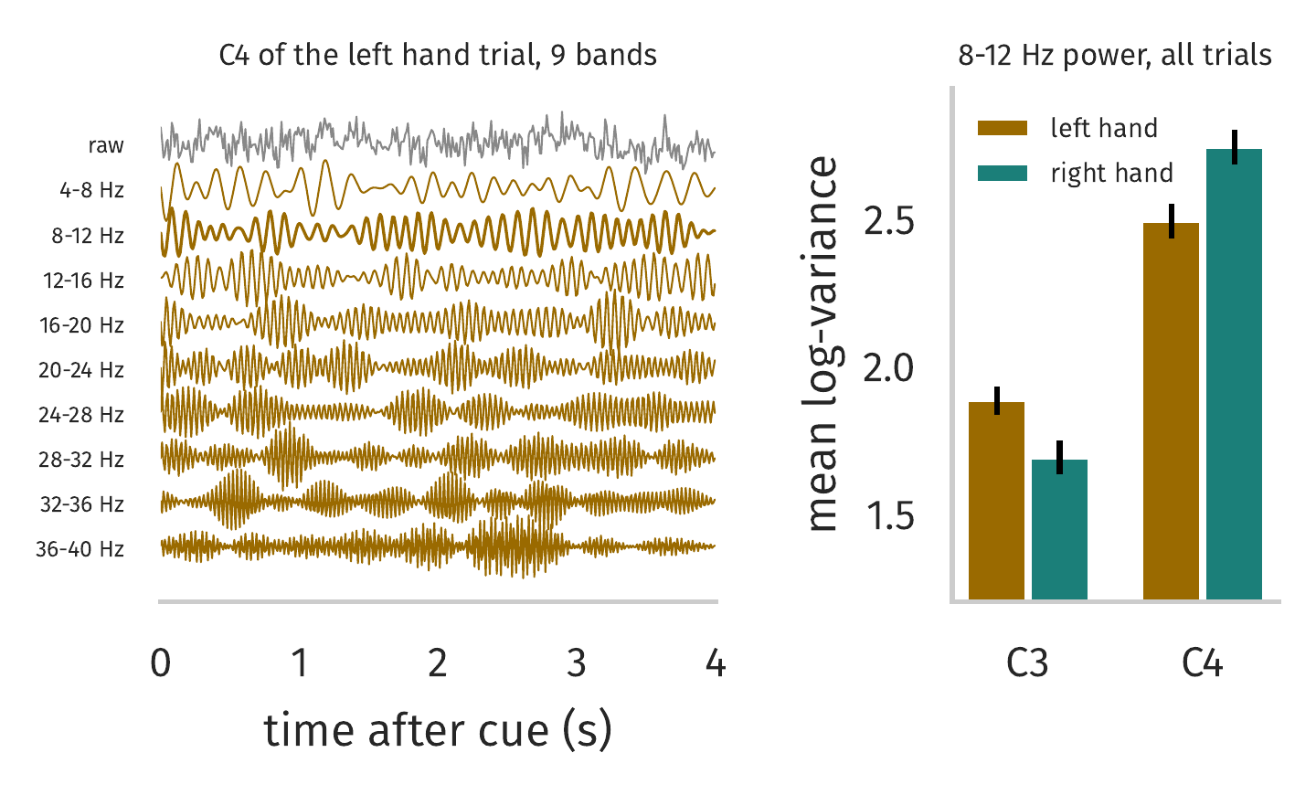
S3 walkthrough (2/5): filter bank, 9 × 20 × 400
Left: C4 of the left hand trial split into 9 bands (each trace scaled on its own)
Right: 8-12 Hz power is lower at C4 for left hand and lower at C3 for right hand
That is contralateral ERD [lecture p.51]
Subject 3, session T only (144 trials, 72 per class). Example trials = the trial closest to its class mean. CSP and scaler fit on all session T trials of S3 for this picture; no accuracy is computed here.

Slide 10
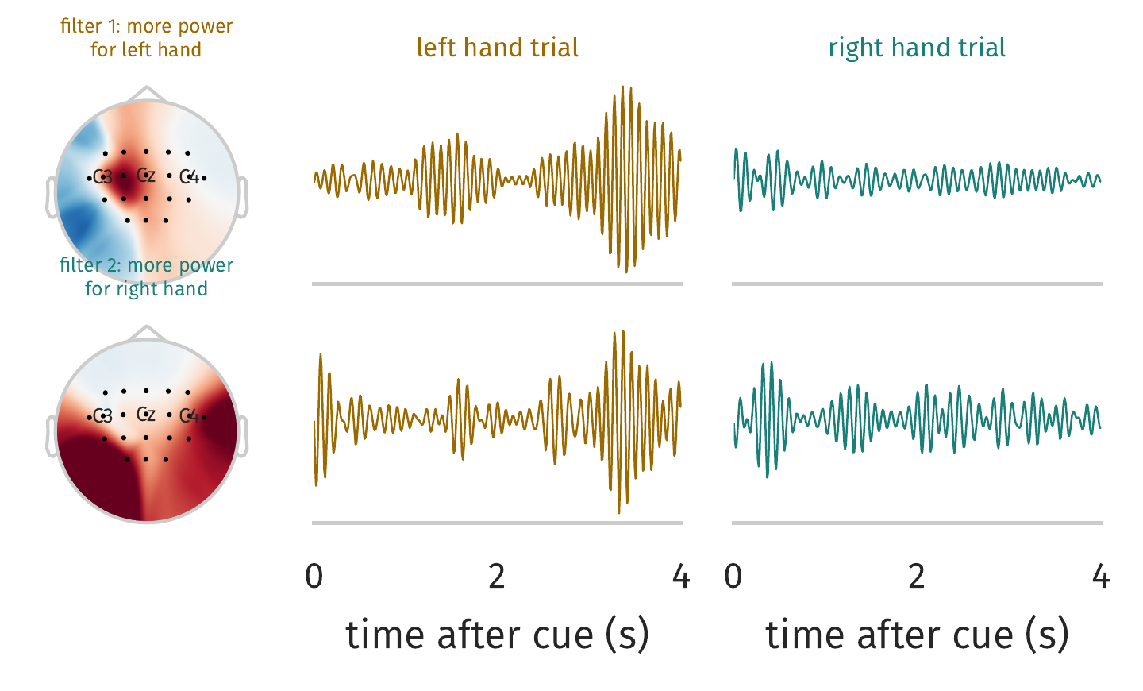
S3 walkthrough (3/5): CSP per band, 36 × 400 (8-12 Hz shown)
Maps: spatial pattern of each filter, i.e. where it looks [lecture p.58]
Filter 1 gives more power for left hand, filter 2 for right hand
Filter 1 shows the gap clearly in these two trials; filter 2 less so, single trials are noisy
20 channels become 4 signals per band; time is untouched
Subject 3, session T only (144 trials, 72 per class). Example trials = the trial closest to its class mean. CSP and scaler fit on all session T trials of S3 for this picture; no accuracy is computed here.

Slide 11
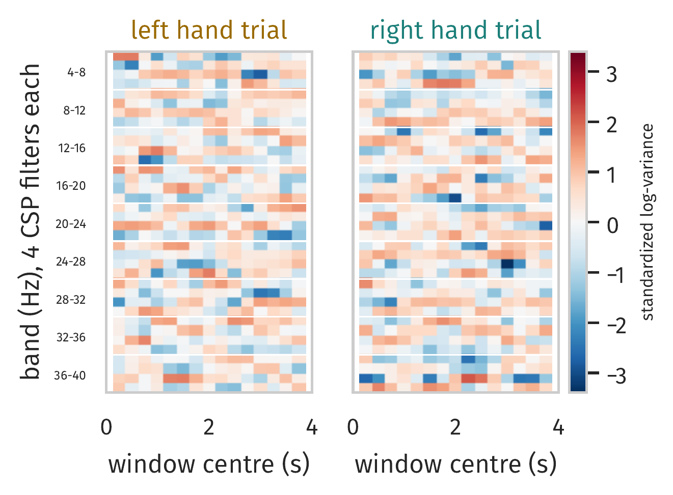
S3 walkthrough (4/5): windowed log-variance, 36 × 15
The same two trials as the model sees them: 36 rows (9 bands × 4 filters) × 15 windows, standardized
One trial alone is noisy; the class difference shows up only across many trials (next slide)
Subject 3, session T only (144 trials, 72 per class). Example trials = the trial closest to its class mean. CSP and scaler fit on all session T trials of S3 for this picture; no accuracy is computed here.

Slide 12
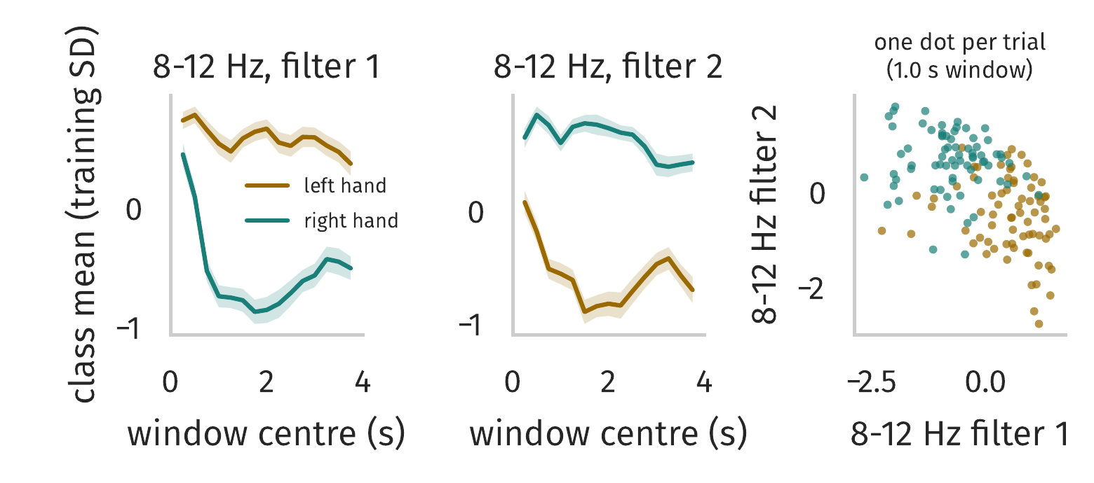
S3 walkthrough (5/5): do the features separate the classes?
Class means of the two 8-12 Hz filters: the gap is small right after the cue and grows within about 1 s, the timing our windows keep
Right: every trial at the 1.0 s window, using only 2 of the 540 numbers, already mostly separable
S3 is one of the easier subjects (quick LDA check: 95.8%), so other subjects look less clean
Subject 3, session T only (144 trials, 72 per class). Example trials = the trial closest to its class mean. CSP and scaler fit on all session T trials of S3 for this picture; no accuracy is computed here.

