Slide 1
Big Data Technologies – Assignment 1 Presentation
Name: Safkat Hasin Alavi
ID:48726591
Macquarie University

Slide 2
Introduction
Brief overview of assignment objectives:
-Implement data ingestion and analysis pipeline using MongoDB & Neo4j.
-Explore fraud detection via Graph Data Science (GDS).
Tools used: MongoDB, Neo4j, Cypher, and GDS library.

Slide 3
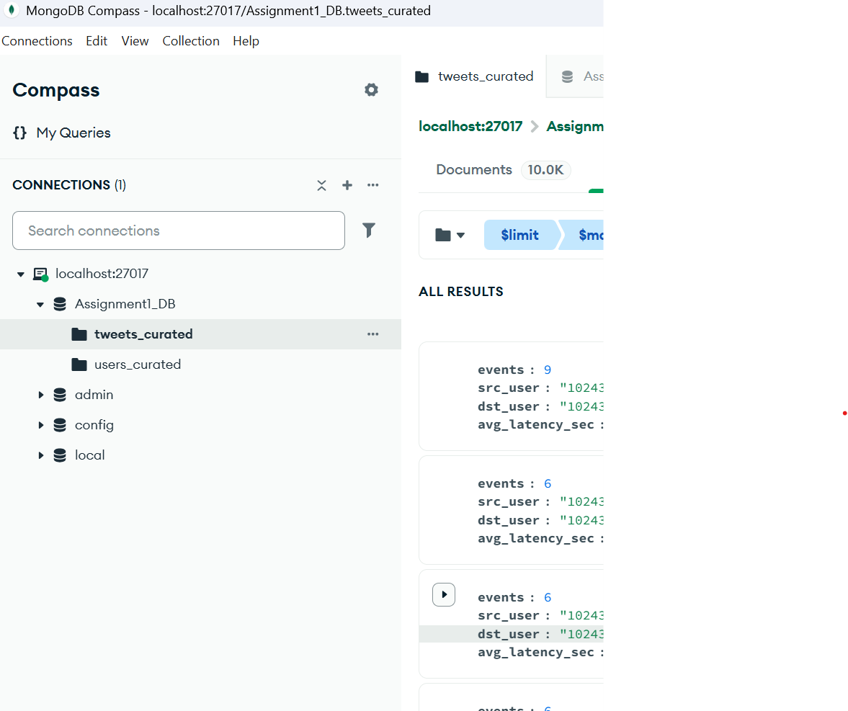
MongoDB Data Pipeline
Overview of MongoDB ingestion workflow.
  Data Cleaning (Removed ObjectId , NumberLong , malformed JSON)
Key features:
  JSON data ingestion.
  Index creation for efficient querying.

Slide 4
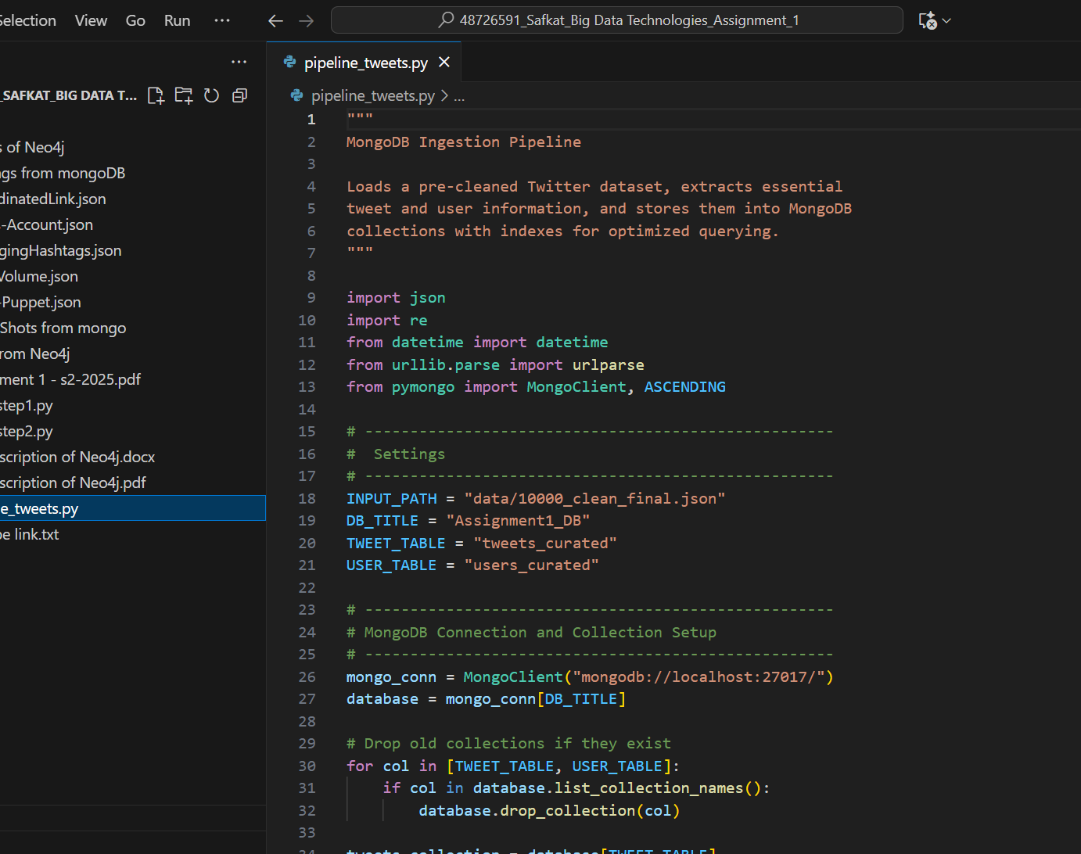
MongoDB – Analytical Queries
Key Query 1: Emerging Hashtags (Growth Rate)
- Used $unwind , $dateTrunc , $group , $setWindowFields
- Computed week-over-week hashtag growth.
Key Query 2: Coordinated Link Bursts
  - Detected domains with ≥3 users posting within 60 seconds.
  - Used $match , $setWindowFields , $group .
Key Query 3: High-volume Near-Duplicates per User

Slide 5
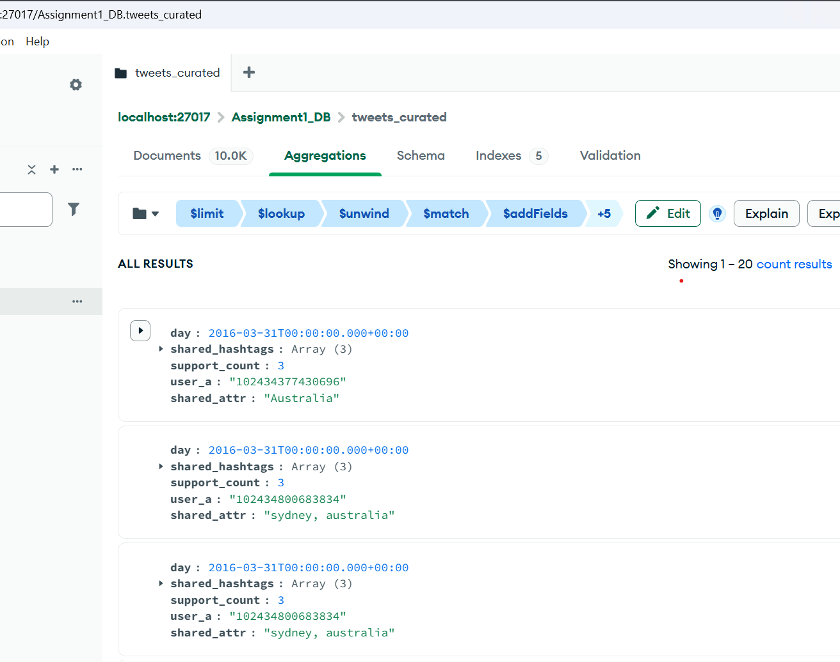
MongoDB – Advanced Integrity & Coordination Detection
Key Query 1: Sock-puppet Signals
Key Query 2: Cross-account Promotion Chains.

Slide 6
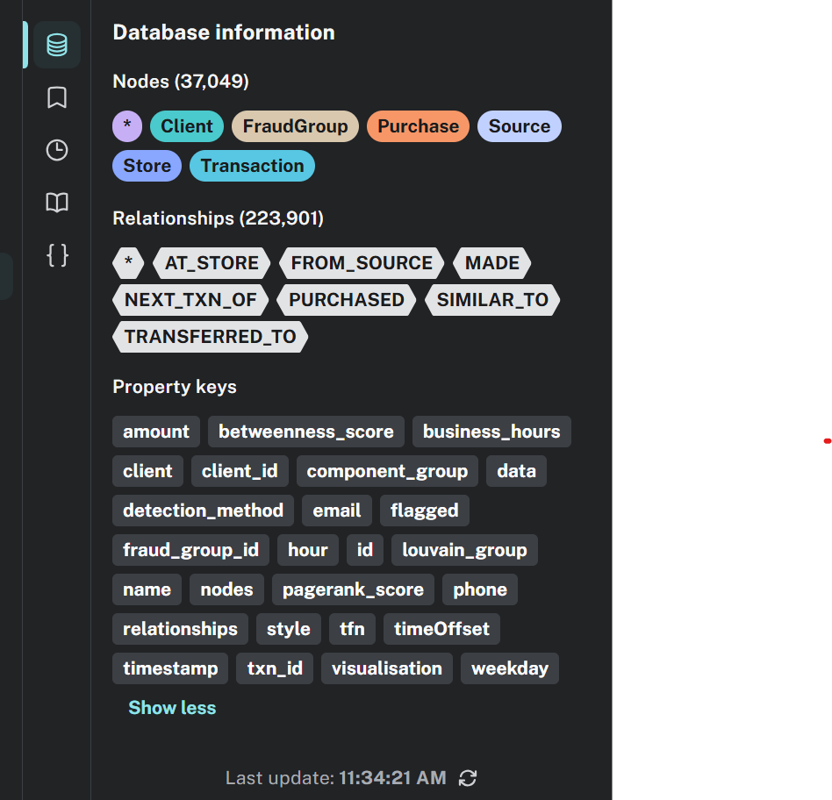
Neo4j – Data Model
Data model design:
Nodes: Client, Store, Transaction, Source.
Relationships: PURCHASED, TRANSFERRED_TO, SIMILAR_TO, NEXT_TXN_OF.
Design emphasis on scalability and extensibility.

Slide 7
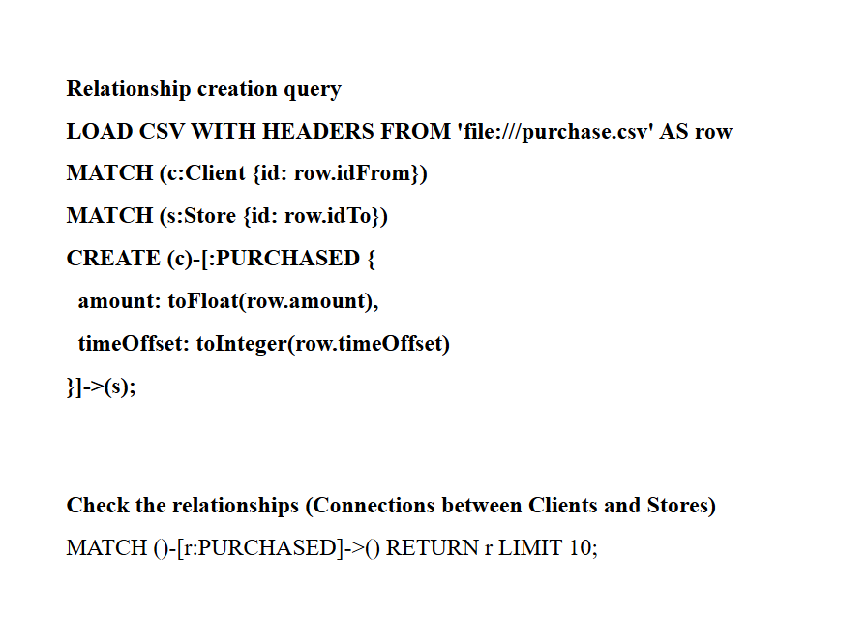
Temporal Representation & Integrity
• Converted timeOffset into absolute timestamps ( datetime ).
• Derived temporal features: hour, weekday, business hours flag.
• Indexed fields for query efficiency.
• Data integrity maintained with unique constraints.

Slide 8
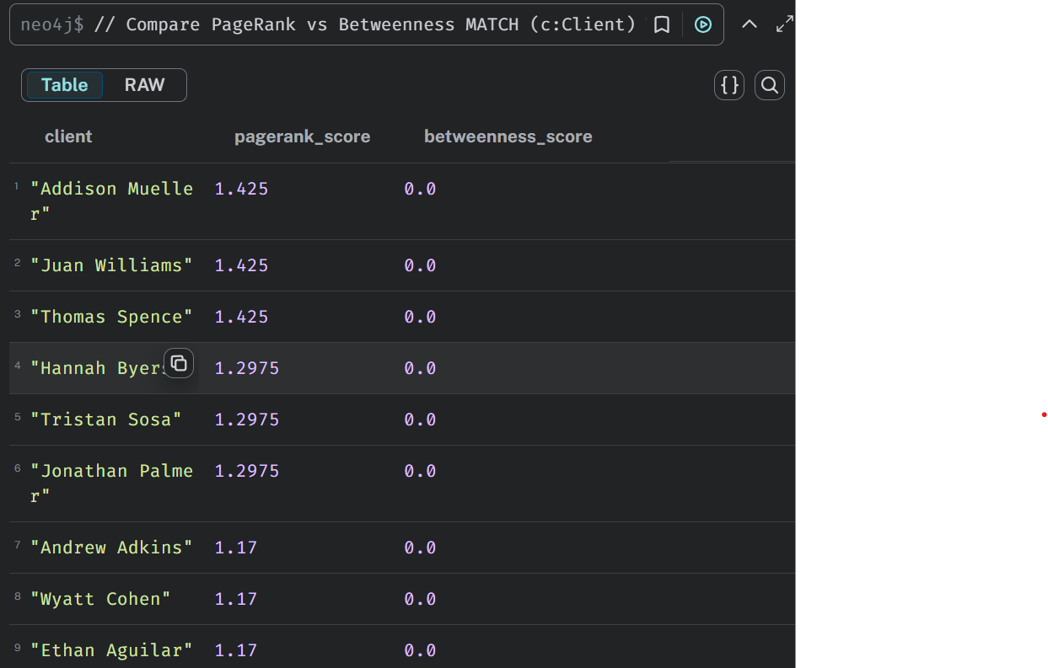
Cypher Query Demonstrations
Example queries executed in Neo4j:
Problem 1: Clients spending most in a specific window.
Problem 2: Clients with largest negative cashflow.
Problem 3: Pass-through detection for suspicious sellers.
Problem 4: Transaction temporal ordering.

Slide 9
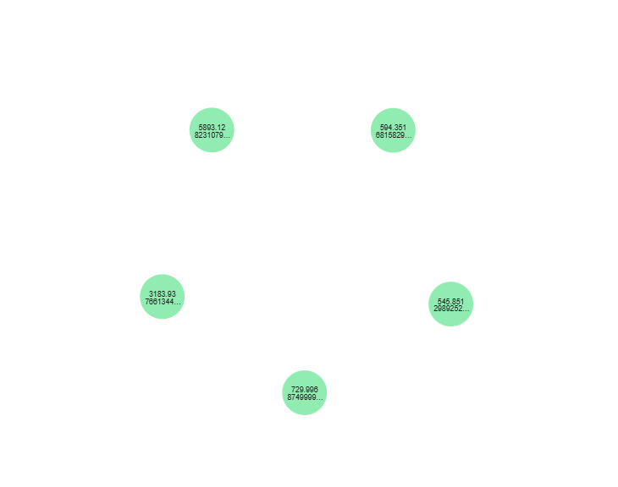
Graph Data Science (GDS) Analysis
Algorithms applied:
Louvain & Connected Components for community detection.
PageRank & Betweenness for centrality analysis.
Insights:
Identification of dense fraud clusters.
Detection of key intermediary clients.

Slide 10
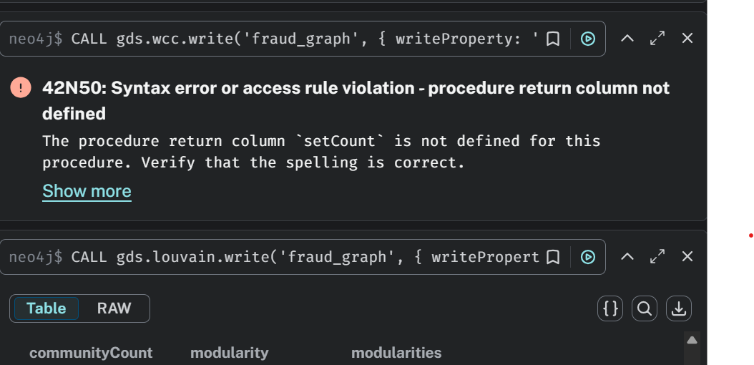
Slide 8: Conclusion & Reflections
Challenges Faced:
- Cleaning malformed JSON from Twitter dataset.
- Building efficient graph projections in Neo4j.
- Understanding GDS pipeline configurations.
Key Learnings:
- Indexing and relationship modeling dramatically improve query time.
- Graph algorithms reveal hidden fraud structures unseen in tabular data.
- Integration of MongoDB + Neo4j = holistic data ecosystem.
Future Work: Extend to real-time fraud detection and explainable AI integration.

Slide 11
THANK YOU
Safkat Hasin Alavi Student
ID: 48726591
Macquarie University – COMP8871 Big Data Technologies

