Slide 1
Secure Data hiding in image using steganography
CAPSTONE PROJECT
Presented By: Prateek
Student Name : Prateek
College Name & Department : Guru Nanak Dev Engineering College, Bidar Bachelor of Engineering CSE

Slide 2
OUTLINE
Problem Statement
Technology used
Wow factor
End users
Result
Conclusion
Git-hub Link
Future scope

Slide 3
Problem Statement
In today's digital world, secure communication is crucial to protect sensitive information from unauthorized access. Traditional encryption methods can attract attention, making hidden communication a challenge. This project addresses the need for covert message transmission by implementing image steganography, where secret messages are embedded within an image’s pixel data, ensuring secure and discreet communication.

Slide 4
Technology used
Programming Language: Python
Libraries Used:
OpenCV (cv2) – For image processing
OS – For file handling and execution
String – For character encoding
Concepts Implemented:
Image Steganography (Hiding messages in pixel data)
Encryption & Decryption
Pixel Manipulation
Platform Used:
Windows (Tested) ️
Can be adapted for Linux/MacOS with minor changes

Slide 5
Wow factors
Lightweight & Simple: Minimal dependencies, easy to run.
Custom Passcode Protection: Ensures only authorized decryption.
Pixel-Level Encoding: Embeds messages without altering image visibly.
Cross-Platform Compatibility: Works on Windows, adaptable to Linux/MacOS.
Fast Execution: Efficient message hiding and retrieval using OpenCV.
Beginner-Friendly: Easy to understand and modify for learning.

Slide 6
End users
Cybersecurity Enthusiasts: Learning steganography for secure communication.
Journalists & Whistleblowers: Concealing sensitive messages in images.
Researchers & Students: Exploring steganography and cryptography concepts.
Privacy-Conscious Individuals: Securing personal or confidential data.
Hackers & Ethical Hackers: Understanding steganographic vulnerabilities. ️‍
Forensic Experts: Detecting hidden data in digital images.

Slide 7
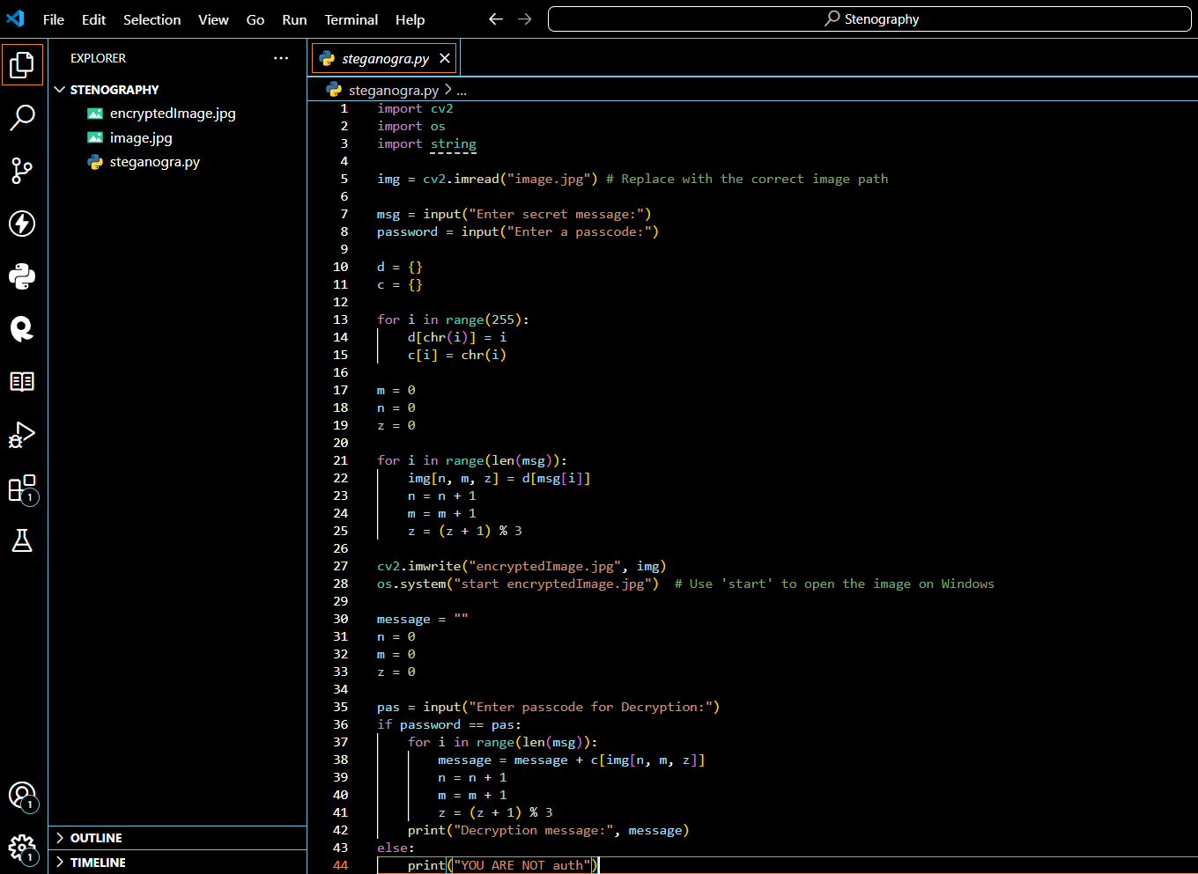
Results

Slide 8
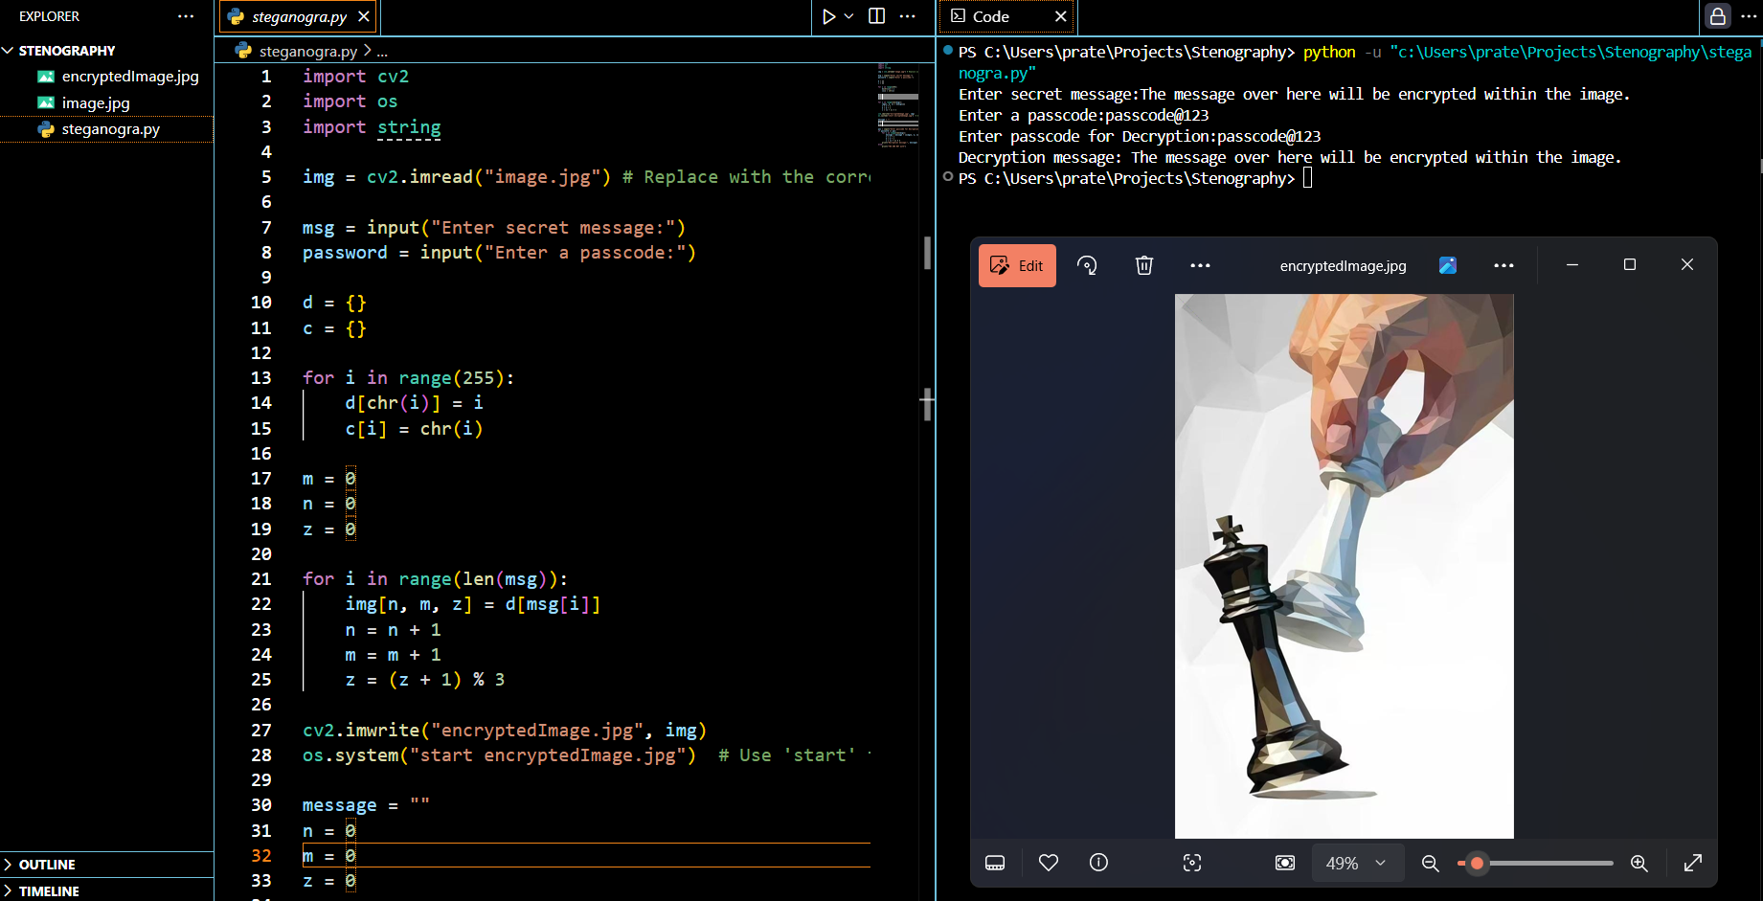
Results

Slide 9
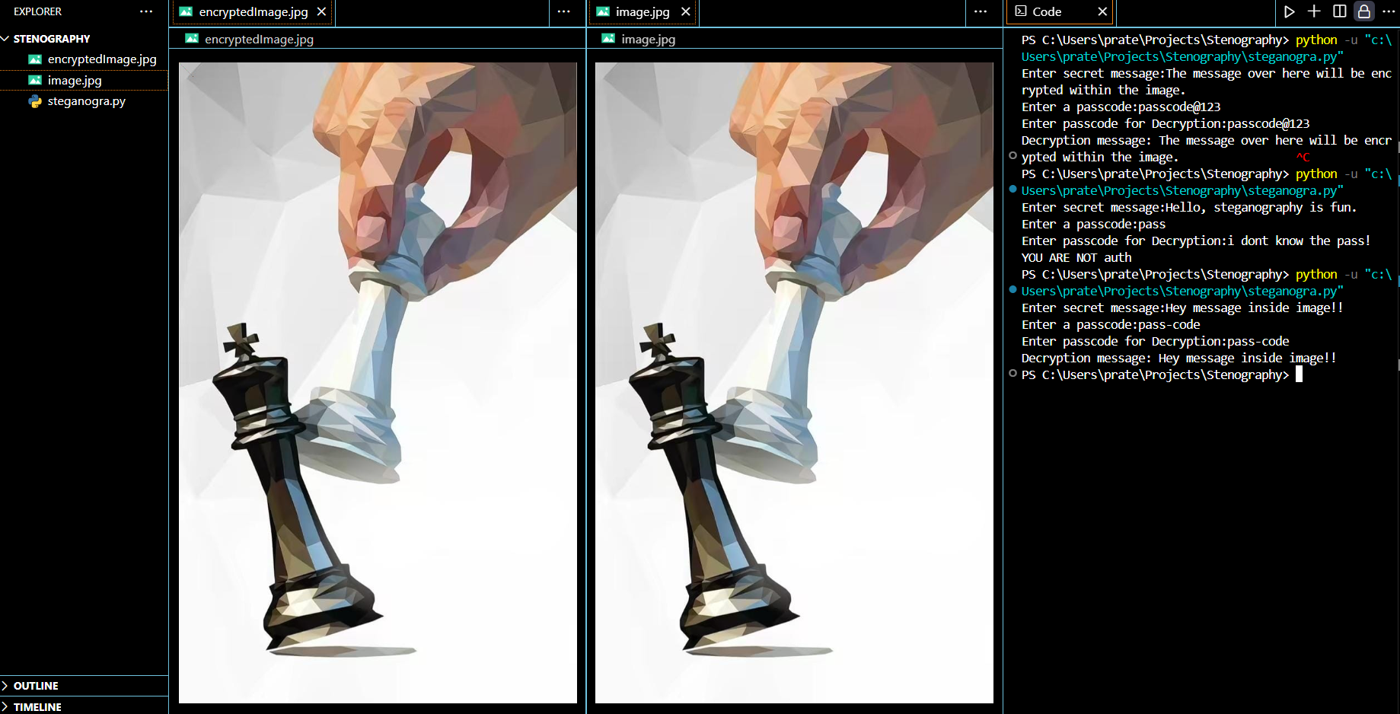
Results

Slide 10
Conclusion
This project successfully addresses the challenge of secure and discreet communication by implementing image steganography. By embedding secret messages within pixel data, it ensures confidentiality without attracting attention like traditional encryption methods. With its lightweight design, passcode protection, and cross-platform adaptability, this tool provides an effective solution for covert message transmission while being accessible to cybersecurity enthusiasts, researchers, and privacy-conscious users.

Slide 11
GitHub Link
https://github.com/prateek-d-y/steganography.git

Slide 12
Future scope
Enhanced Security: Implement stronger encryption algorithms for added protection.
Adaptive Steganography: Use AI to optimize pixel modifications for better concealment.
Multi-Format Support: Extend functionality to support different image and video formats.
Mobile & Web Integration: Develop a mobile or web-based version for wider accessibility.
Detection Prevention: Improve techniques to evade steganalysis and detection tools.

Slide 13
Let's stay more secure THANK YOU

