Slide 1
C++(Object Oriented Programming)
Prateek Pudasainee

Slide 2
Recap
Loops.
Functions.
OOP recap
OOP constructs(class, objects, attributes, methods)

Slide 3
Contents
Access Specifiers.
Constructors
Destructors.

Slide 4
Access specifiers
Access specifiers define how members (variables & methods) of a class can be accessed from outside the class.
Why access specifiers?
To protect data from being accidentally changed.
To implement Encapsulation, a key pillar of OOP.

Slide 5
Access specifiers
Access Specifier | Access Level | Where it can be accessed
public | 🔓 Open | Anywhere (outside and inside the class)
private | 🔒 Locked | Only inside the same class
protected | 🚪 Inheritance Door | Only inside the class and derived (child) classes

Slide 6
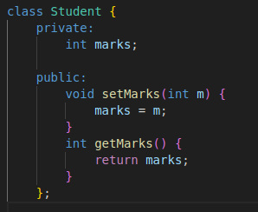
Access specifiers

Slide 7
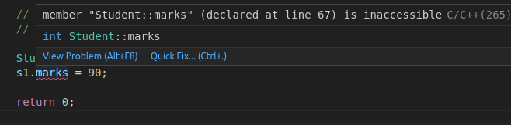

Access specifiers
Cannot directly access private members.
Must use public methods.

Slide 8

Access specifiers*

Slide 9
Constructors
A constructor is a special function that:
Has the same name as the class.
Is automatically called when an object is created.
Is used to initialize variables or set default values.
Why constructor?
Without a constructor, you'd have to manually set everything each time you create an object.

Slide 10
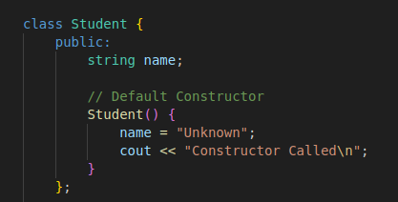
Constructors

Slide 11
Constructors
The function Student() is the constructor
It's called automatically when a Student object is created
It initializes name to "Unknown"

Slide 12


Constructors

Slide 13
Constructors*
No return type (not even void)
Can be overloaded

Slide 14
Parameterized Constructor*
A constructor that accepts arguments to initialize an object with custom values.
Useful when object initialization needs specific data at the time of creation.
Syntax:
ClassName(type1 param1, type2 param2) { ... }

Slide 15
Constructor Overloading*
Defining multiple constructors with different parameters.
Similar to function overloading.

Slide 16
Class Activity for Constructors
Create a class called Profile with the following members:
string name
int age
string city
Implement the following constructors:
Default constructor: Sets name to "Unknown", age to 0, and city to "Not Set".
Parameterized constructor (name only): Sets name from user, default age = 18, city = "Unknown".
Parameterized constructor (name, age, city): Initializes all values.
Add a method void displayProfile() to print the profile details.
In main(), ask each student to:
Create 3 objects using different constructors.
Display each object’s profile.

Slide 17

Destructor
A destructor is a special member function that is automatically called when an object goes out of scope.
Same name as the class, but starts with a tilde ~
No parameters, no return type
Cannot be overloaded (only one destructor per class)

Slide 18
Destructor
Clean up when object’s job is done.
Release resources like:
Memory (delete)
Files (close file handles)
Network or database connections

Slide 19
Destructor*
Without destructors:
Memory leaks can happen
Files may remain open
Program crashes or slows down
Destructors make sure things are properly cleaned up so your program runs smoothly and safely.

Slide 20
Destructor class activity
Create a class with constructor.
Create two objects of the same class.
Create a destructor that displays “Destructor called”
Called those objects in two different blocks and see theresult.

Slide 21
Quiz
Which of the following access specifiers allows class members to be accessed from anywhere in the program?
private
protected
public
internal

Slide 22
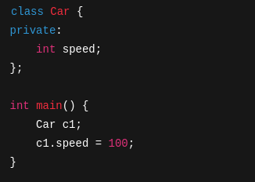
Quiz
What will happen when the following code is compiled?
The code will compile and run successfully
Runtime error
Compile-time error: 'speed' is private
The value of speed will be printed

Slide 23
Quiz
Which of the following best describes the protected access specifier?
Members are accessible only within the same class
Members are accessible within the same class and by derived classes
Members are accessible from anywhere
Members are not accessible at all

Slide 24
Quiz
What is the purpose of a constructor in C++?
To destroy an object
To initialize an object when it is created
To define new methods
To allocate memory manually

Slide 25
Quiz
Can constructors be overloaded in C++?
No
Yes, but only with default arguments
Yes, by changing the number or type of parameters
Only with different return types

Slide 26
Quiz
When is a destructor automatically called?
When a class is declared.
When an object is copied.
When an object goes out of scope.
When an object is declared with new
.

