Slide 1
C++(Object Oriented Programming)
Prateek Pudasainee

Slide 2
Recap
Access Specifiers.
Constructors
Destructors.

Slide 3
Quiz
Which of the following access specifiers allows class members to be accessed from anywhere in the program?
private
protected
public
internal

Slide 4
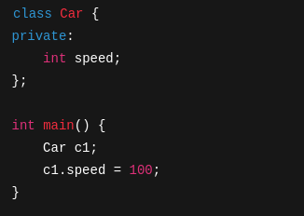
Quiz
What will happen when the following code is compiled?
The code will compile and run successfully
Runtime error
Compile-time error: 'speed' is private
The value of speed will be printed

Slide 5
Quiz
Which of the following best describes the protected access specifier?
Members are accessible only within the same class
Members are accessible within the same class and by derived classes
Members are accessible from anywhere
Members are not accessible at all

Slide 6
Quiz
What is the purpose of a constructor in C++?
To destroy an object
To initialize an object when it is created
To define new methods
To allocate memory manually

Slide 7
Quiz
Can constructors be overloaded in C++?
No
Yes, but only with default arguments
Yes, by changing the number or type of parameters
Only with different return types

Slide 8
Quiz
When is a destructor automatically called?
When a class is declared.
When an object is copied.
When an object goes out of scope.
When an object is declared with new
.

Slide 9
Destructor class activity
Create a class with constructor.
Create two objects of the same class.
Create a destructor that displays “Destructor called”
Called those objects in two different blocks and see the result.

Slide 10
Content
Static and non static class members.
Four pillars of OOP basic overview..
Inheritance.
Abstraction.
Encapsulation.
Polymorphism.

Slide 11
Static and Non static class members
Members = Variables(attributes) + Functions (methods)
Two types:
Non-static members (Object-specific)
Static Members (Shared by all objects)

Slide 12
Static and Non static class members
Non-static members:
Each object gets its own copy.
Accessed using object name.
Lifetime: As long as the object exists.

Slide 13
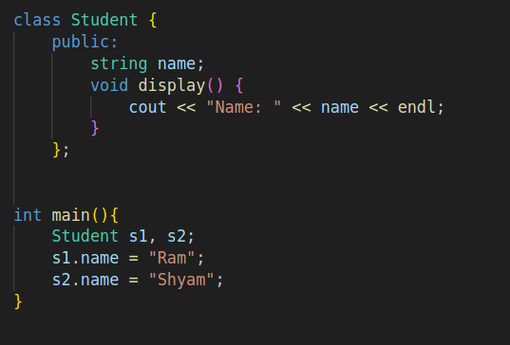
Static and Non static class members

Slide 14
Static and Non static class members
Static members:
Belong to the class, not the object.
Only one copy shared across all objects.
Declared with static keyword.
Can be accessed using class name or object.

Slide 15
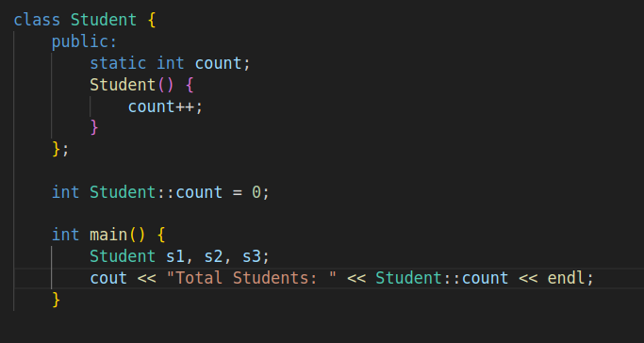
Static and Non static class members

Slide 16
Static and Non static class members
Static Member functions
Can access only static data members.
Do not need an object to be called.
Called using Classname:functionName()

Slide 17
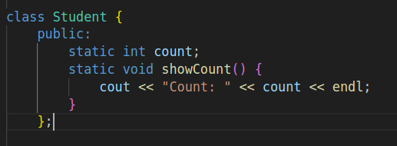
Static and Non static class members

Slide 18
Static and Non static class members
Use cases:
Counting objects
Config/settings shared across objects
Utility/helper functions (e.g., Math::add())

Slide 19
Static and Non static class members
Activity:
Create a Car class with:
Static member: totalCars.
Non-static: carModel, carID.
Count number of car objects created.
Add a static function to display total Cars.

Slide 20
Pillars of OOP
Inheritance.
Abstraction.
Encapsulation.
Polymorphism.

Slide 21
Inheritance
Inheritance is a feature of Object-Oriented Programming (OOP).
It allows one class to reuse the properties and behaviors of another class.
The class that reuses is called the child or derived class.
The class being reused is called the parent or base class.
Child class gets features of Parent class — like passing down traits in a family!

Slide 22
Inheritance
Why inheritance?
Code Reusability.
Avoids Redundancy.
Easy Maintenance.
Real-world Modeling .

Slide 23
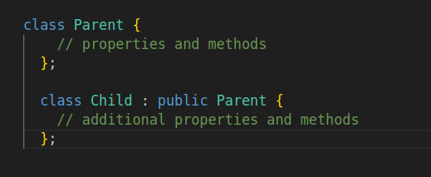
Inheritance

Slide 24
Types of inheritance
Single Inheritance.
Multilevel Inheritance.
Multiple Inheritance.
Hierarchical Inheritance
Hybrid Inheritance.

Slide 25
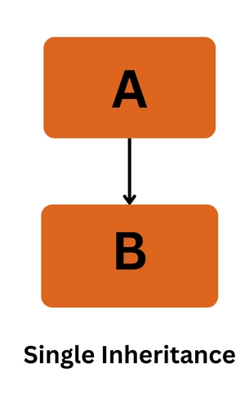
Types of inheritance*
Single Inheritance.
One derived class inherits from one base class.

Slide 26
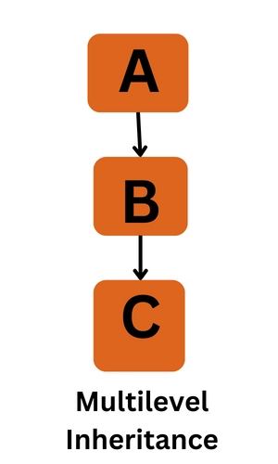
Types of inheritance*
Multilevel Inheritance.
A class inherits from a derived class (i.e., inheritance of inheritance).

Slide 27
Types of inheritance
Activity:
Define a base class with at least one method/property
Create at least 2 levels of inheritance
Call inherited methods from main()

