Slide 1
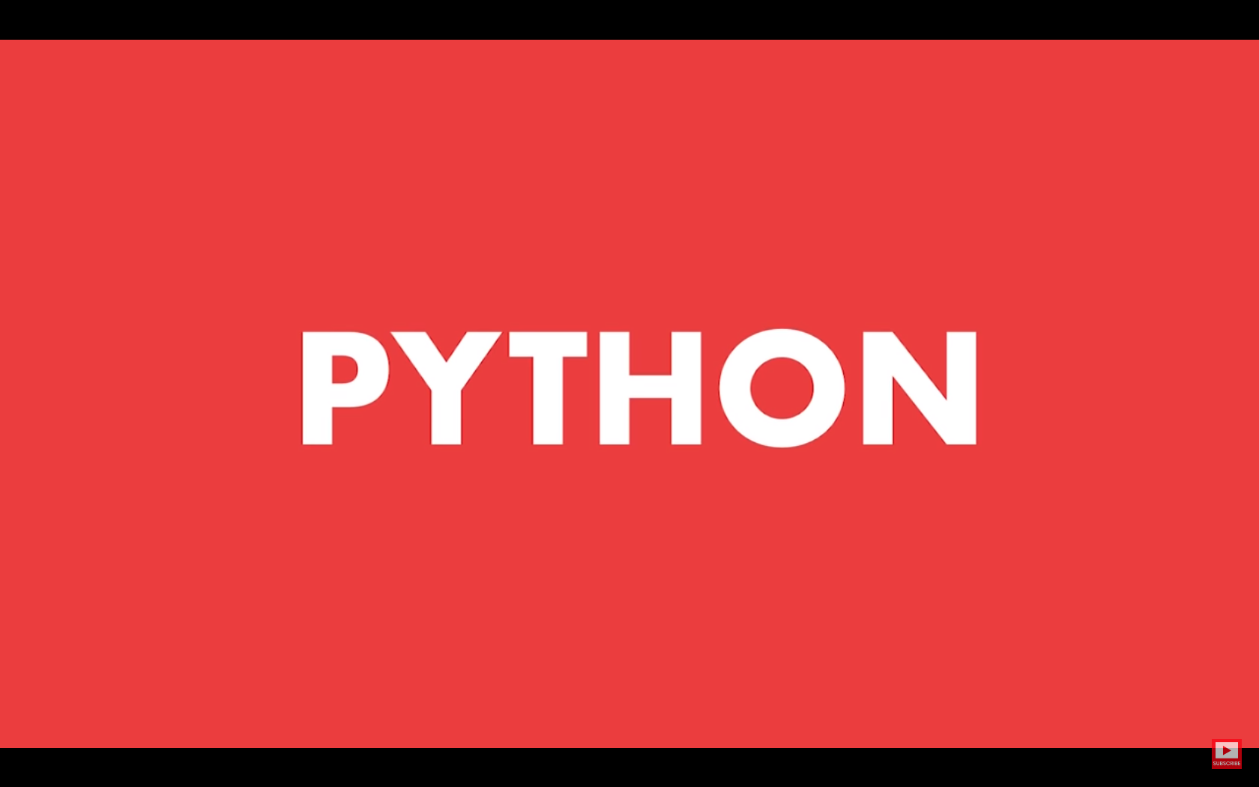

Slide 2
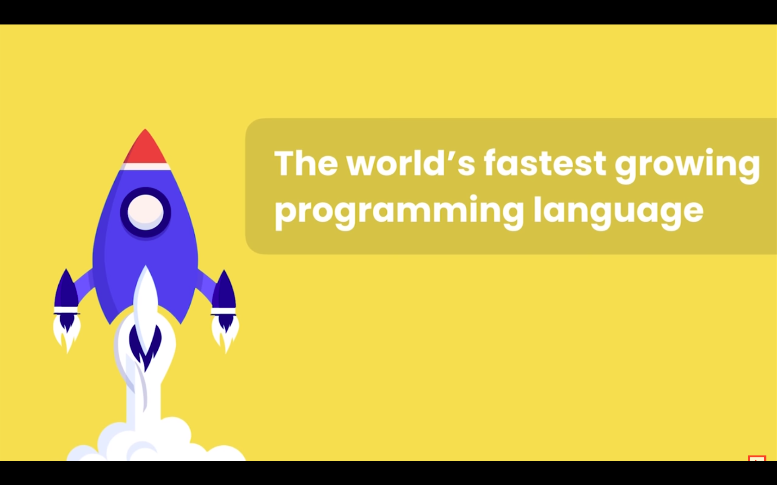

Slide 3
Python is the world’s fastest growing programming language, not just among software engineers, but also amongst Mathematicians, Data Analysts, Accountants, Network Engineers and even kids, because it’s a very beginner friendly language.

Slide 4
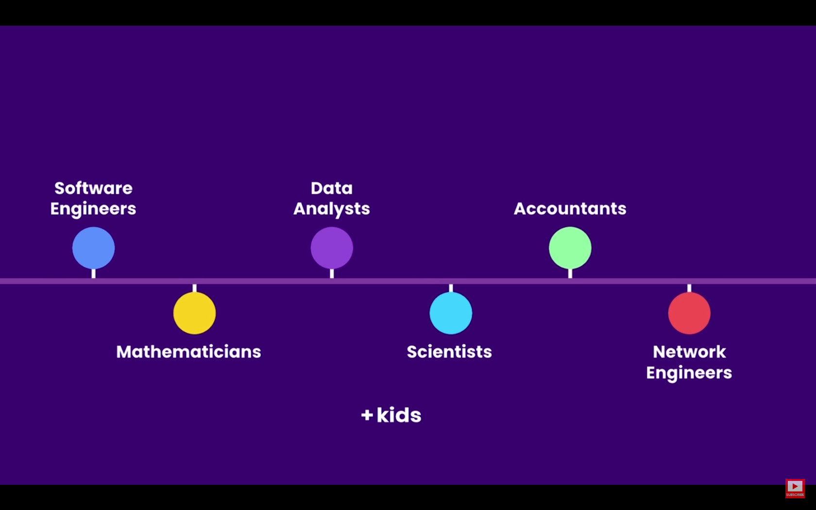

Slide 5
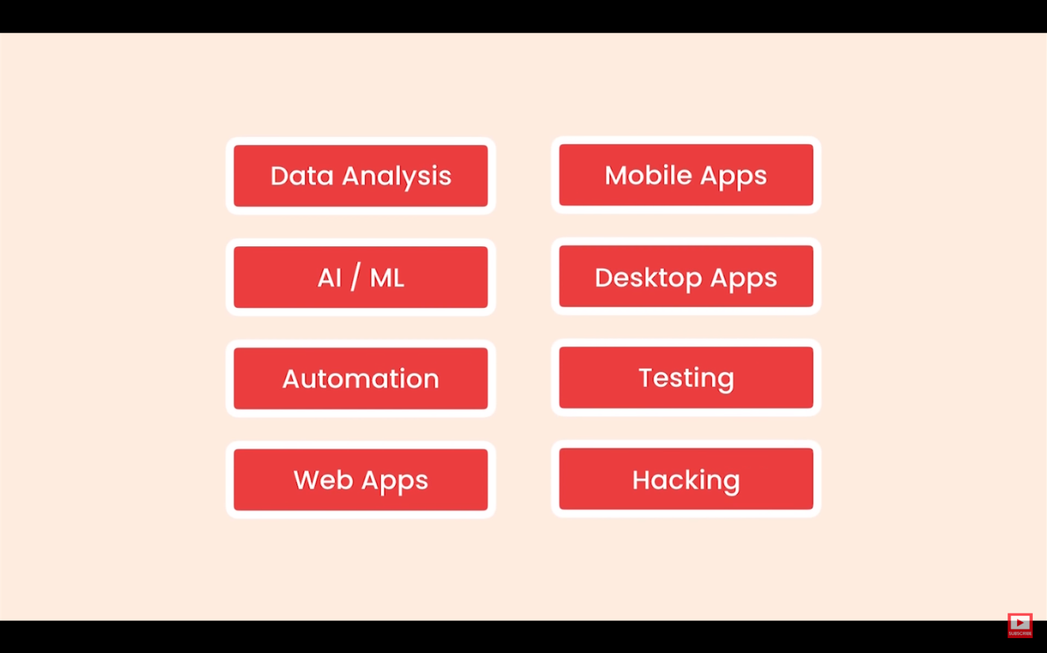
Python is a multipurpose language

Slide 6
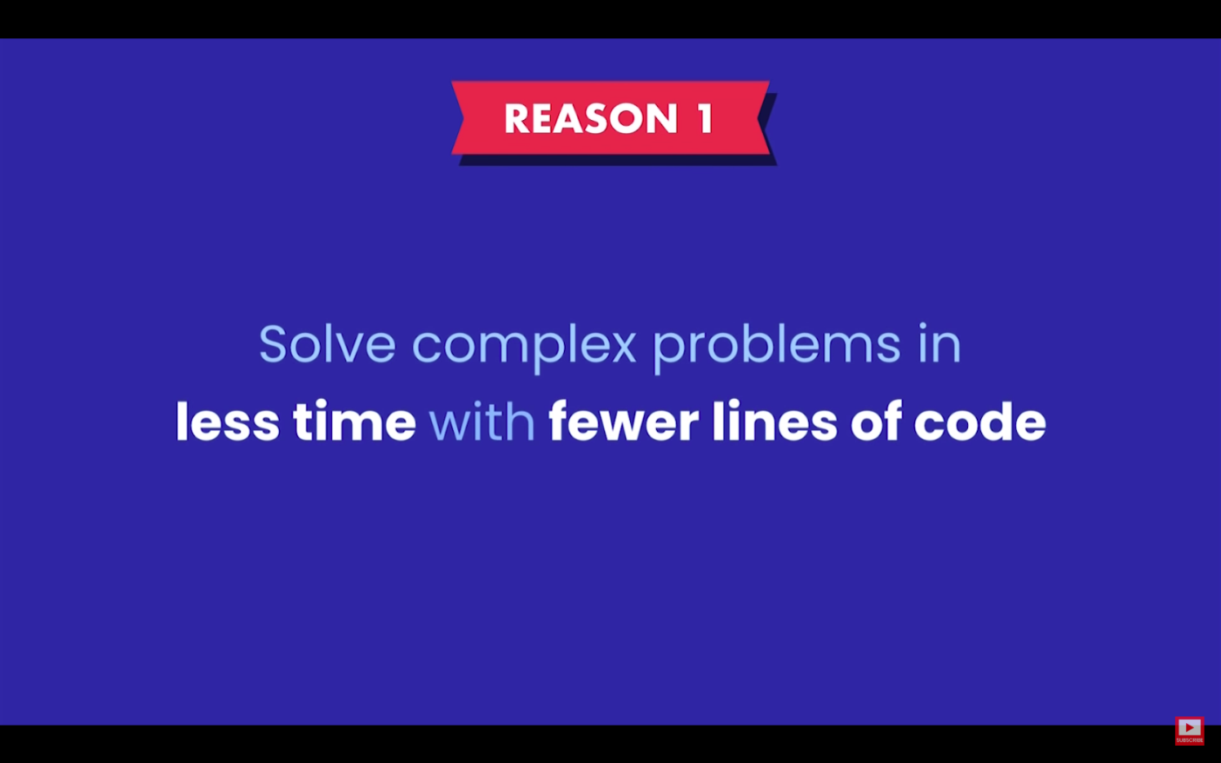

Slide 7
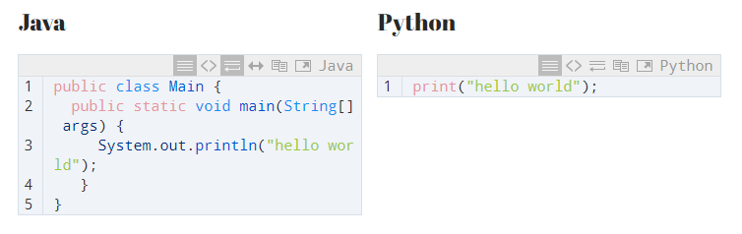

Slide 8


Slide 9
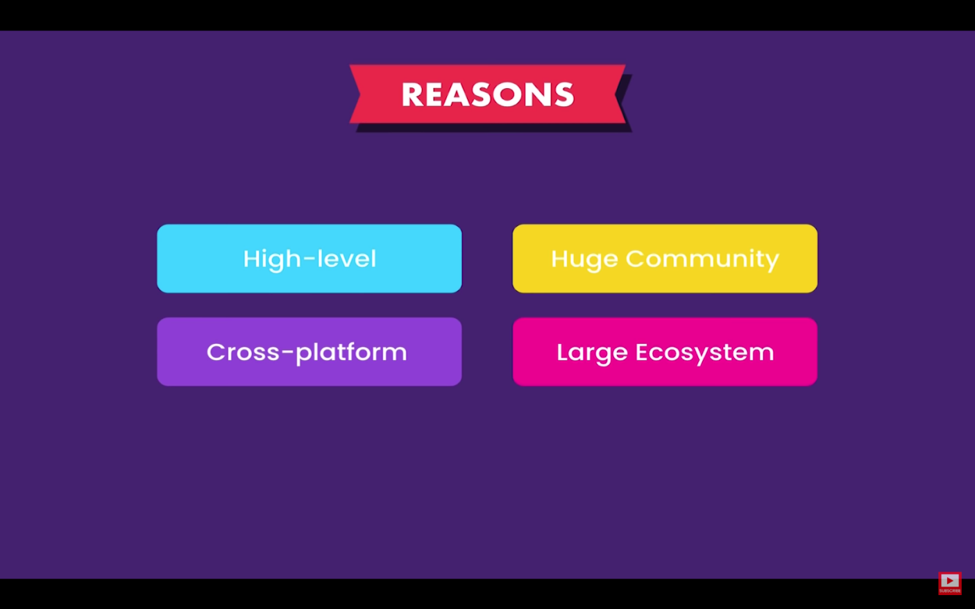

Slide 10
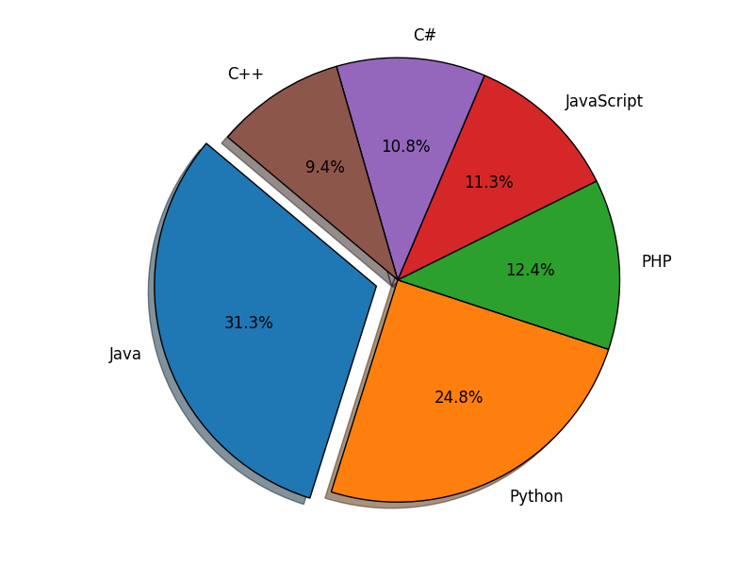

Slide 11


Slide 12


Slide 13
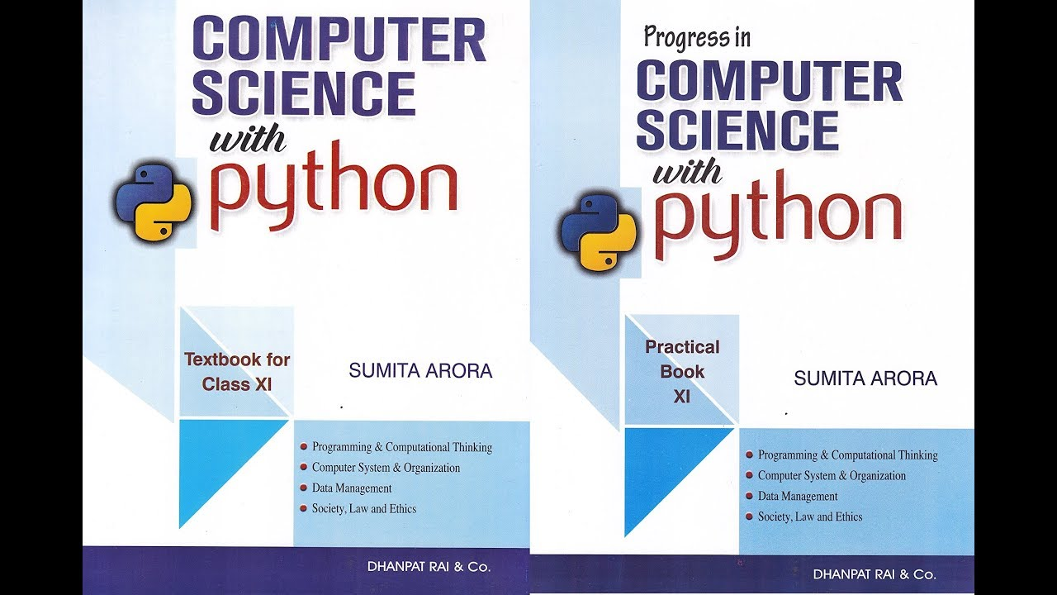

Slide 14
