Slide 1

Ai pose detection

Slide 2
SUMMER INTERNSHIP ^{Submitted by – PRATEEK ARORA} ^{Roll no -2K20CUN01077} ^{Class – CSE-5B-G1}

Slide 3
ABSTRACT
AI pose detection is a helpful tool which can help us optimize us our fitness activity, it tracks human body and points to the body joints to create a tracking system, which is connected internally to system image processing device through its internal modules.

Slide 4
OBJECTIVE
The ultimate objective of this tool is to provide an efficient and optimized way to optimize your fitness activities, it tracks movement in real time and in calculating your reps and activity.

Slide 5
PURPOSE
Purpose is to create an AI based fitness tracker, which can prove be useful in daily fitness schedules.

Slide 6
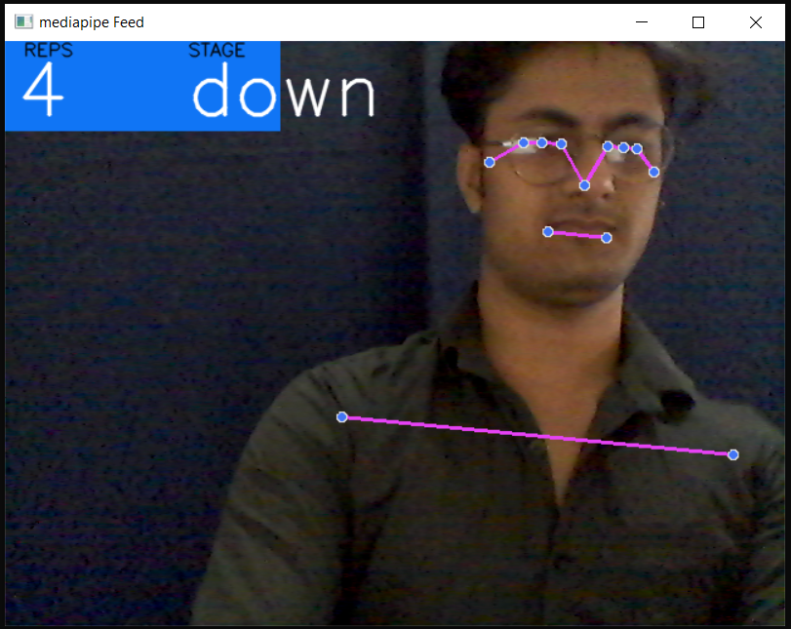
GUI OF TOOL

Slide 7
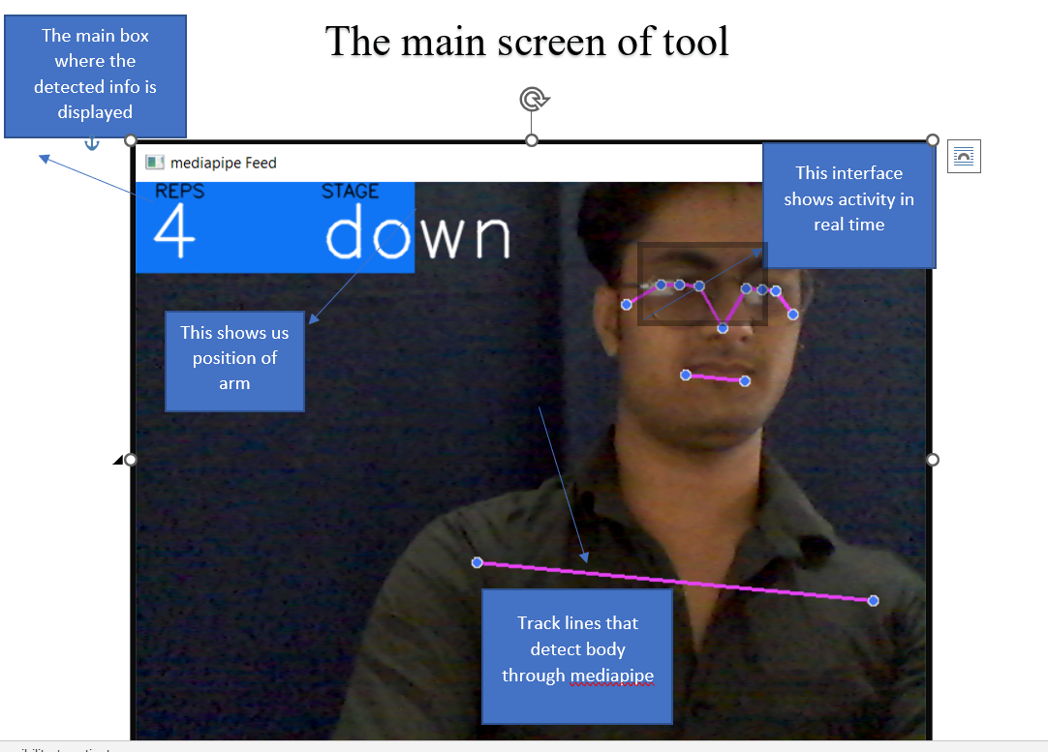

Slide 8
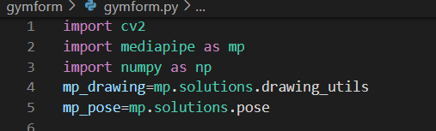

EXPLAINATION AND IMPLEMENTATION
This part of code is to import required files for the program to run.
This turns ON the system which opens the camera of the system to run mediapipe interface.
Main program or function which enables us to build the program, track records of body movement.

Slide 9
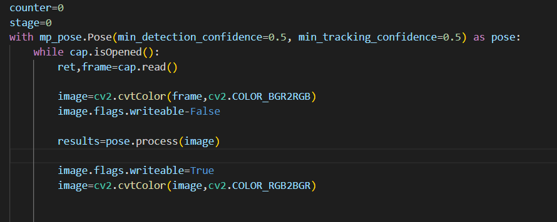
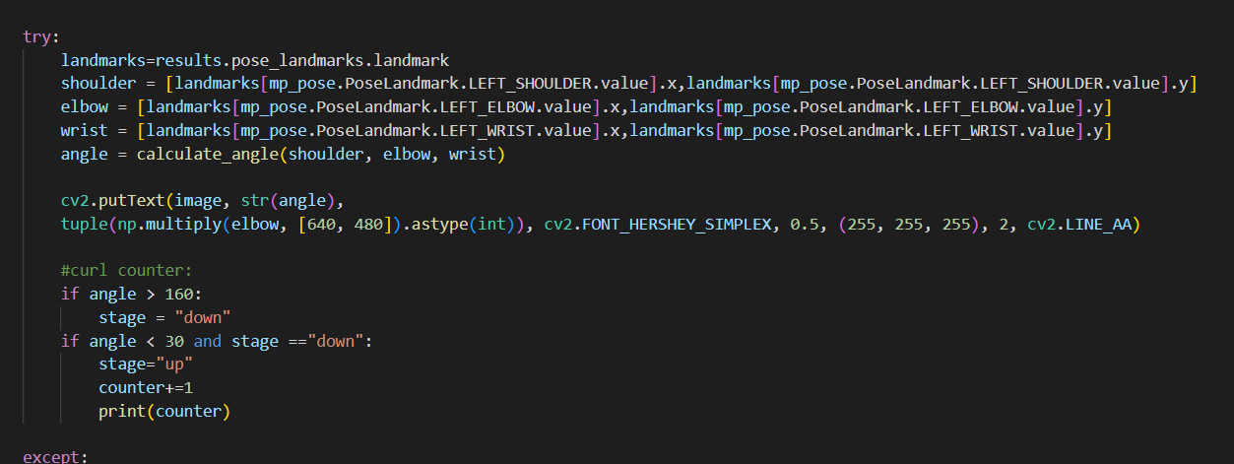
Main program or function which enables us to build the program, track records of body movement.
This part tracks body, shows colouration detects arm and shoulders

Slide 10
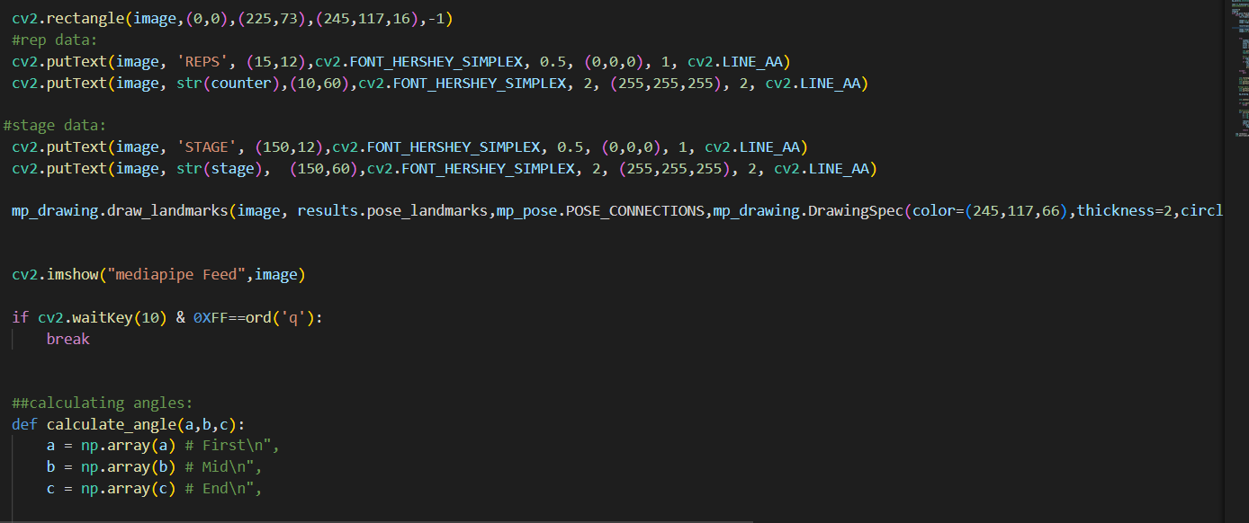

Slide 11
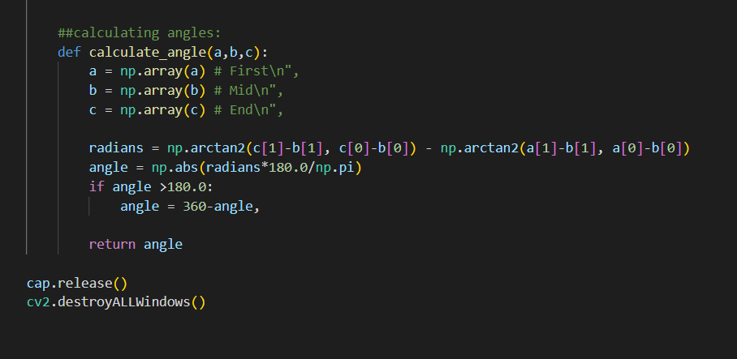

Slide 12
Python Project Prerequisites:
IDE Used: Visual Studio Code
Python Packages Installation (opencv, mediapipe).

Slide 13


