Slide 1
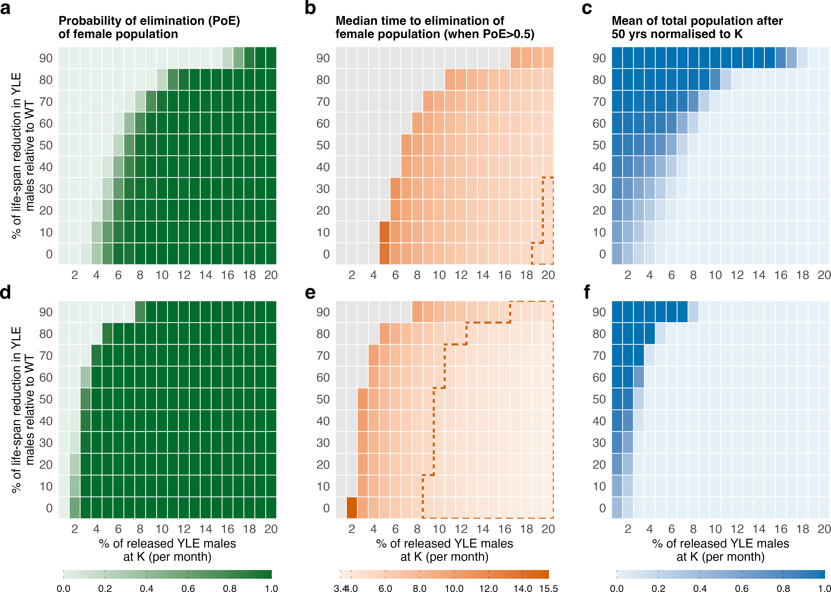


Haplosufficient female-specific target
PoE$≥$0.5
Partial Haploinsufficiency Leading to Reduced Fertility (in fEW)
Median TTE
$≤$ 5 yrs
(in yrs)

