Slide 1
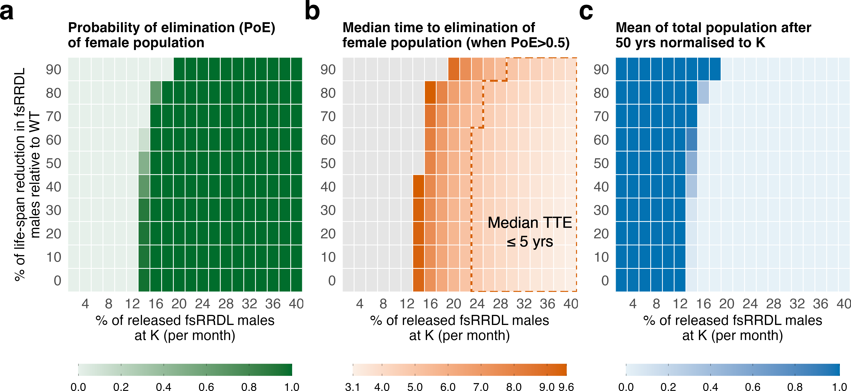
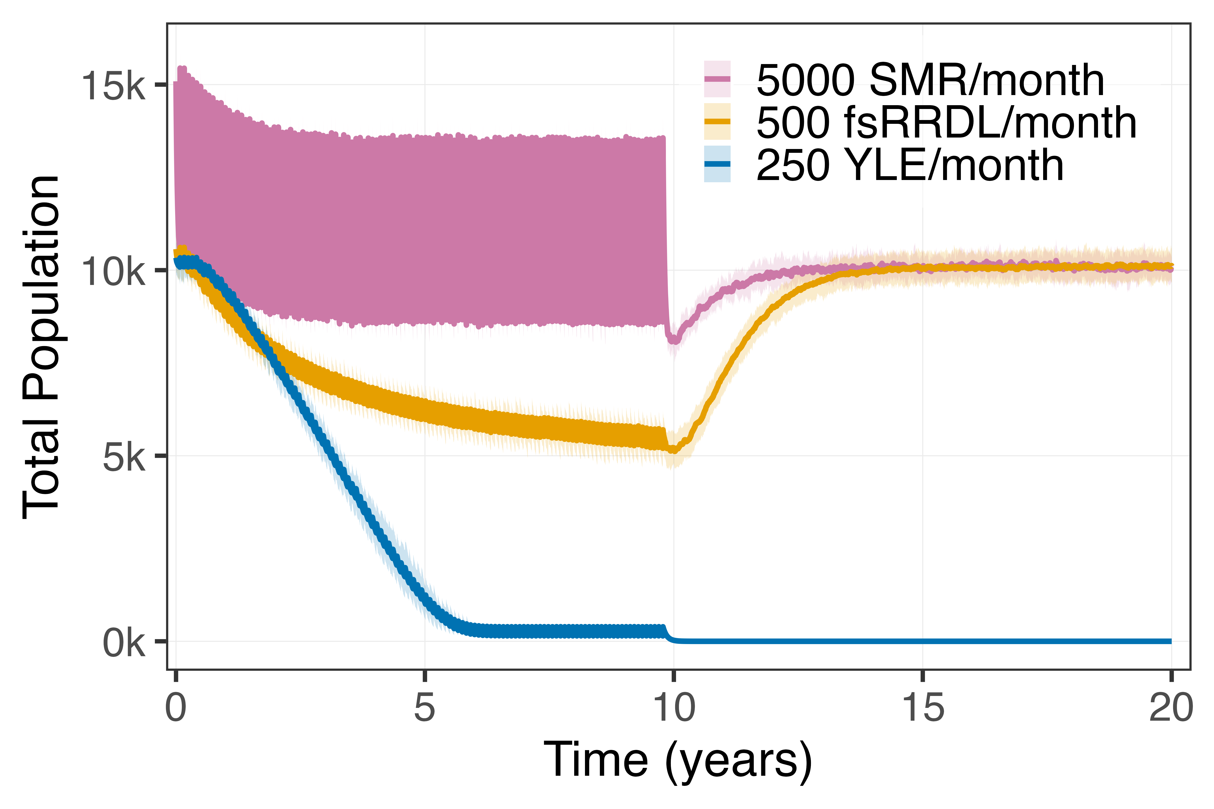
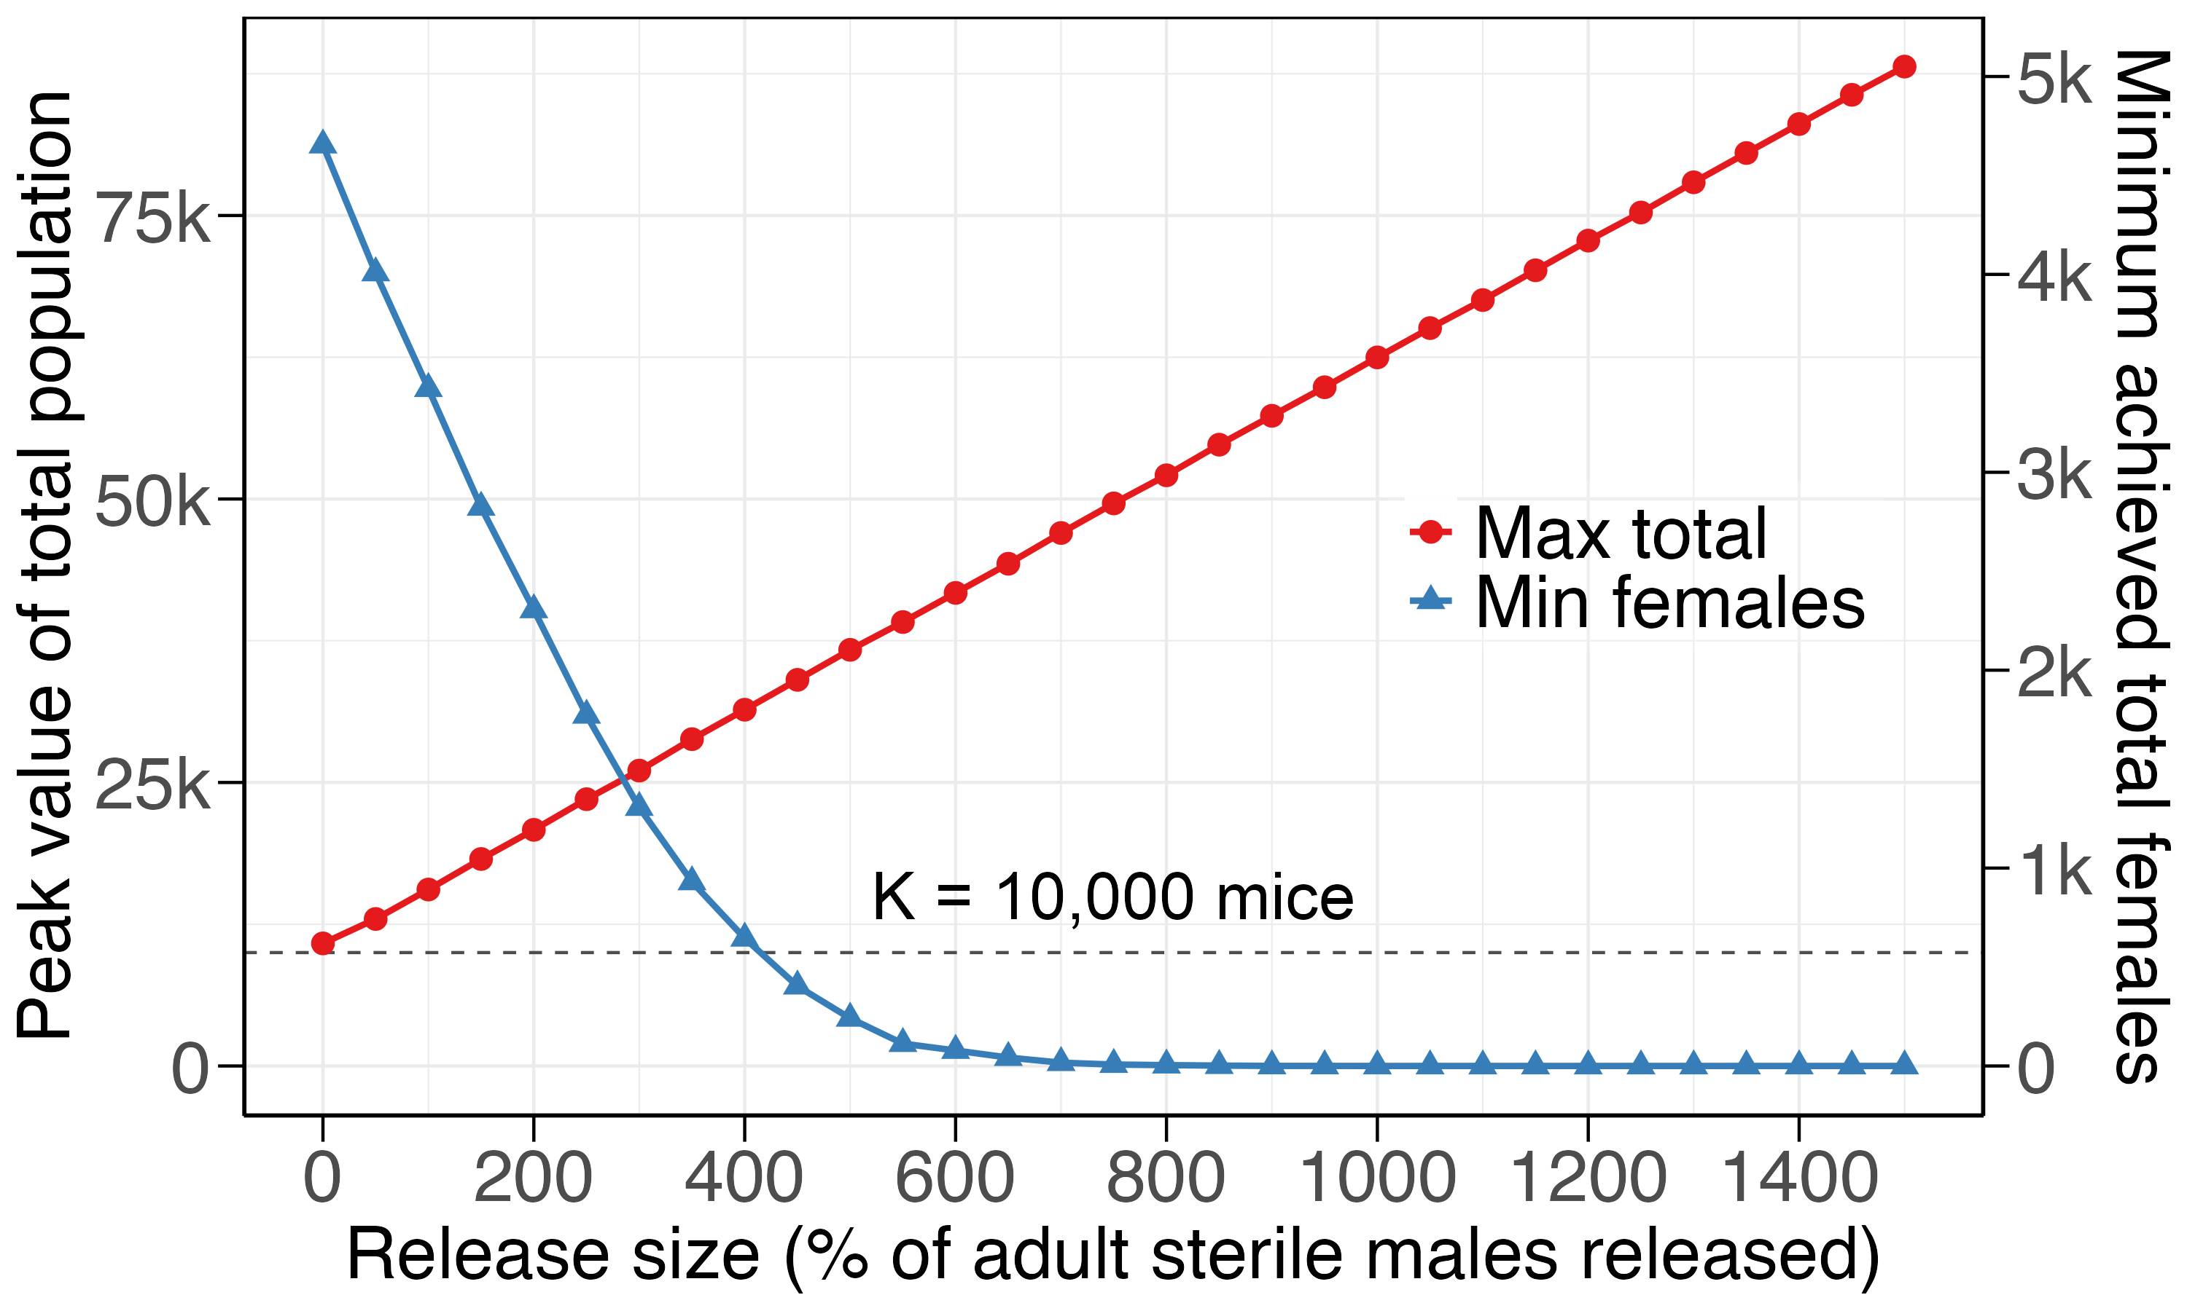

Median time to elimination (TTE) of female population (when PoE$≥$0.5)
(in years)
d
e
Maximum Population Size

