Slide 1
Presentation for Bank of Baroda Hackathon 2024
Your Team Name : Finance specials
Your team bio : Building Gen AI solution for BOB
Date : 28 June 2024

Slide 2
Problem Statement?
Why did you decide to solve this Problem statement?
Traditional financial advisory services often provide generic advice that doesn’t account for individual customer preferences, goals, or real-time financial data.
Customers increasingly expect personalized financial guidance that adapts to their changing life circumstances and market conditions.
Robo-advisors, while automated, typically lack the ability to integrate real-time data streams, limiting their responsiveness to market fluctuations.
Manual financial advisors can provide personalized advice but often at higher costs and with scalability challenges.
Customers today demand transparency, real-time insights, and explanations behind financial recommendations to build trust and confidence in their financial decisions.
Meeting these expectations not only enhances customer satisfaction but also drives customer retention and loyalty in a competitive market.

Slide 3
Pre-Requisite
What are the alternatives/competitive products for the problem you are solving?
Traditional Financial Advisory Services:
Typically rely on manual processes and generalized financial planning.
Lack real-time data integration and AI-driven insights.
Examples include financial advisors at traditional banks and independent advisory firms.
Robo-Advisors:
Automated investment platforms that use algorithms to allocate and manage clients’ assets.
Limited in their ability to provide real-time financial advice and lack human interaction.
Examples include Betterment, Wealthfront, and other algorithm-based investment tools.
Basic Financial Planning Tools:
Offered by banks and fintech companies for budgeting, expense tracking, and basic financial analysis.
Lack comprehensive integration of demographic data, real-time market insights, and personalized financial advice.
Examples include Mint, Personal Capital, and other financial management apps.

Slide 4
Tools or resources
Azure tools or resources which are likely to be used by you for the prototype, if your idea gets selected
Azure Stream Analytics for real-time data processing.
Azure Machine Learning for AI model development.
Azure OpenAI (GPT-4) for generative AI.
Power BI for interactive dashboards.
Azure Data Factory for data integration.
Azure DevOps for CI/CD.
Azure Monitor and Azure Log Analytics for monitoring and logging.

Slide 5
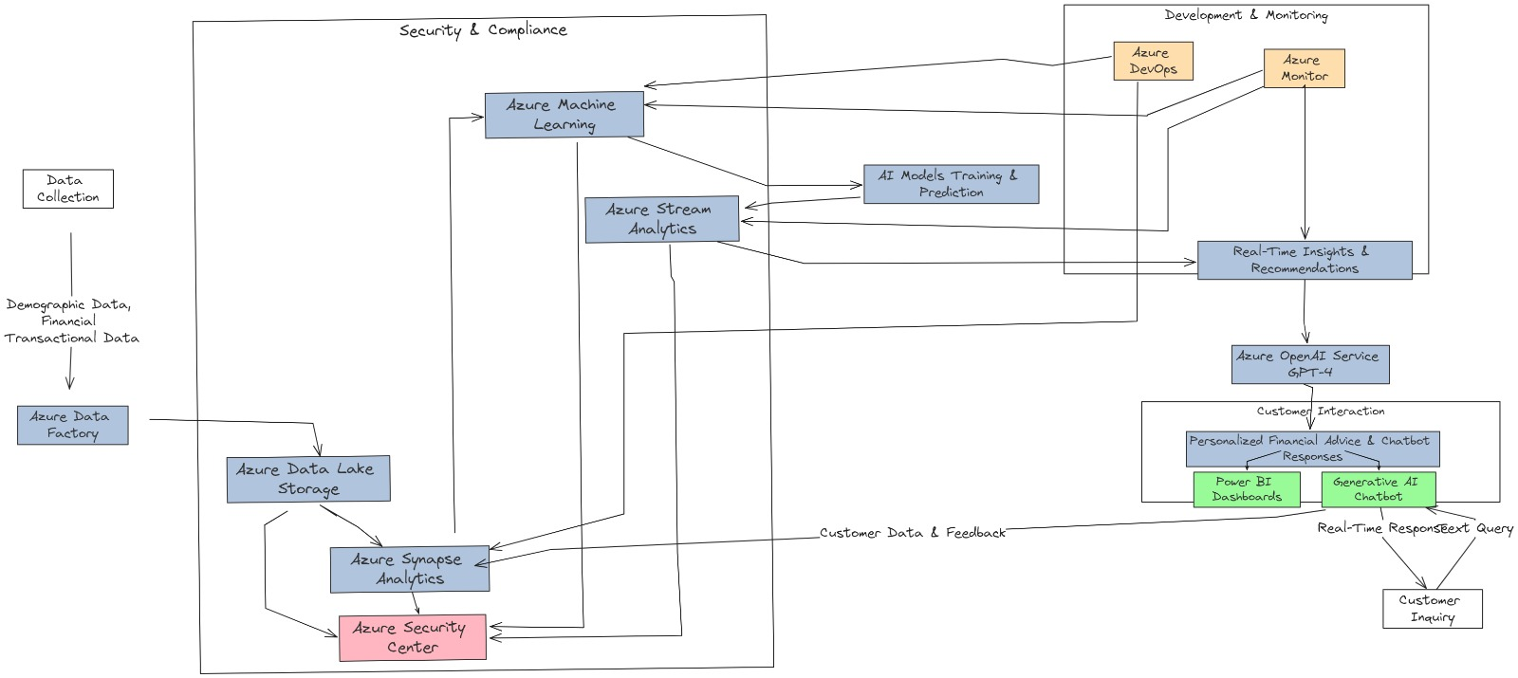
Any Supporting Functional Documents
Present your solution, talk about methodology, architecture & scalability
- Here is the prototype of the solution we are building to tackle this challenge also followed by the Git repository link:
https://github.com/prateek2102/BOB-Hackathon-2024

Slide 6
Key Differentiators & Adoption Plan
How is your solution better than alternatives and how do you plan to build adoption?
Key Differentiators:
Holistic integration of demographic and financial data.
Real-time insights with explainable AI.
Continuous learning and adaptation of AI models.
Adoption Plan:
Pilot with select customer segments.
Marketing campaign highlighting personalized financial advice.
Collaborations with financial planners and advisors to refine and promote the solution.

Slide 7
GitHub Repository Link & supporting diagrams, screenshots, if any
How far it can go?
Advanced Predictive Analytics: Implement more sophisticated predictive models to anticipate market trends and user financial needs proactively.
Integration with More Financial Data Sources: Expand the range of data sources, including international markets, to provide more comprehensive advice.
Enhanced Personalization Algorithms: Develop deeper personalization algorithms that consider a broader array of user behaviors and preferences.
Mobile App Development: Create a mobile application to provide users with on-the-go access to their financial insights and advice.

Slide 8
Business Potential and Relevance
What are the business applications of the problem you are solving?
Business Potential:
Increased customer engagement and retention.
Revenue growth through personalized investment strategies.
Competitive advantage through advanced AI-driven services.
Relevance:
High market demand for personalized financial management.
Compliance with financial regulations through transparent AI-driven advice.

Slide 9
Uniqueness of Approach and Solution
What is the unique aspects of the proposed idea?
Unique Approach:
Holistic data integration.
Real-time insights.
Explainable AI
Unique Solution:
Generative AI models (Azure OpenAI GPT-4).
Interactive Power BI dashboards.
Continuous learning and adaptation of AI models.

Slide 10
User Experience
How will your idea enhance the user experience?
Personalized engagement tailored to individual financial situations and goals.
Intuitive Power BI dashboards for easy visualization and understanding of financial data.
Clear explanations provided by Explainable AI features.
Real-time updates to keep financial advice relevant.

Slide 11
Scalability
How effectively can your solution be scaled to accommodate growth without compromising performance?
Cloud infrastructure leveraging Azure’s scalable resources.
Modular design for easy scaling of components.
Elastic computing resources to adjust dynamically based on demand.

Slide 12
Ease of Deployment and Maintenance
How simple is your solution to implement and maintain on an ongoing basis?
Ease of Development:
Comprehensive Azure tools reducing complexity and development time.
Utilization of pre-built models from Azure OpenAI.
Integration with Azure DevOps for streamlined CI/CD processes.
Ease of Maintenance:
Managed services reducing operational burden.
Automated updates and patches.
Robust monitoring and logging capabilities with Azure Monitor and Azure Log Analytics.

Slide 13
Security Considerations
What measures are incorporated to ensure the security and integrity of your solution?
Data encryption at rest and in transit.
Role-based access control (RBAC) for secure data access.
Compliance with global standards and regulations.
Continuous threat detection and real-time alerts.
Privacy protections and data anonymization mechanisms.

Slide 14
Thank You
Team member names: Prateek Saraswat Om Patel

