Slide 1
React and Flux
Prateek Magarde
prateekmag@cybage.com

Slide 2
Index
Introduction

Slide 3
INTRODUCTION
Library developed by Facebook
To develop interactive and reusable components
It can render client side and server side both.
It is using concept of Virtual DOM
Least amount of DOM manipulation

Slide 4
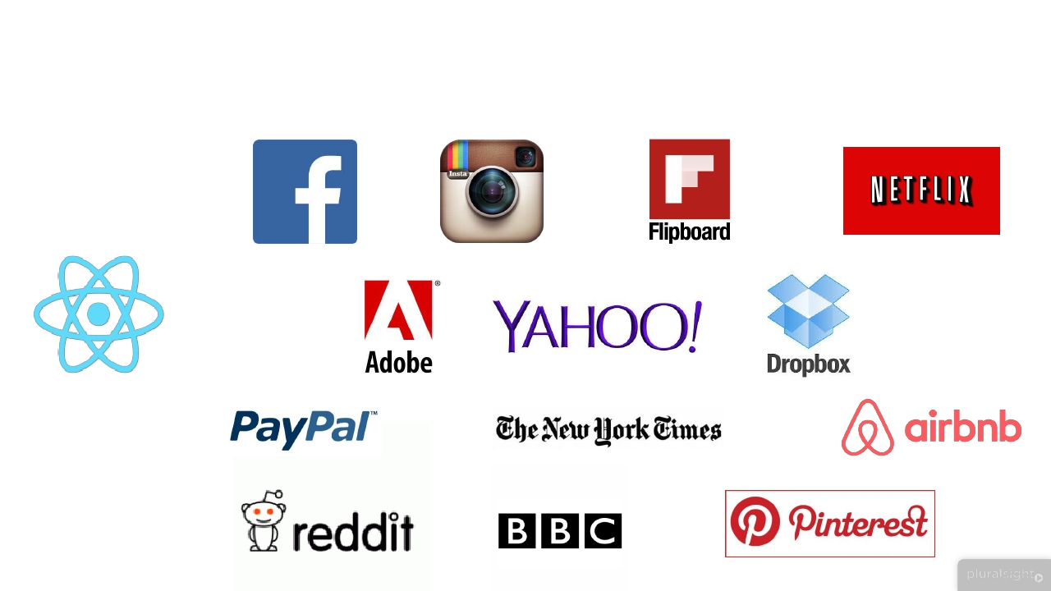
INTRODUCTION - Applications

Slide 5
INTRODUCTION - DOM
DOM – Document object model
Internal structure for browser to store and render webpages
When we update DOM the page gets re-render itself
This is expensive

Slide 6
INTRODUCTION – React updating DOM
React is using concept of Virtual DOM
It’s a internal structure of React
Mimic the browser DOM
Doesn’t do any actual rendering
Everything is done in its Virtual DOM
First it identifies what has changed > Second, Where it needs to update
This is fast

Slide 7
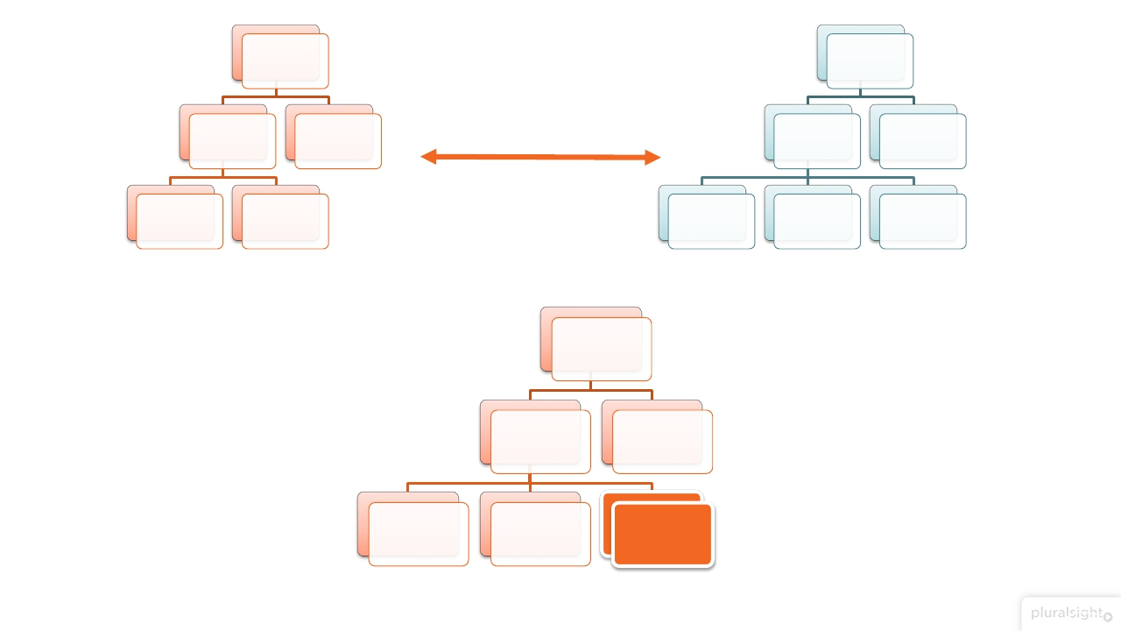

















div
div
ul
p
ul
p
Diff
li
li
li
li
li
Browser DOM
Virtual DOM
div
ul
li
p
li
li
Update and Render

Slide 8

INTRODUCTION – React updating DOM

Slide 9


Slide 10
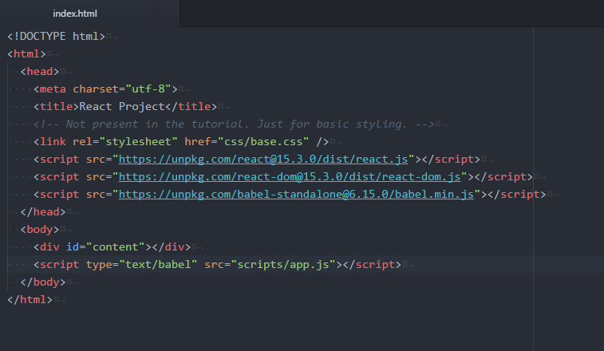
Setup
In Index.html

Slide 11
Setup
Through online libraries
React => For react
React-DOM => is the communicator between React and DOM
Babel => To convert JSX into JS

Slide 12
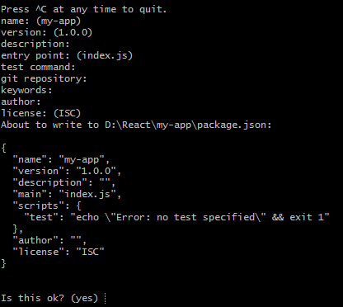
Setup
Through npm
First create a npm directory
It will ask you for few details related to your project
npm init

Slide 13
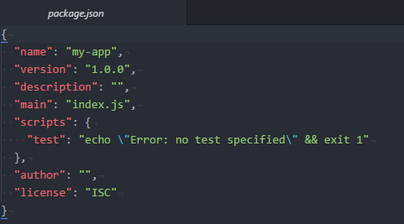
Setup
Through npm
This will create a package.json file

Slide 14
Setup
Through npm
Now we need few useful packages
react – for react library (P)
react-dom – to interact with DOM (P)
babel-cli – To transpile your code from one format to another (D)
babel-preset-react – To let babel knows that its react code (JSX->JS) (D)
babel-preset-es2015 – To support ES6. (D)
Some other useful npms
browserify – To load the npm modules in your browser (D)
babelify – To support babel with browserify (P)
nodemon – To keep watch on a file transpilation (D)
require – To use require.js (D)
watchify - Update any source file and your browserify bundle (D)

Slide 15
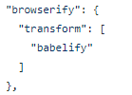
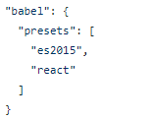
Setup
Through npm
Now we need few configuration to support browserify and babel with ES6

Slide 16
Setup
Through npm
Now we need a script to run to build our package
To run this script
Lets have a server
"watch-build": "watchify -t -o build/app.js -v -d src/js/app.jsx"
npm run watch:sb
npm install –g http-server http-server –p <port number>

Slide 17

Thanks to pay your attention guys…

Slide 18
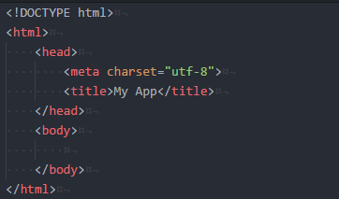

Let’s Start with very basic
Let’s create an src/index.html file.
Let’s create a div with id content.
Then we include our build/app.js file.
AND HERE WE ARE READY TO CODE…

Slide 19
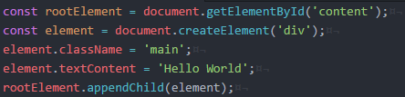
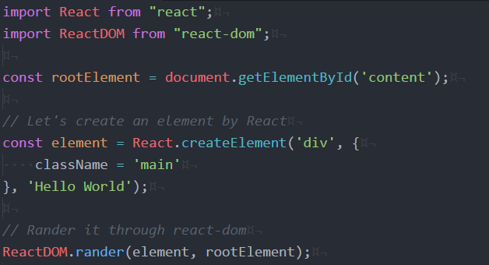
Create HTML elements with React.createElement
In normal Javascript
In React

Slide 20
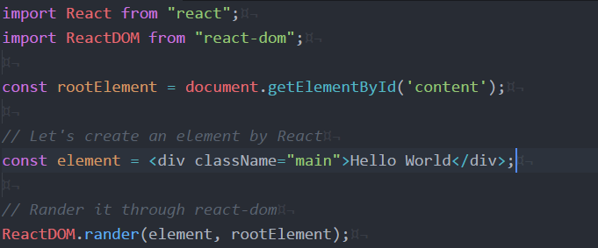
Create HTML elements with React.createElement
But we are using JSX
For HTML
class=“abc”
For React
className=“abc”
How it can work so fine with div in jsvascript.
Yeah that’s JSX and Babel is the main HERO…

Slide 21

Create HTML elements with React.createElement
Use javascript in JSX
Using { }

Slide 22
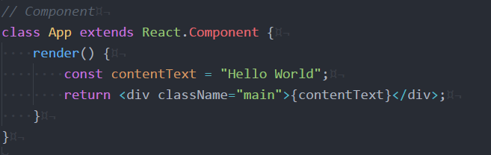
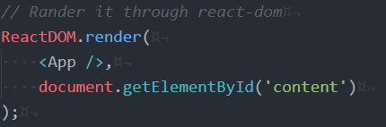
Components
Create a component
To create a component we are using class which is gonna extends from
React.Component

Slide 23
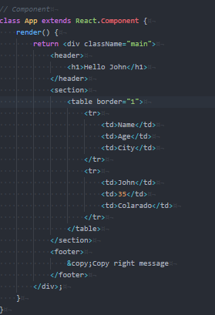
Components
Let’s say I have Header, Content and Body component

Slide 24
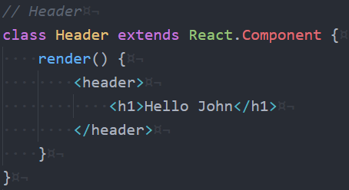
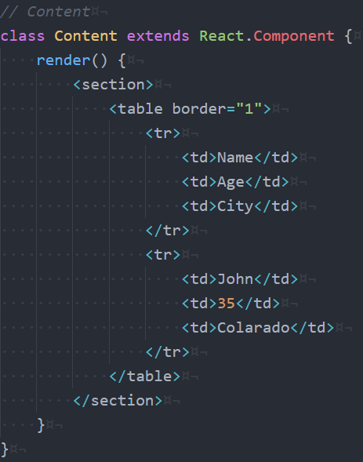
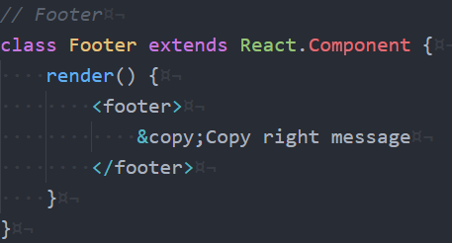
Components
Now I am creating separate components and including it

Slide 25
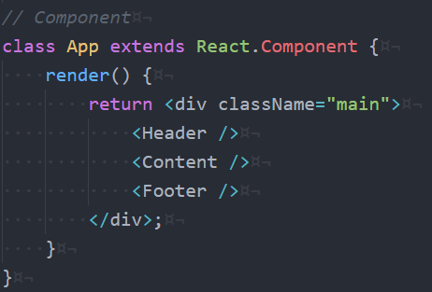
Components
Now I am creating separate components and including it

Slide 26
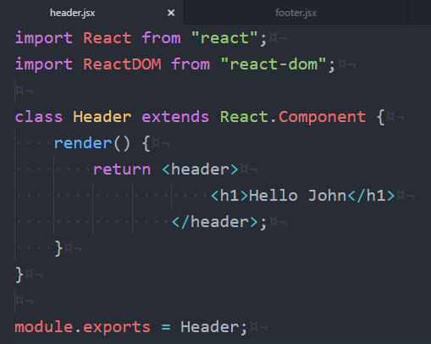
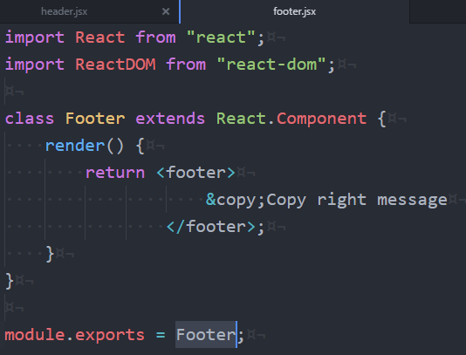
Components
We can also keep in separate JSX files
Let’s say I am creating a separate folder say common
Keeping Header and footer file there

Slide 27
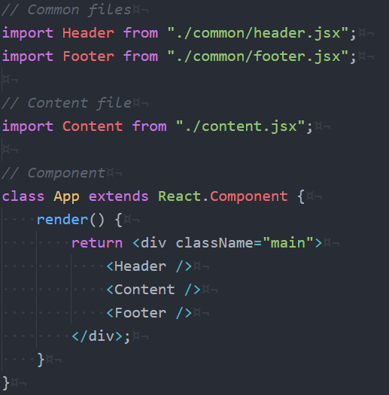
Components
Including Header, Footer and Content

Slide 28


Slide 29
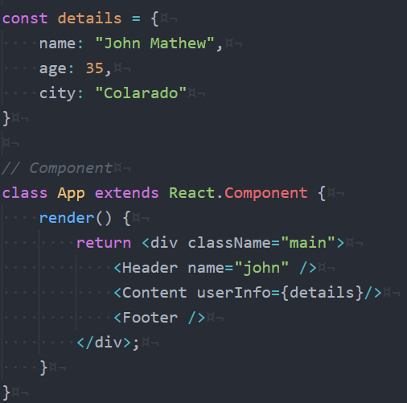
Props
We can pass data to children components using props
We can pass any
kind of data like
string or object or
function

Slide 30
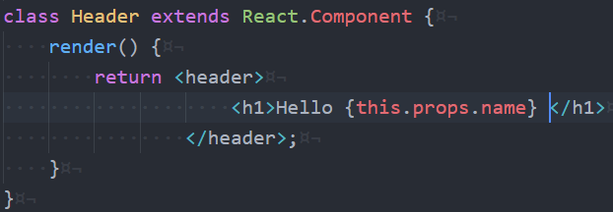
Props
We can access the props like

Slide 31
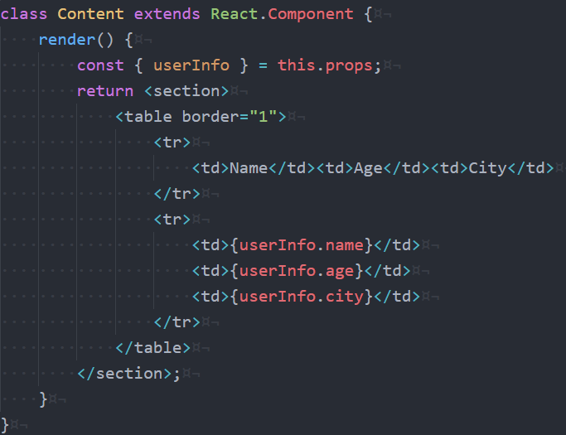
Props
We can access the props like

Slide 32

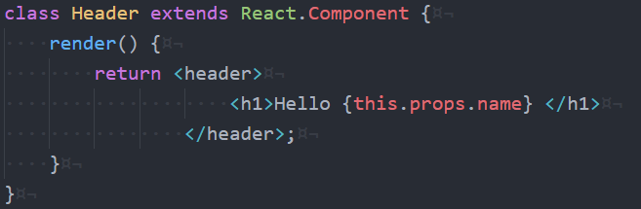
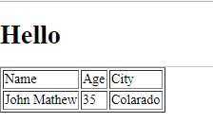
PropTypes
So sometimes people are making mistakes to pass props
Let’s say in Header I am passing the prop as true
But in the component it is expecting a string
In the output it will show nothing

Slide 33
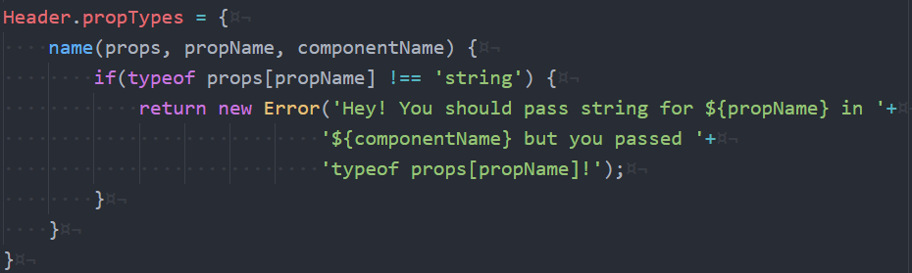
PropTypes
How we can validate that In Normal World of Javascript

Slide 34
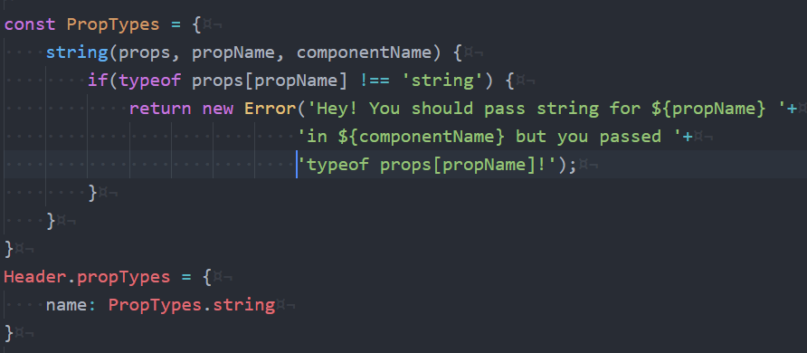
PropTypes
We can also write it like

Slide 35
PropTypes
In React World
Here we need to include an npm, built by React team
X
We Can remove this

Slide 36
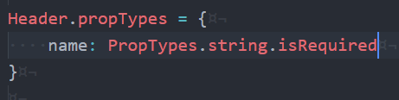
PropTypes
In React World
If the prop is required

Slide 37
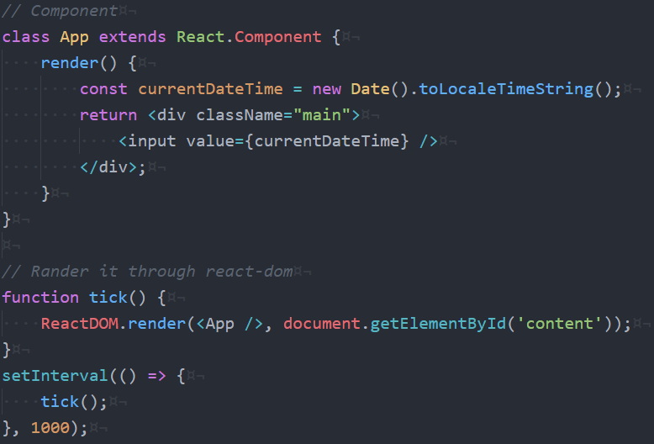
Virtual DOM

Slide 38
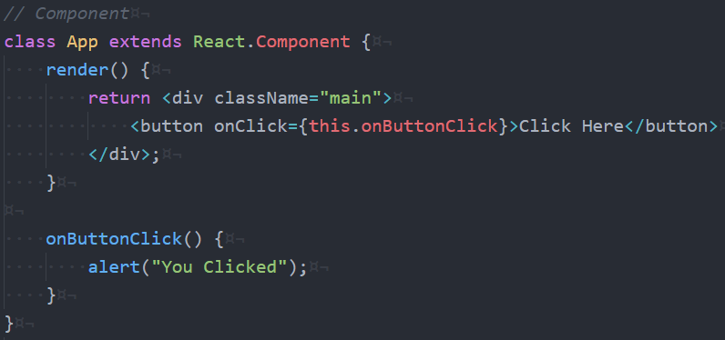
Events
Always in Camel Case
onClick
onChange

Slide 39
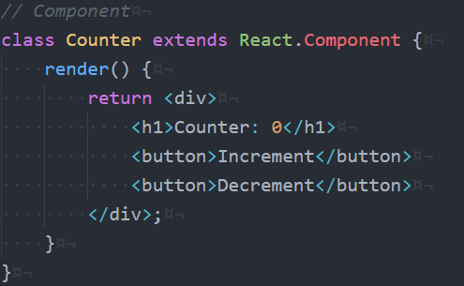
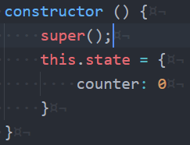
Component State
Let’s have a Counter component
Now we are having Counter from state. And I can define default state in
constructor as initial method of component

Slide 40
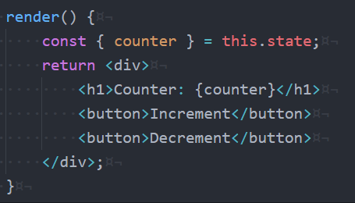
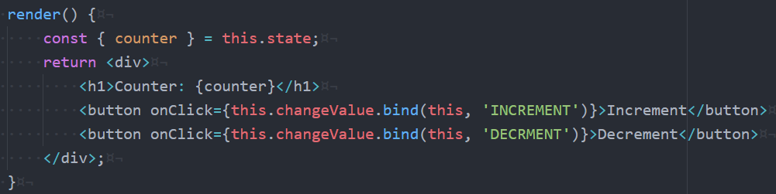
Component State
Now we are using counter from state

Slide 41
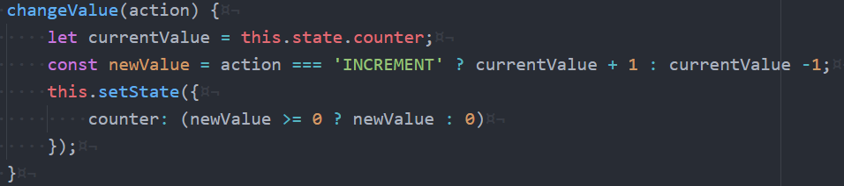
Component State
This.setState
And it will call render method everytime after setting the state value

Slide 42
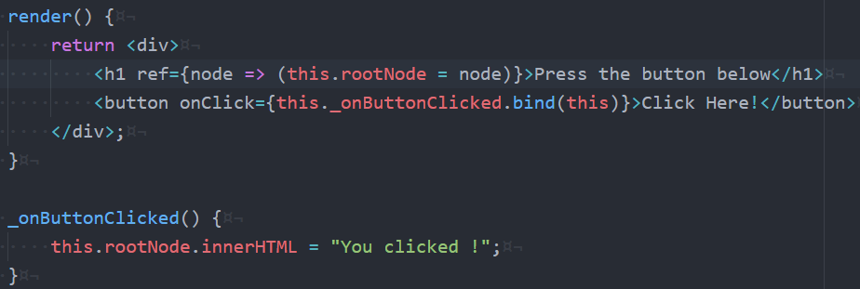
Element ref
Sometimes we need access to the DOM node directly to get the value of
form fields or for other reasons.
In that case we can use refs.

Slide 43
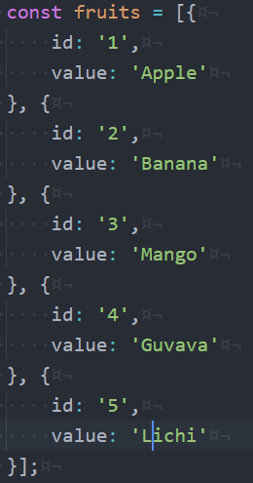
Key
Lets say we have an array

Slide 44
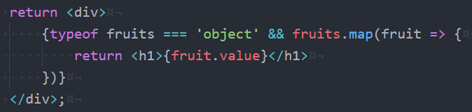
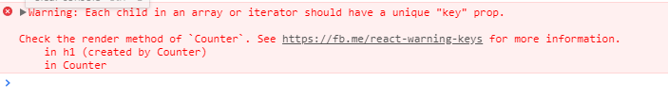
Key
In my render method

Slide 45
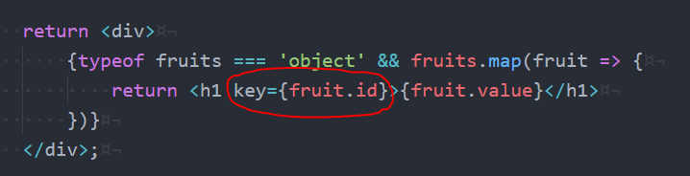
Key
To avoid this warning

Slide 46
Component Lifecycle
componentWillMount
componentDidMount
componentWillReceiveProps
shouldComponentUpdate
componentWillUpdate
componentDidUpdate
componentWillUnmount

Slide 47

Component Lifecycle - componentWillMount
When
Before initial render, both client and server
Why
Good spot to set initial state

Slide 48

Component Lifecycle - componentDidMount
When
After render
Why
Access DOM, integrate with frameworks, set timers, AJAX requests

Slide 49

Component Lifecycle - componentWillReceiveProps
When
When receiving new props. Not called on initial render
Why
Set state before a render

Slide 50

Component Lifecycle - componentWillUpdate
When
Imidiately before rendering when new props or state are being received
Not called on initial render
Why
Prepare for an update

Slide 51
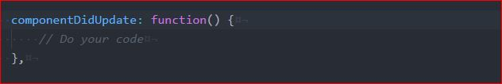
Component Lifecycle - componentDidUpdate
When
After component update to the DOM
Not called for the initial render
Why
Work with the DOM after as update

Slide 52

Component Lifecycle - componentWillUnmount
When
Immediately before component is removed from the DOM
Why
Cleanup

Slide 53
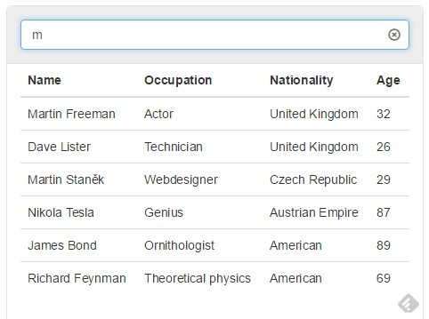
Assignment -2

Slide 54


Slide 55

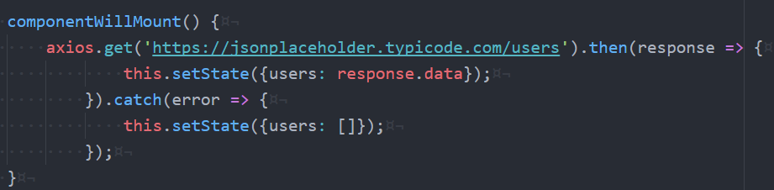
React HTTP Service Call
axios
Let’s import first
In componentWillMount I can call my service
npm install --save axios

Slide 56
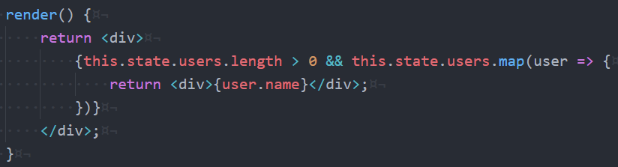
React HTTP Service Call

Slide 57
Single Page Application

Slide 58
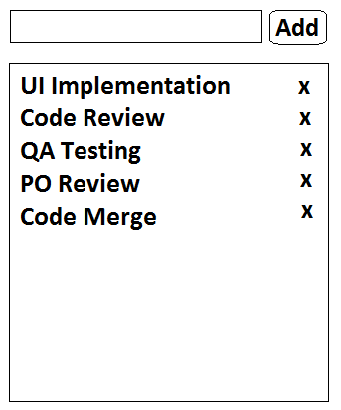
Assignment
2. To Do – There is a text box in which you can type your task and by clicking
on Add button it should be added to the list. And by clicking on (x) button
it should remove that task.

Slide 59


