Slide 1
All Javascript
Prateek Magarde
pmagarde@tavisca.com

Slide 2
Session 1 – Javascript Funndamentals

Slide 3
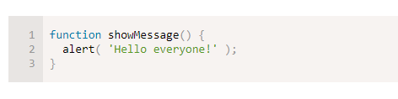
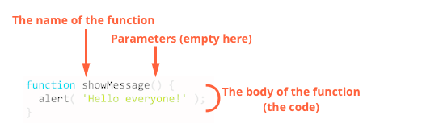
Functions
When we need to perform similar operation in many places.
Function Declaration:

Slide 4
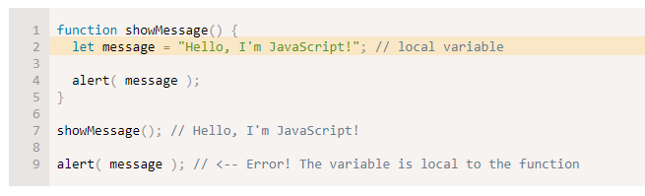
Functions
Local Variables:
A variable declared inside the function is only accessible inside the function.

Slide 5
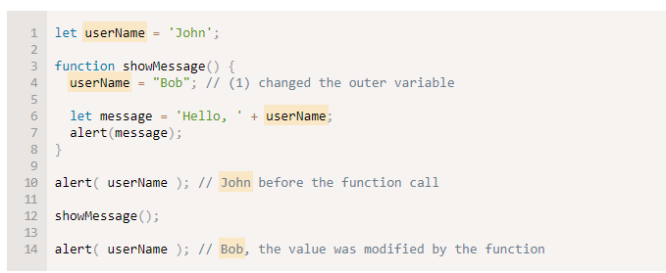
Functions
Outer or Global Variables:

Slide 6
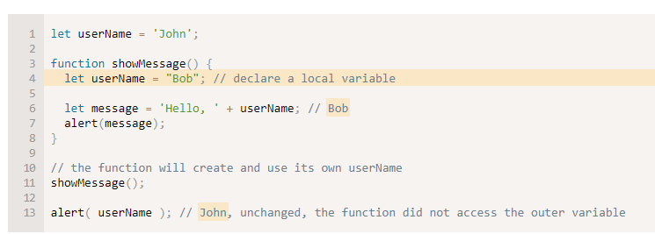
Functions
Outer and Inner Variables:

Slide 7
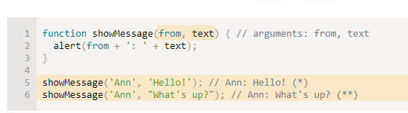
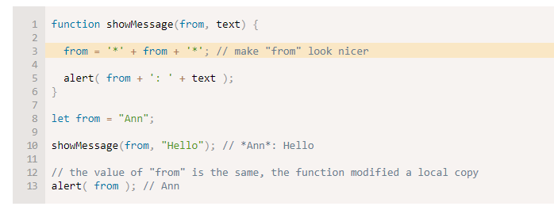
Functions
Parameters:

Slide 8

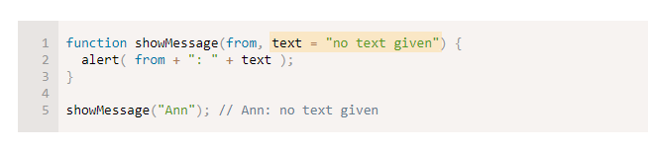
Functions
Default Values:
If a parameter is not provided, then its value become undefined.

Slide 9
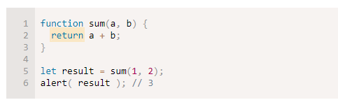
Functions
Returning a Value:

Slide 10
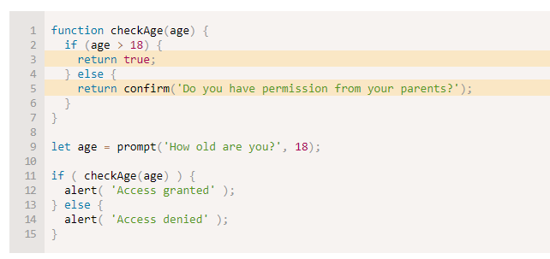
Functions
Returning a Value: Multiple Return

Slide 11
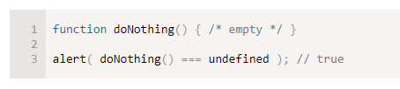
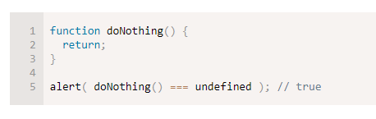
Functions
Funtion without return is always equal to undefined

Slide 12
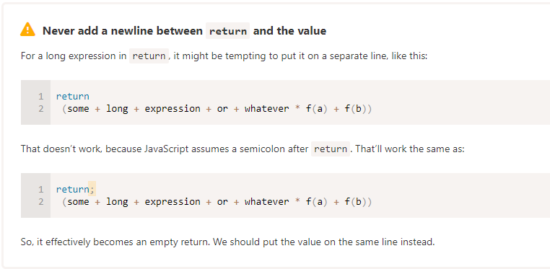
Functions
Few best practices

Slide 13
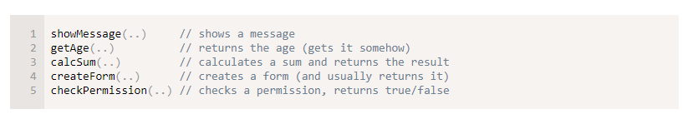
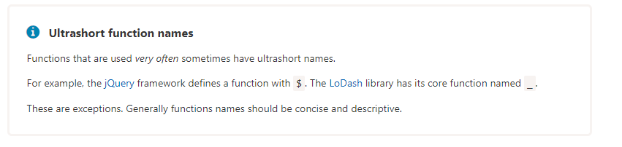
Functions
Naming a Function

Slide 14
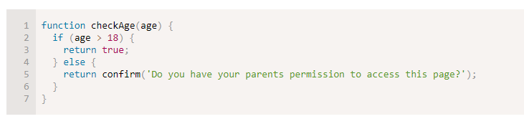
Functions
Code Practice:
Rewrite this function with ? or : or ||

Slide 15
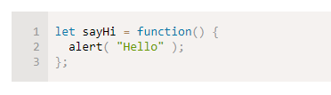
Functions Expression And Arrows
Function Expression:

Slide 16
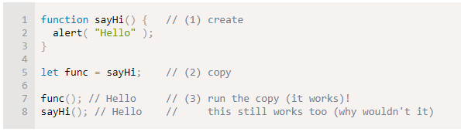
Functions Expression And Arrows
Function Expression:
Create a Function and assign its value to a variable.

Slide 17
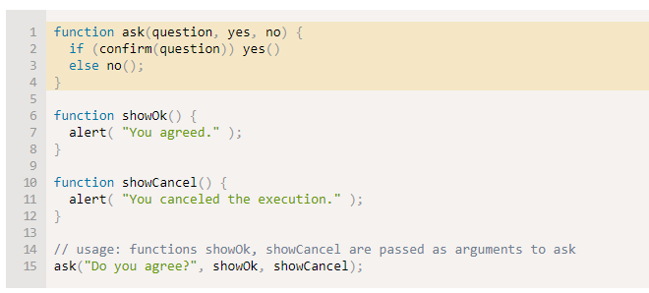
Functions Expression And Arrows
Callback Function:
Call Back Function

Slide 18
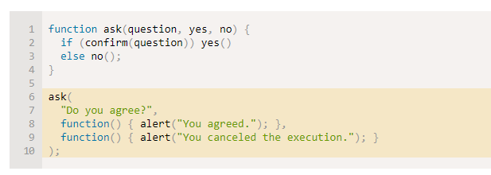
Functions Expression And Arrows
Callback Function:

Slide 19
Functions Expression And Arrows
Function Expression Vs Function Declaration:
Declaration | Expression
a function, declared as a separate statement | a function, created inside an expression or inside another syntax construct.
A Function Declaration is usable in the whole script/code block. | A Function Expression is created when the execution reaches it and is usable from then on.
When a Function Declaration is made within a code block, it is visible everywhere inside that block. But not outside of it. | To achieve LHS scenario we can create a variable and assign function to it.

Slide 20

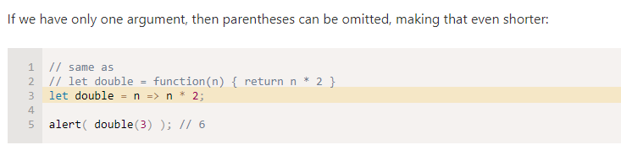
Functions Expression And Arrows
Arrow Function:

Slide 21
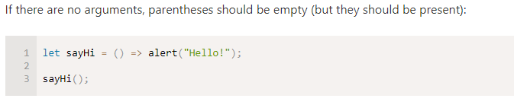
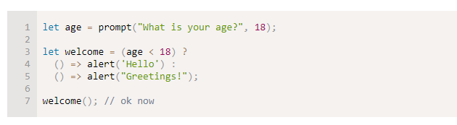
Functions Expression And Arrows
Arrow Function:

Slide 22
Functions Expression And Arrows
Arrow Function:
It does not have this
this.abc = 10;
$.someServiceCall( () => {
console.log(this.abc); // 10
});
this.abc = 10;
$.someServiceCall( function() {
console.log(this.abc); // Undefined
});

Slide 23
Session 2 – Code Quality and Objects

Slide 24
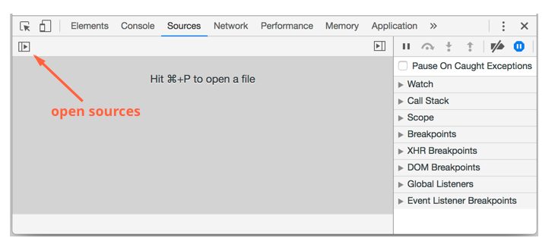
Code Quality: Debugging in Chrome
The “Sources“ Pane:
https://javascript.info/article/debugging-chrome/debugging/index.html
Open any page in Chrome
Open Inspect Element
Click on Sources Pane

Slide 25
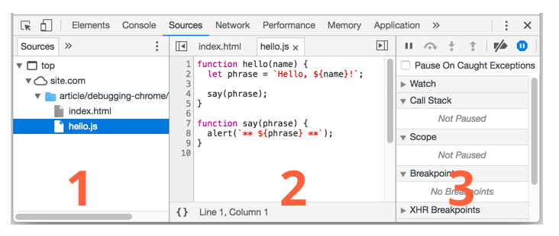
Code Quality: Debugging in Chrome
The “Sources“ Pane:
Resource Zone
Source Zone
Information and Control Zone

Slide 26
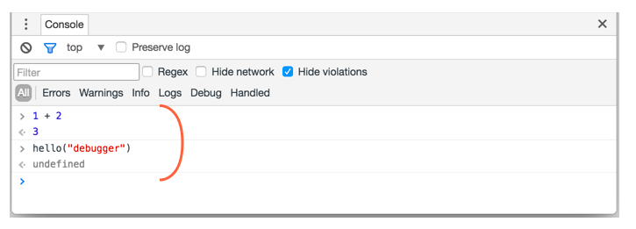
Code Quality: Debugging in Chrome
Console:

Slide 27
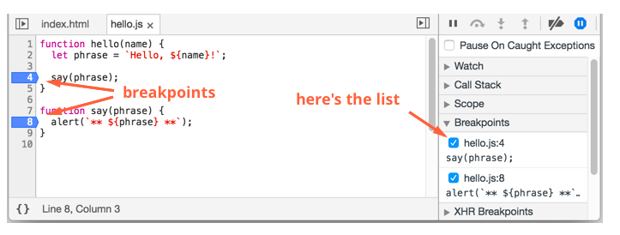
Code Quality: Debugging in Chrome
Breakpoints:

Slide 28
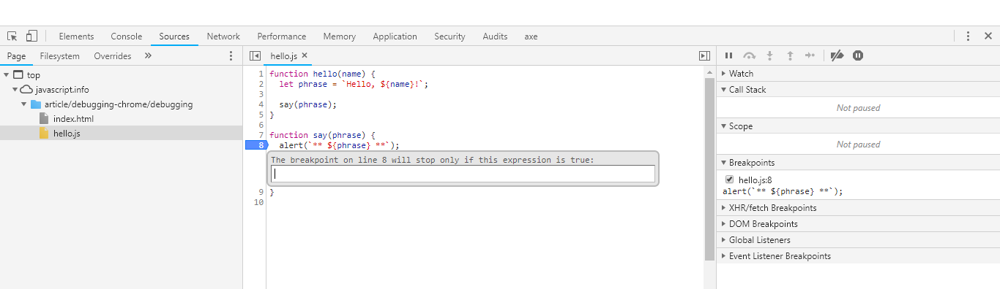
Code Quality: Debugging in Chrome
Conditional Breakpoints:

Slide 29
Code Quality: Debugging in Chrome
Restart Frame:

Slide 30
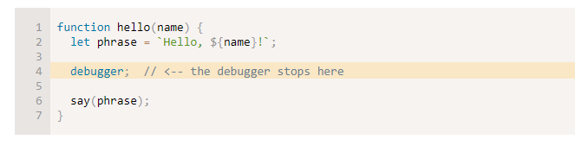
Code Quality: Debugging in Chrome
Debugger Command:

Slide 31
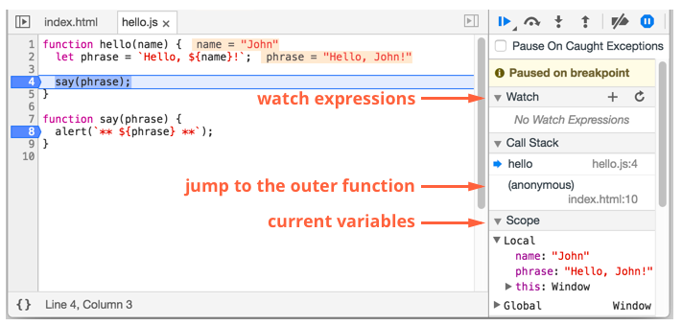
Code Quality: Debugging in Chrome
Pause and Look Around:

Slide 32
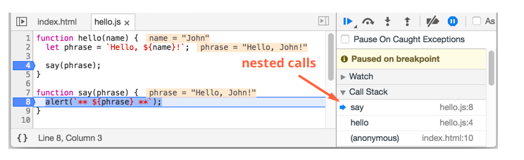
Code Quality: Debugging in Chrome
Tracing the Execution:

Slide 33
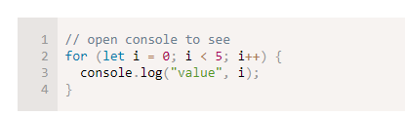
Code Quality: Debugging in Chrome
Logging:

Slide 34
Code Quality: Coding styles
Syntax:
1. Curly braces should starts from same line for if or for and etc.
2. Line Length should be 80 to 120.
3. Indentation should be 2 or 4 tab depending on your coding standards
4. One statement or expression should end up with a semi colon.
5. Avoid multiple level of nesting.
6. You can write your code first and then function declaration. But that depends on your preference.

Slide 35
Code Quality: Coding styles
Style Guides:
Always use a style guide where you can define your coding standards.
There are few style guides are available for best practices.
1 Google Javascript Styleguide
2. Airbnb JS Styleguide
3. Ideomatic.js
4. StandardJS

Slide 36
Code Quality: Coding styles
Automated Linters:
Linters are tools that can automatically check your code and suggest you the best practices and refectoring.
JSLint
JS Hint
ESLint
Here you can find how to integrate a linter
https://javascript.info/coding-style

Slide 37
Code Quality: Comments
Comments:
Your comments should:
Describe the architecture
Document the function usage
Describe the feature of the code

Slide 38
Code Quality: Ninja Code
Ninja Code Practices:
Make your code as short as possible.
Try to use variable names as short as you can.
Try to use obj, data, value, item, elem in your variable name to make it more readable.
You can also name a variable by its type str, num,…
Use smart synonyms like display…, show…, get…
Try to use actions for its events getData, checkPermission.

Slide 39
Code Quality: Automated testing with mocha
To be continued in Unit testing session…

Slide 40
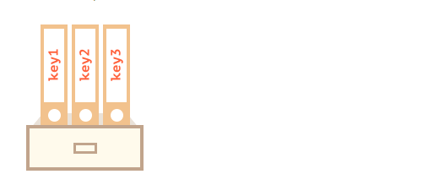
Objects: The Basics
Objects:
Stored key values pair
It can be created with { }

Slide 41

Objects: The Basics
Objects:

Slide 42
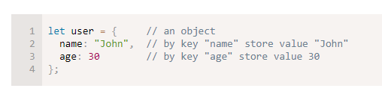

Objects: The Basics
Literals and Properties:
Get value from object:

Slide 43

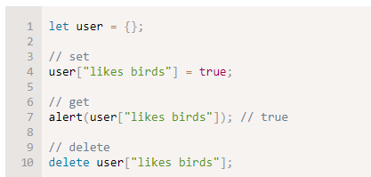

Objects: The Basics
Delete a value from object:
Square Bracket:
For multi word keys we can use square bracket

Slide 44
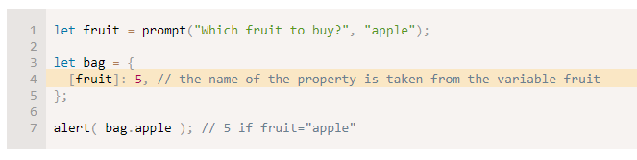
Objects: The Basics
Computed Properties:

Slide 45
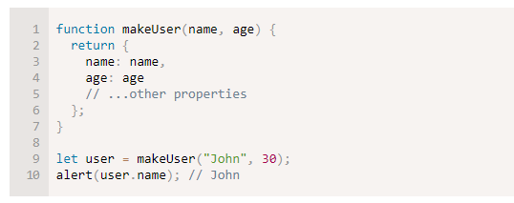
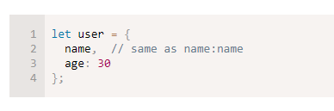
Objects: The Basics
Property Value Shorthand - Before
Property Value Shorthand - Before

Slide 46

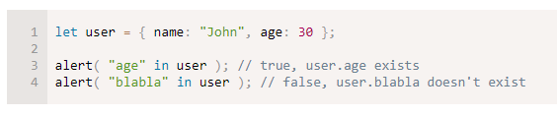
Objects: The Basics
Existence Check

Slide 47
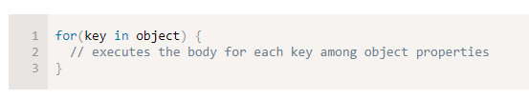
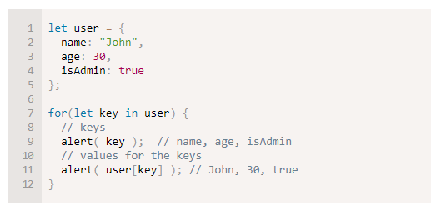
Objects: The Basics
The “for…in” Loop:

Slide 48
Objects: The Basics
The “for…in” Loop:

