Slide 1
Basic GUI Calculator
(USING TKINTER)
BY – PRATEEK AGRAWAL

Slide 2
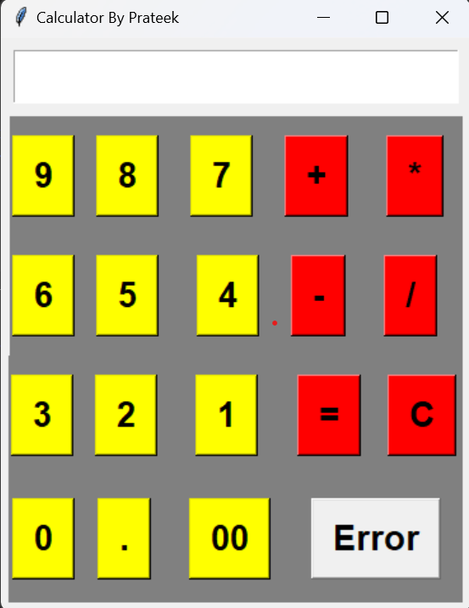
INTRODUCTION
This Simple Calculator is designed with the help of Tkinter which provides all the basic functionality for creating graphical user interfaces.
It calculates all basic arithmetical operations with the help of Button & Frames.

Slide 3
With the Help of
Scvalue as a global string variable ,
Frame ,
Button ,
Click (event) ,
Eval for all the calculations ,

Slide 4
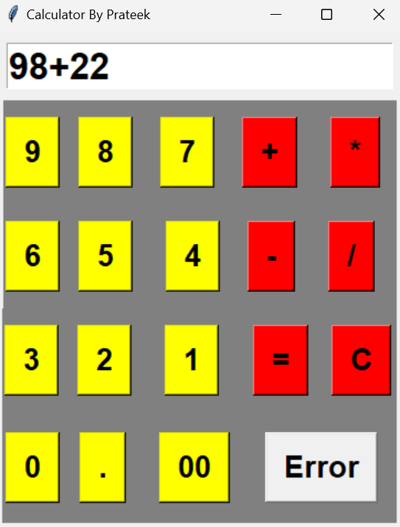
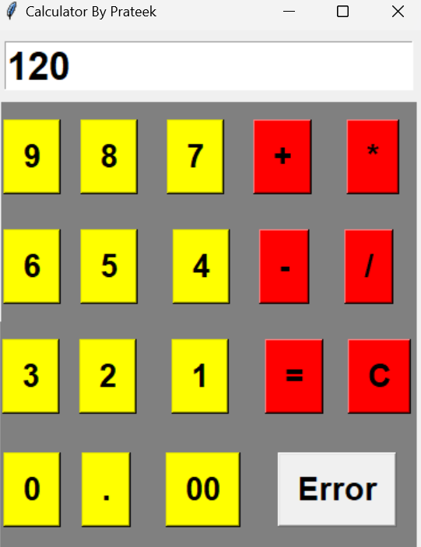
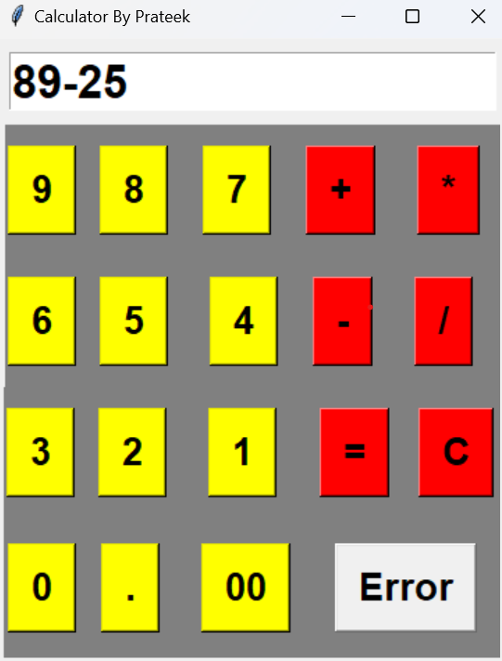
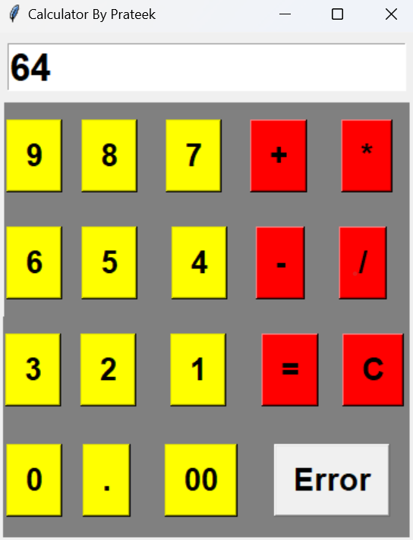
Includes
ADDITION
SUBTRACTION

Slide 5
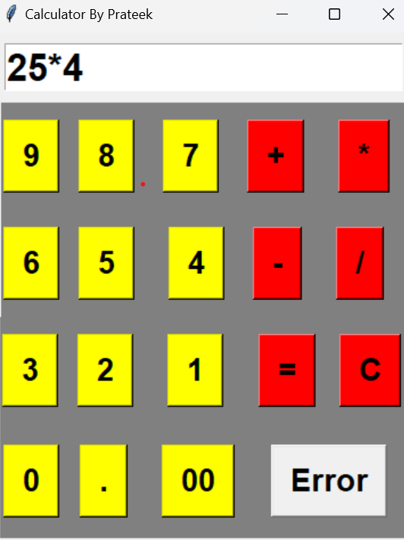
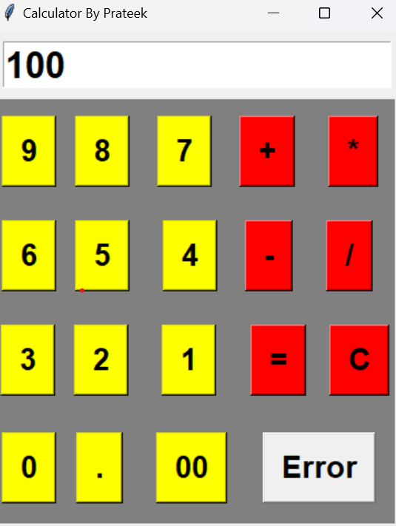

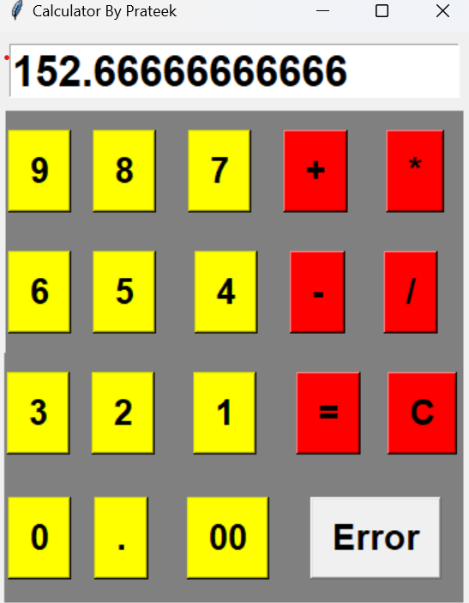
Includes
MULTIPLICATION
DIVISION

Slide 6
CONCLUSION
Have done with the help of GreeksforGreeks , youtube , and with some other browser.
It is still in progress for better adjustment.

Slide 7
THANKYOU

