Slide 1
Project – 3 EDA for Real Estate Pricing
By – PRATEEK AGRAWAL

Slide 2
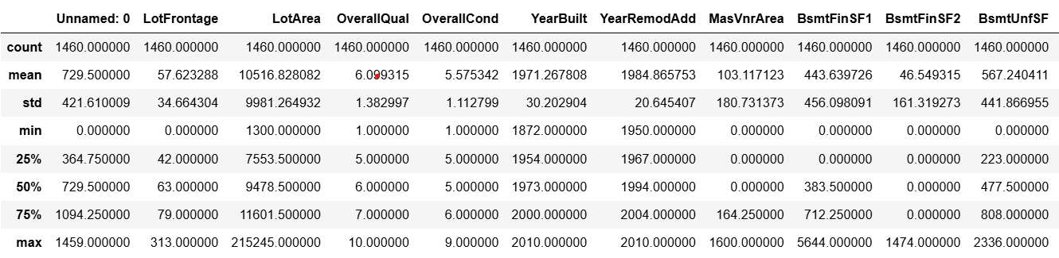
Dataset Overview
The dataset contains information on housing features such as size, quality, and location.

Slide 3
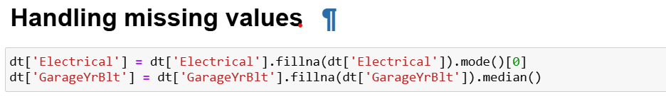
Data Preprocessing Steps
Using .describe() , .info(), .head(), .tail()
Handled duplicates value if any present there
Handled missing values, encoded categorical features, and removed inconsistencies.

Slide 4
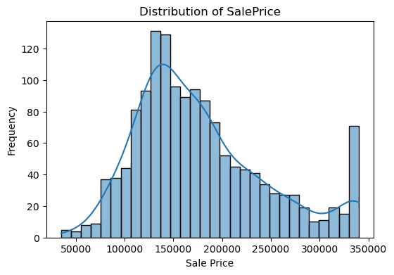
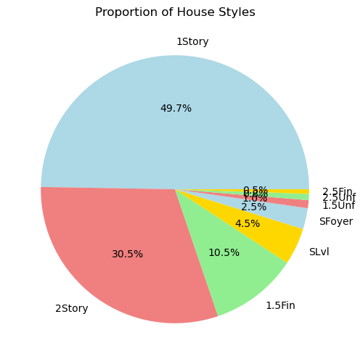
Univariate Analysis
Analyzed individual variables like SalePrice, LotArea, and Neighborhood distribution.

Slide 5
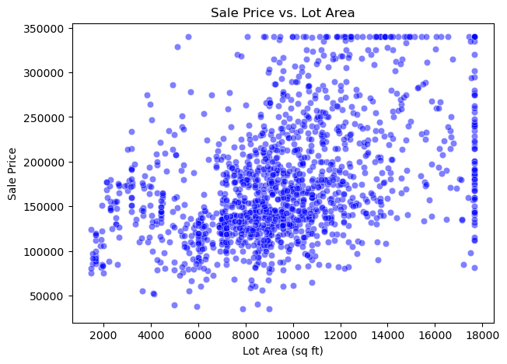
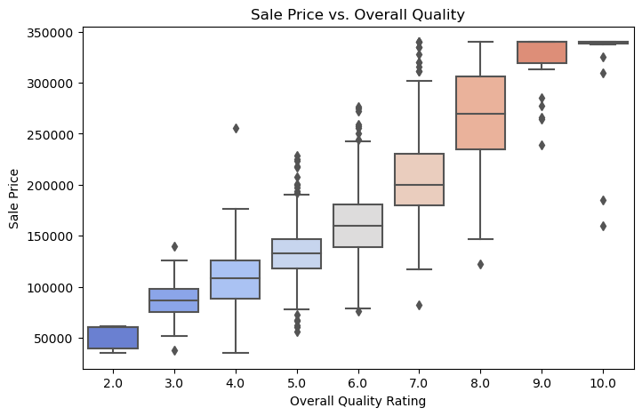
Bivariate Analysis
Examined relationships between features using scatter plots, heatmaps, and correlation matrices.

Slide 6
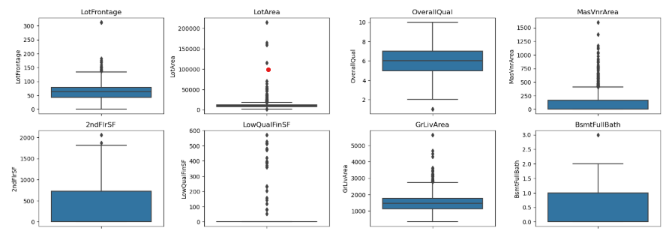
Outlier Detection & Handling
Identified extreme values using boxplots and capped outliers for better analysis.
Before Handling Outliers Plots -

Slide 7
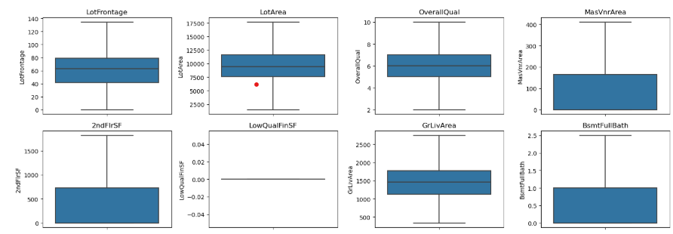
Outlier Detection & Handling
After Handling Outliers Plots -

Slide 8
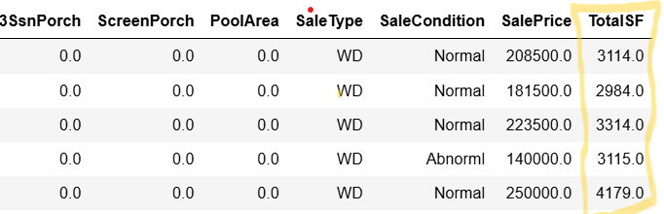
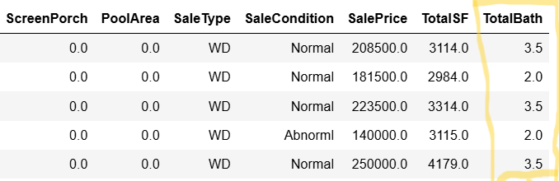
Feature Engineering
Created new variables like TotalSF (total square footage) to enhance predictions.

Slide 9
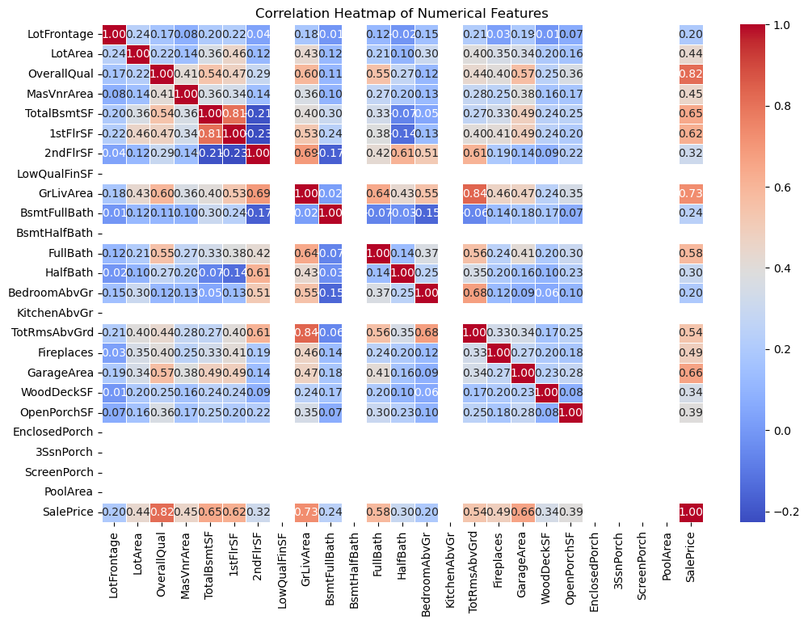
Correlation Analysis
Used heatmaps to identify strong correlations, e.g., OverallQual vs. SalePrice.

Slide 10
Key Insights & Interpretations
Higher quality homes, larger living areas, and newer homes have higher prices.

Slide 11
Final Conclusions
Key factors like house size, quality, and location play a major role in pricing.

Slide 12
Challenges Faced
Handled missing data, addressed skewed distributions, and selected the best features.

Slide 13
Future Scope & Improvements
Further analysis on more datasets, advanced ML models, and pricing optimization.

Slide 14
Thank you

