Slide 1
Project – 5 USER ANALYTICS IN THE COMMUNICATION INDUSTRY
By – PRATEEK AGRAWAL

Slide 2
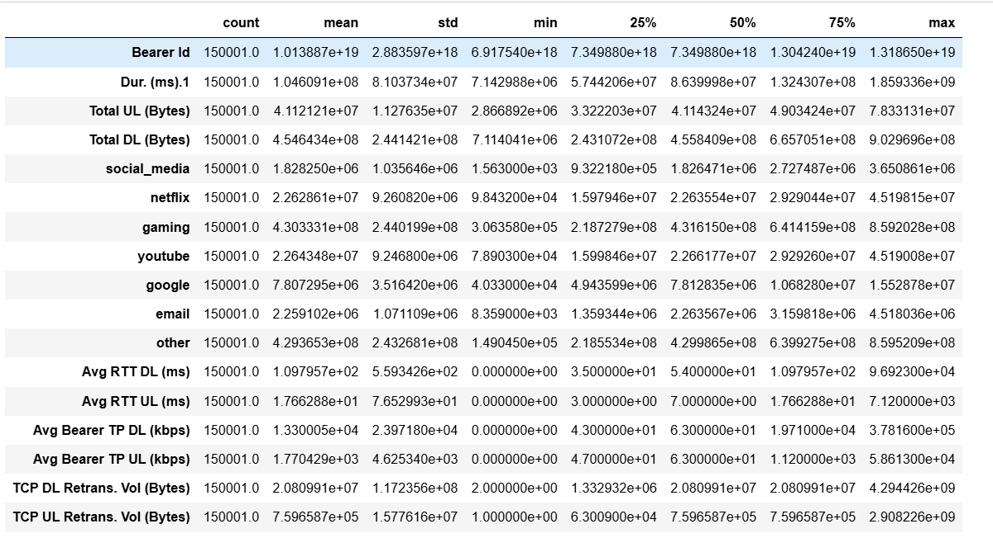
USER OVERVIEW ANALYSIS
The dataset contains information on telecome industry features.

Slide 3
The figure 1.0 in the previous slide summarises the statistics of the quantitative variables.
The min value is the smallest value while the max is the largest value in the variable’s observations.
50% is the middle element (median) when the data is arranged in order of magnitude while 25% and 75% are the median values for the top and bottom halves of the data.
mean value is the arithmetic mean which is the central value of a discrete set of numbers.
Std is the dispersion of a dataset relative to its mean value.
The measures displayed vary across the features. This can be explained by the different units of measurement across some of them. For the variables where the unit of measurement is constant, for instance, the applications, the variation can be explained by different levels of usage by the users.

Slide 4
GRAPHICAL UNIVARIATE ANALYSIS
The UPPER plot is somewhat symmetric and bell-shaped indicating Normally distributed unimodal data with a mean of 22628606 which matches the non-graphical analysis.
A qqplot indicating heavily skewed right-tailed normal distribution.

Slide 5
BIVARIATE Analysis
Correlation is a measure of the strength of a linear relationship between two quantitative variable.
Here, No correlation between netflix and total bytes.
Positive correlation between gaming and total bytes. Could be as a result of high volume of gaming data compared to other apps.

Slide 6
The heatmap below shows that the applications have no correlation (linear relationship) with each other.
The plot below shows total data per decile class. The classes are generated based on the total sessions duration.

Slide 7
USER ENGAGEMENT Analysis
These are Cluster1, Cluster2, Cluster3 respectively.
A summary of clusters generated from performing a KMeans analysis on the users based on the sessions count, sessions duration and sessions traffic.

Slide 8
USER ENGAGEMENT Analysis
Session frequency: The minimum values are the same across the clusters since 1 is the least possible value of session frequency. The maximum values vary with the highest session frequency falling under cluster 2. The average values also vary depending on the the values of the sessions-frequency under each cluster
Sessions Duration: The minimum values have a slight variation across the clusters. The maximum values’ variation is a bit wider, with the highest value falling under cluster 2. This could be due to the presence of the highest session-frequency in the cluster assuming correlation between sessions frequency and duration. The same explanation extends to the mean values.
Sessions Traffic: The behaviour observed in the sessions duration is replicated in sessions traffic too. The explanation stands: the values in cluster 2 are overally higher than those in 1 and 3 due to the presence of the highest session-frequency value in the cluster assuming a correlation between sessions frequency and sessions traffic.

Slide 9
USER EXPERIENCE ANALYSIS
10 of the top, bottom and most frequent tcp, rtt and tp values in the dataset.
There’s a variation in the top, bottom and frequent values across the 3 features.
The variation is due to different units of measurement and the different aspects each feature represents.
The most frequent values in RTT and TP are genarally low values unlike frequent TCP values.
The gap between the top and bottom values across the 3 features is extremely large.
Throuput distribution: The variable is right-skewed unimodal normally distributed with a mean of 12400 and standard deviation of 14661.
Average TCP retransmission per handset type.

Slide 10
Clusters description on the experience metrics (Total TCP, Total RTT and Total Throughput).
Cluster 1 has the highest number of users. Thus, on average, most users have 1 type of handset, overally low throughput values, low RTT values and medium TCP values.
● Cluster 2 is the 2nd most populated cluster. On average, users have 2 types of handsets, high RTT values,high throughput values and high TCP values.
● Cluster 3 is the least populated. Users in this cluster have on average: 1 type of handset, low TCP values, medium RTT values and medium throughput values.
Average experience and engagement scores per cluster.

Slide 11
Limitations:
Some of the columns in the datasets have large percentages of missing values, thus cannot be analysed.
The data has no timestamp. It might contain old records which might give a false overview of the current situation.
The analysis is focused only on the user leaving out potential insights that could be obtained from other aspects like handsets-analysis.
The call detail record (voice channel) is ignored and more focus is put on data sessions detail record.
Recommendations:
The company has some weaknesses and strengths based on the analysis. It is worth buying with some changes to be made:
The handset types should be stocked depending on their number of users.
More gaming handsets should be introduced given that majority of traffic is as a result of games.
More features should be added to the existing gaming apps to increase sessions traffic.
Handsets with a wide variety of applications should be introduced to in order to capture the attention of less engaged users.
Poor performing handsets based on RTT, TP and TCP values should be replaced by the excellent performers

Slide 12
Thank you

