Slide 1
DIABETIC RETINOPATHY DETECTION USING FEDERATED LEARNING

Slide 2
ABSTRACT
Diabetic retinopathy is a serious complication of Diabetes Mellitus and a leading cause of vision loss if not detected early. This project presents a web-based system for automatic detection using deep learning integrated with a Federated Learning approach. The system is developed using the Flask framework with features such as user registration, login, image upload, and real-time prediction. A Convolutional Neural Network (CNN) is used for feature extraction and classification of retinal fundus images into diabetic and non-diabetic categories. The model is trained using the Mendeley Data dataset to ensure accuracy and reliability. Federated Learning enables decentralized model training across multiple clients without sharing sensitive data, ensuring privacy. The system aggregates locally trained models to improve overall prediction performance. It provides a simple and user-friendly interface for easy image upload and instant results. The proposed system supports early diagnosis and assists healthcare professionals in screening. Overall, it offers an efficient, scalable, and privacy-preserving solution for diabetic retinopathy detection.

Slide 3
OVERVIEW
Diabetic retinopathy is a major eye disease caused by prolonged diabetes and is one of the leading causes of blindness worldwide. Early detection and timely treatment are essential to prevent severe vision loss. Traditional diagnostic methods require expert ophthalmologists and can be time-consuming and costly. With the advancement of artificial intelligence, deep learning techniques have shown promising results in medical image analysis. Convolutional Neural Networks (CNNs) are widely used for extracting important features from retinal images and improving classification accuracy. However, handling sensitive medical data raises privacy concerns when training centralized models. To address this issue, Federated Learning enables decentralized model training without sharing raw data.

Slide 4
PROJECT OBJECTIVES
To develop an automated detection system for diabetic retinopathy – Enables automatic identification of diabetic retinopathy from retinal images for faster diagnosis.
To utilize Convolutional Neural Networks (CNN) for feature extraction and classification – Uses CNN to extract image features and accurately classify disease presence.
To implement Federated Learning for privacy-preserving model training – Ensures secure and decentralized model training without sharing sensitive data.
To design a user-friendly web application using Flask – Provides an easy interface for users to upload images and view results.
To enable real-time prediction and faster diagnosis – Delivers instant results to support quick medical decisions.

Slide 5
EXISTING SYSTEM
IDx-DR – An FDA-approved AI system that detects diabetic retinopathy automatically but relies on centralized clinical infrastructure.
EyeAI – A web-based CNN application for detecting multiple eye diseases with moderate accuracy but limited privacy features.
AIDRSS – A large-scale screening system in India that classifies multiple stages of diabetic retinopathy using deep learning.
PerceptronCARE – A telemedicine-based platform that provides real-time diagnosis using CNN but depends on centralized cloud storage.

Slide 6
DISADVANTAGES OF THE EXISTING SYSTEM
Lack of Data Privacy – Solved by Federated Learning, keeping patient data secure on local devices.
Dependency on Centralized Infrastructure – Reduced through decentralized training, improving system reliability.
Limited Accessibility – Overcome by providing a web-based Flask application accessible to all users.
High Cost of Implementation – Minimized using open-source technologies for an affordable solution.
Lack of Real-Time Prediction – Addressed by enabling instant image analysis and quick results.
Poor Scalability – Improved by distributing training across multiple clients using Federated Learning.
Limited Model Generalization – Enhanced by learning from diverse decentralized datasets.
Complex User Interfaces – Simplified with an easy-to-use and user-friendly interface.

Slide 7
PROPOSED SYSTEM
The proposed system is a web-based application designed for the automatic detection of diabetic retinopathy using deep learning and Federated Learning techniques. It is developed using the Flask framework to provide an easy and accessible interface for users. The system allows users to register, log in, and upload retinal fundus images for analysis. A Convolutional Neural Network (CNN) is used for feature extraction and classification of images into diabetic and non-diabetic categories. Federated Learning is implemented to enable decentralized model training without sharing sensitive medical data. This ensures data privacy and security while improving model performance through collaborative learning. The system aggregates locally trained models to generate a global model for accurate prediction. It provides real-time results, helping in early diagnosis and reducing the risk of vision loss. The application is designed to be user-friendly and accessible even in remote areas. Overall, the proposed system offers an efficient, scalable, and privacy-preserving solution for diabetic retinopathy detection.

Slide 8
ADVANTAGES OF PROPOSED SYSTEM
Enhanced Data Privacy and Security – Protects sensitive data by keeping it on local devices using Federated Learning.
Decentralized Model Training – Enables distributed training across multiple clients without relying on a central server.
Improved Model Accuracy and Generalization – Enhances performance by learning from diverse datasets.
Real-Time Prediction – Provides instant results for faster diagnosis and decision-making.
User-Friendly Web Interface – Offers a simple and easy-to-use platform for all users.
Cost-Effective Solution – Reduces cost by using open-source tools and minimal infrastructure.

Slide 9
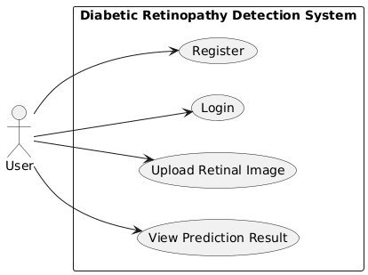
USECASE DIAGRAM

Slide 10
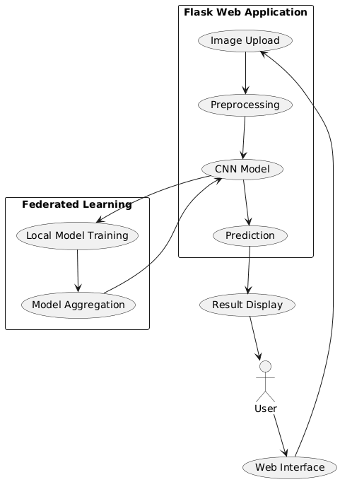
ARCHITECTURE DIAGRAM

Slide 11
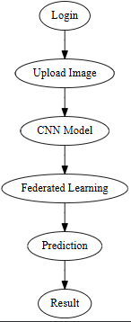
FLOW DIAGRAM

Slide 12
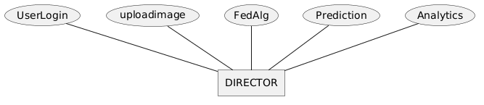
ER DIAGRAM

Slide 13
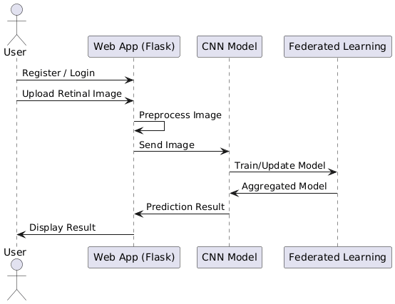
SEQUENCE DIAGRAM

Slide 14
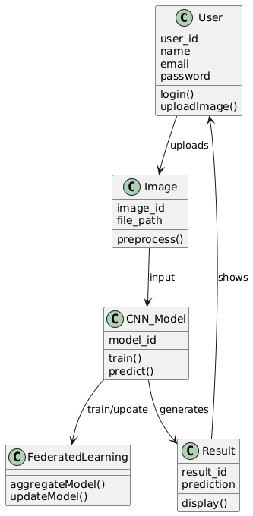
CLASS DIAGRAM

Slide 15
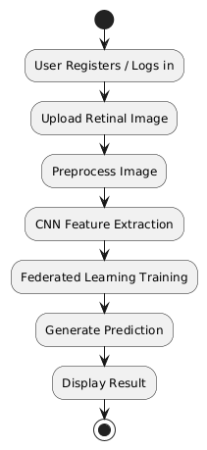
ACTIVITY DIAGRAM

Slide 16
MODULES
. User Authentication
· Image Upload and Pre-processing
· CNN-Based Feature Extraction and Classification
· Federated Learning Training
· Prediction and Result Display

Slide 17
User Authentication Module
This module handles user registration, login, and secure access to the system. It ensures that only authorized users can upload images and view predictions. User credentials are stored securely, and session management is implemented to maintain login status. This module improves system security and provides a personalized experience for each user.
Key Points:
User Registration – Allows new users to create an account.
User Login – Authenticates users using credentials.
Session Management – Maintains active user sessions securely.
Data Security – Protects user information from unauthorized access.

Slide 18
🔹 Image Upload and Preprocessing Module
This module allows users to upload retinal fundus images for analysis. It also performs preprocessing steps such as resizing, normalization, and noise reduction to prepare the images for model input. Proper preprocessing improves the quality of input data and enhances model accuracy.
Key Points:
Image Upload – Enables users to upload retinal images.
Image Resizing – Adjusts image size to match model requirements.
Normalization – Standardizes pixel values for consistency.
Noise Reduction – Removes unwanted distortions in images

Slide 19
🔹 CNN-Based Feature Extraction and Classification Module
This module uses a Convolutional Neural Network (CNN) to extract important features from retinal images and classify them into diabetic retinopathy or non-diabetic categories. It plays a key role in identifying patterns and abnormalities in the images with high accuracy.
Key Points:
Feature Extraction – Identifies important patterns from images.
Model Training – Learns from labeled dataset images.
Classification – Categorizes images into classes.
Accuracy Optimization – Improves prediction performance.

Slide 20
🔹 Federated Learning Training Module
This module implements Federated Learning to train the model across multiple decentralized clients without sharing raw data. It collects model updates from different sources and aggregates them to build a global model. This ensures privacy while improving model performance through collaborative learning.
Key Points:
Local Training – Trains model on individual client data.
Model Aggregation – Combines updates into a global model.
Privacy Preservation – Keeps user data secure locally.
Distributed Learning – Enables learning from multiple sources.

Slide 21
🔹 Prediction and Result Display Module
This module provides the final output to the user by analyzing the uploaded image and displaying whether diabetic retinopathy is detected or not. It ensures real-time prediction and presents results in a clear and understandable format for users.
Key Points:
Real-Time Prediction – Generates instant results.
Result Display – Shows classification outcome to users.
User Feedback – Provides clear diagnostic information.
System Response – Ensures fast and efficient output.

Slide 22
SYSTEM REQUIREMENTS
HARDWARE REQUIREMENTS
Processor Name : Intel core 4
Processor Speed : 3.2 GHz
RAM : 8 GB
Hard Disk Capacity : 128 GB
Display Device : 14’ to 19’ Inch Monitor
Keyboard Type : PS2 or USB
Mouse Type : PS2 or USB
SOFTWARE REQUIREMENTS:
OS : Windows 10
Software : Anaconda Navigator
Database : SQLite
UI Design : Flask
Web Browser : Chrome

Slide 23
CONCLUSION
The proposed system provides an efficient and reliable solution for the early detection of diabetic retinopathy using advanced deep learning techniques. By integrating Convolutional Neural Networks (CNN), the system effectively extracts features and classifies retinal images with high accuracy. The use of Federated Learning ensures data privacy by enabling decentralized model training without sharing sensitive information. The Flask-based web application offers a simple and user-friendly interface for easy access and usability. The system delivers real-time predictions, helping in quick diagnosis and timely medical intervention. It reduces the workload of healthcare professionals by automating the screening process. The solution is cost-effective and accessible, making it suitable for both urban and rural areas.

Slide 24
FUTURE ENHANCEMENT
The proposed system can be further enhanced by extending the model to detect multiple stages of diabetic retinopathy instead of simple binary classification. Integration with mobile applications can improve accessibility and allow users to capture and upload retinal images directly from smartphones. The system can be improved by incorporating more advanced deep learning models to increase accuracy and efficiency. Adding real-time video-based eye screening can further enhance diagnostic capabilities. The Federated Learning framework can be expanded to include more participants such as hospitals and research centers for better model training. Integration with cloud platforms can improve scalability and performance. The system can also include multilingual support to reach a wider audience. Implementing explainable AI techniques can help users and doctors understand prediction results more clearly.

Slide 25
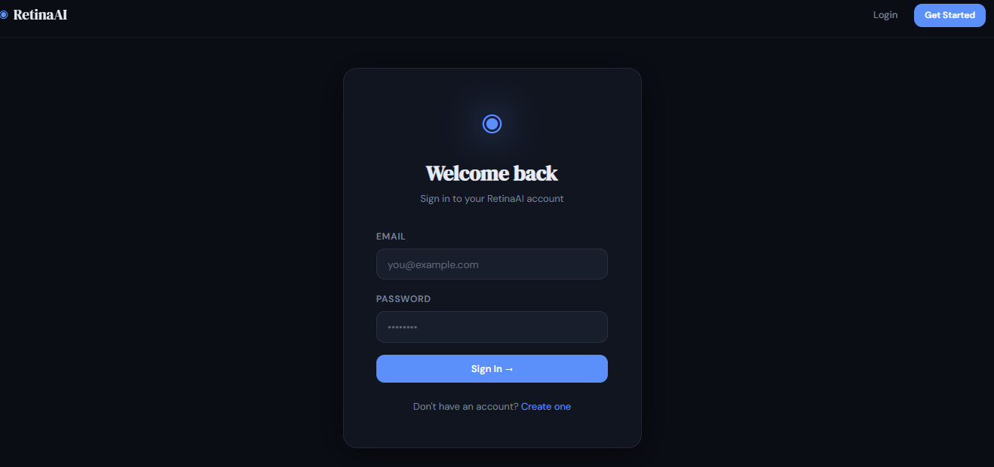
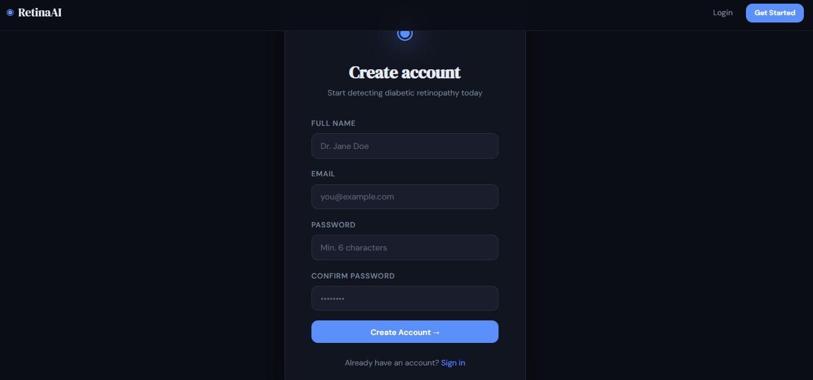
SAMPLE SCREENSHOTS
Login Page / Register Page

Slide 26
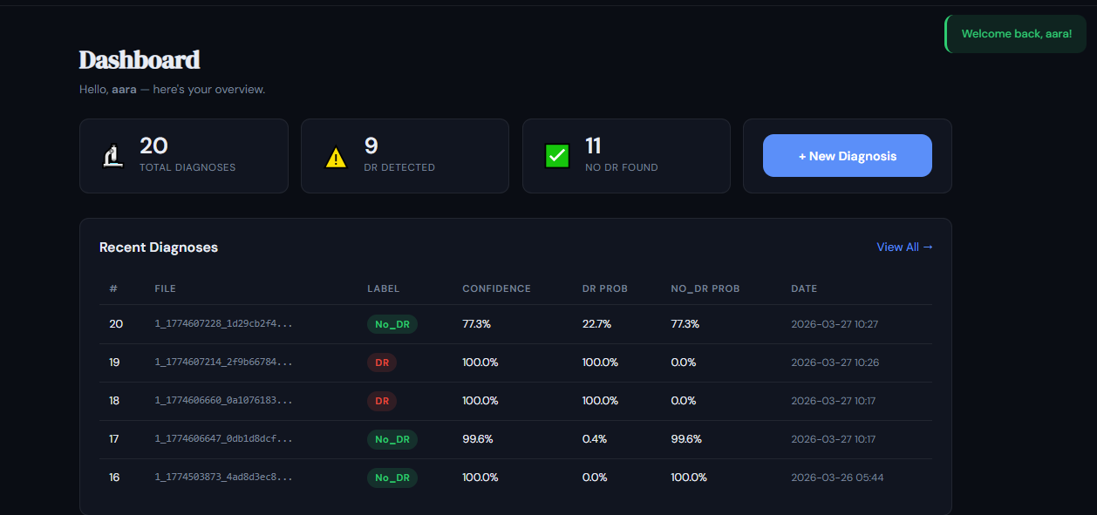
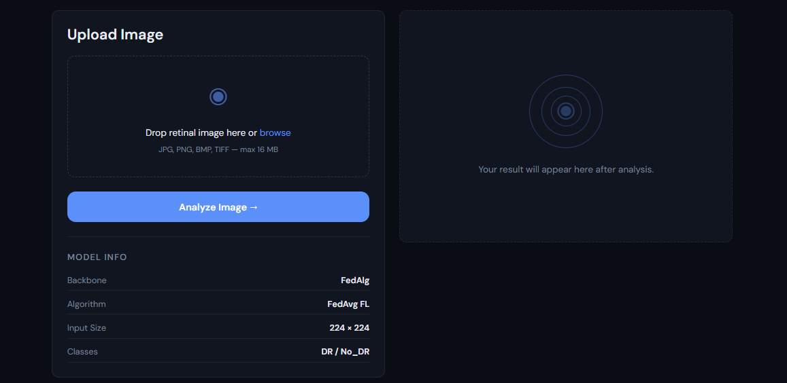
Dashboard page
Prediction page

Slide 27
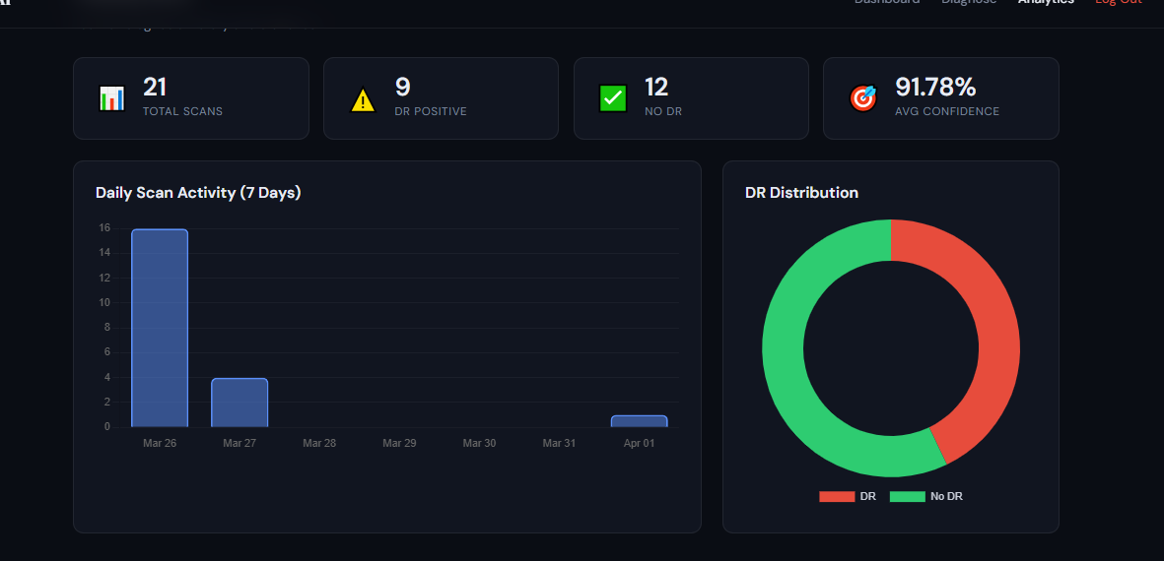
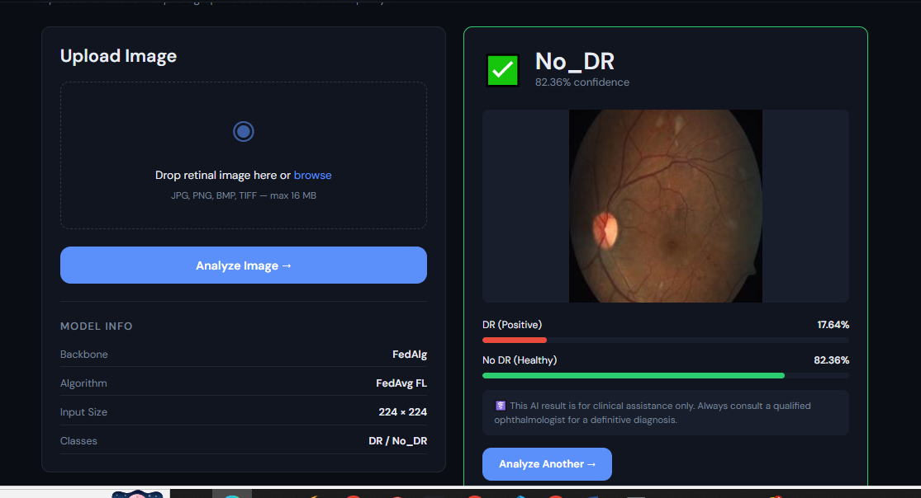
Analytics Page

Slide 28
REFERENCES
[1] Gulshan, V., Peng, L., Coram, M., et al., “Development and Validation of a Deep Learning Algorithm for Detection of Diabetic Retinopathy in Retinal Fundus Photographs,” JAMA, vol. 316, no. 22, pp. 2402–2410, Dec. 2016.
[2] Li, Z., He, Y., Keel, S., et al., “Efficacy of a Deep Learning System for Detecting Diabetic Retinopathy in Community-Based Primary Care Settings,” npj Digital Medicine, vol. 1, no. 1, p. 22, 2018.
[3] McMahan, B., Moore, E., Ramage, D., et al., “Communication-Efficient Learning of Deep Networks from Decentralized Data,” Proc. AISTATS, pp. 1273–1282, 2017.
[4] Sheller, M. J., Reina, G. A., Edwards, B., et al., “Multi-Institutional Deep Learning Modeling Without Sharing Patient Data: A Feasibility Study on Brain Tumor Segmentation,” Brainlesion Workshop, pp. 92–104, 2019.
[5] Razzak, M. I., Naz, S., and Zaib, A., “Deep Learning for Medical Image Processing: Overview, Challenges and the Future,” Springer, pp. 323–350, 2018.

Slide 29
REFERENCES
[6] Kermany, D. S., Goldbaum, M., Cai, W., et al., “Identifying Medical Diagnoses and Treatable Diseases by Image-Based Deep Learning,” Cell, vol. 172, no. 5, pp. 1122–1131, Feb. 2018.
[7] LeCun, Y., Bengio, Y., and Hinton, G., “Deep Learning,” Nature, vol. 521, no. 7553, pp. 436–444, May 2015.
[8] Hard, A., Rao, K., Mathews, R., et al., “Federated Learning for Mobile Keyboard Prediction,” arXiv preprint arXiv:1811.03604, 2018.
[9] Abràmoff, M. D., Lavin, P. T., Birch, M., et al., “Pivotal Trial of an Autonomous AI-Based Diagnostic System for Detection of Diabetic Retinopathy,” npj Digital Medicine, vol. 1, no. 1, p. 39, 2018.
[10] Ting, D. S. W., Cheung, C. Y., Lim, G., et al., “Development and Validation of a Deep Learning System for Diabetic Retinopathy and Related Eye Diseases,” JAMA, vol. 318, no. 22, pp. 2211–2223, 2017.

Slide 30
Thank You…

