Slide 1
Create and operate Kubernetes clusters on your own infrastructure

Slide 2
Simplify on-premises Kubernetes management with default component configurations and automated cluster management tools.
Manage your own infrastructure to reduce support costs and avoid maintaining redundant open-source and third-party tools.
Maintain an on-premises Kubernetes environment that’s more reliable than self-managed Kubernetes offerings

Slide 3
How it works
Amazon EKS Anywhere lets you create and operate Kubernetes clusters on your own infrastructure. Amazon EKS Anywhere builds on the strengths of Amazon EKS Distro and provides open-source software that’s up to date and patched so you can have an on-premises Kubernetes environment that’s more reliable than a self-managed Kubernetes offering.

Slide 4
Use cases
Maintain data sovereignty
Keep large datasets on premises and maintain data location legal requirements concerning data location.
Accelerate and simplify migration to AWS
Connect your Amazon EKS Anywhere clusters to the Amazon EKS console to view the cluster configuration and workload statu
Secure applications in disconnected environments
Deploy and operate highly available clusters with the same Kubernetes distribution that powers Amazon Elastic Kubernetes Service (EKS) on AWS.

Slide 5
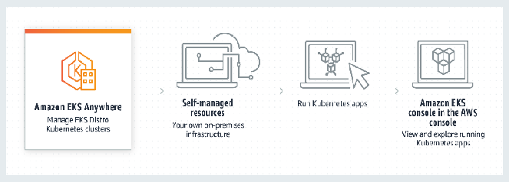

Streamline maintenance to save time
Focus on your business by removing the need to maintain upstream Kubernetes clusters and security patches

Slide 6
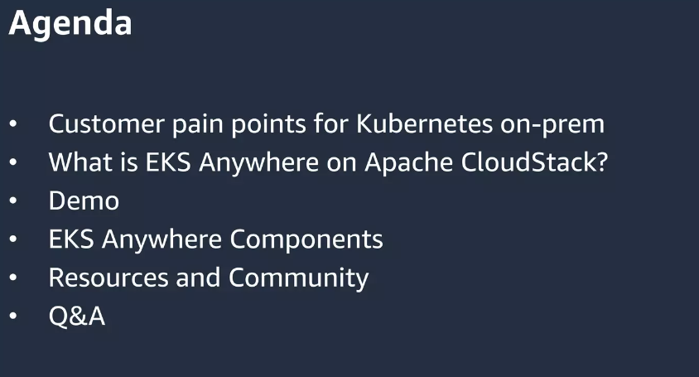

Slide 7
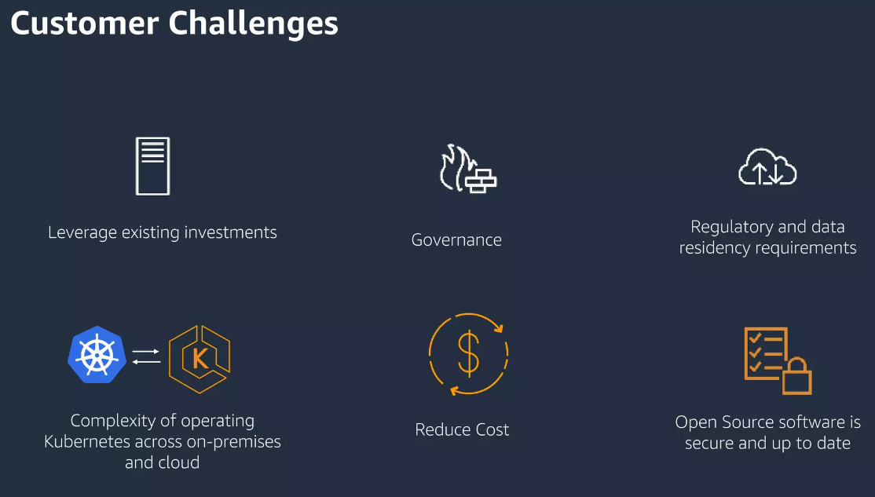

Slide 8
