Slide 1
Python - 2

Slide 2
Python Data Structure
Python has 4 basic built-in data structures namely:
Lists
Tuple
Set
Dictionary

Slide 3
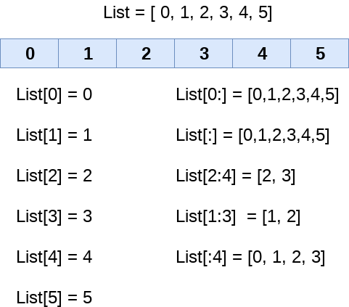
Lists
Lists in Python are used to store collection of heterogeneous items.
These are mutable, which means that you can change their content.
Lists are created using [ ] with data separated by comma(,).
They can be accessed just like Strings
There are many functions that can be carried out on lists like: append(), insert(), remove(), sort(), etc

Slide 4
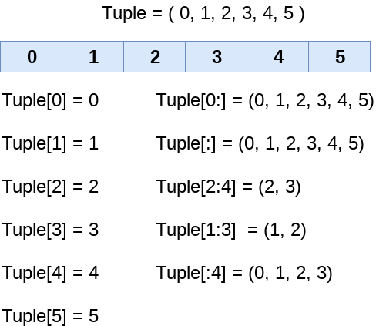
Tuple
Tuple is a collection of data which is ordered and immutable
By Immutable it is meant that tuple once created, we cannot change its values
Tuples are created using ( ) with data separated by comma (,)
Basic tuple functions are: max(), min(), count(), len(), etc
Example: It can be used in situation where we want to pass the control to someone else but we do not want them to manipulate data in our collection

Slide 5
Sets
A Set is a collection of unique objects which is unordered and unindexed.
A Set is created using { } with data separated by comma (,)
We cannot access items from sets since it is unindexed and unordered
Once a set is created we cannot change its item but we can add new items.
Basic Set functions are add(), update(), remove(), discard()

Slide 6
Dictionary
It is collection of data which is unordered, changeable and indexed.
It is created using { } in the format of key and values.
Syntax: {key:value}
Common dictionary methods are clear(), keys(), values(), pop(), etc

Slide 7
Functions
A function is a set of statements that take inputs, do some specific computation and produces output.
Python provides you many inbuilt functions, but it also gives the flexibility to create our own functions.
a function is defined using the def keyword:
Syntax: def my_function():
Parameters
Information can be passed to functions as parameter.
Parameters are specified after the function name, inside the parentheses.
Any number of parameters can be passed in a function, separated by comma(,)
Syntax: def my_function(fname):

Slide 8
Lambda Function
A lambda function is an anonymous function.
the lambda keyword is used to create anonymous functions.
Syntax: lambda arguments: expression
We use lambda functions when we require a nameless function for a short period of time.
Lambda functions can be used along with built-in functions like filter(), map() and reduce().
The filter() function in Python takes in a function and a list as arguments and filter out all the elements of a sequence.
The map() function in Python takes in a function and a list as argument. The function is called with a lambda function and a list and a new list is returned which contains all the lambda modified items.
The reduce() function in Python takes in a function and a list as argument. The function is called with a lambda function and a list and a new reduced result is returned.This is a part of functools module.

Slide 9
Class / Objects
Python is an object oriented programming language. Almost everything in Python is an object, with its properties and methods. A Class is like a "blueprint" for creating objects.
A Class is created using the keyword class
Syntax: class Person:
Object
An object is an instantiation of Class
Example: obj = Person()
Here obj is the object of class Person
__init__() Function
All classes have a function called __init__(), which is always executed when the class is being initiated.
It also acts as a constructor, that is a class function that instantiates an object to predefined values.
__init__() is a built-in function
It is used to assign values to object properties
Example: def __init__(self, name, age):
self.name = name
self.age = age

Slide 10
OOPs
Python is an Object-Oriented programming language
An Object has two characteristics
Attributes
Behaviour
Example: Object: Man
Attributes: Name, Age
Behaviour: Talking, walking, eating
In Python, the concept of OOP follows some basic principles:
Inheritance: A process of defining a class that inherits all the methods and properties from another class.
Encapsulation: Hiding the private details of a class from other objects.
Polymorphism: A concept of using common operation in different ways for different data input.
(Python doesn't support method overloading but method overriding)

