Slide 1
Introduction to
NumPy and Pandas

Slide 2
Introduction
NumPy stands for ‘Numerical Python’
NumPy is a Python library used for Scientific computations in Python
It is open source library
Used to perform mathematical and statistical operations
Provides fast precompiled functions for numerical routines
Suitable for multi-dimensional arrays and matrices multiplications

Slide 3
Installation and importing
You can use conda to install numpy-
conda install numpy
------------------------------------------------------------
import numpy as np

Slide 4
Creating NumPy array
np.arange(12)
np.ones((2,3))
np.eye(3)
np.zeros((1,2))
np.full((3,2),7)
np.linspace(0,1,5)

Slide 5
Mathematical and Statistical Operations
a = np.arange(9).reshape(3,3)
b = np.array([10,10,10])
add = np.add(a,b)
sub = np.subtract(a,b)
pow = np.power(a,3)
--------------------------------------------------------
arr = np.random.randint(1,10,10)
arr.min()
arr.max()
arr.mean()
arr.std()

Slide 6
Introduction to Pandas
Pandas is another software library written for Python
It is used for data Manipulation and analysis
It is an open source library
It offers two very important data structure
Series: 1-D array of values with an index
DataFrame: 2-D array of values with both row and column index
It offers tools for reading and writing data from external file source

Slide 7
Installation and Importing
We can use conda to install Pandas
conda install pandas
-------------------------------------
import pandas as pd

Slide 8
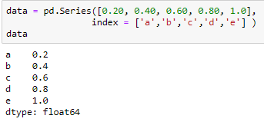
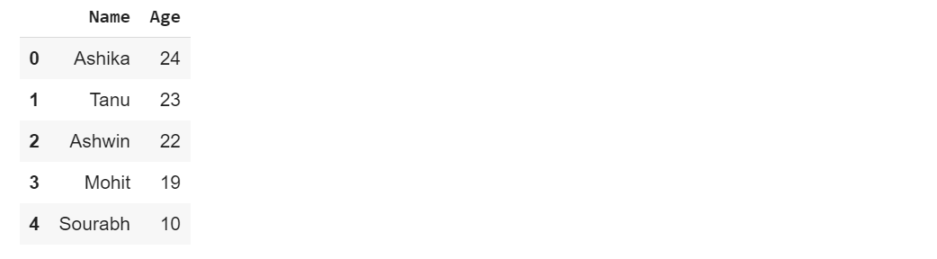
Series
DataFrame

