Slide 1











Statistics
Statistics is the science of collecting, organizing, presenting, analyzing, and interpreting data to assist in making more effective decisions.
Statistical Analysis is used to manipulate, summarize, and investigate data, so as to get useful informative results.
Data Presentation
Summarize /Analyze the data
Data Collection
Statistics
Data Analysis
Build Statistical Model
Predict the future
Data Interpretation

Slide 2
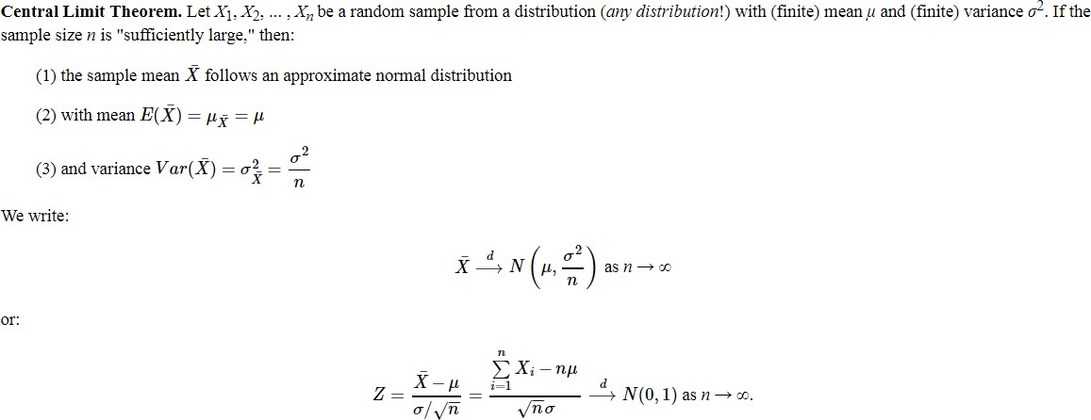
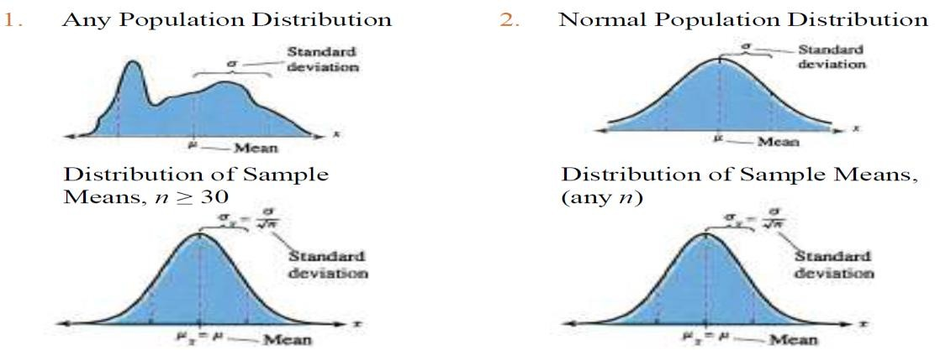
Center Limit Theorem

Slide 3
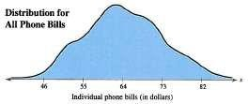


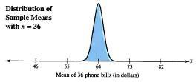
Center Limit Theorem – Example
Phone bills for residents of a city have a mean of $64 and a standard deviation of $9. Random samples of 36 phone bills are drawn from this population and the mean of each sample is determined. Find the mean and standard error of the mean of the sampling distribution. Then sketch a graph of the sampling distribution of sample means.
The mean of the sampling distribution is equal to the population mean
The standard error of the mean is equal to the population standard deviation divided by the square root of n.
Since the sample size is greater than 30, the sampling distribution can be approximated by a normal distribution with

Slide 4
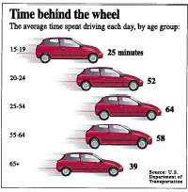
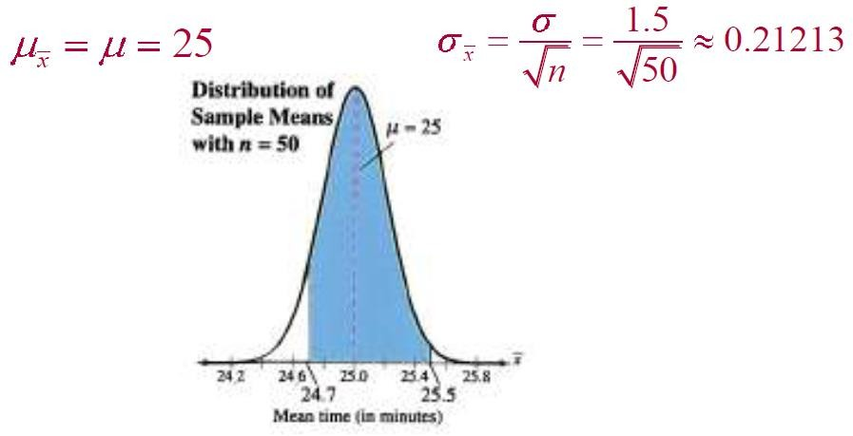
Center Limit Theorem – Example
The graph shows the length of time people spend driving each day. You randomly select 50 drivers age 15 to 19. What is the probability that the mean time they spend driving each day is between 24.7 and 25.5 minutes? Assume that σ = 1.5 minutes.
From the Central Limit Theorem (sample size is greater than 30), the sampling distribution of sample means is approximately normal with

Slide 5
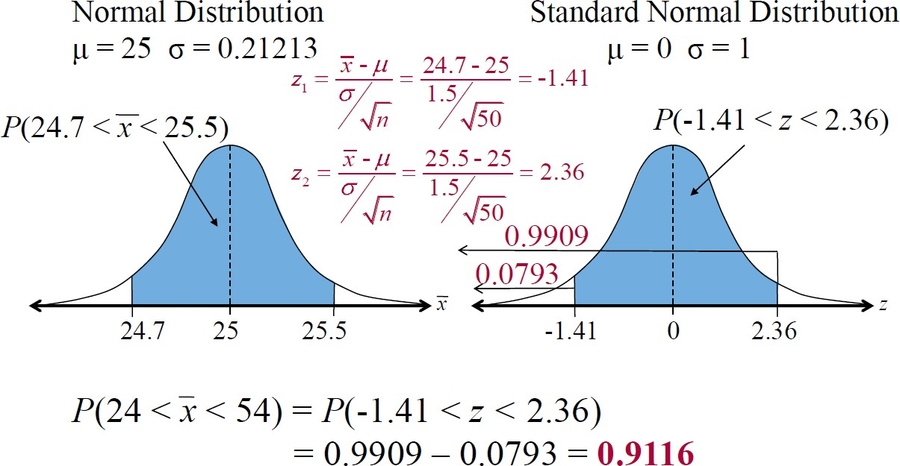
Center Limit Theorem – Example

Slide 6
Parameter Estimation
Point Estimation | Confidence Interval
In point estimation, a single statistic is used to provide an estimate of the population parameter. | An interval estimate is a range of values within which a researcher can say with some confidence that the population parameter Falls, This range is called confidence interval;
For example: Sample Mean is a point estimate of Population Mean. | For example: Interval estimate of the Population mean is [a,b]
Mean of Summer Internship income of business students is $400/week | Mean income is between $380 and $420/week
Reporting the results as a single number is unappealing because nothing inherent in point estimator(x̅) provides any information about how close it is to population parameter(µ)

Slide 7
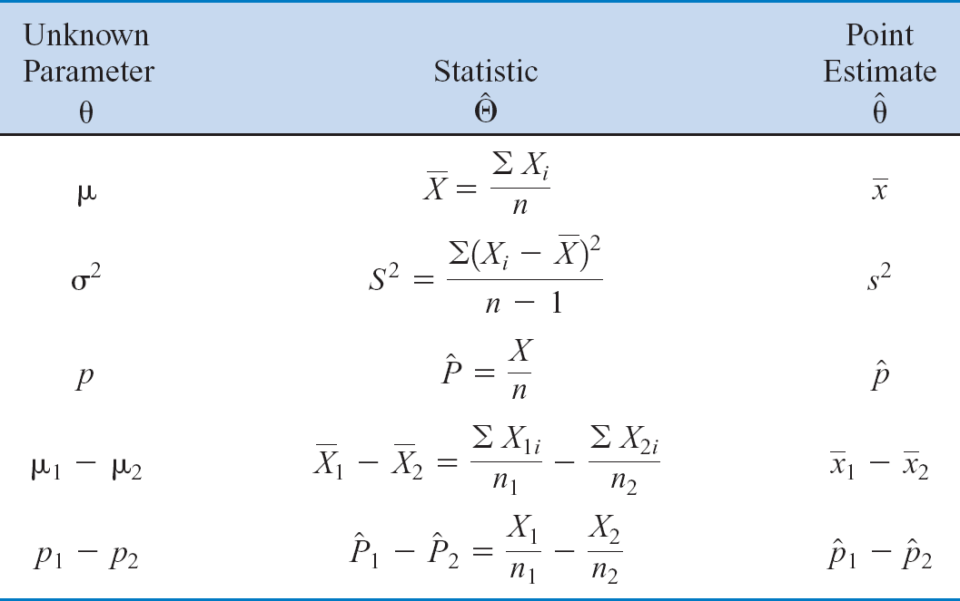
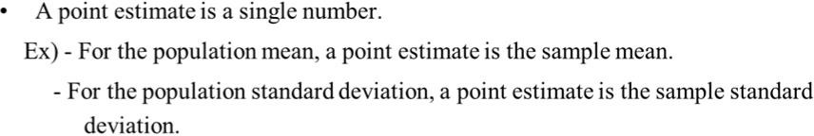
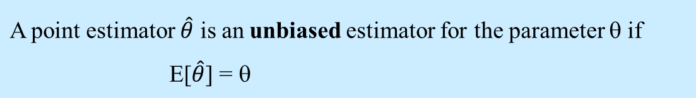
Parameter Estimation
Point Estimate: an estimate of some population parameter θ is is a single numerical
^
value of a statistic _{θ}. The statistic is called the point estimator.
Point Estimator

Slide 8
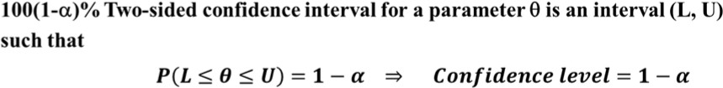
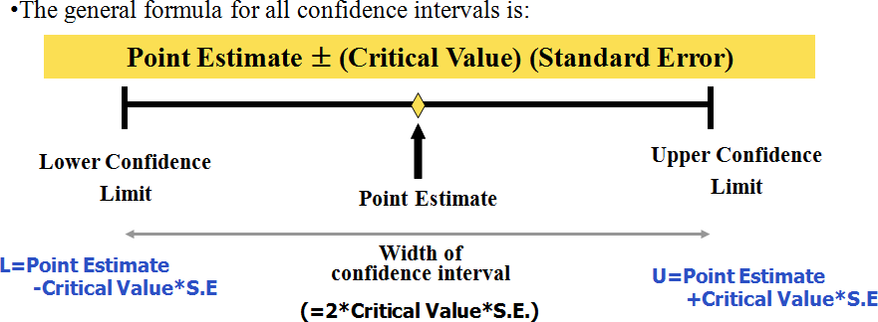
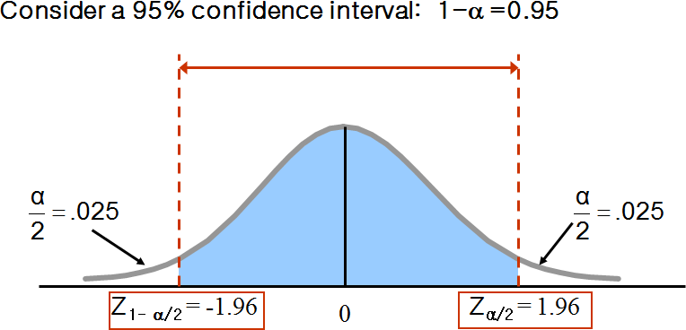
Confidence Interval
An interval estimate is defined by 2 numbers, between which a population parameter
is said to lie.
Confidence Level(1-α) is the probability that a confidence interval will contain the true value of population parameter. For Example: If confidence coefficient is 0.95 % , 95% of the confidence intervals so calculated for a large number of random samples would contain the parameter.

Slide 9
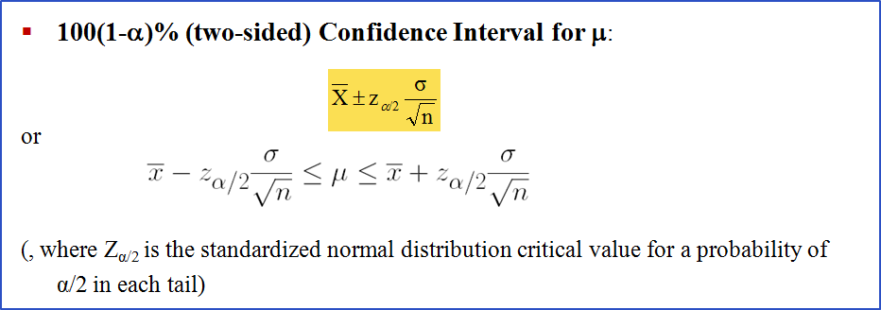
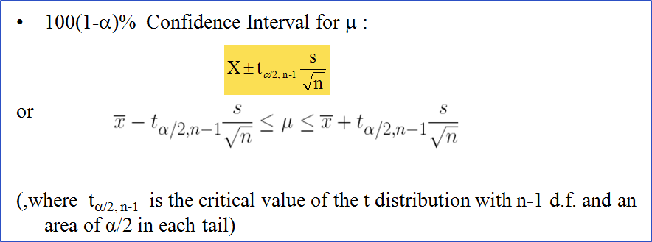
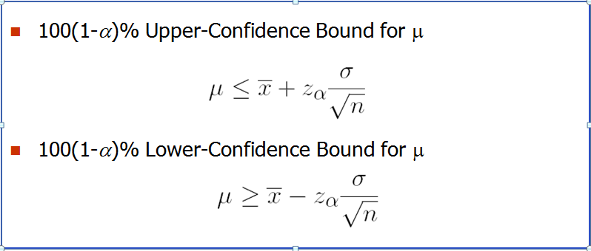
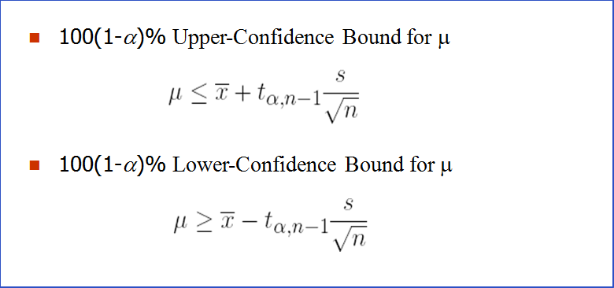
Confidence Interval of Mean
Case 1. Variance is known σ²
Case 2. Variance is unknown

Slide 10
Critical Values vs Confidence Level
Critical Number (z*) | Level of Confidence
3.0 | 99.7%
2.58 (2.576) | 99%
2.0 (more precisely 1.96) | 95%
1.645 | 90%
1.282 | 80%
1.15 | 75%
1.0 | 68%

Slide 11
Confidence Interval of Mean
A sample of 11 circuits from a normal population has a mean resistance of 2.20 ohms. We know from past testing that the population standard deviation is 0.35 ohms. Determine a 95% confidence interval for the true mean resistance of the population.
σ
X ± Z
= 2.20 ± 1.96 (0.35/ 11)
= 2.20 ± .2068
α/ 2
n
Confidence Interval = [1.9932, 2.4068]

Slide 12
Confidence Interval - Quiz
A random sample of 30 households was selected as part of a study on electricity usage, and the number of kilowatt-hours (kWh) was recorded for each household in the sample for the March quarter of 2006. The average usage was found to be 375kWh. Assuming the standard deviation is 81kWh and that the usage is normally distributed, provide an expression for calculating a 99% confidence interval for the mean usage in the March quarter of 2006.
a) | 375±2.756×81/√30
b) | 375±2.575×9/√30
c) | 375±2.33×81/√30
d) | 375±2.575×81/√30

Slide 13
Confidence Interval - Quiz
A random sample of 100 preschool children in Bangalore revealed that only 60 had been vaccinated. Provide an approximate 95% confidence interval for the proportion vaccinated.
a) | 0.6±1.96√(0.6×0.4)/100
b) | 0.6±1.645√(0.6×0.4)/100
c) | 0.6±1.96
d) | 0.6±1.96√1/400

Slide 14
Hypothesis Testing
Example: Chocolate manufacturing company claims that the mean weight of chocolate
bars manufactured in a factory is 3 ounces,
To test the claim we weighed 100 chocolate bars and the average weight was 2.84.
Is 2.84 ounces consistent with the manufacturer’s claim? How confident are we that
the manufacturer has significantly overstated the weight of the chocolate?
Example: Suppose that we are interested in the burning rate of a solid propellant used to power aircrew escape systems.
Our interest focuses on the mean burning rate (a parameter of the distribution of the burning rate).
Let’s say propellant producer claims that the burning rate of solid propellant is 50 cm/s
we are interested in deciding whether or not the mean burning rate is 50 centimeters per second:

Slide 15

Terminologies
A (statistical) hypothesis is a statement or claim about a population parameter (not
about a sample statistic):
Ex) The mean electric bill per household of this city is μ = $132.
The Mean weight of chocolate bars manufactured in a factory is 3 ounces.
Hypothesis testing is a procedure leading to a decision about a hypothesis based on a
random sample
Null Hypothesis (H₀) states the assumption to be tested. A hypothesis testing begins with the assumption that H₀ is true
Alternative Hypothesis (H₁) is the opposite of the null hypothesis. It is the hypothesis that the researcher is trying to prove.
Two-sided Alternative Hypothesis
H₀ : μ = 50cm/s H₁: μ < 50cm/s
One-sided Alternative Hypotheses

Slide 16
Designing Null/Alt. Hypothesis
The length of a certain lumber from a national home building store is supposed to be 8.5 feet. A builder wants to check whether the shipment of lumber she receives has a mean length different from 8.5 feet.
In this example,
We are discussing a mean and therefore set up the hypotheses in terms of μ. Here the value of μ0 is 8.5.
With the builder wanting to check if the mean length is different from 8.5, she would set up the hypotheses as
a two-tailed test:
A consumer test agency wants to see the whether the mean lifetime of a brand of tires is less than 42,000 miles as the tire manufacturer advertises that the average lifetime is at least 42,000 miles.
In this example,
We are discussing a mean and therefore set up the hypotheses in terms of μ. Here the value of μ0 is 42,000.
With the consumer test agency wanting to research that the mean lifetime is below 42,000, we would set up the hypotheses as a left-tailed test:
A political news company believes the national approval rating for the current president has fallen below 40%.
In this example,
We are discussing a proportion and therefore will set up the hypothesis in terms of p. Here is the p0 value is 0.4
Hypotheses would be set up as a left-tailed test:

Slide 17
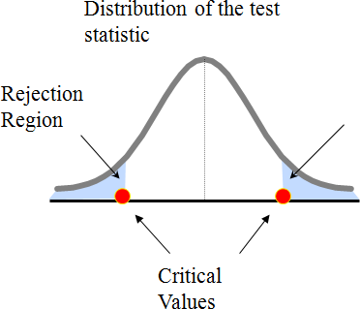
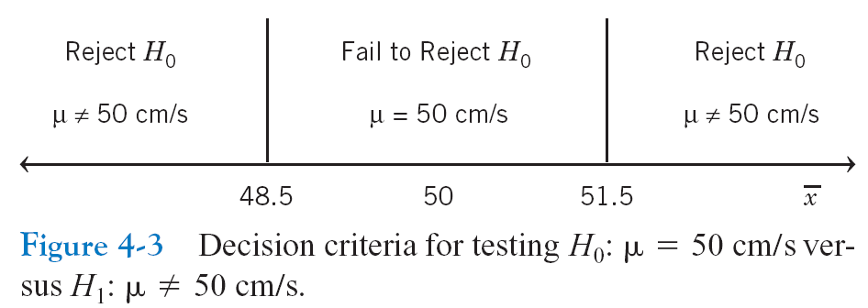
Designing Null/Alt. Hypothesis
🞂 If the sample mean is close to the assumed population mean, the null hypothesis is not
rejected.
🞂 If the sample mean is far from the assumed population mean, the null hypothesis is rejected.
🞂 How far is “far enough” to reject H₀?
Test statistic is a statistic computed from the sample data to make a decision about the hypothesis.
Example: sample mean, sample variance, sample proportion etc.
If the test statistic value falls in the rejection region, we will
reject H₀.
The boundaries that define the rejection regions are called the critical values.

Slide 18
Designing Null/Alt. Hypothesis
The critical values are decided by
i) the distribution of the test statistic
ii) the significance level α
represents
critical value
α/2
H₀: μ = 50
H₁: μ ≠ 50
α/2
Two-tail test
Rejection region is shaded
50
H₀: μ ≤ 50 H₁: μ > 50
α
Upper-tail test
50
H₀: μ ≥ 50
H₁: μ < 50
α
Lower-tail test
50

Slide 19
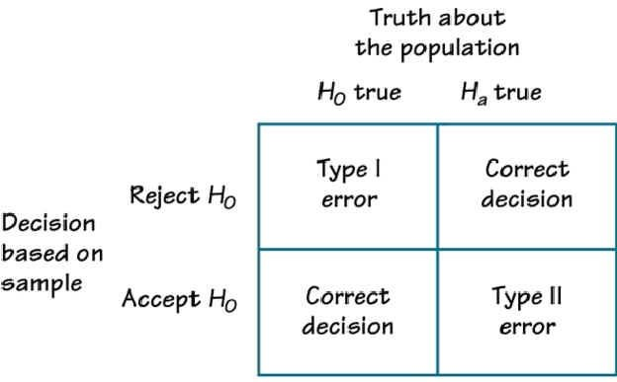
Type of Errors

Slide 20
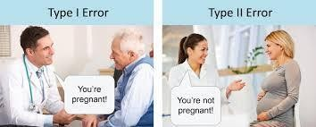



Type of Errors

Slide 21
Hypothesis Testing procedure
State the null hypothesis, H0 and the alternative hypothesis, H1
Choose the significance level, α.
Determine the test statistic to use / Convert Sample Statistic (ex. X) to Test Statistic (ex.
Z-statistic )
Find the critical values and determine the rejection region(s)
Collect data and compute the test statistic value from the sample result
Compare the test statistic to the critical value to determine whether the test statistic falls in the region of rejection.
Make the statistical decision: Reject H0 if the test statistic falls in the rejection region.

Slide 22
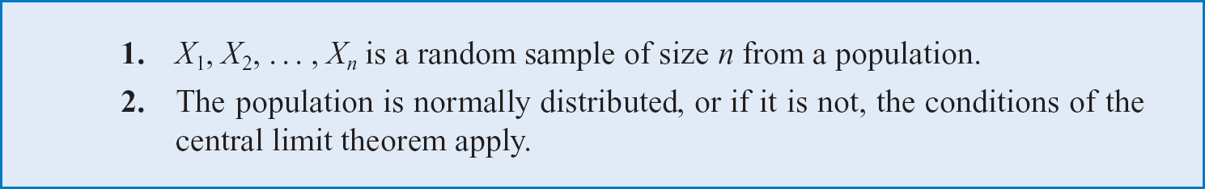
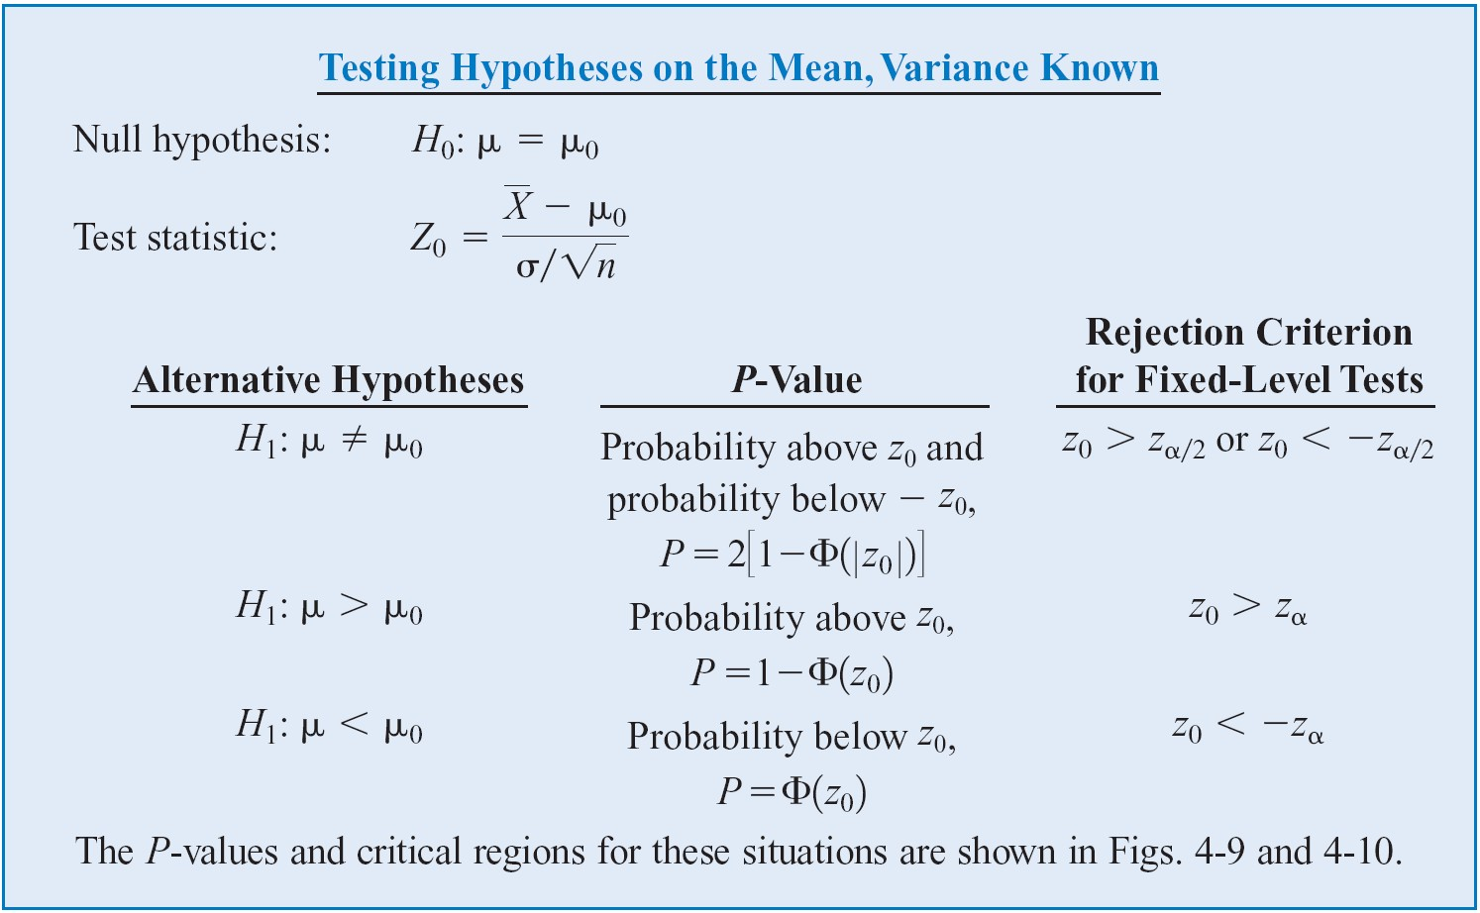
Hypothesis on Mean, Variance Known

Slide 23
Hypothesis Testing procedure
Example To test the claim that the mean weight of chocolate bars manufactured in a factory is 3 ounces, we weighed 100 chocolate bars and the average weight was 2.84. Suppose that, from past records, the standard deviation is known to be 0.8.
State the null and alternative hypotheses
H₀: μ = 3 H₁: μ ≠ 3 (two-sided test)
Choose the desired level of significance
Suppose that α =0 .05 is chosen for this test
Determine the test statistic
σ is known so this is a Z-test
X − μ 2.84 − 3
σ/ n 0.8 / 100
Z =
=
= ^{− 0.16} = −2.0
0.08
0
Find the critical values and determine the rejection region(s)
For α = 0.05 , the critical Z-values are ±1.96 Reject H₀ if z₀ < -1.96 or z₀ > 1.96
Reach a decision and interpret the result
Since z₀ = -2.0 < -1.96, you reject the null hypothesis
That is, there is sufficient evidence that the mean weight of chocolate bars is not equal to 3.

Slide 24
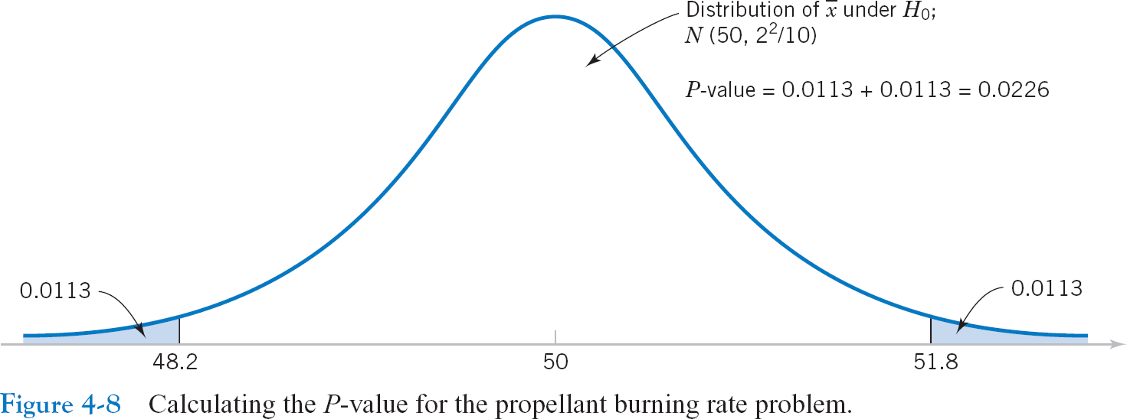
P-Value
The p-value is the probability of obtaining a test statistic equal to or more extreme than
the observed sample value when H₀ is true.
Sometimes referred to as “the observed level of significance” or “Smallest value of α for which H₀ can be rejected”
The p-value measures the plausibility of the null hypothesis,
“The smaller the p-value, the less plausible is the null hypothesis.“
^{H}0.
P-value tells us that if the null hypothesis H₀: μ = 50 is true, the probability of obtaining a random sample whose mean is at least as far from 50 as 51.8 (or 48.2) is 0.0226. Therefore, an observed sample mean of 51.8 is a rarely event if the null hypothesis is true.

Slide 25
P-Value
Example -revisit To test the claim that the mean weight of chocolate bars manufactured
in a factory is 3 ounces, we weighed 100 chocolate bars and the average weight was
2.84. Suppose that, from past records, the standard deviation is known to be 0.8. Test at α=0.05 using p-value.
X = 2.84 is translated to a Z score
p-value = 2P(Z > lz₀l ) =2P(Z>2.0)= 2*0.0228=0.0456
p-value = 0.0456 < α (= 0.05) Thus, we reject the null hypothesis.
Z =
X − μ ₌ 2.84 − 3
σ/ n 0.8 / 100
= ^{− .16} = −2.0
.08
0
α/2 = .025
α/2 = .025
.0228
.0228
-1.96
-2.0
0
1.96
Z
2.0

Slide 26
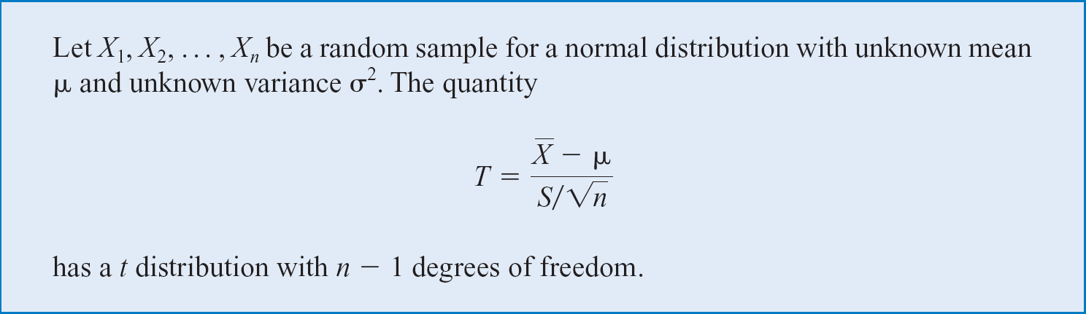
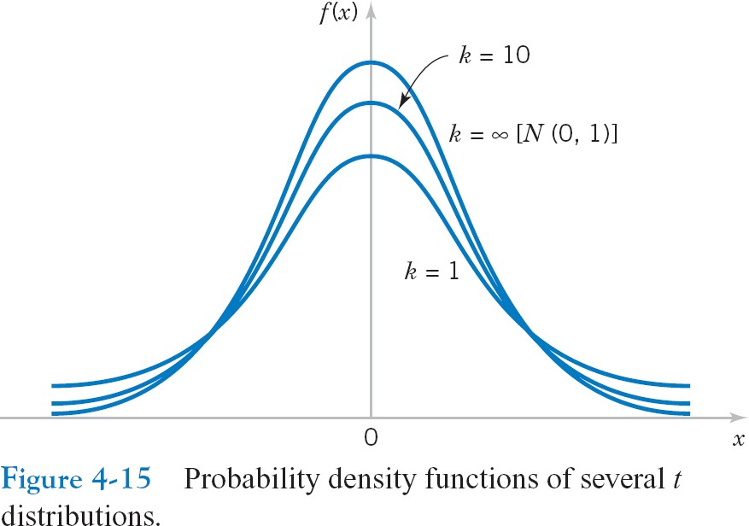
Hypothesis on mean, variance unknown
The t distribution (aka, Student’s t-distribution) is a probability distribution that is used to estimate population parameters when the sample size is small and/or when the population variance is unknown.
Student’s t Distribution
T-distriburions are symmetric and bell shaped but have flatter tails than normal
The mean of the distribution is equal to 0 .
The variance is equal to k / ( k- 2 ), where k is the degrees of freedom
The t value depends on degrees of freedom (d.f.)
As d.f. goes infinity, t-distribution -> N(0,1²)

Slide 27
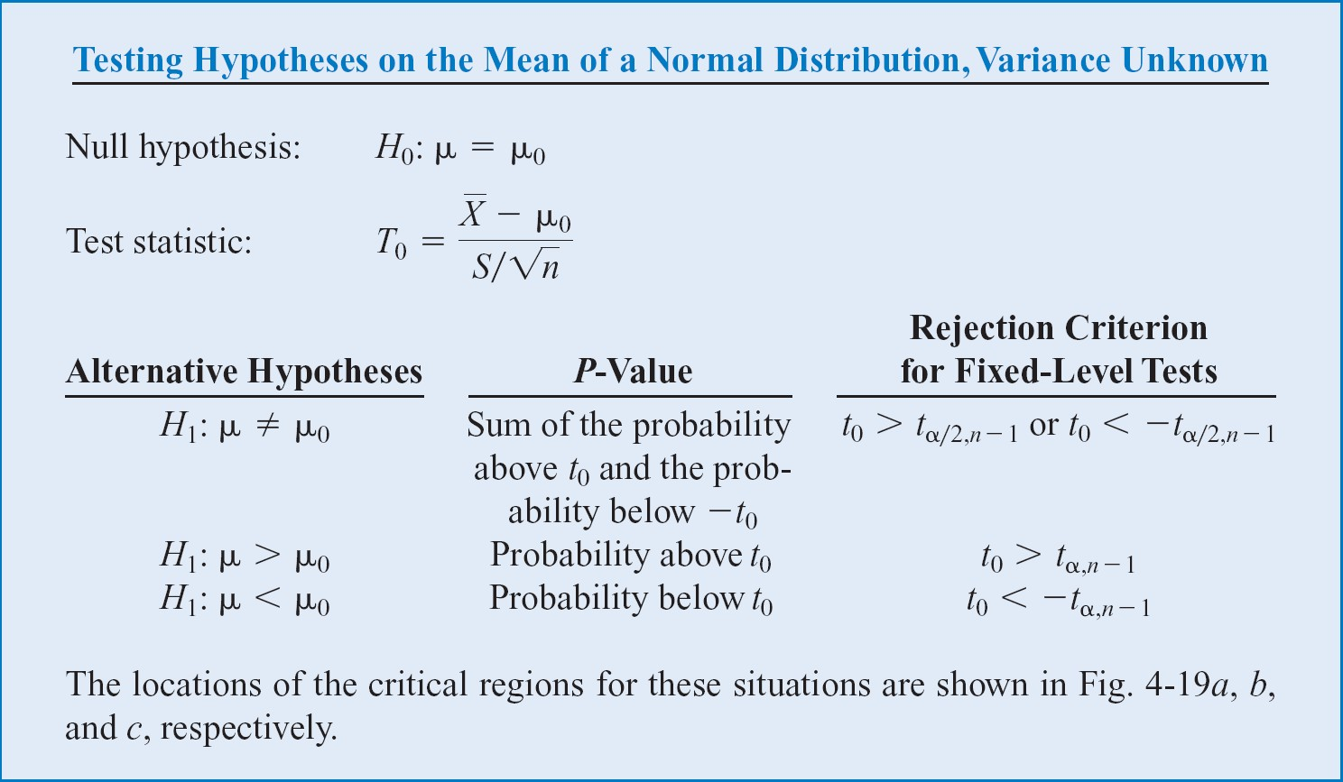
Hypothesis on mean, variance unknown
Assumptions
Population standard deviation is unknown
Population is normally distributed, If population is not normal, use large sample

Slide 28
Hypothesis on mean, variance unknown
Example The mean cost of a hotel room in LA is said to be $168 per night. A random sample of 25 hotels resulted in X = 172.50 and S = 15.40. Test at the α= 0.05 level Assuming the data are normally distributed.
H₀: μ = 168 H₁: μ ≠ 168
σ is unknown, so use a t-statistic
X − μ ₌ 172.50 − 168 S 15.40
n 25
t =
= 1.46
0
Critical Values: t_{0.025}, ₂₄ = ± 2.0639
Reject H₀ if t₀>2.0639 or t₀<-2.0639
Since t₀ does not fall in the rejection region, we cannot reject H₀

Slide 29

Comparing Two Populations
Previously we looked at techniques to estimate and test parameters for one population:
Population Mean Population Variance
We still consider these parameters when we are looking at two populations, however our interest will now be:
The difference between two means
The ratio of two variances

Slide 30

Difference between Two mean
In order to test and estimate the difference between two population means, we draw random samples from each of two populations. Initially we will consider independent samples, that is samples that are completely unrelated to one another.
Because we compare two population means, we use the statistic:

Slide 31



Sampling Distribution of Comparing two population means
is normally distributed if the original population is normal – or – approximately normal if the population are non-normal and the sample sizes are large (n₁, n₂ > 30)
The expected value of is
The variance of is
The Standard error is

Slide 32
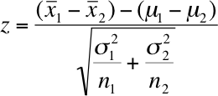
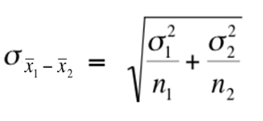
Making Inferences about 𝜇₁ − 𝜇₂
Since is normally distributed, If the original population is normal/approximately normal if the population are non-normal and the sample sizes are large (n₁, n₂ > 30), then:
Standard error
Z is a standard normal (or approximately normal) random variables. We could use this to build test statistics or confidence interval estimators for

Slide 33



Two Sample z-Test for the Means
Example:
A high school math teacher claims that students in her class will score higher on the math portion of the ACT then students in a colleague’s math class. The mean ACT math score for 49 students in her class is 22.1 and the standard deviation is 4.8. The mean ACT math score for 44 of the colleague’s students is 19.8 and the standard deviation is 5.4. At = 0.10, can the teacher’s claim be supported?
=22.1, =19.8 , =49, =44, =4.8,n =5.4 , α=0.10
State the null and alternative hypotheses
H₀: μ0 <=μ1 H₁: μ0 > μ1 (prove)
Choose the desired level of significance
Suppose that α =0 .10 is chosen for this test
Determine the test statistic
σ is known so this is a Z-test
The standard error :-
1.0644
2.161

Slide 34
Critical value: one sided α=0.10
For α = 0.05 , the critical Z-values are 1.28
Reject null hypothesis( H₀ ) accept z₀ > 1.28
α = .010
2.161
-3 -2 -1
0
1.28
Z
Note:-all step are same only changes in test statistics

Slide 35
Chi - square
A chi-square (χ²) statistic is a test that measures how expectations compare to actual observed data (or model results). The data used in calculating a chi-square statistic must be random, raw, mutually exclusive (two or more events that cannot coincide/independent events), drawn from independent variables, and drawn from a large enough sample.
For example, the results of tossing a coin 100 times meet these criteria.
h0:attending class will have absolutely no effect on your test performance.
 | pass | Fail | total
Attended | 25 | 6 | 31
Skipped | 8 | 15 | 23
Total | 33 | 21 | 54

Slide 36

Estimated value = (RowTotal*ColTotal)/GridTotal
= 11.686 calculated p - value = 0.0006 < α
Hence, we will reject null hypothesis
 | Pass | Fail | Total
Attended | 25 (18.94) | 6 (12.05) | 31
Skipped | 8 (14.05) | 15 (8.94) | 23
Total | 33 | 21 | 54

Slide 37
ANOVA Testing
Analysis of variance (ANOVA) is a statistical technique that is used to check if the means of two or more groups are significantly different from each other. ANOVA checks the impact of one or more factors by comparing the means of different samples.
Another measure to compare the samples is called a t-test. When we have only two samples, t-test and ANOVA give the same results. However, using a t-test would not be reliable in cases where there are more than 2 samples since it will have a compounded effect on the error rate of the result.
They help you to figure out if you need to reject the null hypothesis or accept the alternate hypothesis.
For Eg:
A manufacturer has two different processes to make light bulbs. They want to know if one process is better than the other.
Students from different colleges take the same exam. You want to see if one college outperforms the other.

Slide 38
Types of ANOVA Test
ONE-WAY ANOVA: One way Analysis of Variance (ANOVA) is a hypothesis test in which only one categorical variable or single factor is considered. It is a technique which enables us to make a comparison of means of three or more samples with the help of F-distribution.
TWO-WAY ANOVA: Two-way ANOVA as its name signifies, is a hypothesis test wherein the classification of data is based on two factors. It also studies the inter-relationship between independent variables influencing the values of the dependent variable, if any.

