Slide 1
Machine Learning
Algorithms

Slide 2
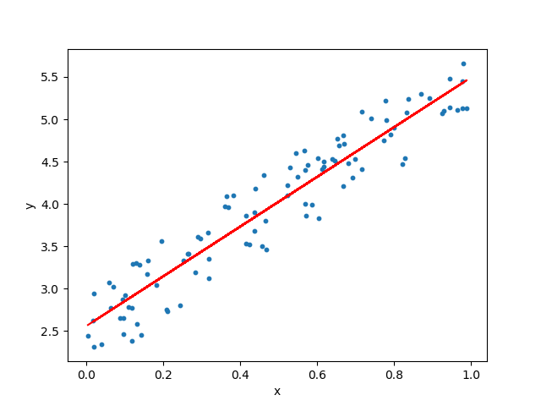
Linear Regression

Slide 3
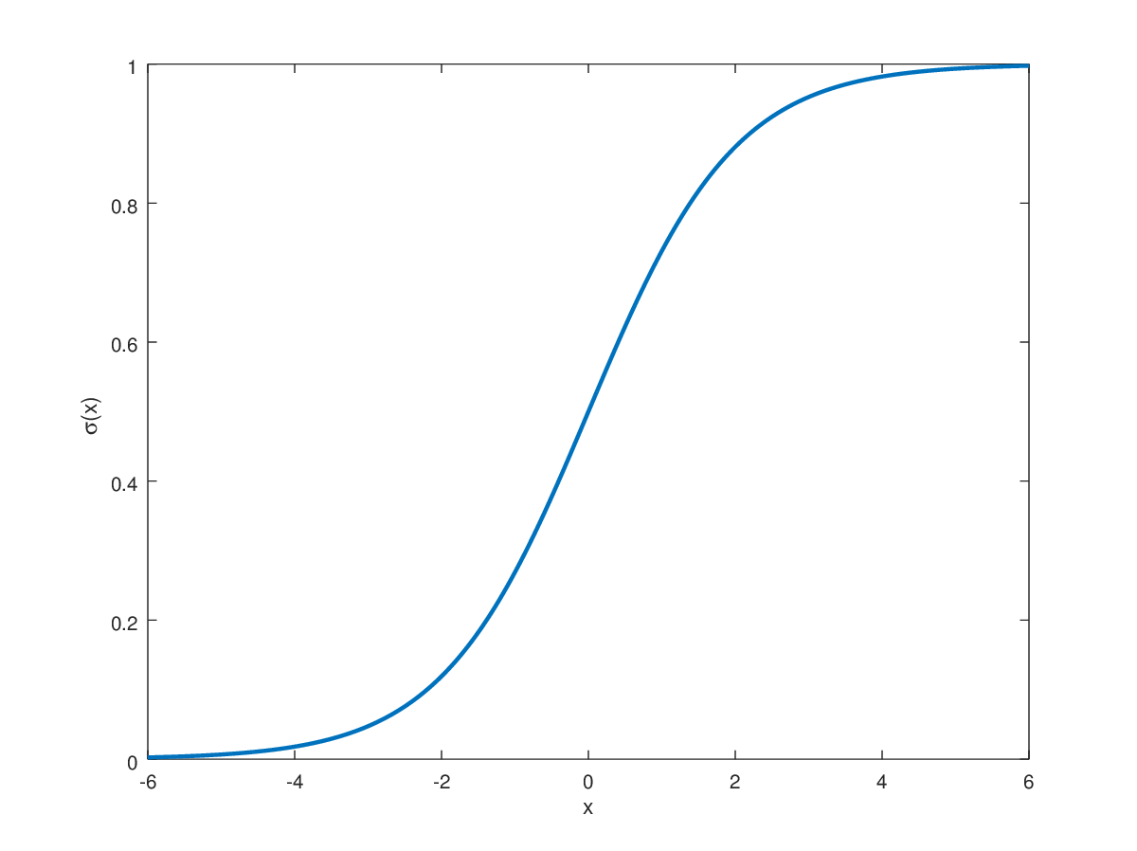
Logistic Regression

Slide 4
Decision Tree
Decision Trees are a non-parametric supervised learning method used for both classification and regression tasks.
In general, decision trees are constructed via an algorithmic approach that identifies ways to split a data set based on different conditions. It is one of the most widely used and practical methods for supervised learning.
The decision rules are generally in form of if-then-else statements. The deeper the tree, the more complex the rules and fitter the model. A decision tree is a tree-like graph with nodes representing the place where we pick an attribute and ask a question; edges represent the answers the to the question; and the leaves represent the actual output or class label.

Slide 5
So, you calculate all these factors for 5 days and form a lookup table like the one below.
Day | Weather | Temperature | Humidity | Wind | Play
1 | Sunny | Hot | High | Weak | No
2 | Cloudy | Hot | High | Weak | Yes
3 | Sunny | Mild | Normal | Strong | Yes
4 | Cloudy | Mild | High | Strong | Yes
5 | Rainy | Mild | High | Strong | No

Slide 6
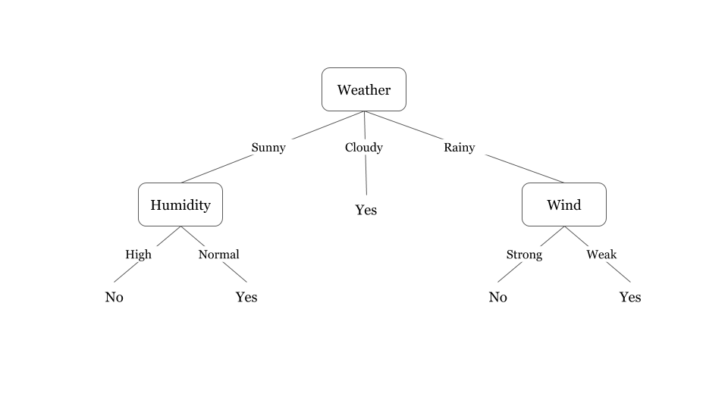
The above tree illustrates a learned decision tree. We can see that each node represents an attribute or feature and the branch from each node represents the outcome of that node. Finally, it's the leaves of the tree where the final decision is made.

Slide 7

Random Forest

Slide 8
KNN(K-Nearest Neighbour)
K Nearest Neighbor(KNN) algorithm is a very simple, easy to understand, versatile and one of the topmost machine learning algorithms. In k-NN classification, the output is a class membership. An object is classified by a plurality vote of its neighbours, with the object being assigned to the class most common among its k nearest neighbours
In KNN, K is the number of nearest neighbours.

Slide 9
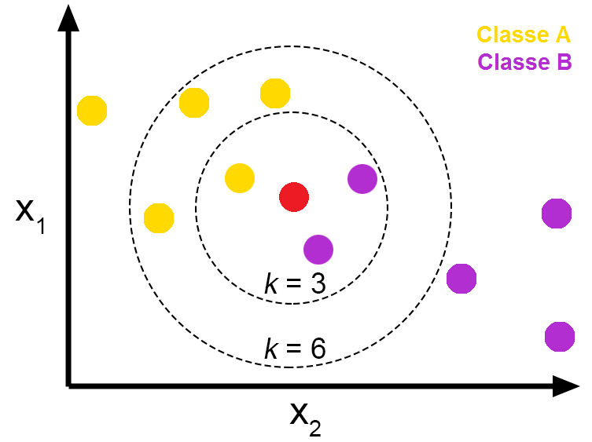

Slide 10
List of Common Machine Learning Algorithms
Linear Regression
Logistic Regression
Decision Tree
SVM
Naive Bayes
kNN
K-Means
Random Forest
Dimensionality Reduction Algorithms
Gradient Boosting algorithms
GBM
XGBoost
LightGBM
CatBoost

