Slide 1
Functional Test Reporting:
- Moving Beyond Test Percentage
- The Anatomy of a good report
PRATEEK KUMAR BAHETI

Slide 2



WRITING TESTS
ANALYZING FAILURES

Slide 3
Do You ???
Have a separate team to analyze test failures
Not have conclusive results to a test report analysis
Constantly refer back to the environment while analyzing test reports

Slide 4
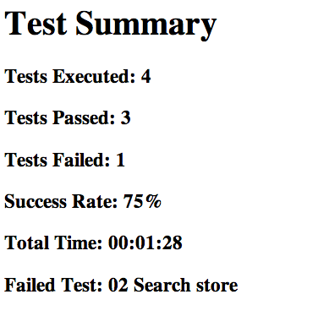
Most Basic Test Report

Slide 5
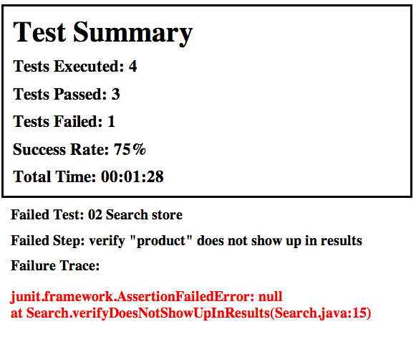
Slightly better ???

Slide 6
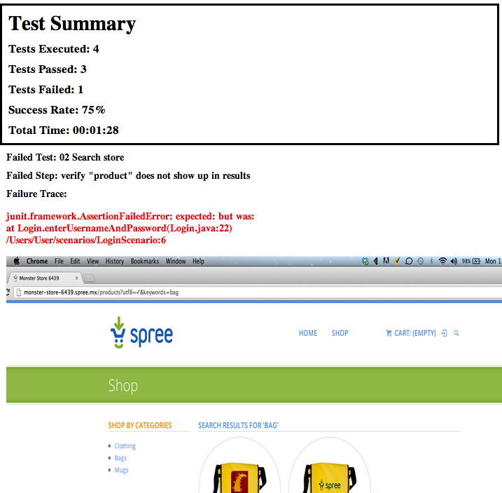
A little more context !!!

Slide 7
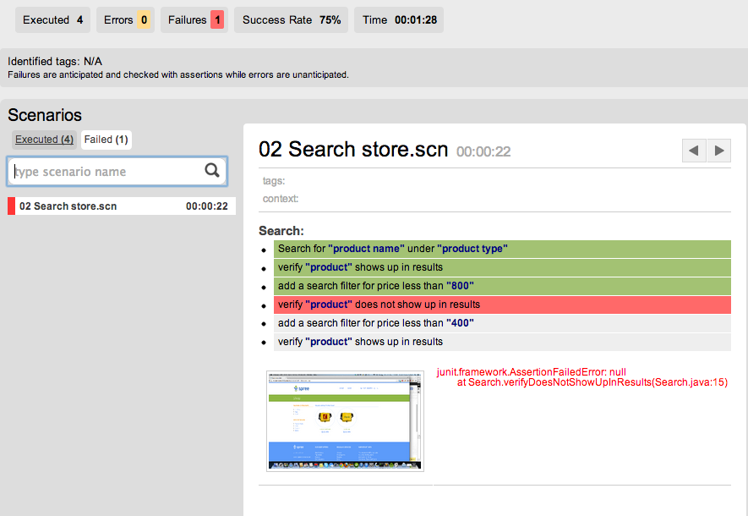
Greater Visibility

Slide 8
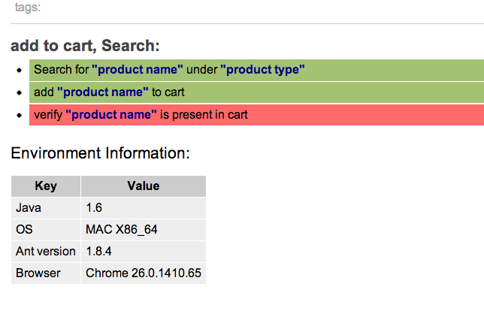
Environment Information in report

Slide 9


Data and Presentation

Slide 10
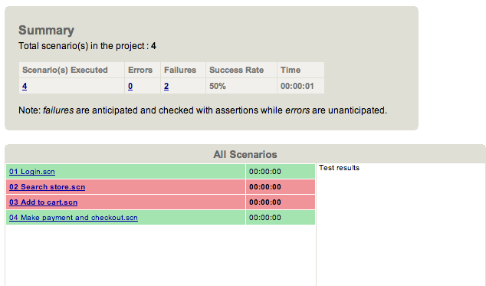
A rigid report

Slide 11
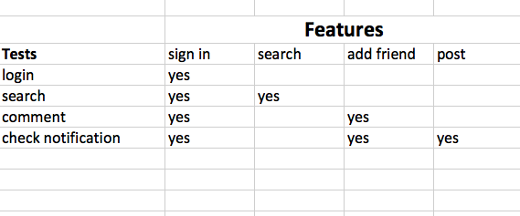
Analyzing features covered in tests.

Slide 12
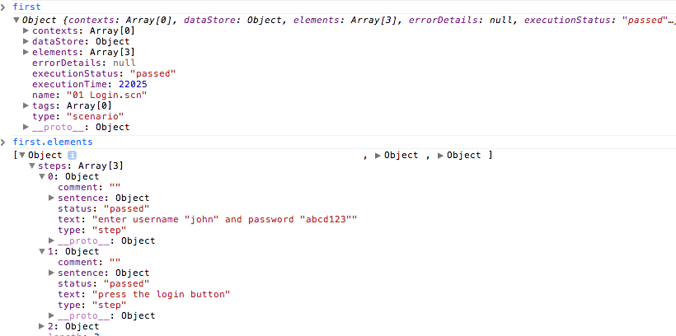
An example JSON data

Slide 13
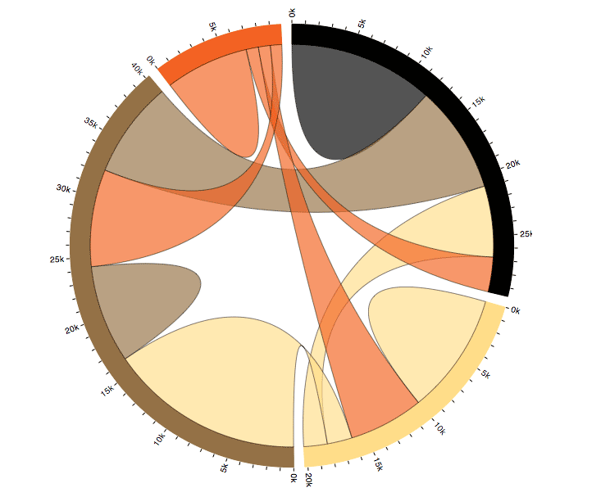
Analysis of your tests

Slide 14
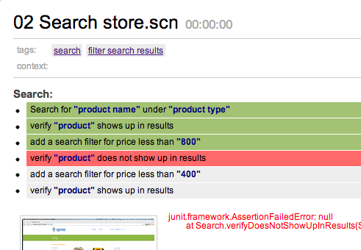
Link to project management tool

Slide 15
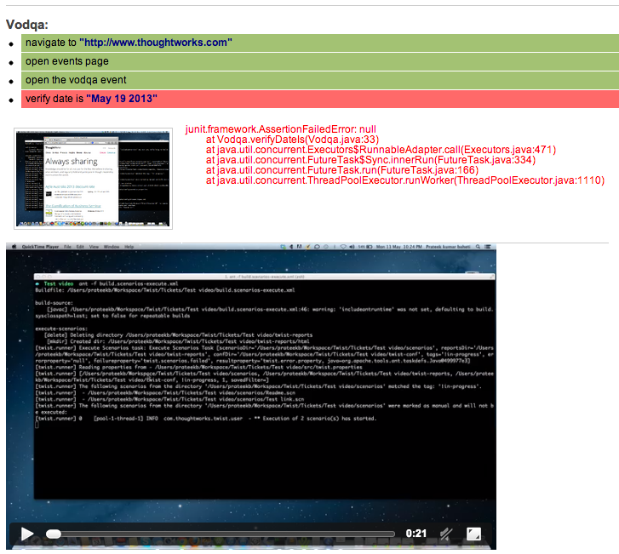
Embed Video in report

Slide 16
Trend analysis ???

Slide 17
Tests are meant to check REGRESSION

Slide 18
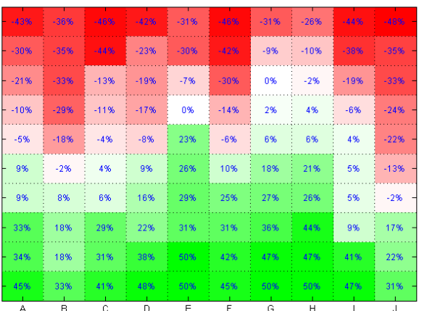
Heat maps for tests

Slide 19
Lets Summarize !!
What does a good report need to have ?
Data separated from presentation
Analysis of test reports

