Slide 1
Another Dynamic Algorithm: Tomasulo Algorithm
For IBM 360/91 about 3 years after CDC 6600
Goal: High Performance without special compilers
Differences between Tomasulo Algorithm & Scoreboard
  Control & buffers distributed with Function Units vs. centralized in scoreboard; called “reservation stations”
  Registers in instructions replaced by pointers to reservation station buffer
  HW renaming of registers to avoid WAW hazards
  Buffer operand values to avoid WAR hazards
  Common Data Bus broadcasts results to all FUs
  Load and Stores treated as FUs as well
Why study? Lead to Alpha 21264, HP 8000, MIPS 10000, Pentium II, Power PC 604 …
Nov. 2, 2004
Lec. 7

Slide 2
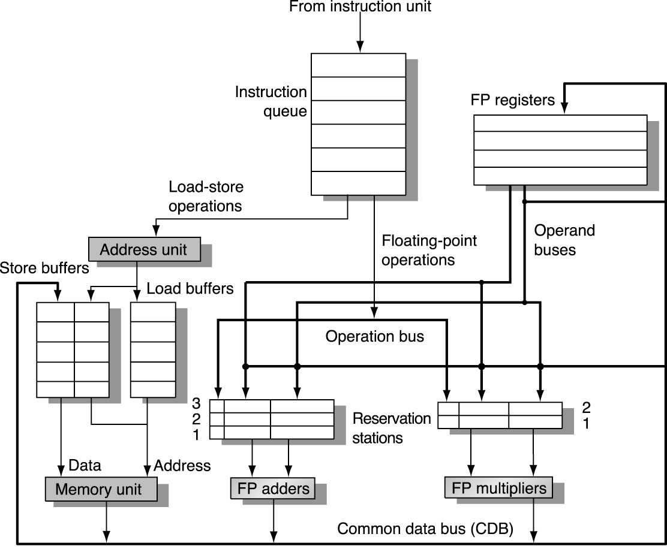
FP unit and load-store unit using Tomasulo’s alg.
Nov. 2, 2004
Lec. 7

Slide 3
Another Dynamic Algorithm: Tomasulo Algorithm
        DIV.D F0, F2, F4
        ADD.D S, F0, F8
        S.D S, 0(R1) register renaming
        SUB.D T, F10, F14
        MUL.D F6, F10, T
Implemented through reservation stations (rs) per functional unit
  Buffers an operand as soon as it is available – avoids WAR hazards.
  Pending instr. designate rs that will provide their inputs – avoids WAW hazards.
  The last write in a sequence of same-register-writing actually updates the register
  Decentralize hazard detection and execution control
  Instruction results are passed directly to the FU from rs rather than from registers
    Through common data bus (CDB)
Nov. 2, 2004
Lec. 7

Slide 4
Three Stages of Tomasulo Algorithm
1. Issue—get instruction from FP Op Queue
  Stall if structural hazard, ie. no space in the rs. If reservation station (rs) is free, the issue logic issues instr to rs & read operands into rs if ready (Register renaming => Solves WAR). Make status of destination register waiting for this latest instn even if the previous instn writing to this register hasn’t completed => Solves WAW hazards.
2. Execution—operate on operands (EX)
  When both operands are ready then execute;
  if not ready, watch CDB for result – Solves RAW
3. Write result—finish execution (WB)
  Write on Common Data Bus to all awaiting units;
  mark reservation station available. Write result into dest. reg. if its status is r. => Solves WAW.
Normal data bus: data + destination (“go to” bus)
CDB: data + source (“come from” bus)
  64 bits of data + 4 bits of Functional Unit source address
  Write if matches expected Functional Unit (produces result)
  Does broadcast
Nov. 2, 2004
Lec. 7

Slide 5
Reservation Station Components
Op—Operation to perform in the unit (e.g., + or –)
Vj, Vk— Value of the source operand.
Qj, Qk— Name of the RS that would provide the source operands. Value zero means the source operands already available in Vj or Vk, or is not necessary.
Busy—Indicates reservation station or FU is busy
Register File Status Qi:
Qi —Indicates which functional unit will write each register, if one exists. Blank (0) when no pending instructions that will write that register meaning that the value is already available.
Nov. 2, 2004
Lec. 7

Slide 6
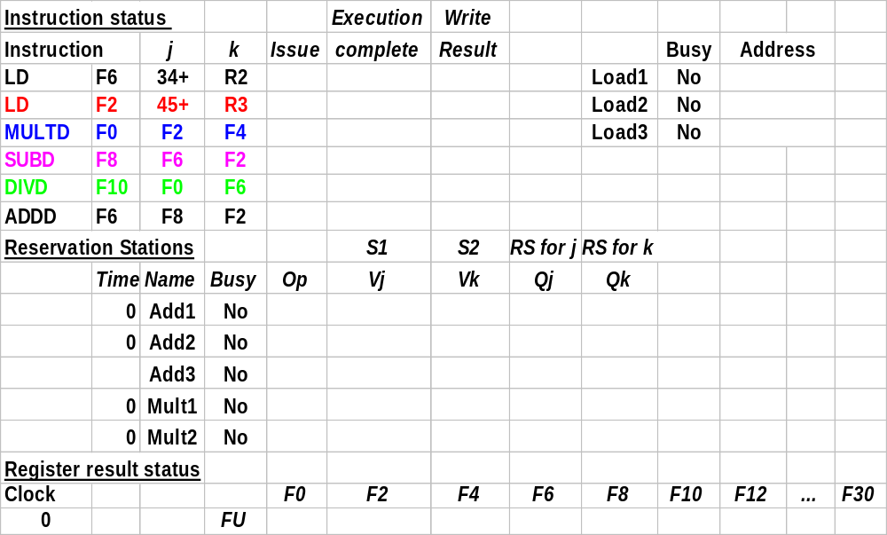
Tomasulo Example Cycle 0
Nov. 2, 2004
Lec. 7

Slide 7
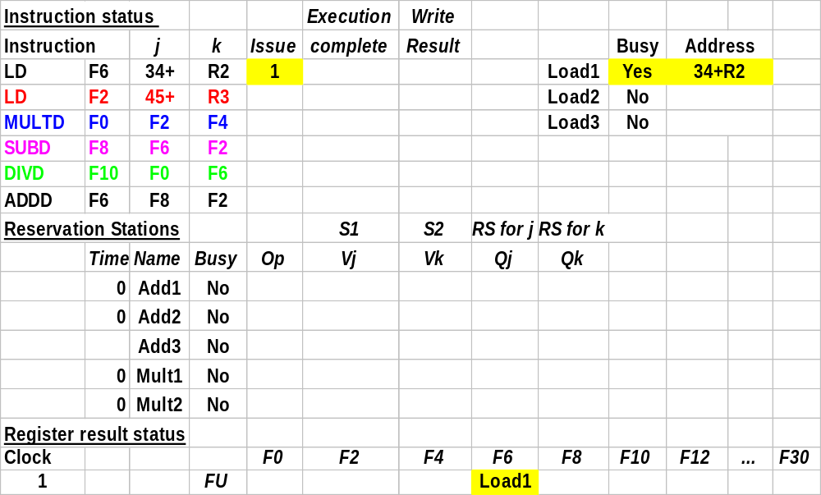
Tomasulo Example Cycle 1
Nov. 2, 2004
Lec. 7

Slide 8
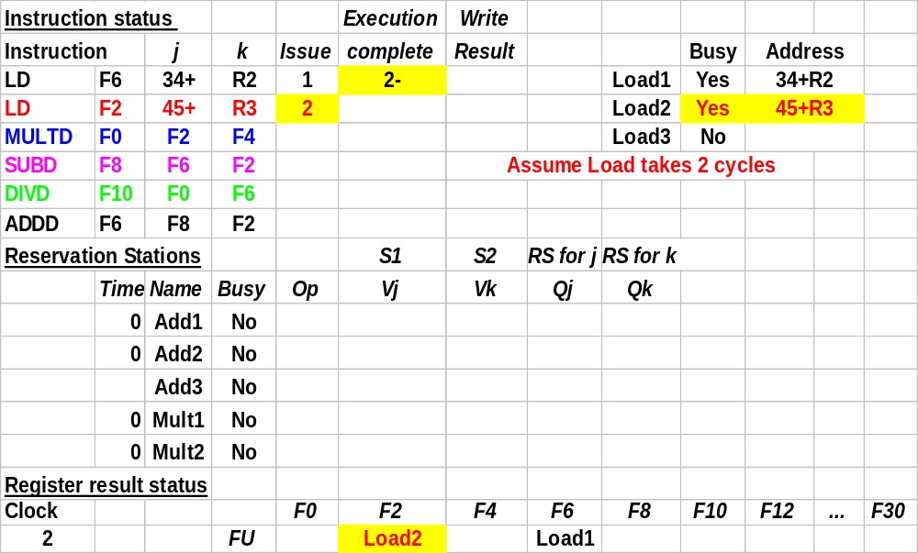
Tomasulo Example Cycle 2
Nov. 2, 2004
Lec. 7

Slide 9
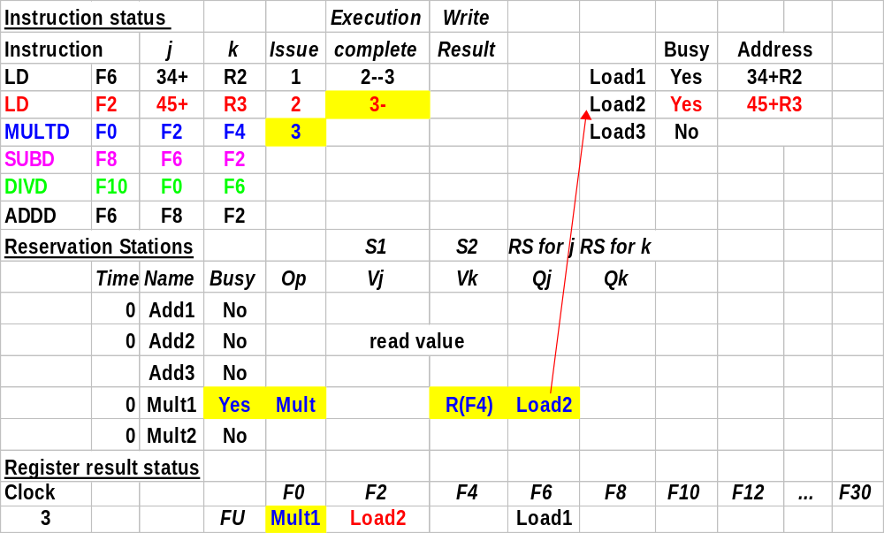
Tomasulo Example Cycle 3
Nov. 2, 2004
Lec. 7

Slide 10
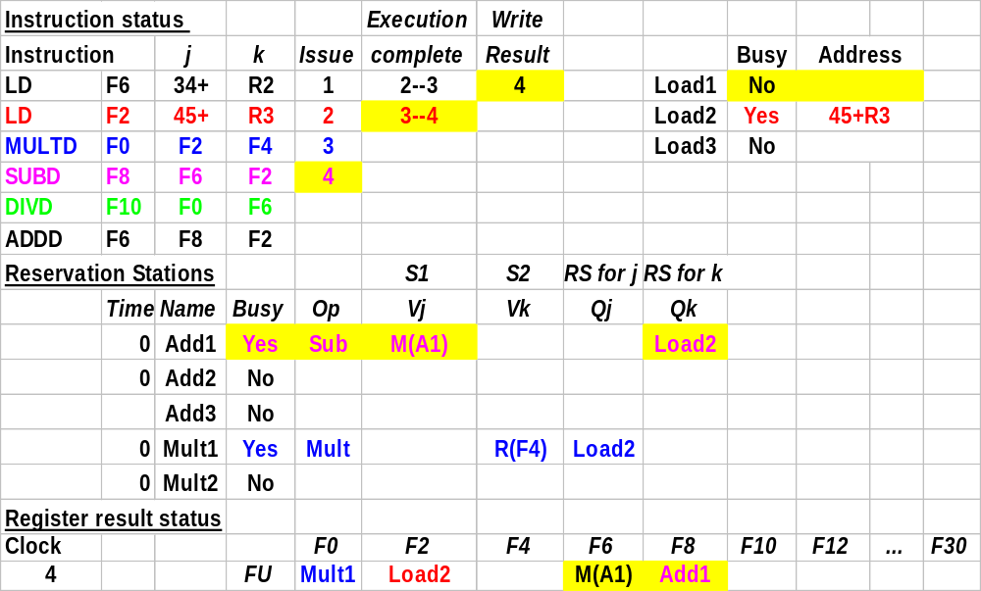
Tomasulo Example Cycle 4
Nov. 2, 2004
Lec. 7

Slide 11
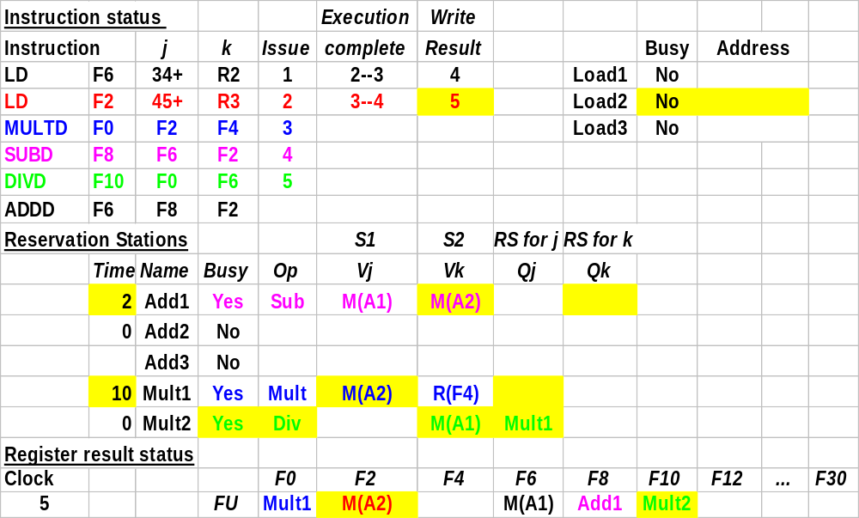
Tomasulo Example Cycle 5
Nov. 2, 2004
Lec. 7

Slide 12
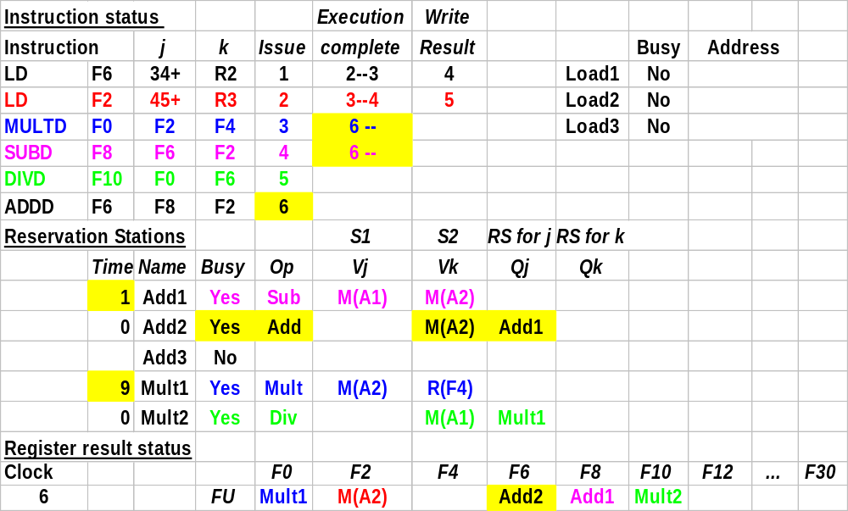
Tomasulo Example Cycle 6
Nov. 2, 2004
Lec. 7

Slide 13
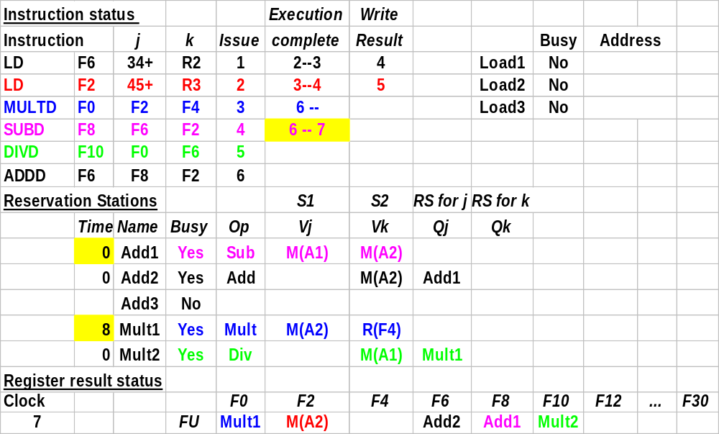
Tomasulo Example Cycle 7
Nov. 2, 2004
Lec. 7

Slide 14
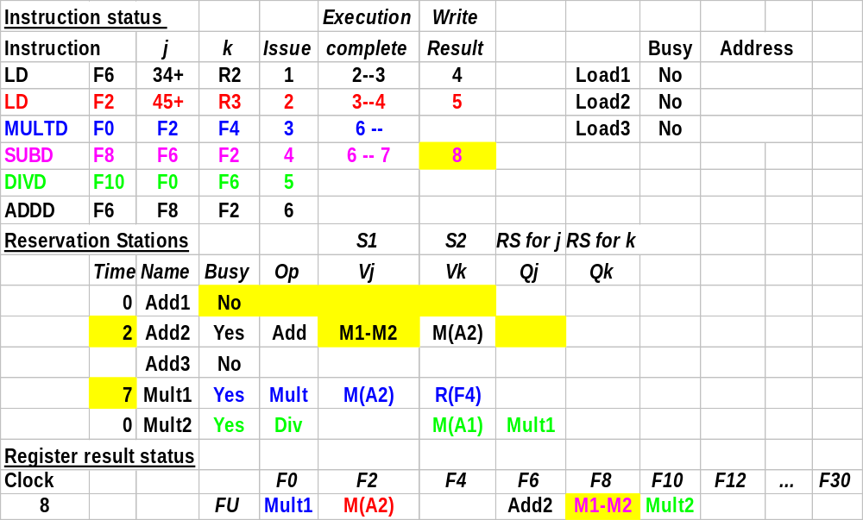
Tomasulo Example Cycle 8
Nov. 2, 2004
Lec. 7

Slide 15
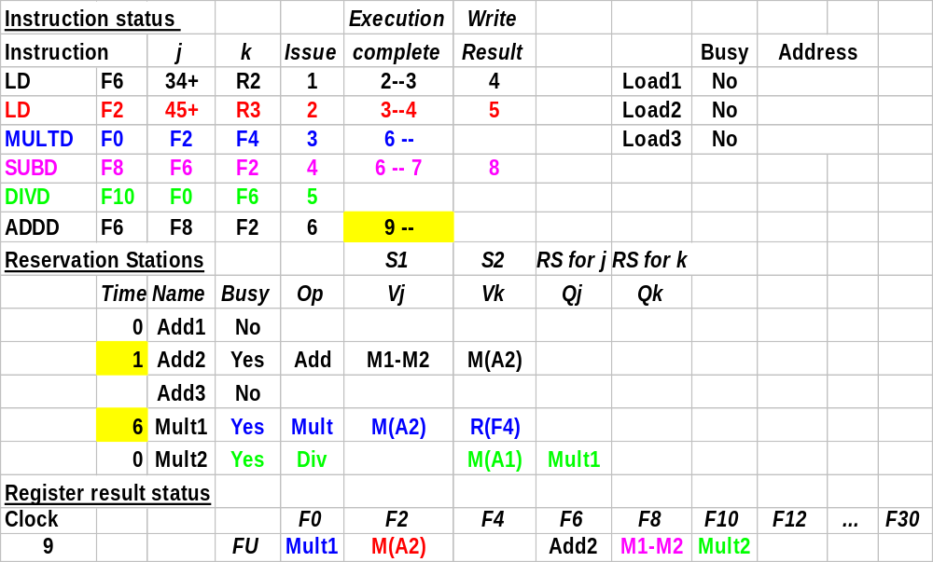
Tomasulo Example Cycle 9
Nov. 2, 2004
Lec. 7

Slide 16
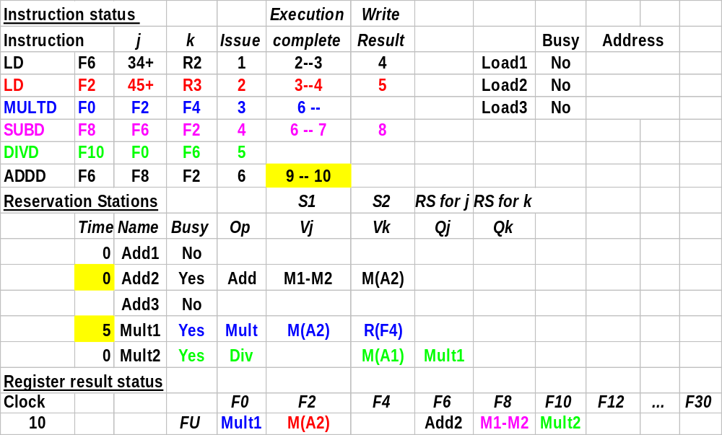
Tomasulo Example Cycle 10
Nov. 2, 2004
Lec. 7

Slide 17
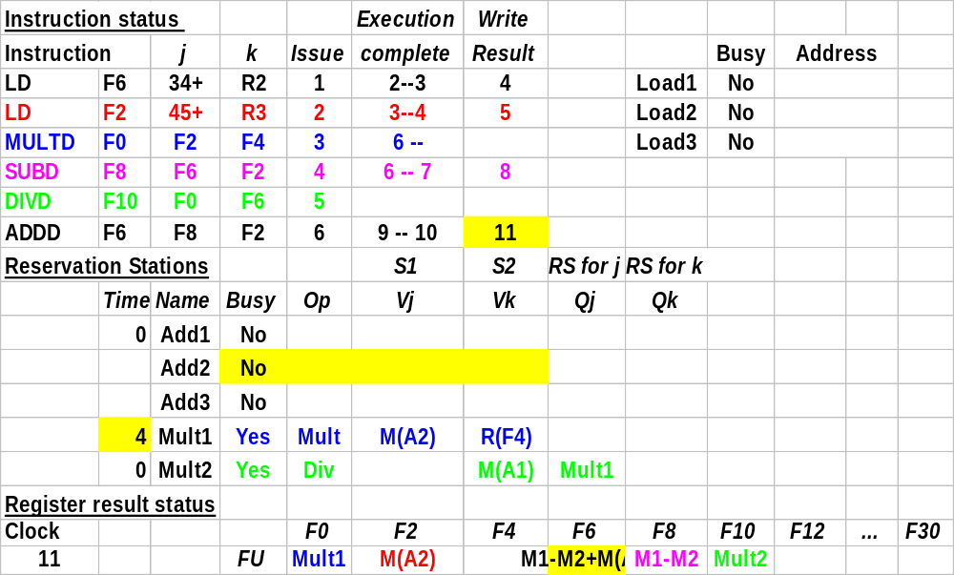
Tomasulo Example Cycle 11
Nov. 2, 2004
Lec. 7

Slide 18
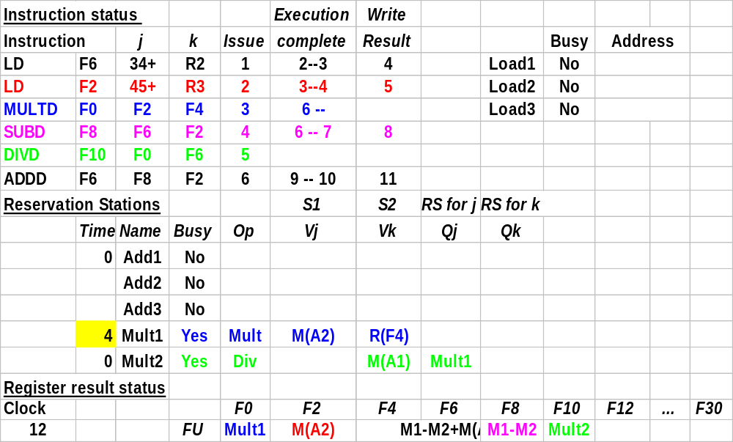
Tomasulo Example Cycle 12
Nov. 2, 2004
Lec. 7

Slide 19
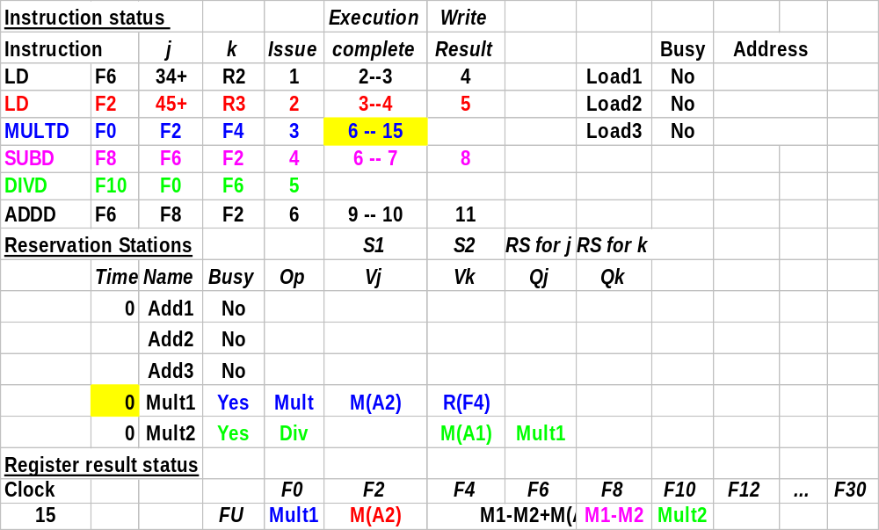
Tomasulo Example Cycle 15
Nov. 2, 2004
Lec. 7

Slide 20
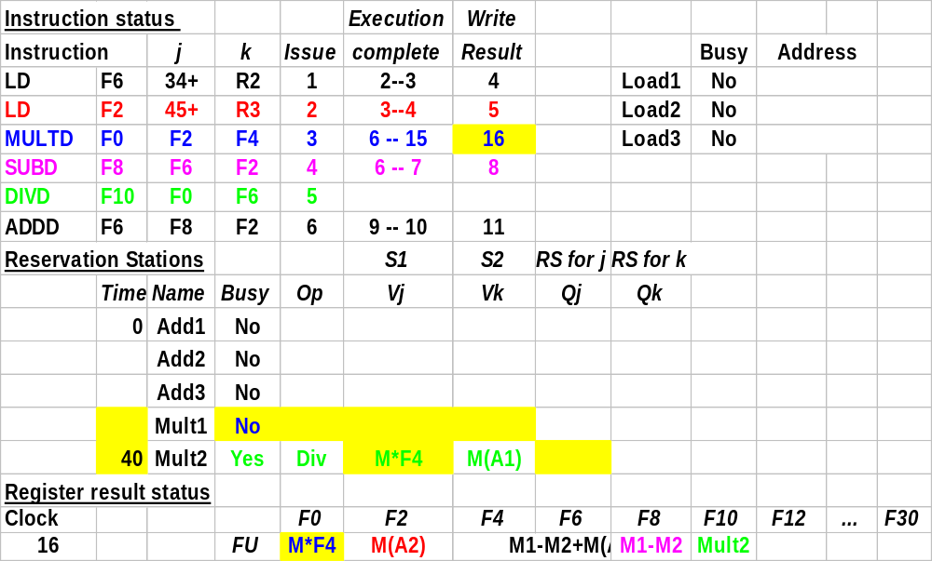
Tomasulo Example Cycle 16
Nov. 2, 2004
Lec. 7

Slide 21
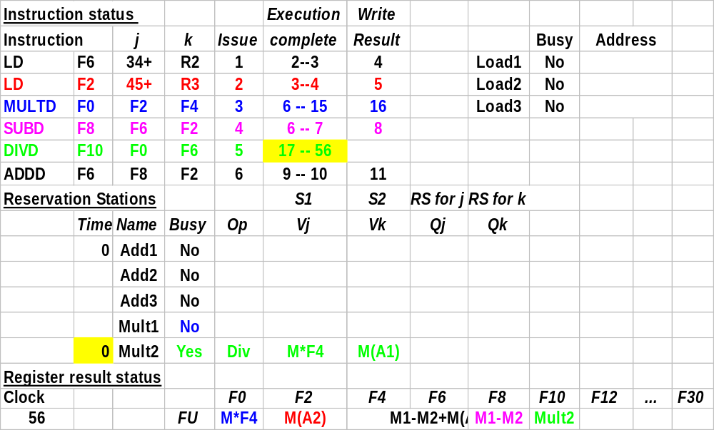
Tomasulo Example Cycle 56
Nov. 2, 2004
Lec. 7

Slide 22
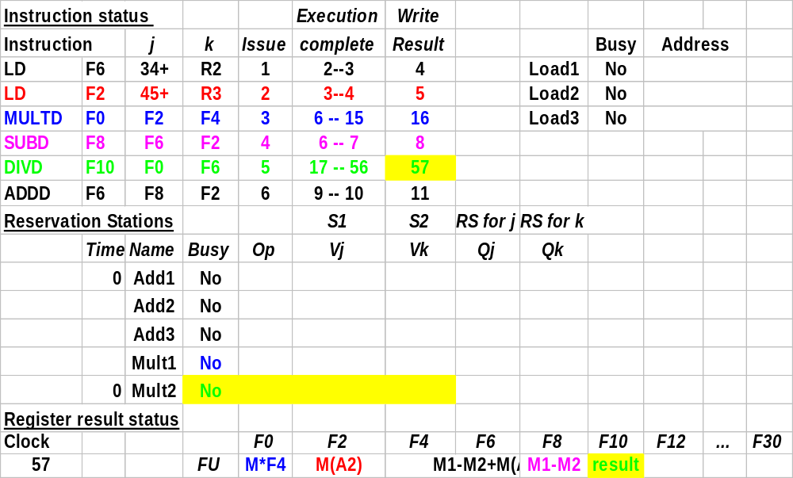
Tomasulo Example Cycle 57
Nov. 2, 2004
Lec. 7

Slide 23
Branch Prediction (3.4, 3.5)
Nov. 2, 2004
Lec. 7

