Slide 1
CAPSTONE PROJECT
Learning Community Analytics
using NLP Topics and Knowledge Diffusion Networks
A case study of the CS50 Stack Exchange community · 4,000 questions · 2019–2026
Prateek Chauhan
Guide: ____________ · September 2026
Notes:
Good morning. My capstone project analyses an online learning community — the CS50 Stack Exchange site where students of Harvard's CS50 course help each other. I combine NLP, to understand what learners talk about, with network science, to understand who helps whom and how knowledge spreads.

Slide 2
The problem
Learning communities are rich in data, but instructors can't see inside them
1
What do learners struggle with?
Thousands of questions, no overview of the hard topics
Goal
Turn raw community data into insight and tools: topics, experts, diffusion, answer prediction and expert recommendation, in one dashboard backed by PostgreSQL.
2
Who carries the community?
A few experts may answer most questions — a single point of failure
3
How does knowledge spread?
Do learners learn from each other, or each on their own?
4
Which questions will go unanswered, and who could answer them?
Stuck learners wait hours or days
2
Notes:
Online communities generate a lot of data, but instructors and platforms have little visibility. These four questions drive the project. The goal is not just analysis but usable tools.

Slide 3
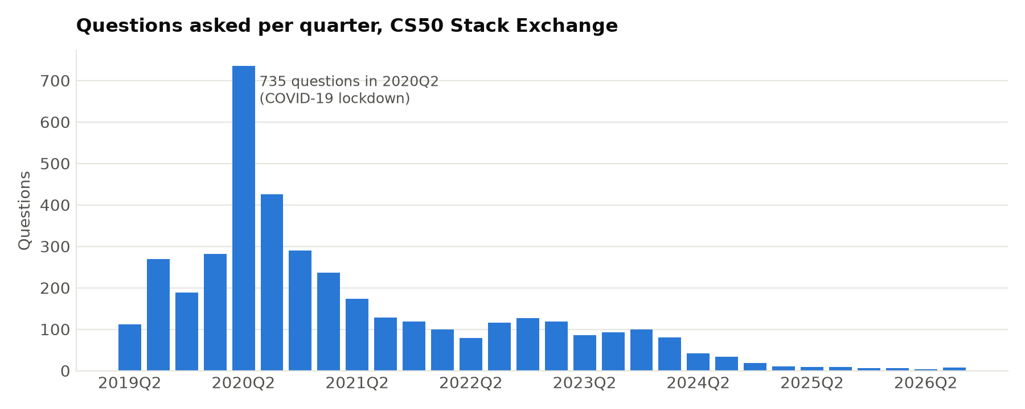
The data: CS50 Stack Exchange
Collected from the Stack Exchange API · 2019-05-13 to 2026-09-18
4,000
4,253
7,168
3,003
questions
answers
comments
users
Activity peaked in 2020Q2 (735 questions): the COVID-19 lockdown
80% of questions include code; 46% mention an error
Median wait for a first answer: 4.0 hours
Stored in PostgreSQL: 5 raw tables + 11 result tables
3
Notes:
I wrote a collector for the Stack Exchange API. Without an API key it only returns 25 pages per query, so it walks back through time in date windows. The data goes into PostgreSQL with primary and foreign keys. Notice the spike in 2020 during the lockdown.

Slide 4
System workflow
One command runs the whole analysis (~10 minutes on a laptop)
1
2
3
4
→
→
→
Collect
Stack Exchange API
Store
PostgreSQL
Clean
HTML, code, lemmas, confusion score
Topics
LDA vs BERTopic
5
6
7
8
→
→
→
Network
Who helps whom
Diffusion
Shuffle test + IC/LT
Predict
Answered? Who can answer?
Dashboard
Streamlit, 7 pages
Runs on PostgreSQL when connected, on CSV files otherwise · fixed random seeds: two full runs gave identical results
4
Notes:
The system is a pipeline of Python modules. Each step reads the previous step's output. The same code runs from PostgreSQL or from CSV files, and fixed seeds make it reproducible.

Slide 5
What do learners talk about?
Topic modeling: classic LDA vs transformer-based BERTopic
1
BERTopic wins on every metric
NMI with the course syllabus: 0.56 vs 0.38
2
Topics = problem sets
speller, filter, recover, caesar, finance, DNA, tideman…
3
A fair comparison
Both models scored on the same vocabulary (words in ≥ 5 questions)
5
Notes:
I compared LDA with BERTopic, which uses sentence embeddings, UMAP and HDBSCAN. I scored both on coherence, diversity and agreement with the course's own tags. BERTopic wins on all three, and its topics match the CS50 problem sets almost one to one, without ever seeing the tags.

Slide 6
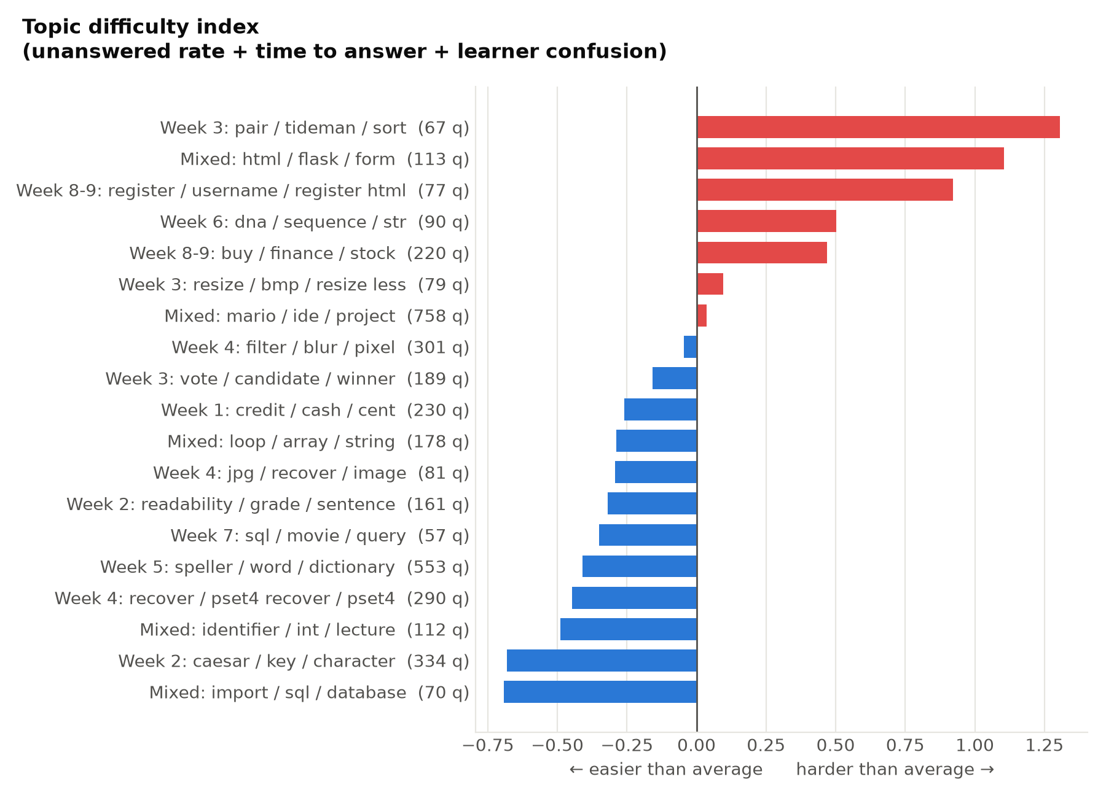
Which topics are hardest?
Difficulty index = unanswered rate + time to answer + learner confusion
45%
of Tideman questions stay unanswered: the hardest topic
Tideman is the problem set CS50 students widely call the hardest, an independent check on the index
Web development (Flask, register, Finance) is next
Early exercises (Caesar, Speller) get fast answers
Action: add walkthroughs and office hours for Week 3 and Week 8–9
6
Notes:
The difficulty index combines three signals. The hardest topic is Tideman, which CS50 students widely regard as the hardest problem set, so the index agrees with what learners already say. This is directly actionable for instructors.

Slide 7
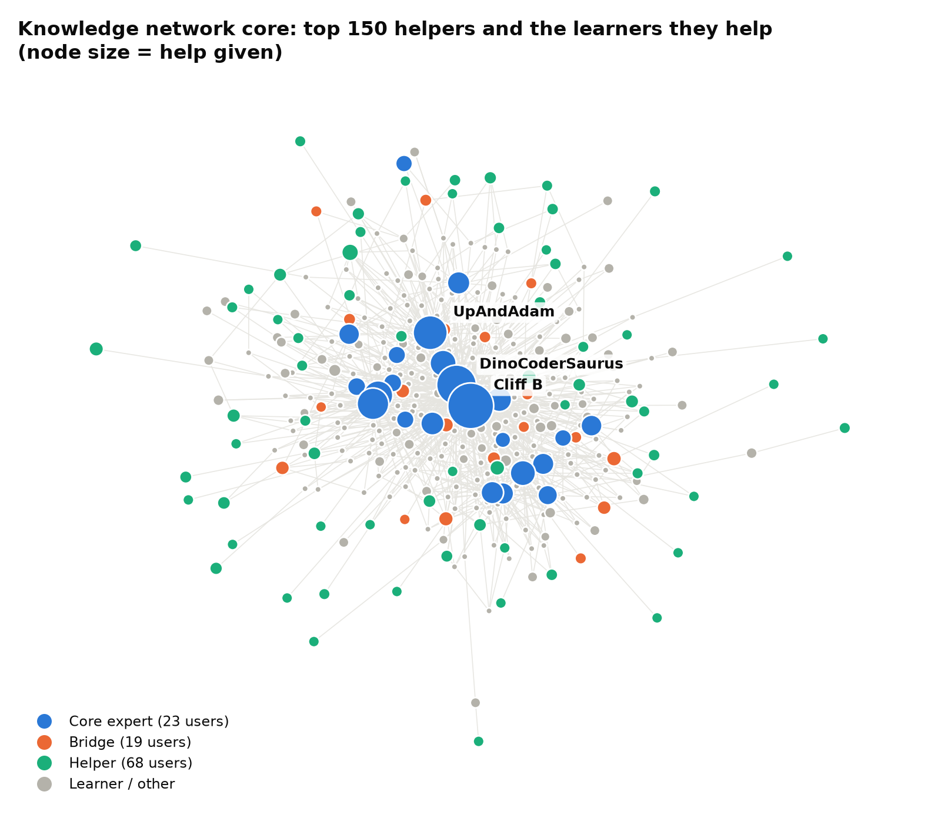
Who helps whom? The knowledge network
2,891 users · 4,245 helper → learner links · 6,930 interactions
81%
16
of all help comes from the top 1% of users
communities with 10+ users (modularity 0.60)
Only 30% of users ever help someone
Reciprocity 0.035: help flows one way, experts → learners
Roles: 23 core experts, 19 bridges, 68 helpers
Validation: 85% of ExpertiseRank's top 20 are also in the top 20 by accepted answers
7
Notes:
Every answer, and every comment by someone other than the asker, is an edge from helper to learner. The network is extremely centralised: the top 1% give most of the help. I validated the expert ranking against accepted answers, which the network never sees.

Slide 8
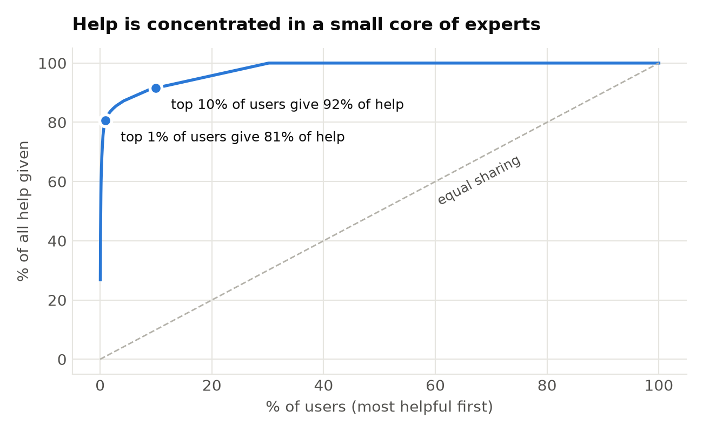
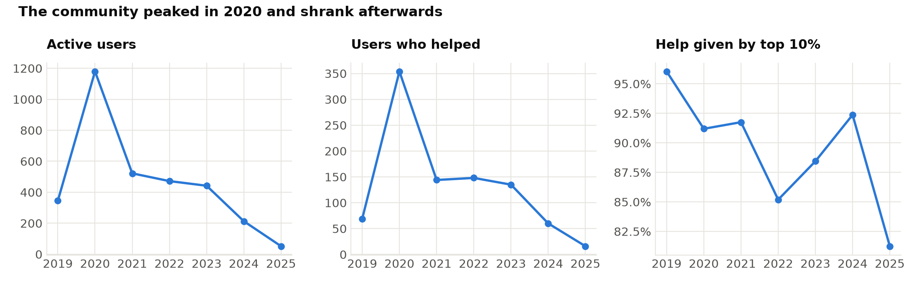
A community that depends on a few people
Help concentration and how the community changed over time
Risk: if the top handful of experts leave, most questions go unanswered. Help Gini = 0.96. Activity has fallen since 2020 while the share of help from the top 10% stays high.
8
Notes:
The Lorenz-style curve shows how unequal help is. Over time the community shrank after 2020, but the dependence on the top experts stayed. Platforms should recognise and support these experts, and spread the load.

Slide 9
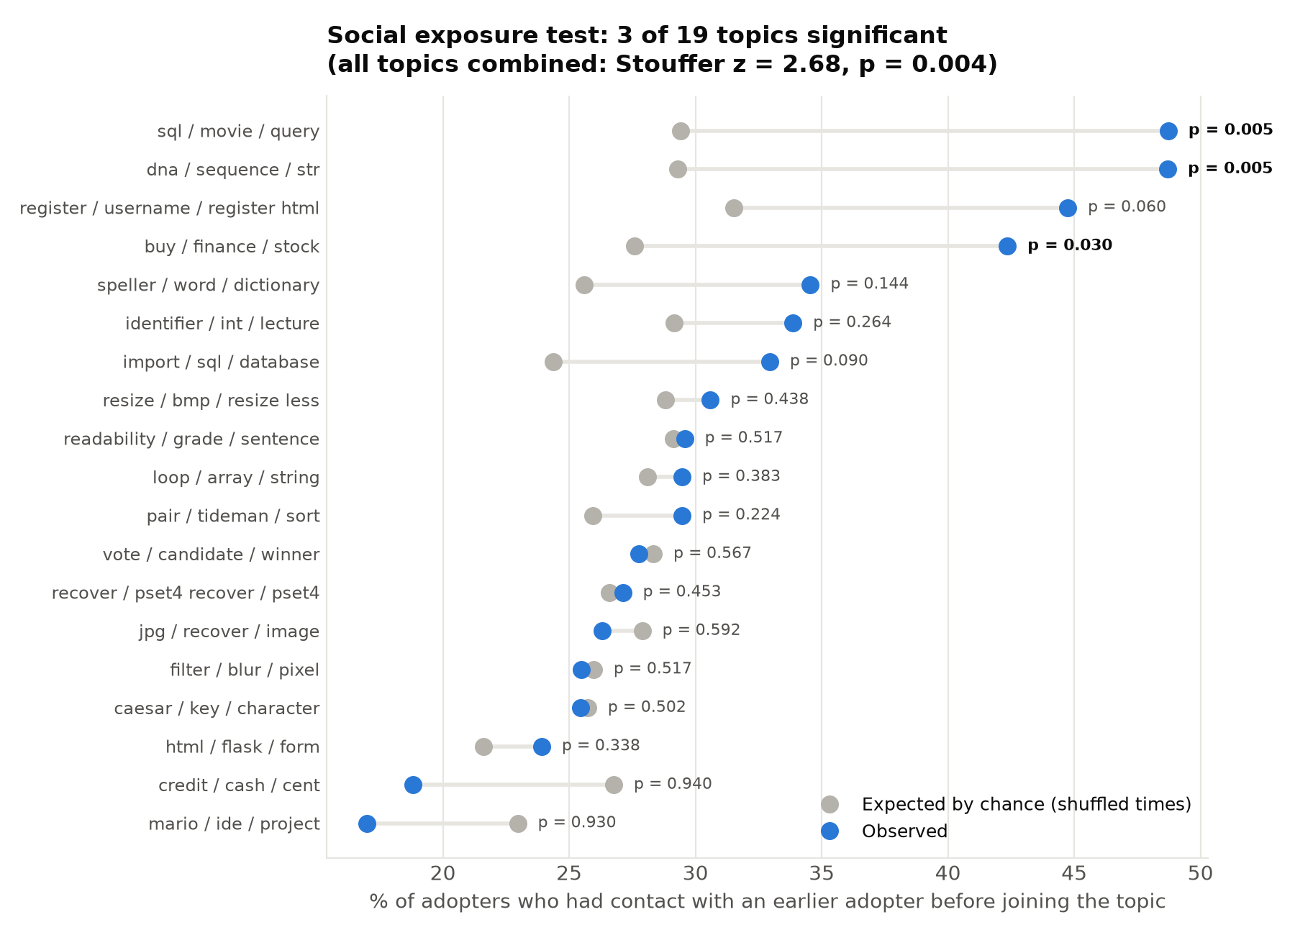
Does knowledge spread through contact?
Shuffle test: did adopters meet earlier adopters more often than chance?
z = 2.68
all topics combined (Stouffer), p = 0.004
Modest but significant social-exposure effect overall
Significant in 3 of 19 topics: buy / finance / stock, dna / sequence / str, sql / movie / query
All of them are later-course topics; beginners arrive at topics independently
Peer learning matters most in advanced units
9
Notes:
A user adopts a topic when they first post in it. I checked whether they had talked to an earlier adopter beforehand, and compared that with 200 random shufflings of the adoption times. Overall there is a significant effect, strongest for the advanced topics. This is evidence consistent with influence, not proof of causation.

Slide 10
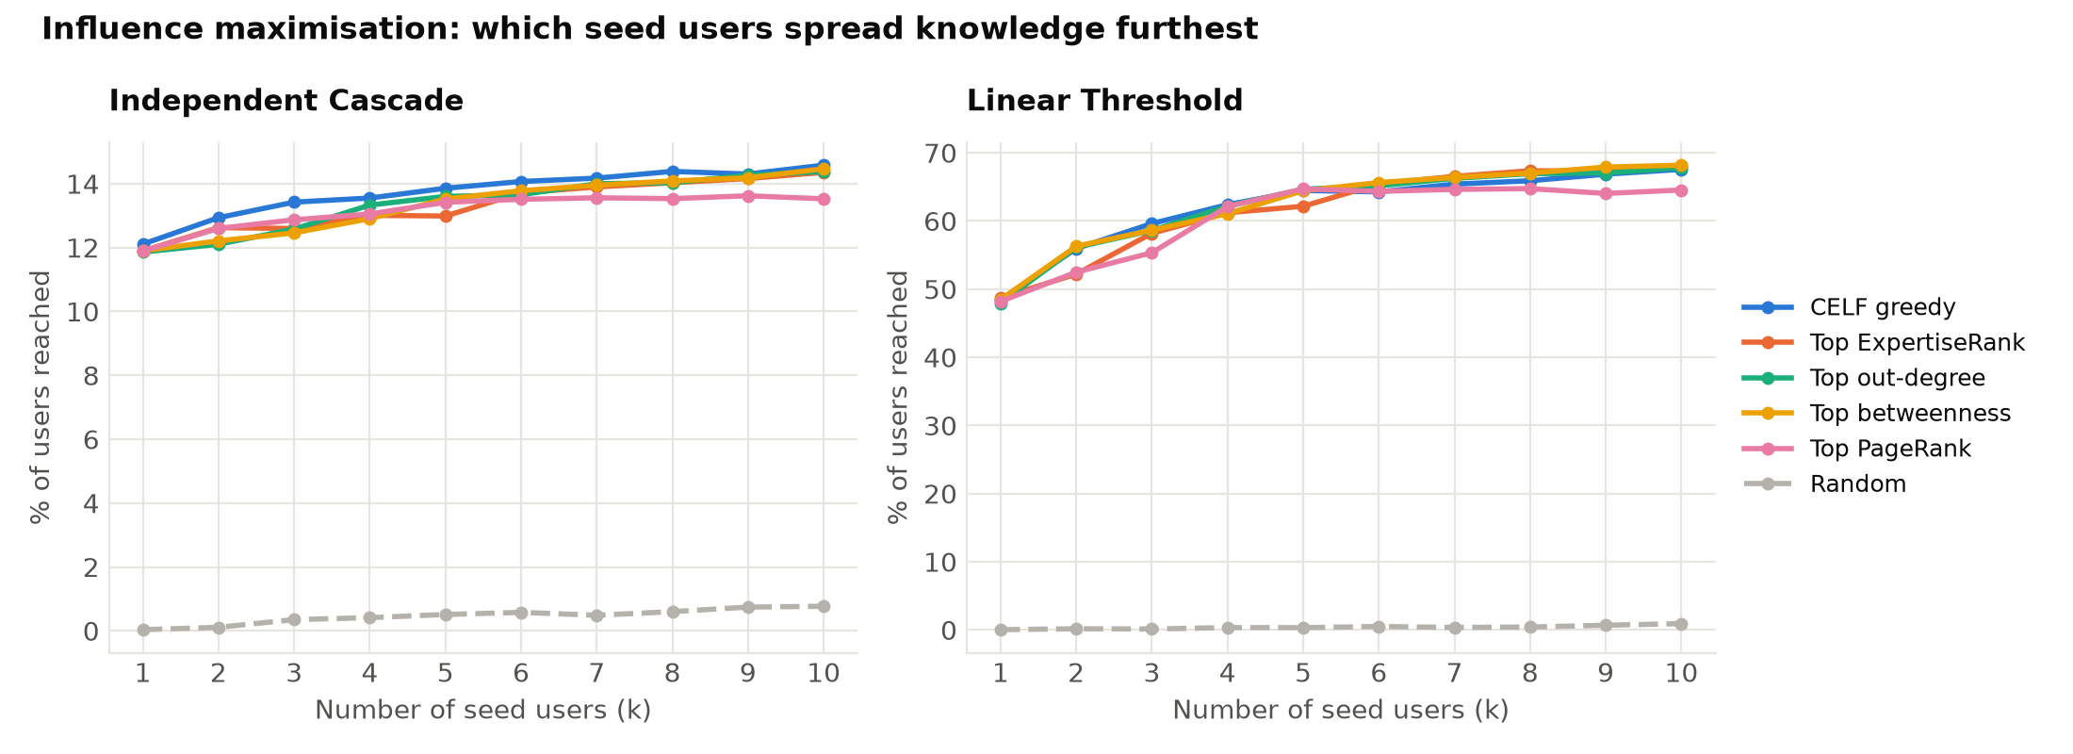
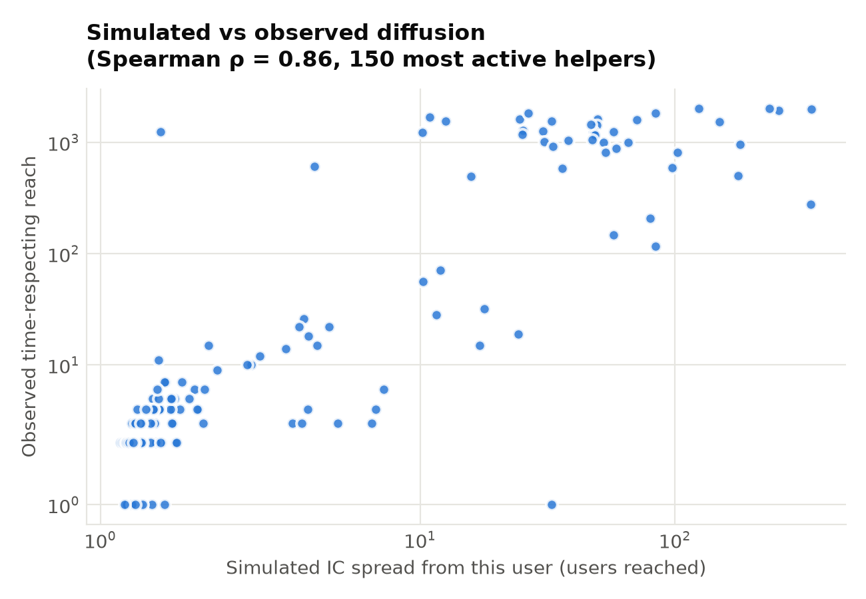
Simulating diffusion: who should seed knowledge?
Independent Cascade and Linear Threshold models, CELF influence maximisation
15% / 68%
ρ = 0.86
Simple rankings (ExpertiseRank, out-degree) are almost as good as CELF, so platforms can find key spreaders cheaply
of users reached by 10 seeds (IC / LT) vs < 1% for random seeds
simulated vs observed time-respecting reach
10
Notes:
I simulated diffusion from different seed sets. CELF greedy is the textbook optimiser, but in such a centralised network simple rankings do almost as well. Importantly, I validated the simulation: each user's simulated spread correlates 0.86 with how far their help actually travelled over time.

Slide 11
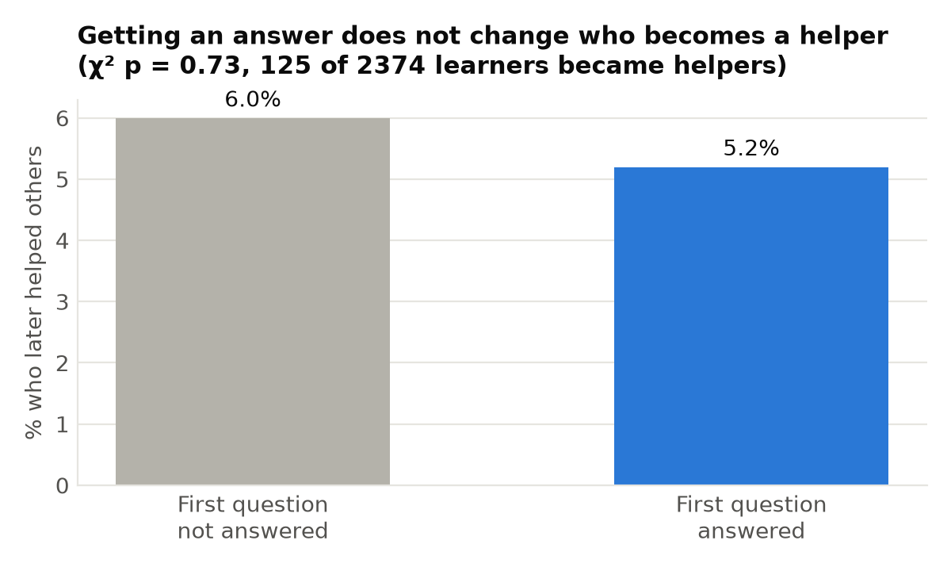
An honest negative result
Do learners who get help go on to help others?
125 of 2,374 learners (5.3%) later answered someone else
Getting an answer made no significant difference (χ² p = 0.73)
An early version showed a strong effect, but it came from counting self-answers as help
Validation caught 3 bugs that had produced impressive but false results
Lesson: check every result against a second source before believing it
11
Notes:
I want to show one negative result. Getting your first question answered does not make you more likely to become a helper. An earlier version of my code said it did, but that was a bug. Catching it through validation is part of doing data science properly.

Slide 12
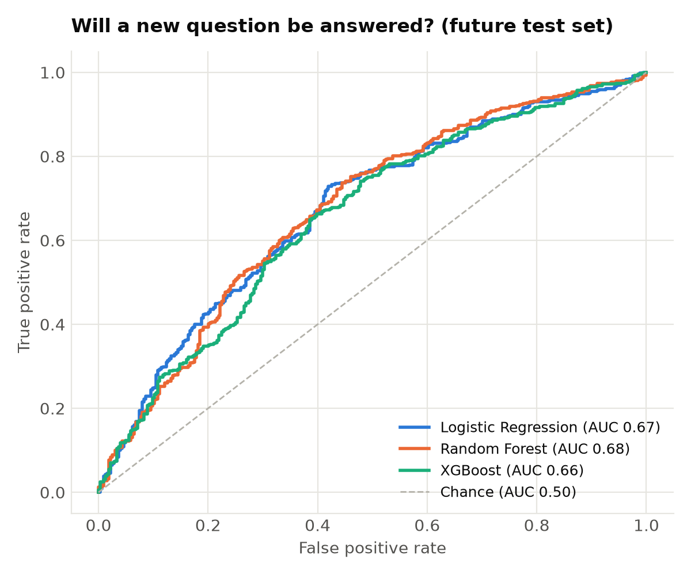
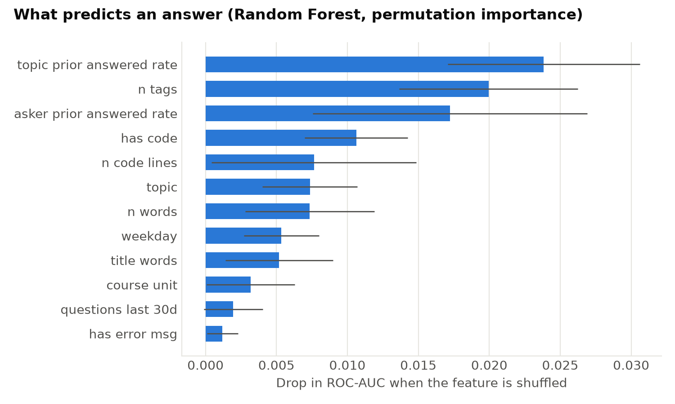
Will a new question get answered?
Leakage-free features · trained on the past 3,168 questions, tested on the newest 792
0.675
Tips for learners: use full tags and include your code
ROC-AUC, Random Forest (baseline 0.500)
12
Notes:
Only information available when the question is posted is used, and I split by time, which is how the model would be used in practice. The best model is a Random Forest at 0.675 ROC-AUC, in line with published work. The top features give practical advice: tag properly and include code.

Slide 13
Expert finder: who can answer this?
Content similarity + authority + recency, evaluated on future questions
81%
of future questions have a real answerer in the top 10 (popularity baseline: 70%)
1
Content
similar past questions they answered
2
Authority
how much they help overall
3
Recency
still active? experts leave
13
Notes:
For a new question, the system finds similar past questions by meaning and scores the people who answered them, then adds authority and recency. Hit at 10 means a person who really answered the question appears in the top 10. The hybrid reaches 81%.

Slide 14
Interactive dashboard
Streamlit app backed by PostgreSQL: live demo
1
Overview
Key numbers and findings
2
Topics
Topic map, difficulty, trends
Tech stack
Python · PostgreSQL · pgAdmin · SQLAlchemy · sentence-transformers · BERTopic · UMAP · HDBSCAN · NLTK · NetworkX · scikit-learn · XGBoost · Plotly · PyVis · Streamlit
3
Knowledge network
Drag-and-zoom graph, top experts
4
Diffusion
Exposure test, adoption curves, seeding
5
Answer prediction
Check your question: chance + tips
6
Expert finder
Type a problem, get experts
7
Database
Run SQL queries on PostgreSQL
14
Notes:
Now a short live demo. [Open the dashboard: show Overview, the topic map, the network graph, then type a question into Check your question and Expert finder, and finally run a SQL query on the Database page.]

Slide 15
Key insights and recommendations
1
Support the hardest units
Tideman and web development need walkthroughs and office hours
2
Protect the core experts
The top 1% give 81% of help: recognise them and spread the load
3
Encourage peer learning in advanced units
That is where social exposure matters
4
Route questions to the right people
The expert finder reaches 81% Hit@10
5
Coach learners to ask well
Full tags and code raise the chance of an answer
15
Notes:
These are the five takeaways, each backed by a result in the project.

Slide 16
Limitations and future work
Limitations
Future work
Sample: 4,000 newest questions; older history is missing
Readers who never post are invisible
The shuffle test supports influence but cannot prove causation
IC/LT parameters are standard values, not fitted ones
Compare several communities (Data Science, Statistics)
LLM-generated topic names and confusion summaries
Fit diffusion parameters from real cascades
Live expert routing, then measure its effect on answer rates
Dropout prediction from network position
16
Notes:
Every study has limits; these are mine, and each suggests a natural next step.

Slide 17
Thank you
Questions?
Code, data and dashboard: github.com/prateekchau25-del/learning-community-analytics
Notes:
Thank you. I'm happy to take questions, or show any part of the dashboard in more detail.

