Slide 1
Design aspects of Li-ion battery for electric vehicles
Under the Supervision of
Dr. B. Pattabhi Ramaiah
Submitted by
Prateek Gandhi
MTech, Mechanical Systems Design
IIT Bhubaneswar
02-12-2021

Slide 2
Objectives
To estimate the SOC dependent mechanical properties of cathode materials will be estimated through molecular dynamics simulations using a Large-scale Atomic/Molecular Massively Parallel Simulator (LAMMPS) since in the presence of high capacity electrodes, lithiation and delithiation are some of the main factors responsible for the short life span of Lithium-based batteries.
Study the performance of the battery, considering the real-time operating conditions like temperature, humidity, to name a few.
02-12-2021
Notes:
In the presence of high capacity electrodes, Lithiation and delithiation are one of the main factors responsible for the short life span of Lithium-based batteries. The SOC dependent mechanical properties of cathode materials as well as crack simulation will be estimated through molecular dynamics simulations using Large-scale Atomic/Molecular Massively Parallel Simulator (LAMMPS).

Slide 3
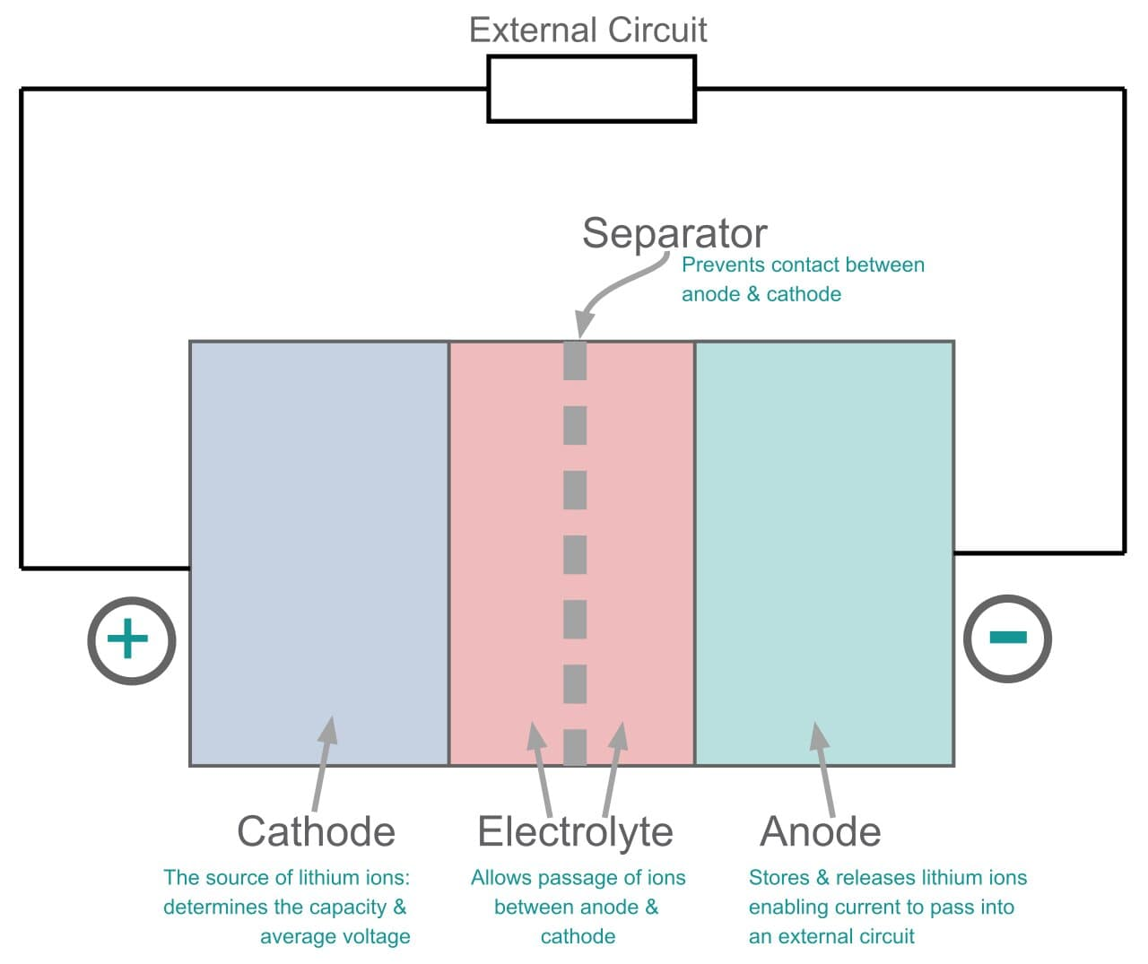
Working of a battery
When the battery is fully charged, lithium exists in between the carbon layers of the graphite. When the battery is discharged, the lithium becomes a lithium ion and an electron the lithium ions can travel through the electrolyte towards the cathode however the electrons have to go around an external circuit where useful electrical work can be extracted.
At the cathode the lithium ions and electrons recombine and go into the layers of the transition metal oxide in a process called intercalation.
When charging the battery the opposite reaction occurs, moving the lithium back into the anode.
This back and forth motion coins the term “rocking chair mechanism” which represents how a lithium-ion battery works.
Figure: A schematic of a conventional battery^{[6]}
[6] https://www.electronics-notes.com/articles/electronic_components/battery-technology/li-ion-lithium-ion-technology.php
02-12-2021

Slide 4
Molecular dynamics modeling of Li_{x}Mn₂O₄
Spinel LiMn₂O₄ is one of the most attractive energy storage materials due to its low cost and reversible and fast intercalation and deintercalation of Li ions.[8]
The LiMn₂O₄ spinel structure (space-group: Fd3m), consists of oxygen ions close-packed array occupy the 32e position, Mn ions occupy the octahedral site 16d, and Li+ occupies the tetrahedral 8a site.
[8] Mohamed, Nourhan, and Nageh K. Allam. "Recent advances in the design of cathode materials for Li-ion batteries." RSC Advances 10, no. 37 (2020): 21662-21685.
02-12-2021

Slide 5
Molecular dynamics modeling of Li_{x}Mn₂O₄
All ions of LMO unit cell are in a cubical structure in the Fd3m space group. [8]
Using the data, the unit cell of LMO was made using VESTA (short for Visualisation for Electronic Structural Analysis). A 3D visualization programme for structural models, volumetric data such as electron/nuclear densities, and crystal morphologies.
Space Group: F d -3 m
a = 8.24500 Å α = 90.0000°
b = 8.24500 Å β = 90.0000°
c = 8.24500 Å γ = 90.0000°
V = 560.4953 Å³
[8] Mohamed, Nourhan, and Nageh K. Allam. "Recent advances in the design of cathode materials for Li-ion batteries." RSC Advances 10, no. 37 (2020): 21662-21685.
02-12-2021

Slide 6
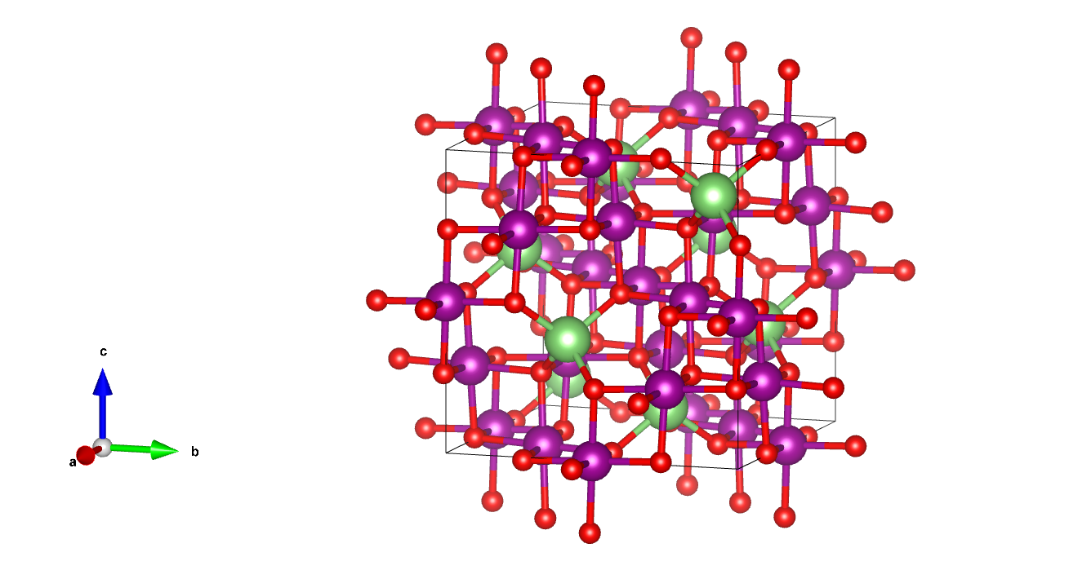
Cell structure of LMO
Figure: Cell structure of LMO made using “VESTA”
02-12-2021

Slide 7
Steps: To calculate Elasticity of LMO as a function of SOC using LAMMPS
To investigate the SOC-dependent mechanical property like Young’s Modulus of LiMn₂O₄, a series of room temperature uniaxial deformation MD simulations at 6(say) different SOC values (i.e., x = 1(fully discharged), 0.625, 0.5, 0.375, 0.25, and 0(fully charged)) and at various strain rates needs to be performed.
Strain rates correspond to different operational C-rates in Li-ion batteries. [9]
To evaluate the stress–strain relationship we use an atomic-level stress tensor in the form of the virial stress. That is expressed as follows:
02-12-2021
[9] Asadi, Ali, Seyed Foad Aghamiri, and Mohammad Reza Talaie. "Molecular dynamics simulation of a Li x Mn 2 O 4 spinel cathode material in Li-ion batteries." RSC Advances 6, no. 116 (2016): 115354-115363.

Slide 8
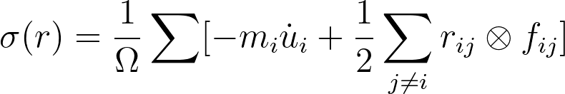
Next steps: To calculate SOC dependent mechanical properties of LMO using LAMMPS
where i and j are the atomic indices, Ω is the total volume, m_{i} is the mass of atom i, is the displacement vector of atom i relative to a reference position, r_{ij} = r_{i} − r_{j}, and f_{ij} is the interatomic force applied on atom i by atom j.
02-12-2021
[9] Asadi, Ali, Seyed Foad Aghamiri, and Mohammad Reza Talaie. "Molecular dynamics simulation of a Li x Mn 2 O 4 spinel cathode material in Li-ion batteries." RSC Advances 6, no. 116 (2016): 115354-115363.

Slide 9
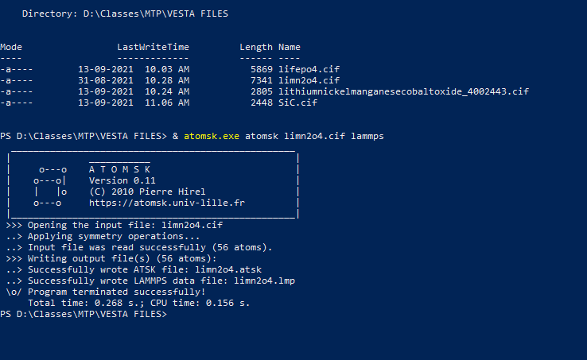
Conversion of the structure to a LAMMPS datafile using Atomsk
Image: Converting the cell structure to LAMMPS datafile.
02-12-2021

Slide 10
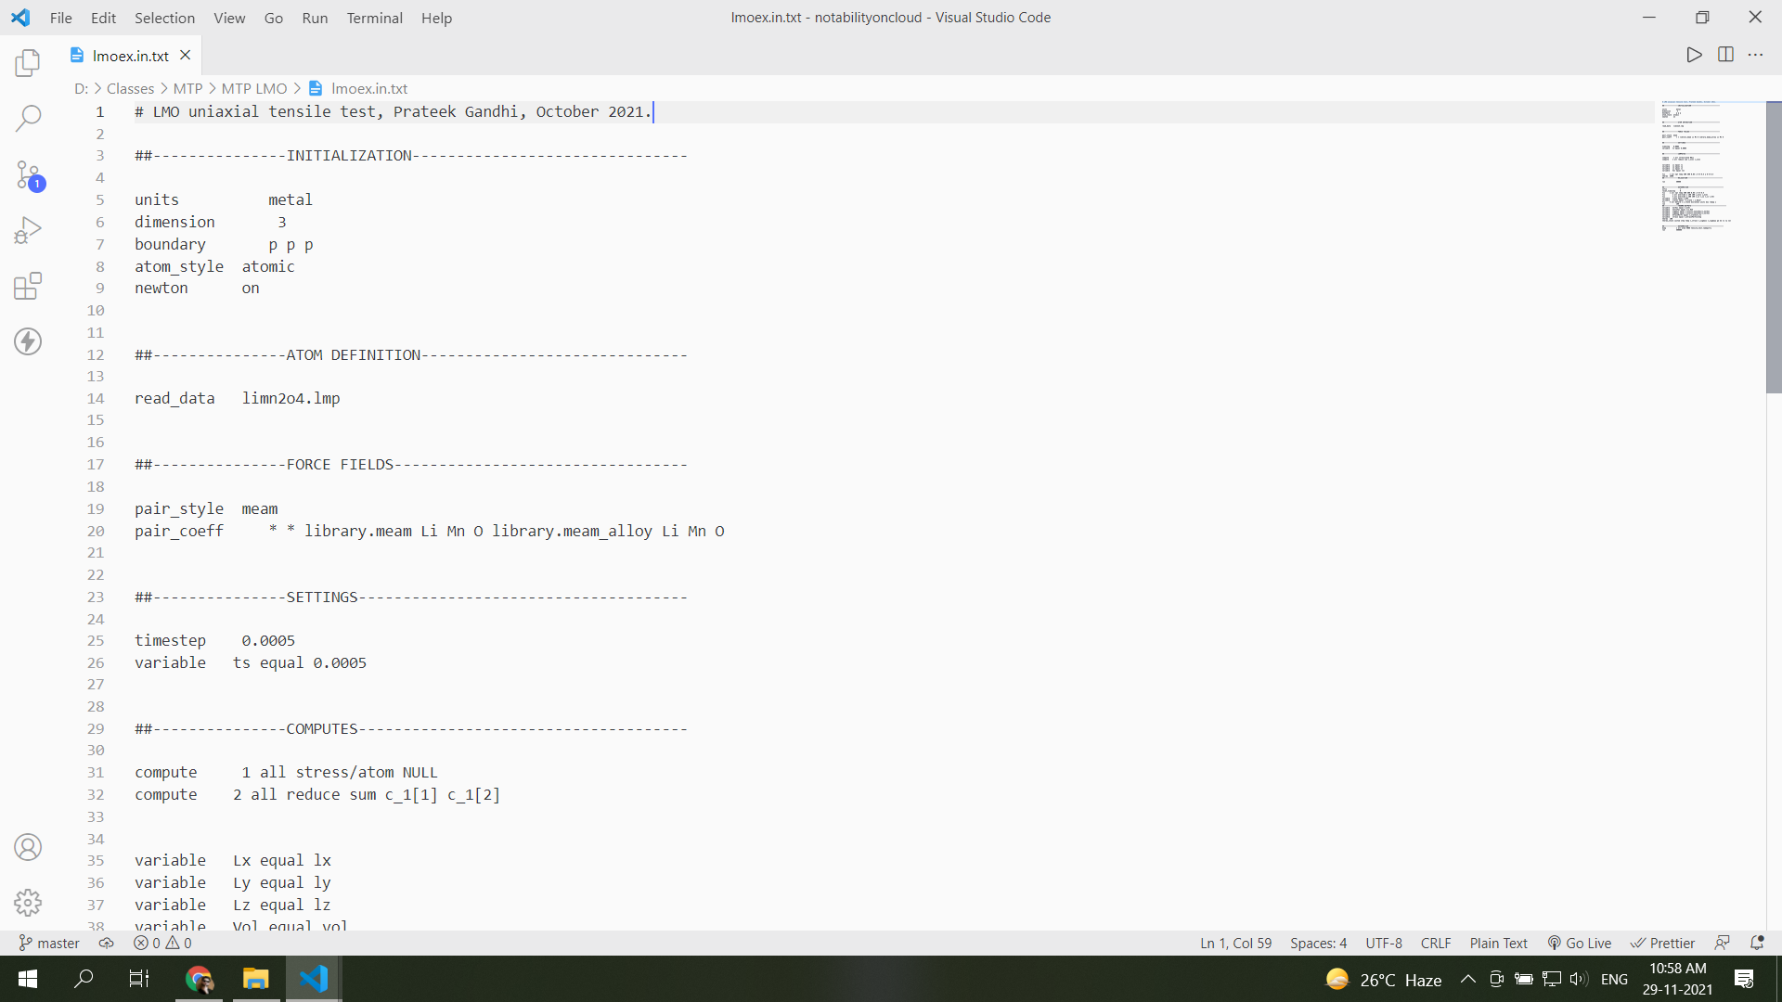
Input script for LAMMPS
Image: LAMMPS input script.
02-12-2021
02-12-2021

Slide 11
Input script for LAMMPS
Image: LAMMPS input script.
02-12-2021
02-12-2021

Slide 12
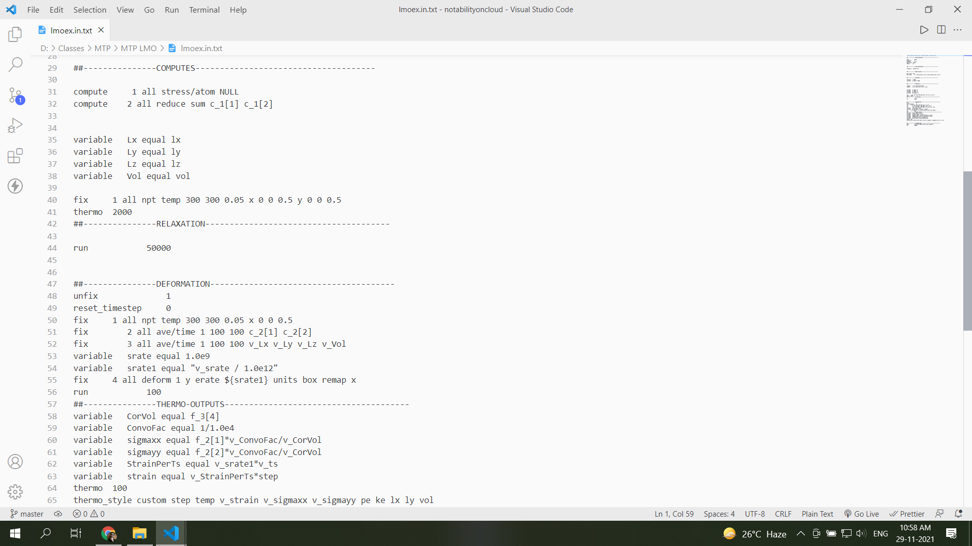
Input script for LAMMPS
Image: LAMMPS input script.
02-12-2021
02-12-2021

Slide 13
Input script for LAMMPS
Image: LAMMPS input script.
02-12-2021
02-12-2021

Slide 14
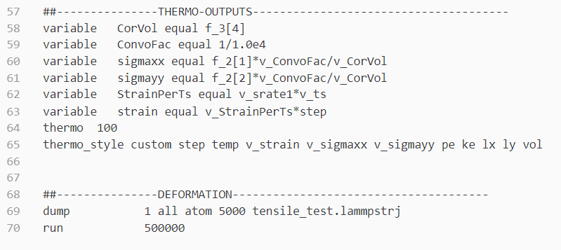
Input script for LAMMPS
Image: LAMMPS input script.
02-12-2021
02-12-2021

Slide 15
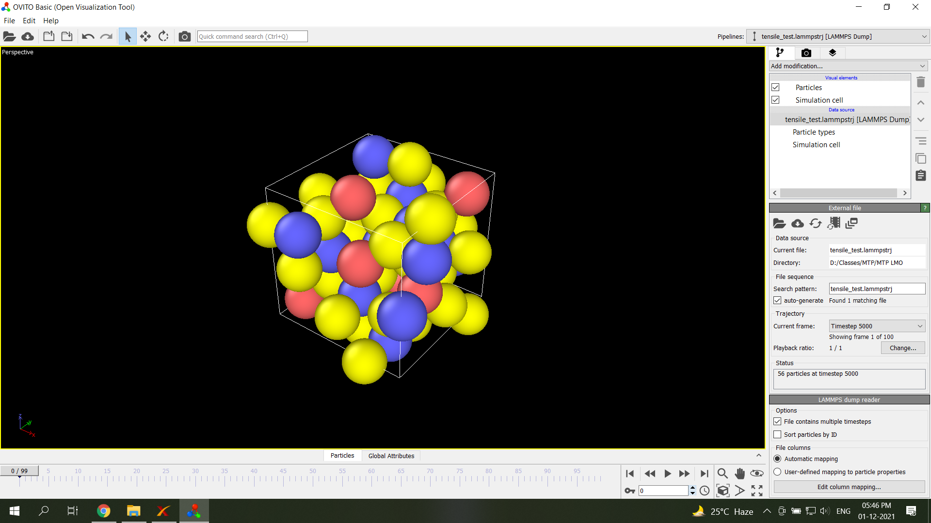
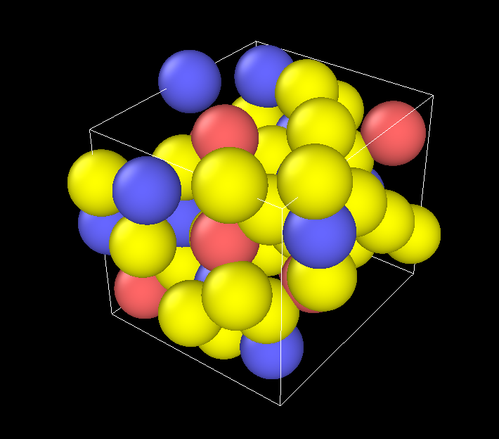
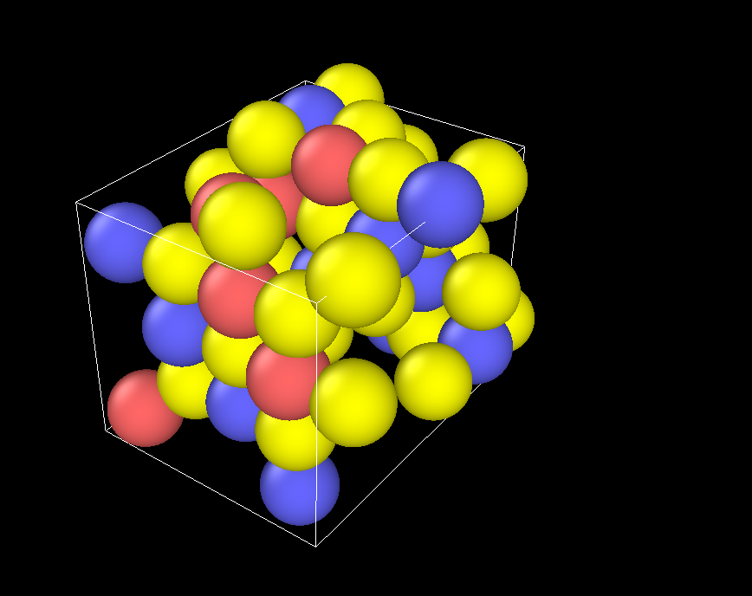
Structure Deformation in OVITO
Figure: (a)
Figure: (b)
Figure: (c)
02-12-2021
Image: (a) Cell structure at 0/99 frame, (b) at 47/99 frame, (c) at 99th frame
02-12-2021

Slide 16
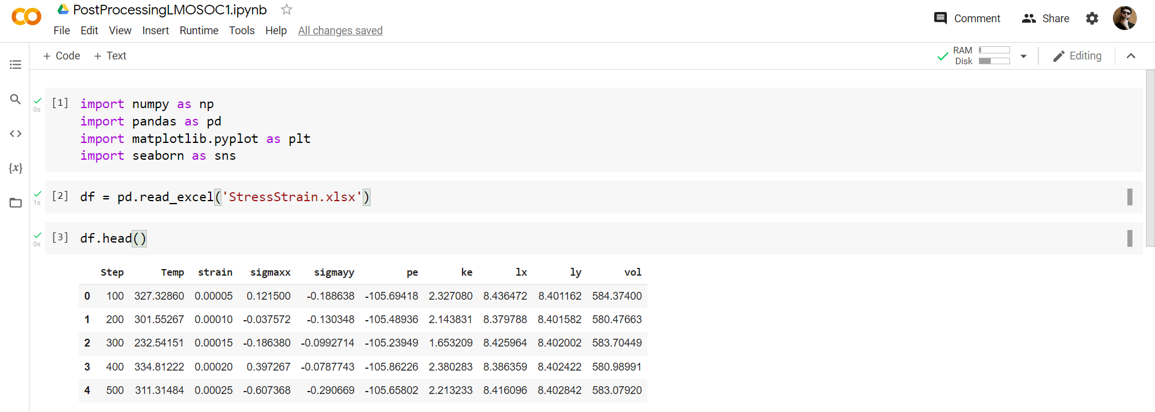
Post processing of the data
Image: Post processing of the data using Python.
02-12-2021

Slide 17
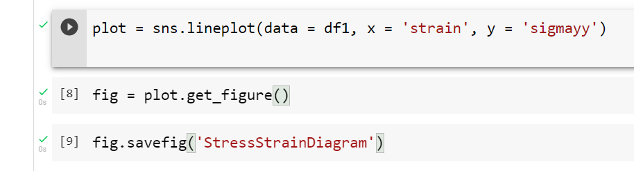
Post processing of the data
Image: Post processing of the data using Python.
02-12-2021

Slide 18
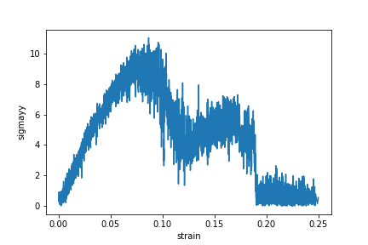
Stress-Strain Diagram
σ_{yy} is in GPa
Figure: Stress - Strain curve for LMO under uniaxial tensile loading.
02-12-2021

Slide 19
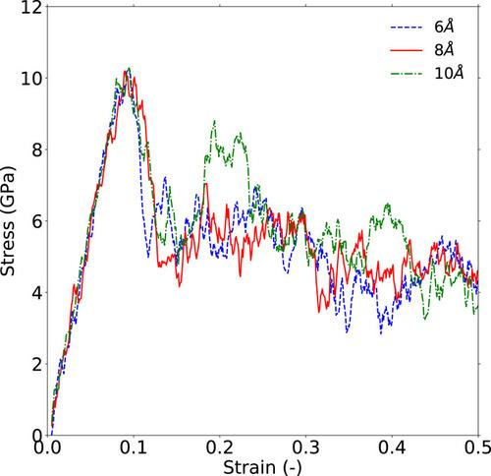
Stress-Strain Diagram
Figure: Stress - Strain curve for LMO under uniaxial tensile loading.^{[9]}
02-12-2021
[9] Asadi, Ali, Seyed Foad Aghamiri, and Mohammad Reza Talaie. "Molecular dynamics simulation of a Li x Mn 2 O 4 spinel cathode material in Li-ion batteries." RSC Advances 6, no. 116 (2016): 115354-115363.

Slide 20
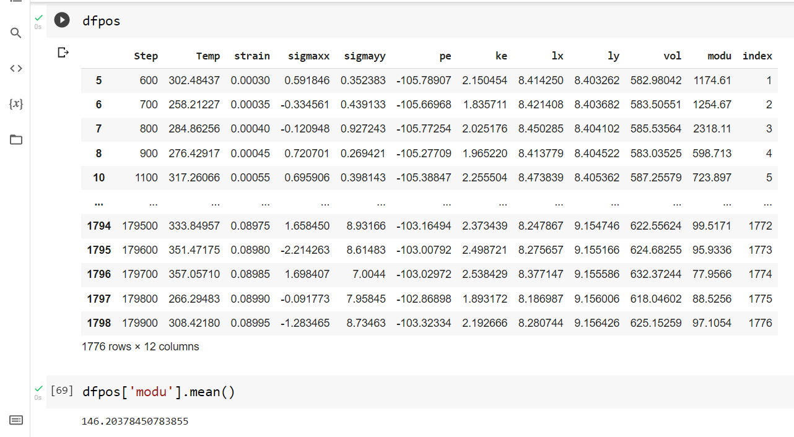
Young’s Modulus
Image: Post processing of the data using Python.
02-12-2021

Slide 21
Conclusion and next steps
Therefore, the Young’s Modulus comes out to be around 146 GPa at SOC = 1.
Result matches with the results reported in the literature.[9]
To make the cell structure at different SOC values by varying the Lithium atoms present in the structure.
To perform the uniaxial tensile test simulations using LAMMPS at different strain rates.
To calculate the Elasticity and understand its behaviour as a function of SOC and strain rates.
To estimate the corresponding power output.
To understand the power characteristics in the presence of defects.
02-12-2021
[9] Asadi, Ali, Seyed Foad Aghamiri, and Mohammad Reza Talaie. "Molecular dynamics simulation of a Li x Mn 2 O 4 spinel cathode material in Li-ion batteries." RSC Advances 6, no. 116 (2016): 115354-115363.

Slide 22
References
[1] https://www.citroen.in/
[2] https://www.massnetcomms.org/software-to-simplify-solar-farm-design/
[3] https://www.ga-asi.com/remotely-piloted-aircraft/mq-9a
[4] https://www.apple.com/in/
[5] https://batteryuniversity.com/article/bu-301a-types-of-battery-cells
[6] https://www.electronics-notes.com/articles/electronic_components/battery-technology/li-ion-lithium-ion-technology.php
02-12-2021

Slide 23
References
[7] Salgado, Rui Martim, Federico Danzi, Joana Espain Oliveira, Anter El-Azab, Pedro Ponces Camanho, and Maria Helena Braga. "The Latest Trends in Electric Vehicles Batteries." Molecules 26, no. 11 (2021): 3188.
[8] Mohamed, Nourhan, and Nageh K. Allam. "Recent advances in the design of cathode materials for Li-ion batteries." RSC Advances 10, no. 37 (2020): 21662-21685.
[9] Asadi, Ali, Seyed Foad Aghamiri, and Mohammad Reza Talaie. "Molecular dynamics simulation of a Li x Mn 2 O 4 spinel cathode material in Li-ion batteries." RSC Advances 6, no. 116 (2016): 115354-115363.
[10] Warner, John T. The handbook of lithium-ion battery pack design: chemistry, components, types and terminology. Elsevier, 2015.
[11] Masias, Alvaro, James Marcicki, and William A. Paxton. "Opportunities and challenges of lithium ion batteries in automotive applications." ACS Energy Letters 6, no. 2 (2021): 621-630.
02-12-2021

Slide 24
References
[12] Miao, Yu, Patrick Hynan, Annette Von Jouanne, and Alexandre Yokochi. "Current Li-ion battery technologies in electric vehicles and opportunities for advancements." Energies 12, no. 6 (2019): 1074.
[13] Bandhauer, Todd M., Srinivas Garimella, and Thomas F. Fuller. "A critical review of thermal issues in lithium-ion batteries." Journal of the Electrochemical Society 158, no. 3 (2011): R1.
[14] Wu, Xiangkun, Kaifang Song, Xiaoyan Zhang, Naifang Hu, Liyuan Li, Wenjie Li, Lan Zhang, and Haitao Zhang. "Safety issues in lithium ion batteries: Materials and cell design." Frontiers in Energy Research 7 (2019): 65.
[15] Stukowski, Alexander. "Visualization and analysis of atomistic simulation data with OVITO–the Open Visualization Tool." Modelling and Simulation in Materials Science and Engineering 18, no. 1 (2009): 015012.
02-12-2021

Slide 25
References
[16] Atomic, Large-scale, and Molecular Massively Parallel Simulator. "Lammps." available at: http:/lammps. sandia. gov (2013).
[17] Momma, Koichi, and Fujio Izumi. "VESTA 3 for three-dimensional visualization of crystal, volumetric and morphology data." Journal of applied crystallography 44, no. 6 (2011): 1272-1276.
[18] Rossouw, M. H., A. De Kock, L. A. De Picciotto, M. M. Thackeray, W. I. F. David, and R. M. Ibberson. "Structural aspects of lithium-manganese-oxide electrodes for rechargeable lithium batteries." Materials research bulletin 25, no. 2 (1990): 173-182.
[19] Hirel, Pierre. "Atomsk: A tool for manipulating and converting atomic data files." Computer Physics Communications 197 (2015): 212-219.
02-12-2021

Slide 26
Thank you.

