Slide 1
INVESTMENT ASSIGNMENT SUBMISSION
Name: Prateek Pande

Slide 2
<Abstract>

Slide 3
<Problem solving methodology>
Use flow chart

Slide 4
<Analysis>

Slide 5
<Analysis>

Slide 6
<Analysis>

Slide 7
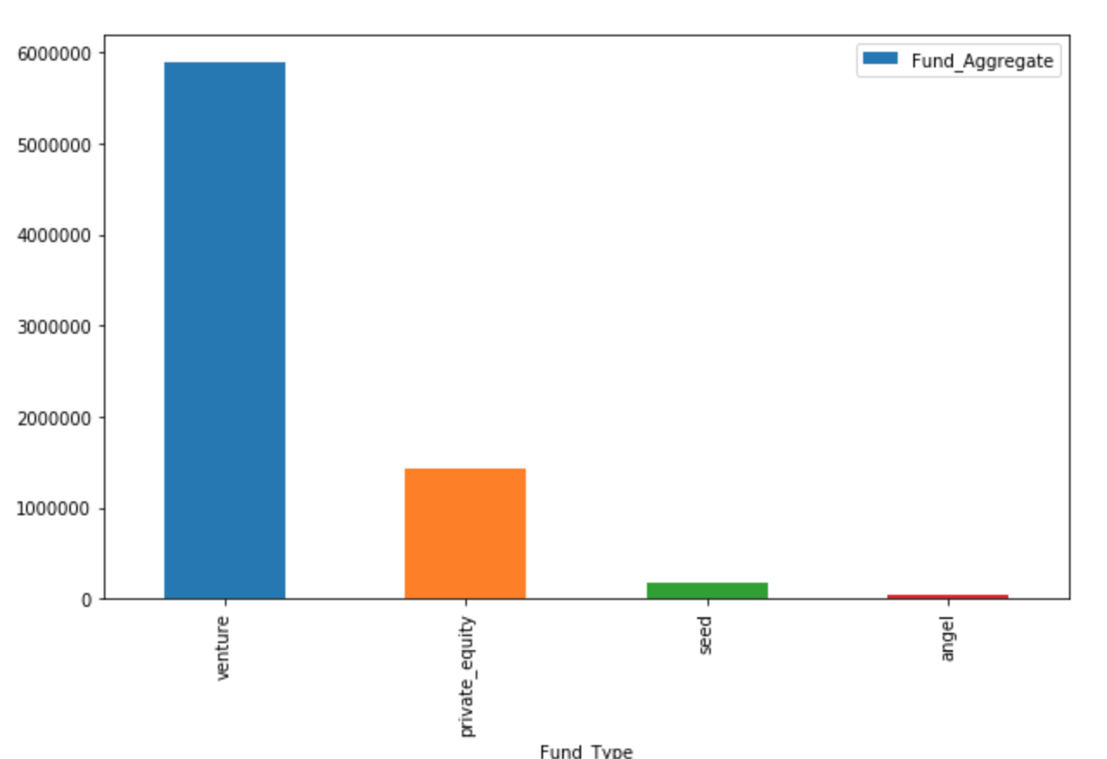
A plot showing the fraction of total investments (globally) in venture, seed, angel, and private equity, and the average amount of investment in each funding type.
Plot 1

Slide 8
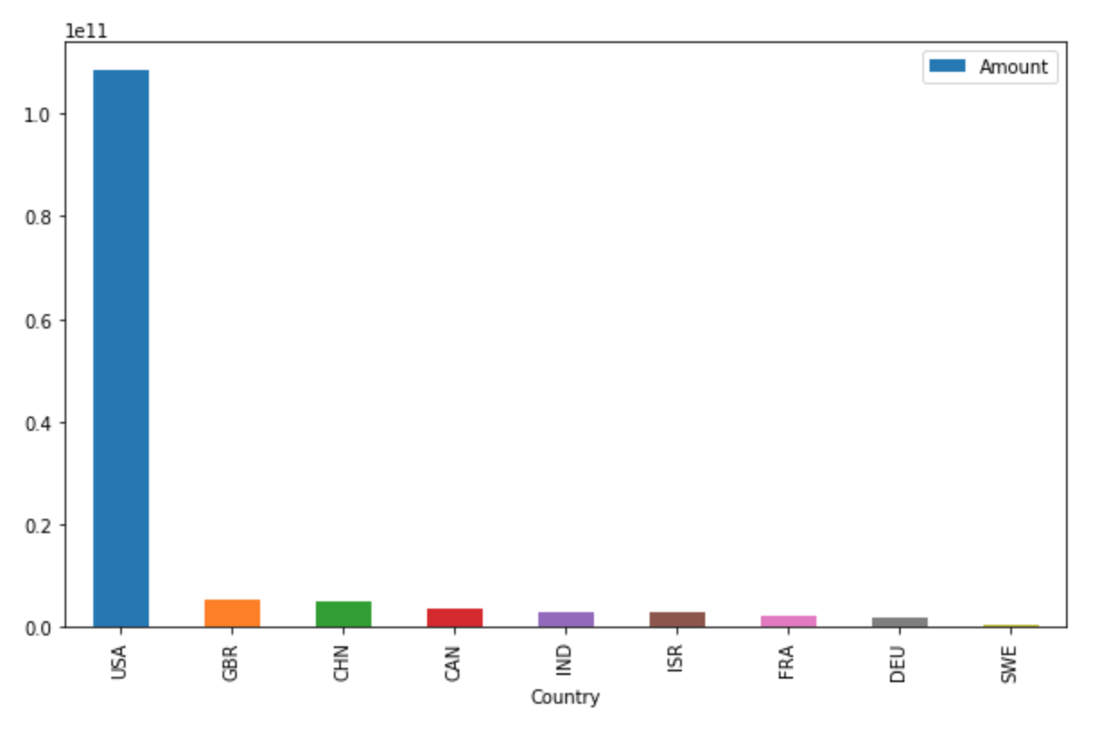
A plot showing the top 9 countries against the total amount of investments of funding type FT.
Plot 2

Slide 9
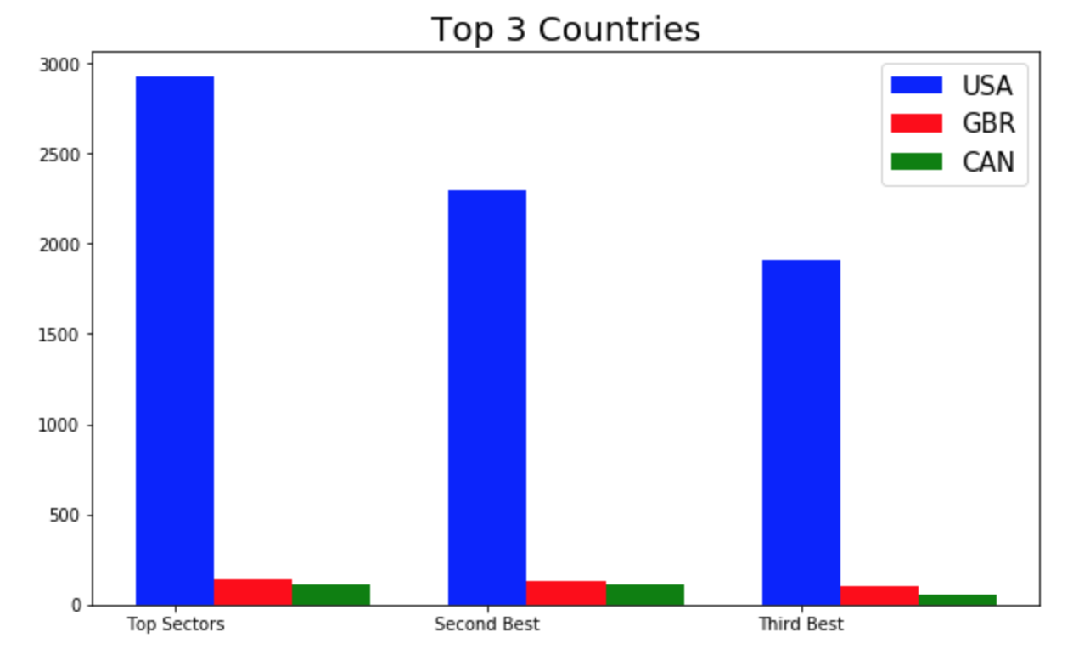
A plot showing the number of investments in the top 3 sectors of the top 3 English speaking countries on one chart
Plot 3

Slide 10
<Conclusions>

