Slide 1


Prepayment Risk Analysis of
Mortgage Backed-Securities
Presented By-
Prateek Jain
Under Guidance of- Mr. Yasin Shah (CEO)

Slide 2
Project Objective
The objective of this project was to analyze and assess the prepayment risk associated with mortgage-backed securities using a dataset provided by Freddie Mac. The goal was to identify trends, patterns, and risk factors that could influence prepayment behaviors, thereby providing actionable insights for financial decision-making. By conducting thorough data preprocessing, creating a detailed Power BI dashboard, and developing DAX queries, the project aimed to deliver a comprehensive analysis that supports risk management strategies and enhances the understanding of prepayment dynamics in the mortgage market.

Slide 3
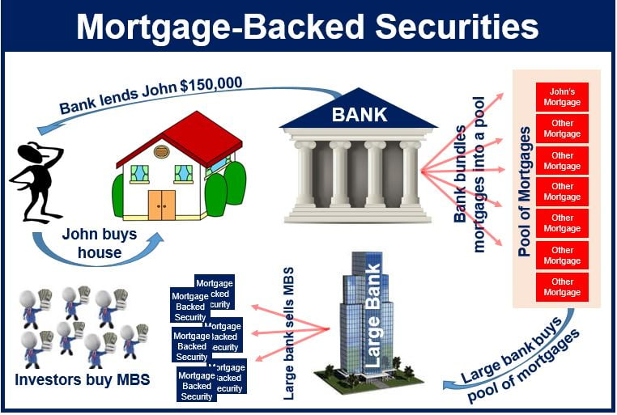
Mortgage-Backed Securities (MBS)
1
Bundle of Home Loans
A mortgage-backed security (MBS) is an investment similar to a bond that is made up of a bundle of home loans bought from the banks that issued them.
2
Discounted Rate
In this system, the loans issued by the bank is in turn sold to investors at a discounted rate to free up the bank funds.
3
Grouped Loans
These loans are sold in the form of bonds by investment banks wherein loans are grouped together according to their type and quality.
4
Investor Safety
For the investor, an MBS is as safe as the mortgage loans that back it up.

Slide 4


Prepayment Risk
Premature Principal Return
Prepayment risk is the risk involved with the premature return of principal on a fixed-income security. When debtors return part of the principal early, they do not have to make interest payments on that part of the principal.
Loss of Interest Income
This means that if the loan issuer prepays the loan, the investors will stop receiving interest on those bonds.
Importance of Evaluation
Hence, it is important to evaluate the prepayment risk on the MBS.

Slide 5


Data
Source
Freddie Mac official portal for home loans
Size
291451 x 28
Data Points
291451
Columns
28

Slide 6

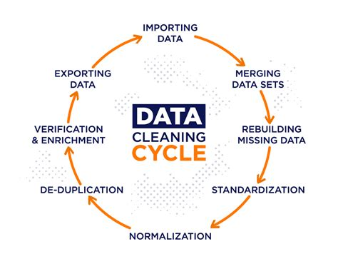
Data Cleaning And Preprocessing
1
Null Value Removal
In this step, the data is primarily cleaned first. This means that the rows with null values are removed, the unwanted columns are dropped from the dataset so that we are able to process the data better.
2
Data Encoding
It also involves data encoding of some of the columns like 'IsFirstTiime'.
3
New Categorical Columns
New categorical columns such as 'CreditRange', 'LTV_range', and 'Repay_range' are created.

Slide 7
Data Modelling And Dashboard Design
KPIs and Visualizations
DAX Queries
DTI Group
The processed and cleaned data is then exported to power bi to create KPIs and visualizations.
New measures for 'Prepayment Rate', 'Delinquency Rate', 'Average Months Delinquent' and 'Total Number of Loans' are created using DAX queries.
New Group for DTI having categories High, Medium and Low is created using DAX query.

Slide 8
Dax Queries
Delinquency Rate
VAR NumDelinquentLoans = CALCULATE(COUNTROWS('LoanExport(Cleaned)'), 'LoanExport(Cleaned)'[EverDelinquent] = 1) VAR TotalLoans = COUNTROWS('LoanExport(Cleaned)') RETURN DIVIDE(NumDelinquentLoans, TotalLoans, 0) * 100
Prepayment Rate
VAR NumPrepaidLoans = CALCULATE(COUNTROWS('LoanExport(Cleaned)'), 'LoanExport(Cleaned)'[MonthsInRepayment] = 1) VAR TotalLoans = COUNTROWS('LoanExport(Cleaned)') RETURN DIVIDE(NumPrepaidLoans, TotalLoans, 0) * 100
Average Months Delinquent
AVERAGE('LoanExport(Cleaned)'[MonthsDelinquent])
Total Number of Loans
COUNTROWS(DISTINCT('LoanExport(Cleaned)'[LoanSeqNum]))
DTI(Group)
IF( [DTI] <= 10, "Low", IF( [DTI] <= 40, "Medium", "High"))

Slide 9
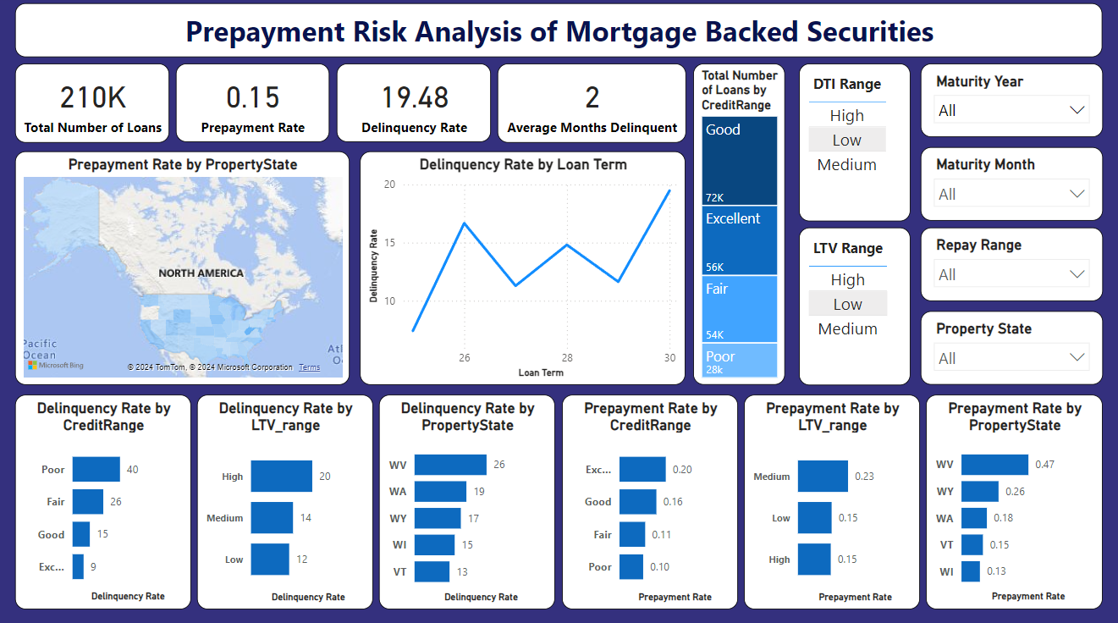

Slide 10




Project Insights
Credit Score 700-750
People having credit score of 700 to 750 have highest number of loans with 72k loans.
Credit Score Less Than 650
People having credit score of less than 650 have highest average delinquency rate of 40%.
Loan-to-Value Ratio 50-1000
People having loan-to-value ratio of 50 to 1000 have highest average delinquency rate of 20%.
West Virginia
West Virginia is having the highest average delinquency rate of 26% followed by Washington with 19% and Wyoming with 17%.

Slide 11


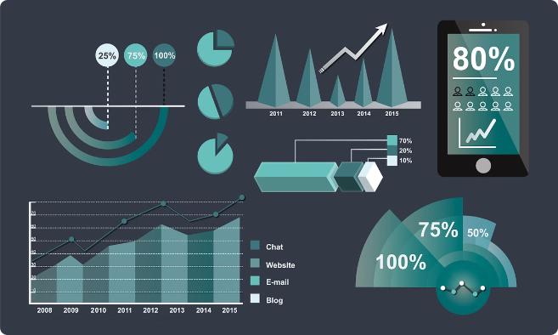
Project Insights
Credit Score 750-900
People having credit score of 750 to 900 have highest average prepayment rate of 0.2.
Loan-to-Value Ratio 25-50
People having loan-to-value ratio of 25 to 50 have highest average prepayment rate of 0.23.
West Virginia
West Virginia is having the highest average prepayment rate of 0.47 followed by Wyoming with 0.26 and Washington with 0.18.

Slide 12
Thank You

