Slide 1
Physician Drug Adoption Prediction
By
Prateek Jalgaonkar

Slide 2
Project Brief
One of the top 5 pharmaceutical companies, Axtratia, headquartered in the US, had launched Axtenna, a drug for the treatment of stage 1 chronic kidney disease, 2.5 years ago. However, some physicians are yet to prescribe it for the first time. A key client stakeholder has reached out to a Decision Sciences Principal in Axtria for help to identify potential physicians who are most likely to start prescribing the drug in the next quarter in order to channelize the marketing efforts more effectively while targeting potential physicians.
Objective:
To create a model that identifies the prospective physicians who have high likelihood to start prescribing the drug in 11th quarter for the first time. We will be using input data files to perform any exploratory data analysis, feature engineering, and to develop a model.

Slide 3
Flow Chart of the Approach
Start
Creation of master modelling data
Exploratory Data Analysis
Data Preprocessing
Building and Validating model
Making predictions and deriving insights
End

Slide 4
STEP 1- Importing and Merging Data
The training set provided consisted of two data set-
The first consisted of Physician Details, like age, tenure, specialization.
The second dataset consisted of Physician activity like total representative visits, seminar attended, brand prescribed etc.
Creation of master data for modeling was a primary task in order to proceed further.
A master data was created under physician data frame with 100000 rows and 32 columns.

Slide 5
STEP 2- Data Cleaning and Pre Processing
The main aim of Data Cleaning is to identify and remove errors & duplicate data, in order to create a reliable dataset. This improves the quality of the training data for analytics and enables accurate decision-making
There were no. of anomalies in the data like missing values, unknown values in categorical data and presence of outliers.
There was a column physician_segment which had more than 50% of the missing data. Hence this needed to be discarded. Similarly there was this gender column which consisted of three attributes Male, Female and Unknown. This needed to be treated as well.
Checking for outliers resulted in cleaning a good amount of data, as there were number of columns with outliers present in our data set lik: total_representative_visits','total_sample_dropped','saving_cards_dropped','vouchers_dropped','total_seminar_as_attendee’, 'total_seminar_as_speaker’ to name a few
In the data preprocessing, number of derived columns were created like physician_tenure was categorized into range. Year_Quarter column was split into year and quarters in order to ease the analysis and so on.
A number of columns were combined together to form one single total, in order to reduce correlation.
Data Exploration made us analyze that our classes are quite balanced with the ratio of no-prescription to prescription instances 6:5

Slide 6
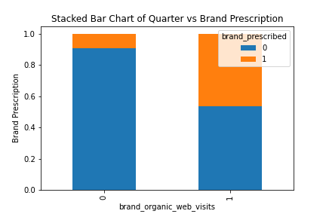
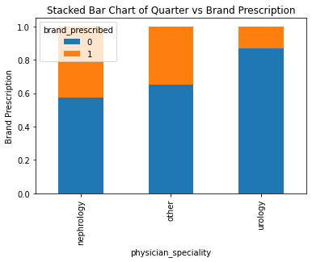
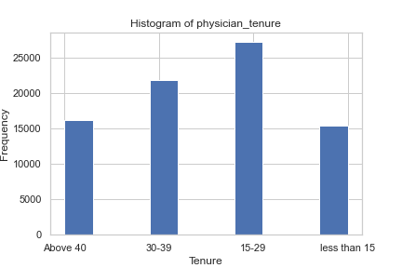
STEP 3- Data Visualization
Observation:
brand_organic_web_visits might be a good predictor of the outcome variable, as the physicians who are not doing brand_organic_web_visits are more likely to not prescribe the brand.
physician_speciality with nephrology prescribes more of the brand as compared to other specialists.
Most of the physician have their tenure between 15 to 29 years

Slide 7
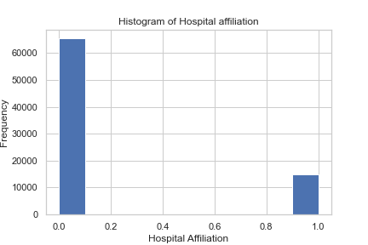
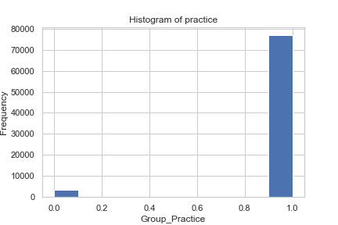
Data Visualization
Observation:
Maximum physician perform the practice in group.
Most of the physicians do not hold any hospital affiliation.

Slide 8
STEP 4- Building and Validating Models
After creating dummy variables and standardizing the variables we observed the correlation matrix and there were number of features which were highly in correlation which were then dropped as per the process.
The data set split in training and test set in a 7:3 ratio.
Feature selection was done on first 15 variables using RFE
Here we got all the variables below the p-value, which seemed quite good for the model.
Checked VIF for the variables, and drop the variable with highest VIF. This resulted in overall accuracy to increase by 0.01.
ROC curve was plotted and the area covered by ROC curve is 0.87

Slide 9
STEP 5- Making Predictions
Confusion matrix for the model:
[11005, 3653]
[ 1873, 7614]
1.Specificity = 0.75
2. Precision = 0.67
3. Recall = 0.80
Training Data Result
We found optimal cutoff point 4.3 which led our precision score: 0.71, recall score: 0.70, F1_score: 0.71 with an overall accuracy of train data to 0.77
Test Data Result:
Nearly same predictions were observed on test data set. The prediction file accuracy was observed to be 0.77 with F1_score of 0.73.

