Slide 1
LendingClub Case Study
@Prateek Kumar Jain
4th January 2022

Slide 2
Background
Lending Club provides loans to borrowers, but a lot of borrower's default, that is they do not return the loan amount with interest back to the lenders.
Such defaults results in the monetary loss for the businesses. Hence, the purpose of this case study is to identify some of the prominent factors which can help understanding borrowers who have higher probability of defaulting.
In this report, some of the factors have been analyzed and identified from the provided data and have been reported.
Time Period: From 2007 to 2011
For UPGRAD: MSC. In ML & AI Program

Slide 3
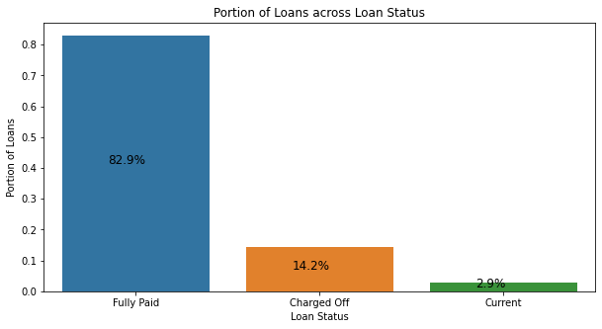
Executive Summary
About 14% of the loans have been Charged-Off
Loan amount ranges from $500 to $350,000
4.6% of the loans are not fully funded and only about 49% of the loans are fully funded by investors
Loans with 60 months tenure have more defaults (23% of 60 months tenure)
Loans with higher interest rates have chances of defaulting more
Lower Grade loans tends to get Charged-off more
A1 rated loans are the safest with default rate of only 3%
Borrowers having lower incomes, have high chance of default
About 29% of the borrowers with 2 bankruptcies, defaulted
26% of the borrowers who took loan for Small Business defaulted
Loans with higher utilization of revolving balance, observed more charged-offs
Time Period: From 2007 to 2011
For UPGRAD: MSC. In ML & AI Program

Slide 4
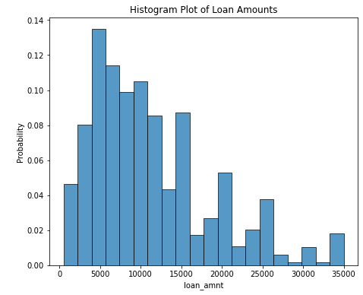
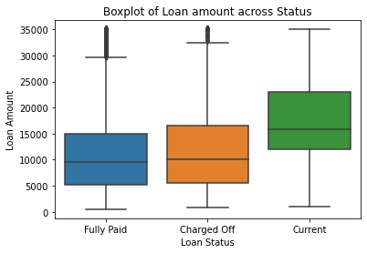
Current loans have higher applied loan amounts
Lowest loan amount is of $500, while maximum is $350,000
About 20% of the loans are of amount < $5,000
Current loans have the highest loan amount
Fully paid, borrowers have the lowest loan amount
Time Period: From 2007 to 2011
For UPGRAD: MSC. In ML & AI Program

Slide 5
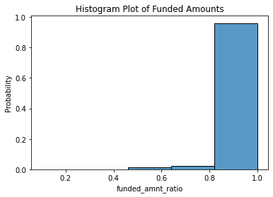
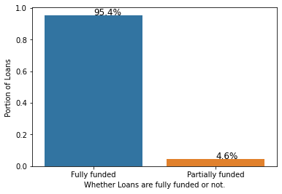
4.6% of the loans are partially funded
Calculation: Funded Loan Amount divided by Requested Loan Amount
Not all of the loans are fully funded
But majority of the loans are fully funded
Calculation: if Funded / Request Loan Amount = 1 Then Fully Funded, else partially Funded
4.6% of the Loans are partially funded
Time Period: From 2007 to 2011
For UPGRAD: MSC. In ML & AI Program

Slide 6
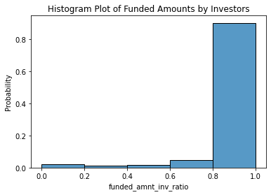
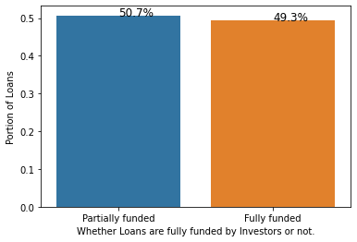
Only 49% of the loans are fully funded by Investors
Calculation: Investor Funded Loan Amount divided by Requested Loan Amount
There are loans which are not at all funded by investors
But majority of the loans are fully funded
Calculation: if Investor Funded / Request Loan Amount = 1 Then Fully Funded, else partially Funded
Less than 50% of the loans are Fully funded by Investors
Time Period: From 2007 to 2011
For UPGRAD: MSC. In ML & AI Program

Slide 7
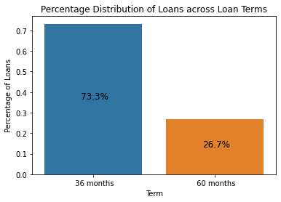
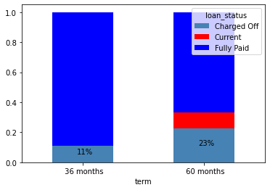
Longer tenure loans have more defaults
73% of the loans have 36 months term
While 27% have 60 months term
Loans having 36 months term have only 11% of the Charged-off borrowers
While 23% of the borrowers with 60 months have been Charged-off
Current Loans also have 60 months term and may default
Time Period: From 2007 to 2011
For UPGRAD: MSC. In ML & AI Program

Slide 8
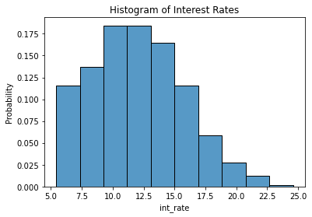
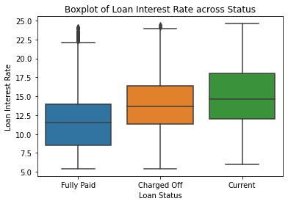
Loans with higher Interest rates have more chance of defaults
Highest number of loans have 10% to 20% Interest rate
Lowest number of Loans have over 20% interest rate
Charged-Off loans have 18% higher median interest rate than Fully Paid loans
Current Loans also have 27% higher median interest rate than Fully paid and may default
Time Period: From 2007 to 2011
For UPGRAD: MSC. In ML & AI Program

Slide 9
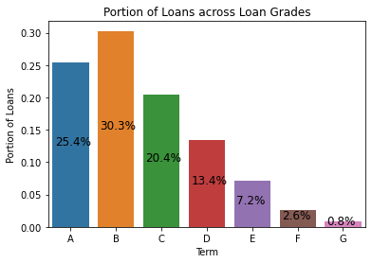
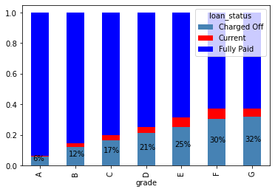
Lower the Grades, higher the chance of default
30% of the loans have Grade B rating
23% of the loans have Grade D or lower rating
Lower the loan rating, higher percentage of loans are Charged-Off
Only 6% of the loans were Charged-Off for loans with Grade A rating
Time Period: From 2007 to 2011
For UPGRAD: MSC. In ML & AI Program

Slide 10
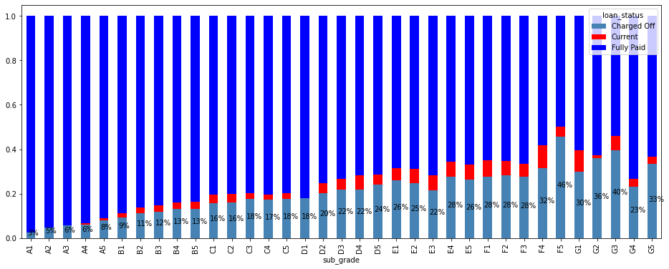
A1 rated loans are the safest with default rate of only 3%
A1 rated loans have the lowest rate of default that is only 3%
Lower Grade loans have much higher rate of default
Time Period: From 2007 to 2011
For UPGRAD: MSC. In ML & AI Program

Slide 11
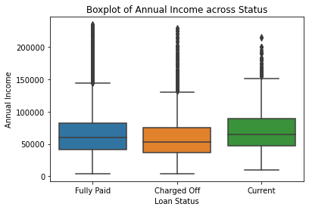
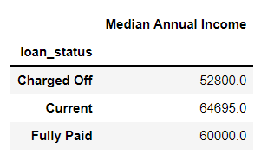
Borrowers with lower incomes have higher chance of defaulting
Borrowers who had defaulted have 12% lower median annual income as compared to Fully-Paid borrowers
Borrowers with on going loans have 7% higher median income than Fully-paid and hence, may not default
Time Period: From 2007 to 2011
For UPGRAD: MSC. In ML & AI Program

Slide 12
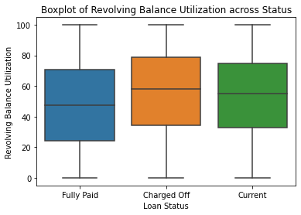
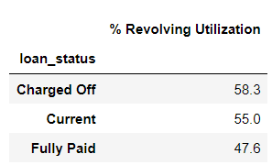
Borrowers having higher Revolving utilization, default more
Borrowers who had defaulted have 5% higher median revolving utilization as compared to Fully-Paid borrowers
Borrowers with on going loans have 12% lower median revolving utilization than Fully-paid and hence, may not default
Time Period: From 2007 to 2011
For UPGRAD: MSC. In ML & AI Program

Slide 13
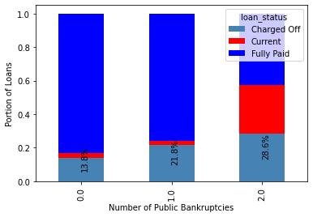
Borrowers having more bankruptcies, default more
Borrowers with no public bankruptcies, have lower percentage of Charged-off loans (14%), While 29% of the borrowers with 2 bankruptcies defaulted
A lot of current borrowers have 2 bankruptcies and hence may default
Time Period: From 2007 to 2011
For UPGRAD: MSC. In ML & AI Program

Slide 14
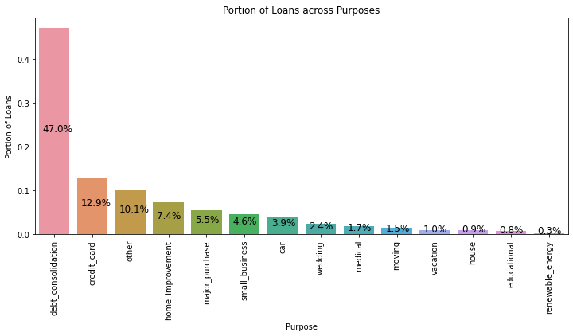
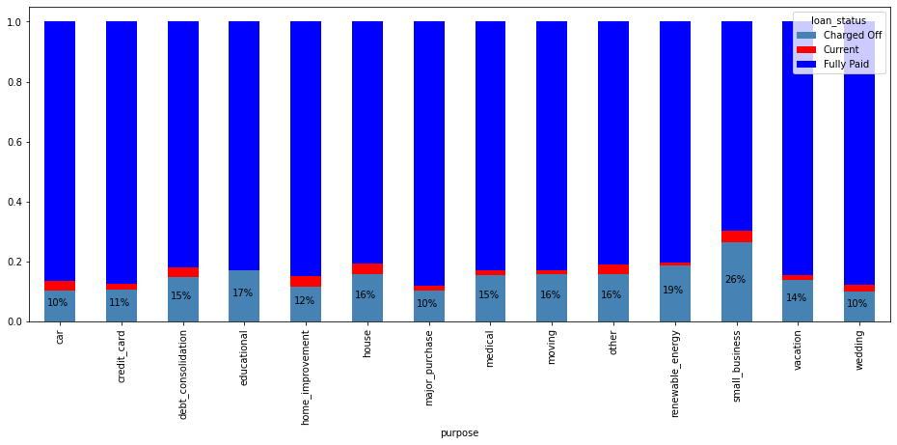
Business related reasons have more defaults
26% of the borrowers who took loan for “Small Business” purpose defaulted
While least defaults (10%) have been observed for “Car” and “Wedding” reasons
47% of the loans had “debt consolidation” as loan purpose
While, small number of loans were taken for Wedding, Medical, Vacation like reasons
Time Period: From 2007 to 2011
For UPGRAD: MSC. In ML & AI Program

Slide 15
Appendix

Slide 16
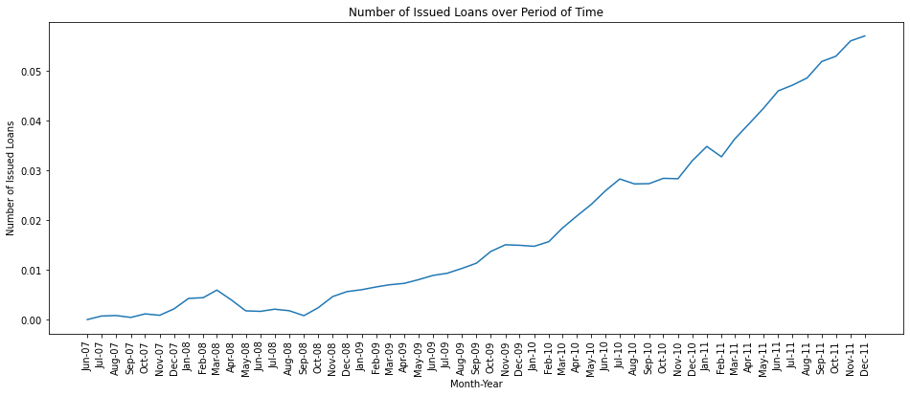
After October of 2008, the number of loans issued kept on growing
Time Period: From 2007 to 2011
For UPGRAD: MSC. In ML & AI Program

Slide 17
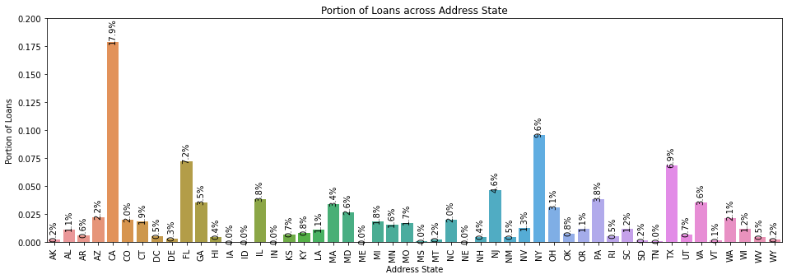
Most Loans have been given in California
Time Period: From 2007 to 2011
For UPGRAD: MSC. In ML & AI Program

Slide 18
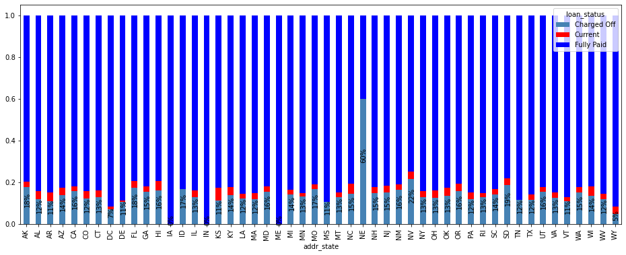
Number of defaults vary across states
NE/Nebraska has the highest percentage of Charged-Off, but, only 3 loans are provided there
+ NV/Nevada has the second highest percentage of Charged-Off (22%)
Time Period: From 2007 to 2011
For UPGRAD: MSC. In ML & AI Program

Slide 19
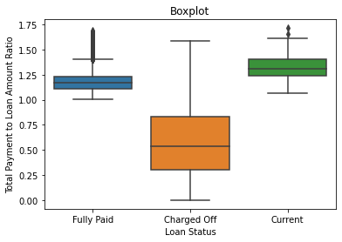
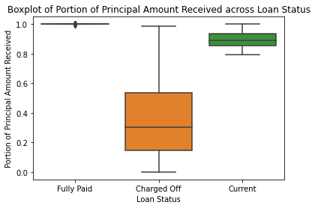
Current status borrowers have returned 80% of principal amount
Calculation: Total Payment divided by Funded Amount
For both Fully-paid and Current customers, more money have been received than the principal amount, which is due to the interest rates.
Calculation: if Total Received Principal divided by Funded Amount
Current status borrowers have already returned 80% of the principal amount
About 50% of the Charged-Off borrowers have return less than 30% of the principal amount
Time Period: From 2007 to 2011
For UPGRAD: MSC. In ML & AI Program

Slide 20
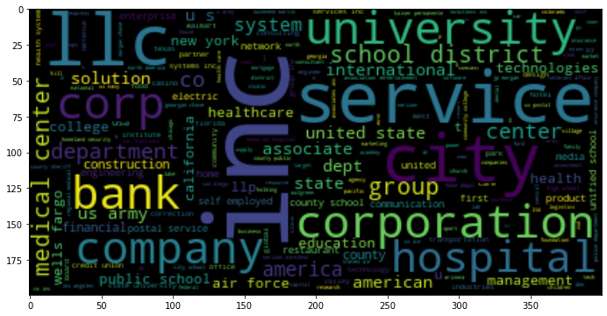
Borrowers’ titles contain corporate, university or hospital related titles
Time Period: From 2007 to 2011
For UPGRAD: MSC. In ML & AI Program

Slide 21
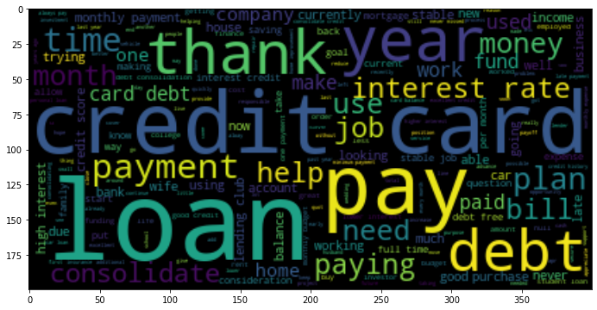
Loan descriptions contains term - "loan", "payment", "credit card", "etc."
Time Period: From 2007 to 2011
For UPGRAD: MSC. In ML & AI Program

