Slide 1
ROOM-PAINTING PUZZLE
Submitted To - DR.SHAMBHAVI.B.S
Submitted By -
AMRUTYA(1BM18IS010)
PRATEEK JAIN(1BM18IS149)

Slide 2
What the puzzle says...
There once lived a king who liked chess.He had a palace whose floor plan mimicked an 8*8 chessboard, with each of the 64 rooms having a door in each if its four walls.
Originally, all the floors in the rooms were painted white. Then the king ordered the floors to be repainted so that they alternated like the squares of a chessboard.
To do this, his painter had to walk through the palace repainting floors in all the rooms he visited from white to black, and vice-versa. The painter was allowed to exit the palace and re-enter it through another door.
We need to find the minimum number of re-paintings that the painter has to do, which should not be more than 60 times.

Slide 3
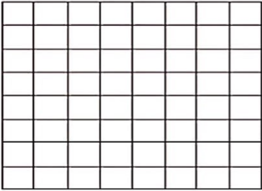
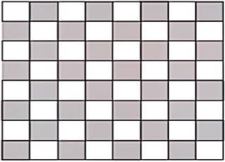
Initially,all the floors are white in color.
After repainting, the floors should resemble the pattern shown beside

Slide 4


Basic notion
The painter enters a room, while leaving it, paints it’s floor black, not necessarily black always.
Since symmetricity exists,the palace can be divided into equal halves diagonally
Condition is that the painter enters the room through a door and exits from the other
REQUIRED - Minimum number of times he needs to repaint all the floors

Slide 5
Approach Chosen-
Divide and Conquer
Data Structure Implemented-
2D arrays
(using dynamic programming)
Tip
2D arrays used in this solution enable us to mark each point in it while the painter leaves the room .

Slide 6
Program
import arcade
SCREEN_WIDTH = 800
SCREEN_HEIGHT = 600
class MyBlock(arcade.Window):
""" Main application class. """
def __init__(self, width, height):
super().__init__(width, height)
arcade.set_background_color(arcade.color.AMAZON)

Slide 7
def setup(self):
pass
def on_draw(self):
arcade.start_render()
def update(self, delta_time):
pass
def main():
game = MyBlock(SCREEN_WIDTH, SCREEN_HEIGHT)
game.setup()
arcade.run()
if __name__ == "__main__":
main()

Slide 8
def setup(self):
# Create the sprite lists
self.player_list = arcade.SpriteList()
self.block_list = arcade.SpriteList()
# Score
self.score = 0
self.player_sprite = arcade.Sprite("images/character.png", SPRITE_SCALING_PLAYER)
self.player_sprite.center_x = 50 # Starting position
self.player_sprite.center_y = 50
self.player_list.append(self.player_sprite)

Slide 9
# Create the block
for i in range(BLOCK_COUNT)
# Position the block
block.center_x = random.randrange(SCREEN_WIDTH)
block.center_y = random.randrange(SCREEN_HEIGHT)
# Add the block to the lists
self.block_list.append(block)

Slide 10
Why did we prefer DIVIDE AND CONQUER approach?
Symmetricity allows us to divide the chessboard into two equal halves along the diagonal
Time efficiency is improved(here it is O(1))

Slide 11
Thank You!!

