Slide 1
BREAST cancer Prediction USING MACHINE LEARNING
GUIDE :
DR. SHEELA S.V
PROFESSOR ISE-DEPT
Submitted by :
PRATEEK JAIN - 1BM18IS149

Slide 2
introduction
Breast cancer is the main cause of women’s death all over the world. It contributes around 12% of all new cancer cases and 25 % of all cancers in women. Breast cancer prediction becomes an important research problem both in the medical as well as in healthcare communities .
Machine learning algorithms and statistical techniques have been employed to develop a large variety of breast cancer prediction models using techniques like Logistic Regression , Decision Trees , K nearest Neighbors (KNN) , Support vector machine (SVM) , etc.
In this study the performance of these algorithms have been analyzed and compared and then concluded which algorithm is best suited for this kind of analysis .

Slide 3
ABSTRACT
Women are seriously threatened by breast cancer with high morbidity and mortality.
The lack of robust prognosis models results in difficulty for doctors to prepare a treatment plan that may prolong patient survival time.
Hence, the requirement of time is to develop the technique which gives minimum error to increase accuracy.
Four algorithm SVM, Logistic Regression, Random Forest and KNN which predict the breast cancer outcome have been compared in the paper using different datasets .
Aim of research categorises in three domains. First domain is prediction of cancer before diagnosis, second domain is prediction of diagnosis and treatment and third domain focuses on outcome during treatment.

Slide 4
Problem statement
There are many algorithms for classification and prediction of breast cancer outcomes.
The present study gives a comparison between the performance of Four classifiers : Logistic Regression , Decision Tree , K Nearest Neighbors (KNN) , Support vector machine (SVM) .
There has not been much research on how these algorithms , especially SVM , behave when feature selection and cross validation are employed as well as how classifier ensembles can help improve the prediction accuracy .

Slide 5
objective
The objective of this study is to analyze the algorithms that can be used in Breast cancer prediction.
The aim is to also include Cross-validation technique to assess the accuracy given by a particular predictive model.
Apart from these , how feature selection can be used to give better accuracy and how Classifier Ensembles perform in the prediction models are also a significant part of this study .

Slide 6
general steps followed in ml
Preprocess
Preprocess the data
Get
Get X and Y.
Split
Split the dataset into training and testing data.
Create
Create individual models based on each classifier .
Train
Train the models using training data .
Compare
Compare their accuracies on testing data.

Slide 7
PROPOSED METHODOLOGY
DATA PREPROCESSING
DATA PREPARATION
FEATURE SELECTION
FEATURE PROJECTION
PREDICTION
MODEL SELECTION
FEATURE SCALING

Slide 8
Phase 1 - Pre-Processing Data - Data pre-processing is a data mining technique that involves transforming raw data into an understandable format. This step is very important because the quality and quantity of data that you gather will directly determine how good your predictive model can be.
Phase2 - Data Preparation - Data Preparation, where we load our data into a suitable place and prepare it for use in our machine learning training. We’ll first put all our data together, and then randomize the ordering.
Phase3 – Feature Selection - The process of reducing the number of input variables when developing a predictive models to both reduce the computational cost of modeling and, in some cases, to improve the performance of the model.
Phase4 – Feature Projection- Transformation of high-dimensional space data to a lower dimensional space (with few attributes). Both linear and nonlinear reduction techniques can be used in this step.

Slide 9
Phase 5 - Feature Scaling- Most of the machine learning algorithms use Euclidian distance between two data points in their computations.
We need to bring all features to the same level of magnitudes. This can be achieved by scaling.
Phase 6 – Model Selection- The model can learn on the training data and can process the future data to predict outcome. They are grouped to Regression and Classification techniques.
A regression problem is when the result is a real or continuous value, such as “salary” or “weight”.
A classification problem is when the result is a category like filtering emails spam” or “not spam”.
Phase 7 – Prediction - Machine learning is using data to answer questions. So Prediction, or inference, is the step where we get to answer some questions. This is the point of all this work, where the value of machine learning is real

Slide 10
Literature survey
ALL THE ALGORITHMS USED IN THIS STUDY ARE DISCUSSED AS FOLLOWS:

Slide 11
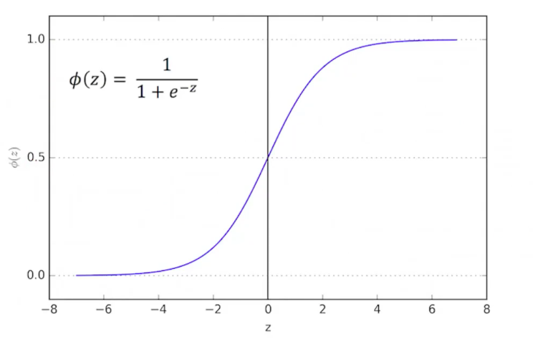
LOGISTIC REGRESSION
Logistic Regression is one of the most fundamental classification algorithms used in ML .
Logistic regression predicts the probability of different samples and then these samples are mapped to a discrete class based on that probability .
It uses Logistic / Sigmoid Function at its core , that’s why it has been named Logistic regression.

Slide 12
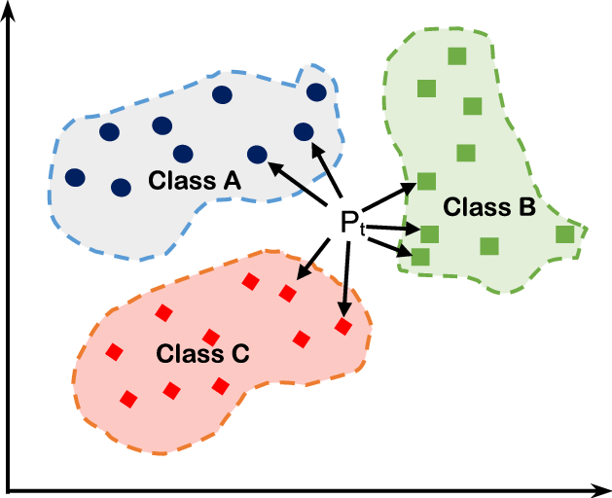
K-Nearest Neighbor
The K-Nearest neighbor algorithm is a classification algorithm.
It takes a bunch of labelled points and uses them to learn how to label other points .
This algorithm classifies cases based on their similarity to other cases .

Slide 13
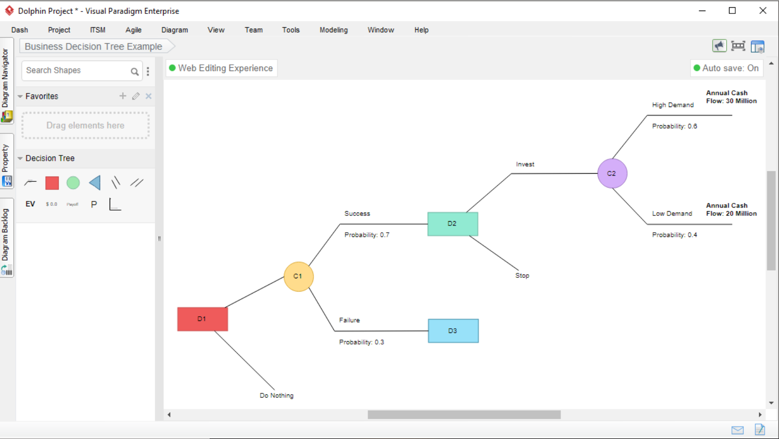
Decision tree
The decision trees are built by splitting the training set into distinct nodes where one node contains all or most of one category of the data .
It uses recursive partitioning to classify the data.
Here, the choice of attribute to split data is very important .

Slide 14
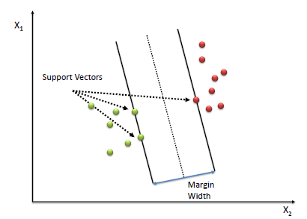
SVM (SUPPORT VECTOR MACHINE )
It’s a supervised machine learning technique .
It is used only for two group classification problem .
It finds a separator which will separate these two classes.
There can be many possible separator .
Finding the separator is quite a tough job .
Kernelling : means mapping data into a higher-dimensional space
Kernel function : Mathematical functions used for this purpose
Performance of SVM depends largely on Kernel functions used .
Common kernel functions : Linear , RBF, Poly and Sigmoid .

Slide 15
System requirement
All the work has been carried out on an i5-8th generation computing machine .
Software used - Jupyter notebook
Programming language used - Python
All the classifier models have been built and their comparisons have been carried out using Sci-Kit learn , Numpy , Pandas , Seaborn and Matplotlib APIs of Python .

Slide 16
DATASETS USED
Datasets used is Wisconsin Breast Cancer (Original) Dataset .
It contains 569 instances and has 33 features .
Out of these 357 samples are Benign (non-cancerous ) and 312 samples are Malignant (Cancerous) .

Slide 17
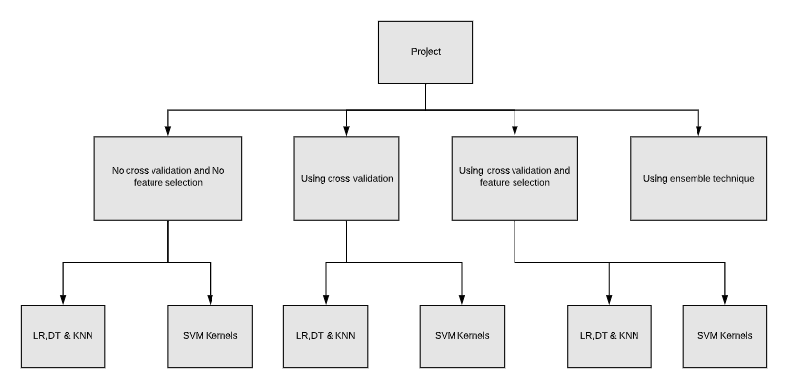
Project LAYOUT

Slide 18
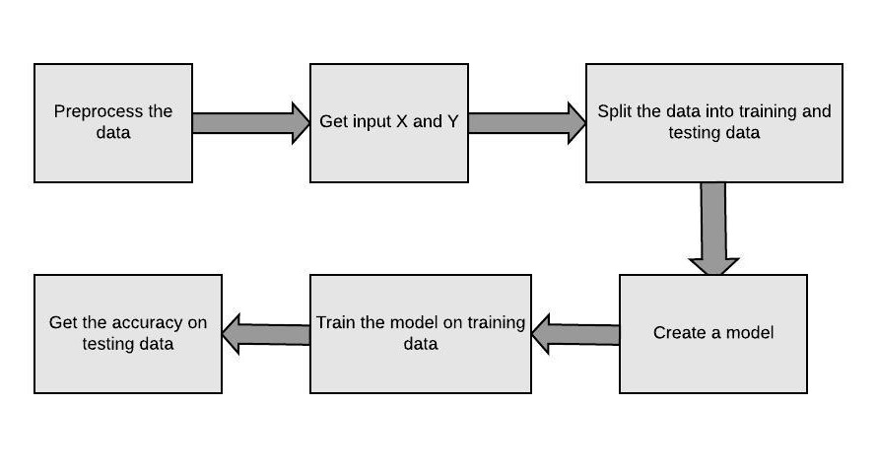
First analysis 1)to compare the performance of Logistic Regression , Decision Tree and K nearest Neighbors . 2)comparing the performance of Support vector machine (SVM) based on the kernel functions used .

Slide 19
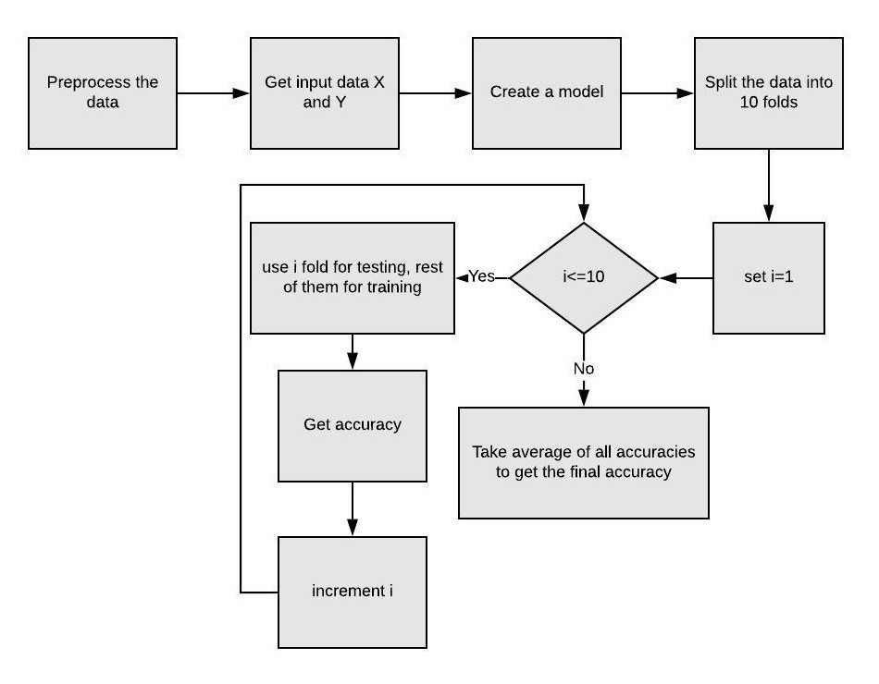
SECOND ANALYSIS USING CROSS VALIDATION

Slide 20
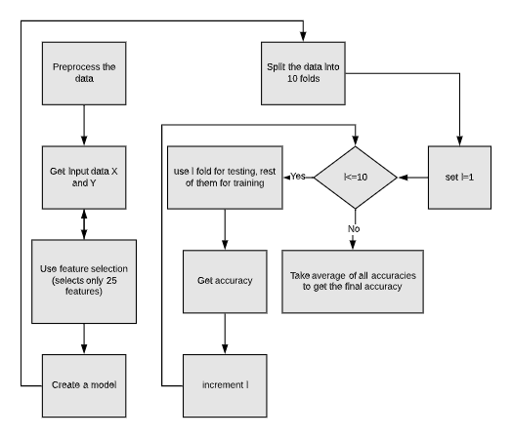
Third analysis using univariate elimination technique for feature selection

Slide 21
Experimental results
We get the following results/comparisons for the different analyses

Slide 22
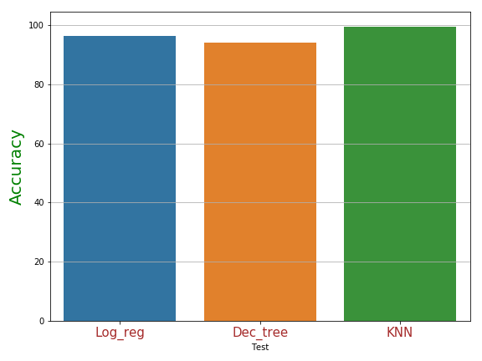
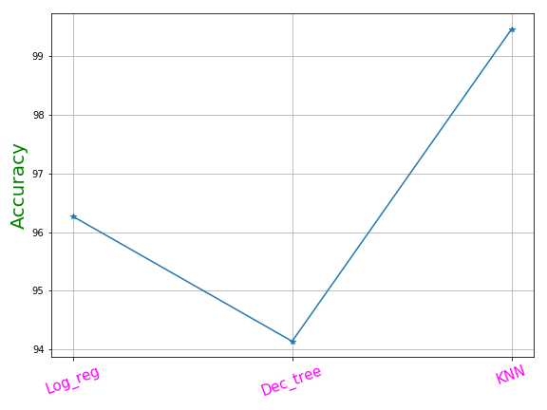
(a)Bar graph comparison , (b) comparison by plot for Log_reg , DT and Knn

Slide 23
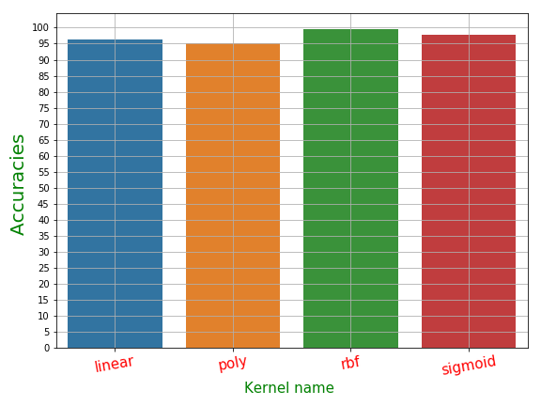
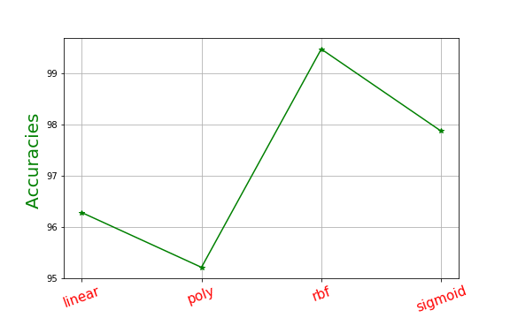
(a) Bar graph comparison , (b) comparison by plot for different kernels

Slide 24
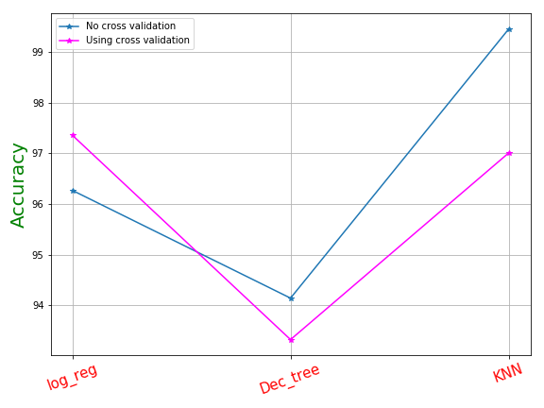
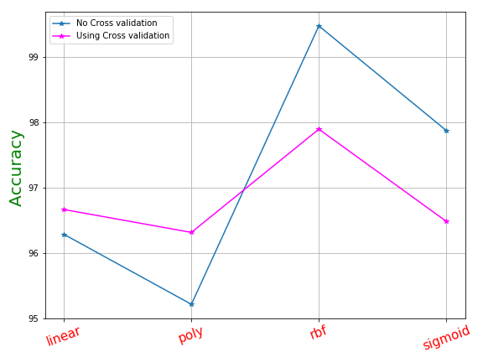
Comparison of accuracies of second analysis with first analysis (a) for log_reg , DT , KNN (b) For different kernels of SVM

Slide 25
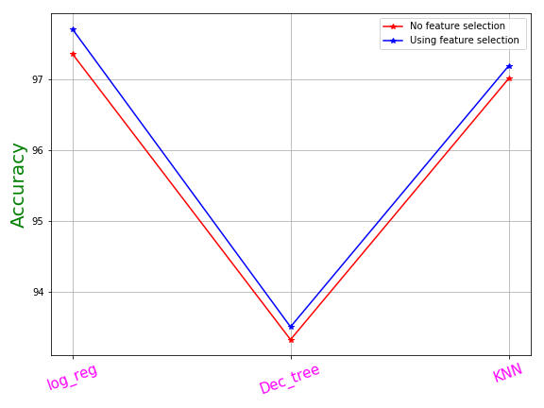
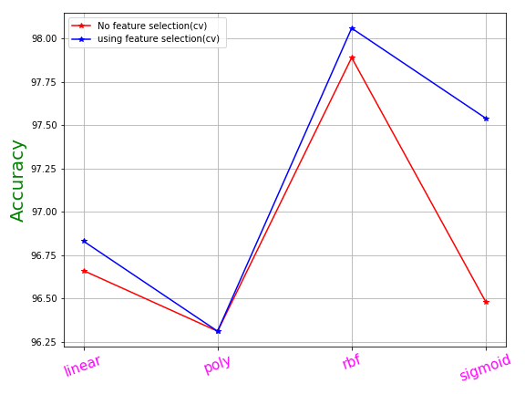
Accuracy comparison using feature selection (a) for Log_reg ,DT , KNN (b) For SVM kernels .

Slide 26
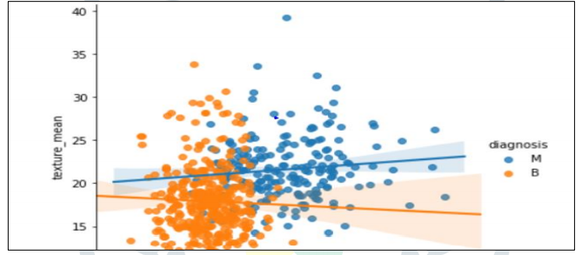
CONCLUSION
We can notice that SVM takes about 0.07 s to build its model unlike k-NN that takes just 0.01s.
It can be explained by the fact that k-NN is a lazy learner and does not do much during training process unlike others classifiers that build the models.
In other hand, the accuracy obtained by SVM (97.13%) is better than the accuracy obtained by C4.5, Naïve Bayes and k-NN that have an accuracy that varies between 95.12 % and 95.28 %.
After creating the predicted model, we can now analyse results obtained. SVM and C4.5 got the highest value (97%) of TP for benign class but KNN correctly predicts 97 % of instance that belongs to malignant class.

Slide 27
FUTURE WORK
The analysis of the results signifies that the integration of multidimensional data along with different classification, feature selection and dimensionality reduction techniques can provide auspicious tools for inference in this domain.
Further research in this field should be carried out for the better performance of the classification techniques so that it can predict on more variables.
We are intending how to parametrize our classification techniques hence to achieve high accuracy. We are looking into many datasets and how further Machine Learning algorithms can be used to characterize Breast Cancer. We want to reduce the error rates with maximum accuracy.

Slide 28
REFERENCES -
BREAST CANCER PREDICTION USING MACHINE LEARNING Ramik Rawal School of Computer Science and Engineering (SCOPE), Vellore Institute of Technology, Gorbachev Road, Vellore, Tamil Nadu 632014, India. © 2020 JETIR May 2020, Volume 7, Issue 5 www.jetir.org (ISSN-2349-5162)

Slide 29
Thank you!!

