Slide 1
BMS COLLEGE OF ENGINEERING
DEPARTMENT OF INFORMATION
SCEINCE AND ENGINEERING
Course – Java Programming
Course Code – 19IS4PCJAV
PROJECT – Simulation of
Sorting Algorithms
PRATEEK JAIN & ANUPAM KUMAR BORUAH
1BM18IS149-1BM18IS013

Slide 2
Abstract
Java programming is used to create animation to visualize and simulate two sorting algorithms: Bubble Sort and Quick Sort. Time Complexity of both the algorithms have been discussed.
Introduction
Sorting a list of items into ascending or descending order can help either a human or a computer find items on that list quickly. This is implemented using sorting algorithms. There are several sorting algorithms. The two main criteria to judge which algorithm is better than the other have been:
Time taken to sort the given data.
Memory Space required to do so.

Slide 3
Problem Statement
Simulation of two sorting techniques: Bubble Sort and Quick Sort and comparison between them.
APIs Used in the Project:
java.util.Random – is used to create random numbers.
javax.swing.JButton – is used to create buttons in JFrame.
javax.swing.JComboBox – is used to create combo box in JFrame.
javax.swing.JOptionPane – is used to create option pane in JFrame.
javax.swing.JTextField – is used to create in text field JFrame.

Slide 4
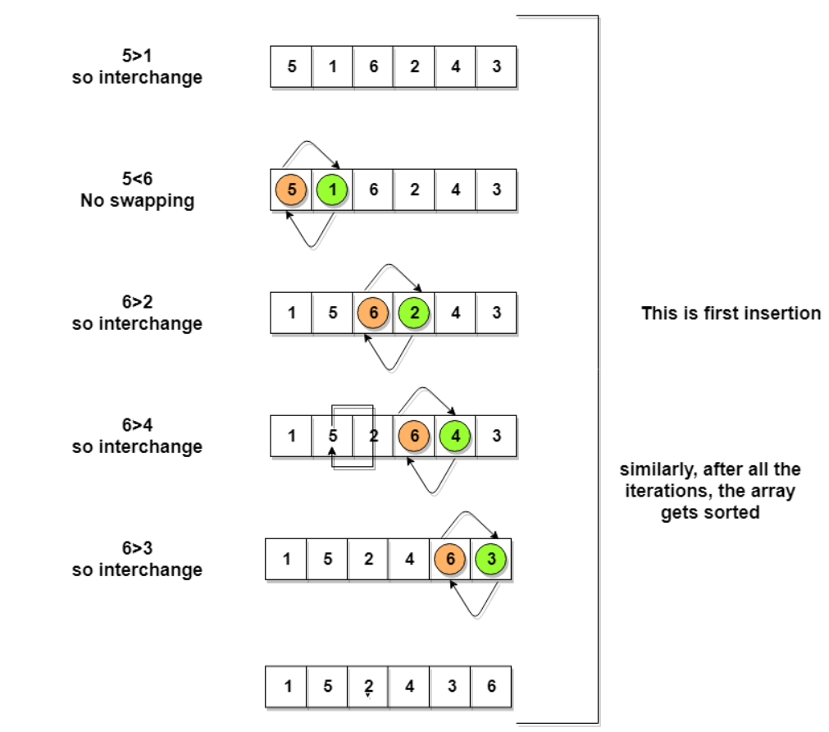
Bubble Sort
Following are the Time and Space complexity for the Bubble Sort algorithm.
Worst Case Time Complexity [ Big-O ]: O(n²)
Best Case Time Complexity [Big-omega]: O(n)
Average Time Complexity [Big-theta]: O(n²)
Space Complexity: O(1)

Slide 5
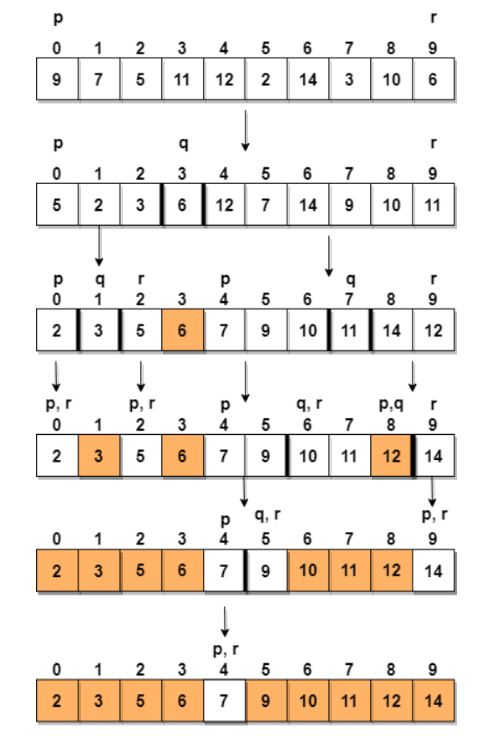
Quick Sort
Following are the Time and Space complexity for the Quick Sort algorithm:
Worst Case Time Complexity [ Big-O ]: O(n²)
Best Case Time Complexity [Big-omega]: O(n*log n)
Average Time Complexity [Big-theta]: O(n*log n)
Space Complexity: O(n*log n)

Slide 6
Java Swing
Used JFrame for the application
Used buttons, labels, combo box and text fields
HIGH LEVEL DESIGN:
Create Thread
Call Sorting algorithms
Use thread to run the animation
Calculate Time Complexity

Slide 7
ANIMATION
1
2
for(int i=0; i<30;i++){
a[n1].setLocation(a[1].getLocation().x, a[n1].getLocation().y+1);
a[n2].setLocation(a[2].getLocation().x, a[n2].getLocation().y-1);
t.sleep(10);
}
length
1
1
1
1
int len = a[n2].getX()- a[n1].getX();
1
2
2
1
1
2
for(int i=0; i<len;i++){
a[n1].setLocation(a[1].getLocation().x+1, a[n1].getLocation().y);
a[n2].setLocation(a[2].getLocation().x-1, a[n2].getLocation().y);
t.sleep(10);}
2
2
2
2
for(int i=0; i<30;i++){
a[n1].setLocation(a[1].getLocation().x, a[n1].getLocation().y-1);
a[n2].setLocation(a[2].getLocation().x, a[n2].getLocation().y+1);
t.sleep(10);}
temp = a[n1];
a[n1]=a[n2];
a[n2]=temp;

Slide 8
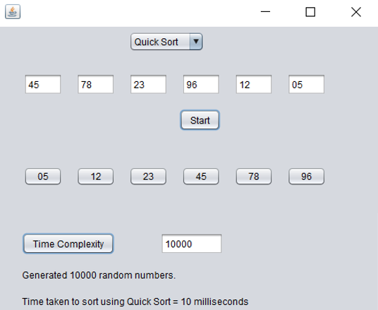
SCREENSHOT OF THE SIMULATION
Select Sort option
Start Button
Enter number of elements
Time Complexity
Time taken

Slide 9
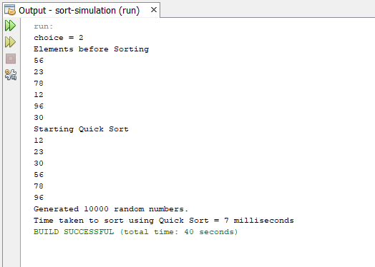
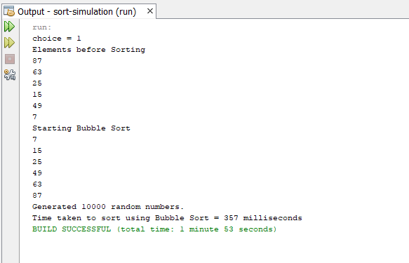
RESULTS
QUICK SORT
BUBBLE SORT

Slide 10
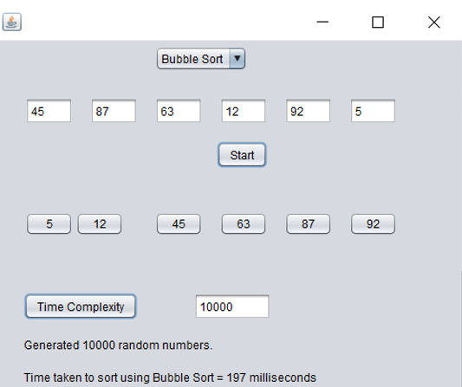
RESULTS
QUICK SORT
BUBBLE SORT

