Slide 1
EthereumGuard
Temporal Graph Neural Networks
Fraud User Classification and Future Attack Prediction
Under guidance of
Dr . Joydeep Chandra
Prateek Rajesh
2001CS43

Slide 2
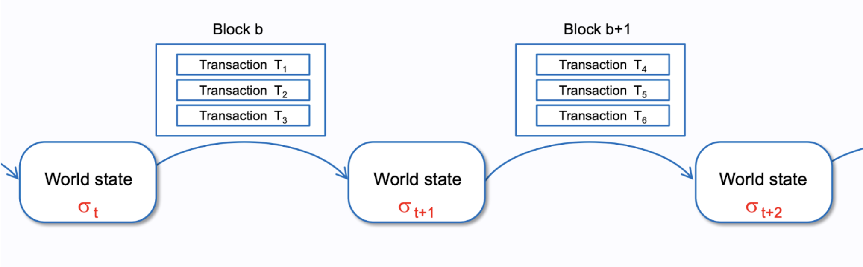
introduction
Goal :
This work mainly focusses on determining the fraud users in Ethereum transaction network, using neural network modelling and identifying the next prey of the fraud user using link prediction
Ethereum transactions:
Phishing: Attackers use fake communication channels or websites
to trick users into revealing their private keys or other sensitive information.
Detection is crucial to prevent such activities .

Slide 3
Dataset description
Utilised a publicly available real-world Ethereum transactions dataset(D₀). This dataset contains six attributes: 'from', 'to', 'amount' 'timestamp', 'FromIsPhi’, 'ToIsPhi' and added a ‘isPhi’ attribute to it.
Extracted three more datasets namely First-order Transaction Network of Phishing Nodes(D₁)Second-order Transaction Network of Phishing Nodes(D₂). Which were analyzed with the The Label of phishing account on Ethereum (D₃),to make it resemble our original dataset (D₀).
From(0)
Timestamp
t
To(1)
value
DataSet | Node Count | 1s (phishing nodes) | 0s (legit nodes)
D0 | 45,868 | 1,262 | 44,606
D1 | 38,792 | 891 | 37,901
D2 | 3,13,806 | 33 | 3,13,773

Slide 4
Data preprocessing
The data set has been pre-processed and converted into several npy files mentioned below:
- x:
17-dimensional node features.(node2vec)
- y: node label wrt idx.
Nodes of Class 1 are fraud users and nodes of 0 are normal users, and they the two classes to be predicted.
- edge_index: shape (n, 2).
Each edge is in the form (id_a, id_b), where ids are the indices in x.
- edge_type:
2 types of edges.
- edge_timestamp:
The desensitized timestamp of each edge.
- train_mask, valid_mask, test_mask:
Nodes of Class 0 and Class 1 are randomly splitted by 70/15/15.

Slide 5
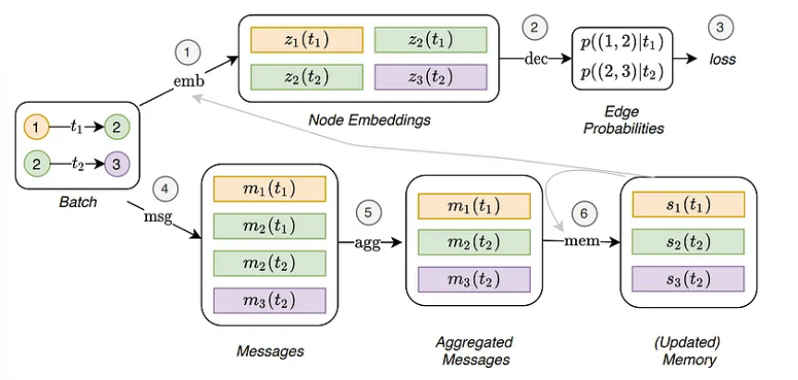
model architecture
Temporal Edge Aggregation
Temporal Convolutional Layers
Node Memory Update Functions

Slide 6
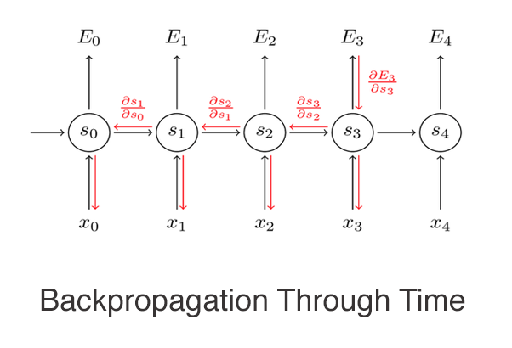
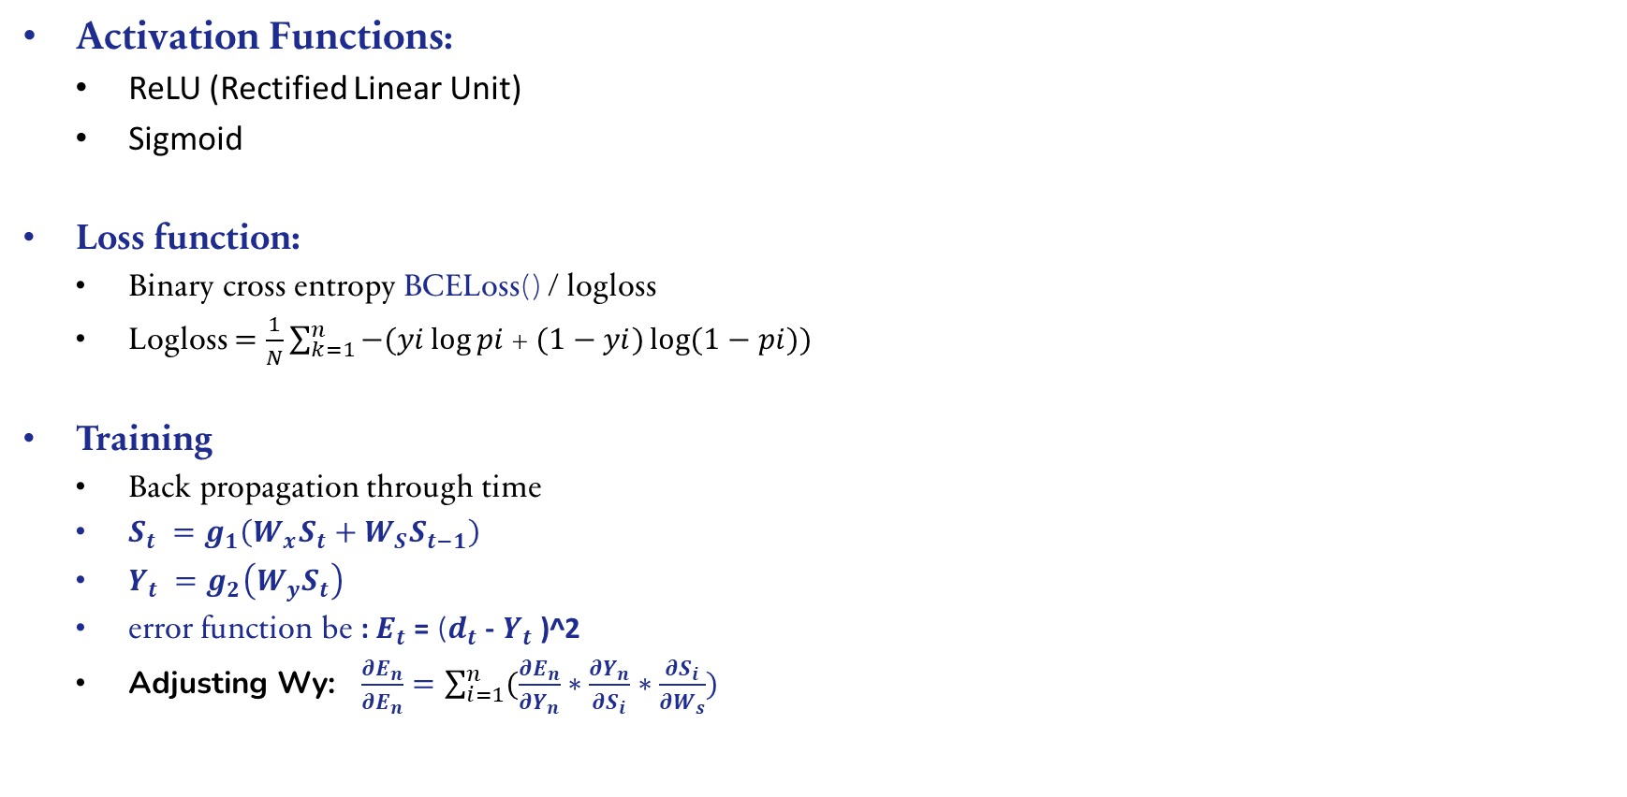
Activation Functions:
ReLU (Rectified Linear Unit)
Sigmoid
Loss function:
Binary cross entropy BCELoss() / logloss
Logloss $=\frac{1}{N}\sum_{k=1}^{n}{−(yi\log{pi }}$+ $(1−yi)\log{(1−pi)) }$
Training
Back propagation through time
$S_{t} =g_{1}\left(W_{x}S_{t}+W_{S}S_{t−1}\right)$
$Y_{t} =g_{2}\left(W_{y}S_{t}\right)$
$\text{error} \text{function} \text{be}$ : $E_{t}$= ($d_{t}$- $Y_{t}$)^2
Adjusting Wy: $\frac{∂E_{n}}{∂E_{n}}=\sum_{i=1}^{n}{(\frac{∂E_{n}}{∂Y_{n}}∗\frac{∂Y_{n}}{∂S_{i}}∗\frac{∂S_{i}}{∂W_{s}})}$

Slide 7
Handling Temporal Aspects.
Sliding Window
The input of the model is a temporal sequence of graph snapshots, where each snapshot represents the state of the graph at a specific time step.
A sliding window is initialized, processes the graph data within the sliding window to learn representations of nodes and edges
Graph Aggregation
To maintain hidden states that capture information from previous time steps. The hidden states are updated as new temporal information is processed,

Slide 8
link prediction
Aim is to detect the possible link/edge between nodes or users , so that we can estimate whom the phisher is going to attack in the future .
Temporal Sampling:
Pairs of nodes at different time steps are sampled to create positive training examples.
These positive examples represent pairs of nodes that are connected by an edge at a specific time step.
The goal is to teach the model to recognize and predict such connections.
Negative Sampling:
To create a balanced training set and avoid biases, negative samples are generated.
Negative samples represent pairs of nodes that do not have an edge between them at a specific time step.
This step is crucial for preventing the model from learning a bias towards predicting edges all the time, especially in scenarios where the graph is sparse.
Compute probabilities for edges between sources and destination and between sources and negatives by first computing temporal embeddings

Slide 9
Performance Metrics Calculation:
ROC AUC , AP , PRECESSION RECALL AND F1 SCORE
FOR NO OF hidden layers = 2
link predection
INFO:root:Test statistics: auc: 0.9910711587185895, ap: 0.9889703899174705
node classification
with n=2
INFO:root:Final val auc: 0.977224101517755 ± 0.001156373851952963
INFO:root:Final test auc: 0.9777608113643679 ± 0.0009574188530518374
INFO:root:Final val prec: 0.8632626849666023 ± 0.015892174615879613
INFO:root:Final test prec: 0.8612875746082043 ± 0.010870547439176668
INFO:root:Final val rec: 0.7938888888888889 ± 0.0058001702827281095
INFO:root:Final test rec: 0.8068181818181819 ± 0.009507500301523603
f1 score : 0.83316357166
For n=3 : f1 score = 0.84410950756

Slide 10
Baseline comparison
 | precission | recall | f1-score
Xai et al | 82 | 81 | 81
Wan et al | 73 | 72 | 78
TTAGN | 83 | 80 | 82
Node2vec | 47 | 54 | 46
Deepwalk | 55 | 57 | 54
GCN | 51 | 54 | 50
DyGCN | 76 | 78 | 76
GIN | 61 | 56 | 62
our model | 87 | 81 | 84

Slide 11
baseline comparison :

Slide 12
Future work
Enhancing the model for improved performance and achieving superior metrics
in EthereumGUARD, culminating in a research paper documenting the advancements and findings.
Thank you !
Prateek Rajesh
2001CS43

