Slide 1
Web Object Attention Model For Image and Text Object
By
Prateek Rastogi
Under The Guidance Of
Dr. Samit Bhattacharya

Slide 2
Outline
Introduction
Previous Work
Data Collection
Data Analysis
Empirical Validation
Conclusion And Future Work

Slide 3
Introduction

Slide 4
Motivation
Webpage: Delivers information to the user.
Most important content should attract user attention early.
Web designer can use eye tracking instrument, but it is costly and the process is tedious.

Slide 5
Objective
To develop a attention model for predicting the fixation sequence
of human eye on a webpage.

Slide 6
Previous Work

Slide 7
Guided Search
Parallel Processing followed by Limited Capacity Processing .
Applicable only when user has particular task in mind.

Slide 8
Visual Saliency Model
Three Factors: colour, intensity, orientation.
Generates Saliency Map.
Works only on images of resolution 640 x 480.

Slide 9
Web Attention Model
Tries to measure attention factor in the form of a mathematical equation.
Takes chromatic contrast, intensity contrast, and size of object into account.
Poor real world results.

Slide 10
Model To Predict Attention Sequence of Web Objects
Extends Web Attention Model.
Removes Intensity Contrast and Includes x and y-position.
Works well on webpages that only have images.

Slide 11
Model To Predict Attention Sequence of Both Image And Text Objects
Tries to broaden previous model to include both image and text objects.
Collects empirical data in the form of gaze plots of eye tracking instrument.
Evaluates 150 real webpages to identify object types.

Slide 12
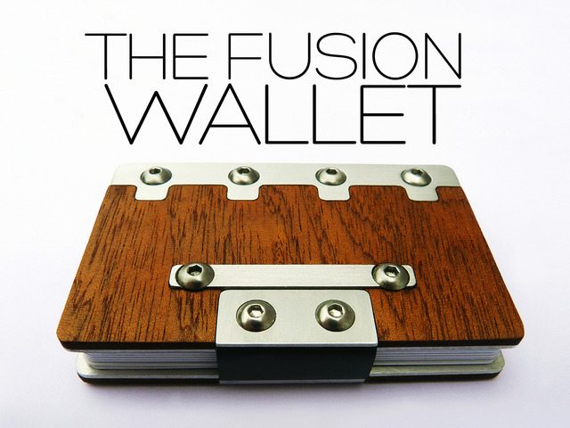
So what a web object is really?
Coherent region of a webpage that conveys a single information.

Slide 13
Types of Web Object
Pure Image.
Image Overlapped with Text.
Image with caption.
Paragraph.
List.
Table.
Heading.
Menu.
Interactive Objects.

Slide 14
Data Collection

Slide 15
We have extracted the following features in .csv format to determine the rank of web objects:
Area: Area of web object in square pixels. Maximum area of the webpage is 1310720 pixel² i.e. 1280*1024.
Mean: Average gray scale value of the object. This is the sum of the gray values of all the pixels in the object divided by the number of pixels.
StdDev: Standard deviation of the gray values used to generate the mean gray value i.e. Root Mean Square Contrast of the object.
Mode: Most frequently occurring grey value within the object.
Centroid: The center of the object. This is the average of the x and y coordinates of all of the pixels in the image or selection. Uses the X and Y Headings. Leftmost-Topmost point of the screen in taken as origin.

Slide 16
Centre of Mass: This is the brightness-weighted average of the x and y coordinates all pixels in the image or selection. Uses the XM and YM headings. These coordinates are the first order spatial moments. In almost all cases, it is very close to Centroid. So, we have excluded it in our data analysis, but they may be feed into classifiers to get better accuracy.
Min: Minimum grey value within the object.
Max: Maximum grey value inside an object.
Median: The median value of pixels in an object.

Slide 17
Features of the web objects of a webpage

Slide 18
Data Analysis

Slide 19
Key factors revealed from the analysis of combined rank of objects:
Y-axis
81 objects are ranked as per as their Y-distance from the top.
25 objects showed inconsistency in their rank.
Position
In 80% of the cases, entry position of the user’s eye was the centre of screen.

Slide 20
X-axis
Although in the data collected, we have taken leftmost-topmost corner of screen as (0,0), but for analysis, consider the centre of the screen is defined as X=0, as it is more intuitive.
In 19 occasions, a object on the left side of the screen is seen before right side objects.
In 13 instances, a object on the right side of the screen is seen before left side objects.
Size
9 of the 15 objects that ranked first were large images overlapped with text.
These 9 objects were attended 97 out of 135 times.

Slide 21
Contrast
In 69.71% cases, high contrast objects generally grab user attention early.
Mean
In 65.23% cases, we have seen that mean grey scale value increases for the object seen later, if all other factors are constant.
Mode
It is observed that mode grey value has no influence on the object rank.

Slide 22
Median
Median grey scale value has little or no effect on the rank of object.
Min and Max Grey Value
Minimum grey scale value for most objects is 0 and maximum grey scale value for most objects is 255. Thus, min and max grey value of object has no considerable effect on object rank.

Slide 23
Empirical Validation

Slide 24
For Validation, we tested our hypothesis on two sets of experimental data. The results obtained are:
Y-axis
77% of the objects from the validation data are ranked correctly, according to their Y-distance from the top.
Position
In 67.11% of the slides, user’s eye was first fixated at the centre of the screen.

Slide 25
X-axis
In 53% cases, left side object is seen before right side object.
Size
In 91.67% occasions, larger objects ranked first.

Slide 26
Contrast
In validation data set I and set II, we have found that in 72.31% cases high contrast objects are seen earlier than low contrast objects.
Mean Grey Scale Value
In 63.57% cases in validation data, we have seen that mean grey scale value is lesser for the object seen earlier.

Slide 27
Conclusion And Future Work

Slide 28
Conclusion
Larger objects are more likely to attract user’s attention.
Objects near the centre of the screen are noticed sooner.
High contrast objects catch user attention early.
Mean grey value increases for objects seen later.
Objects on the top of screen are generally seen earlier.

Slide 29
Future Work
Derivation of mathematical equation by combining identified factors.

Slide 30
Thank You

