Slide 1
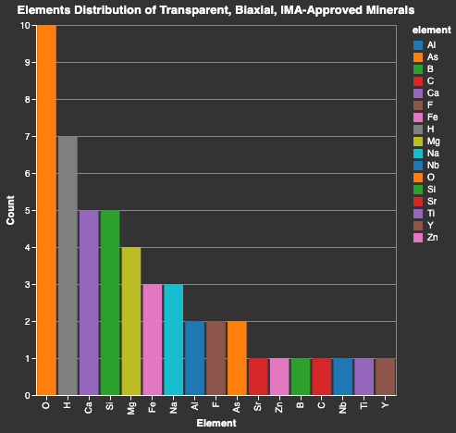
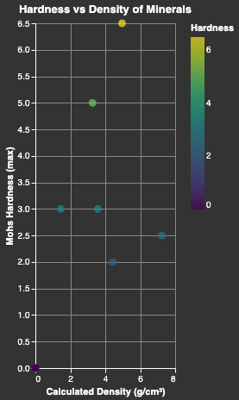
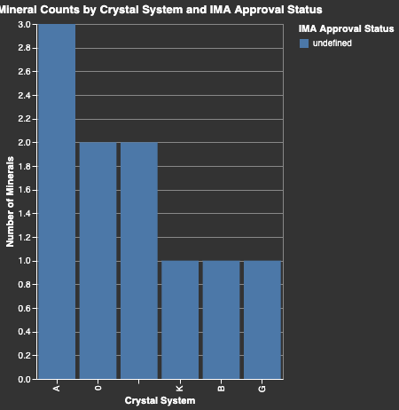
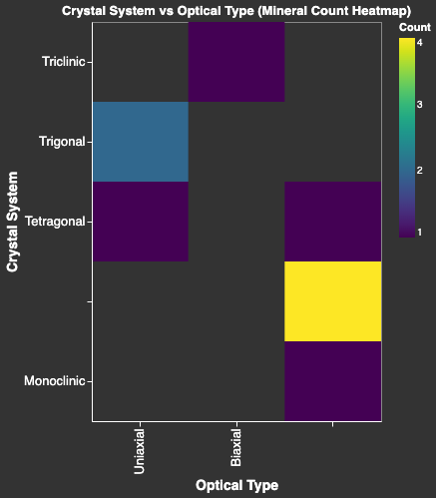

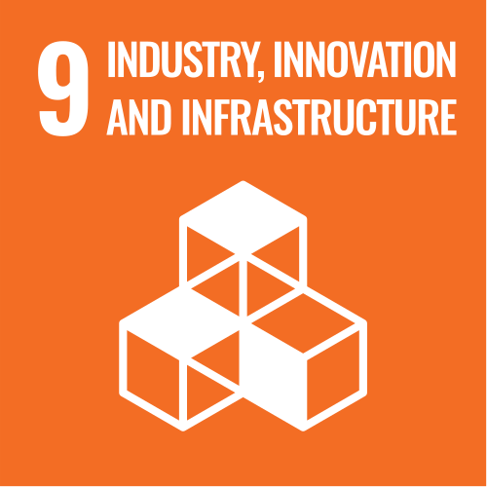




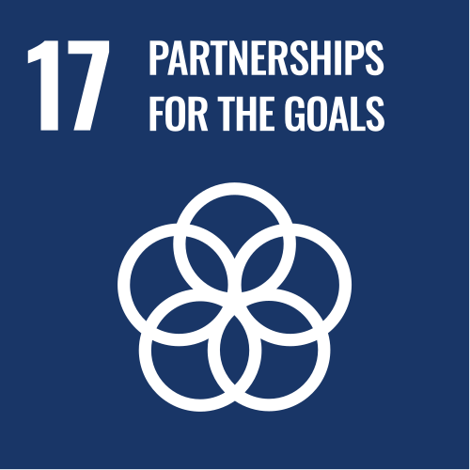


LLM-Driven Smart Agents for User-Friendly Access to an Open Data Portal
Team Members: Safal Shrestha, Pratik Rauniyar, Bidhi Paudel, Sikha Chaudhary
Background & Objective:
CONCEPT DEVELOPMENT:
THE FINAL DESIGN:
Mindat.org holds massive data of mineral species across 40+ API endpoints. Query in git requires geoscience knowledge, and API parameters are inaccessible to most researchers. The Alchemist eliminates that barrier with LLM-driven multi-agent automation.
Multi-agent Architecture: One supervisor agent and several specialized agents.
LLMs Driven Agents: Translate natural language into structured API queries.
Input and Output Validation: Iterative prototyping and testing to ensure accurate outputs.
VALUE PROPOSITION:
🔬 Researchers — analyze mineral data without coding
🌿 Students — explore geoscience using natural language
📊 Policy makers — visualize global mineral distributions
CONCLUSIONS:
KEY REQUIREMENT:
✓ Multi-agent LangGraph system successfully routes natural-language mineral queries to specialized agents
✓ MCP tool layer decouples data collection from agent logic — 6 reusable tools registered
✓ Vega-Lite renderer produces interactive plots with just one Natural Language prompt.
Accept natural language queries and translate to structured Mindat API calls
Multi-step workflow: retrieve, analyze, visualize in one agent pass
Generate histograms, network diagrams, and locality heatmaps
Secure auth, persistent sessions, and cross-platform deployment
ACKNOWLEDGMENT:
Dr. Xiaogang (Marshall) Ma — Faculty Advisor Dr. Jiyin Zhang — Postdoctoral researcher
Dr. Terence Soule - Professor Mindat.org API, University of Idaho CS Dept.
VALIDATION:
90% | Success Rate
4 | MCP Tools
5 | Specialized Agents
3.1s | Average latency
Visualization output
Database integration
Auth end to end flow
System latency <1.5s
Agent Input and Output Optimization
TECHNOLOGY STACK:
Backend
Frontend

