Slide 1
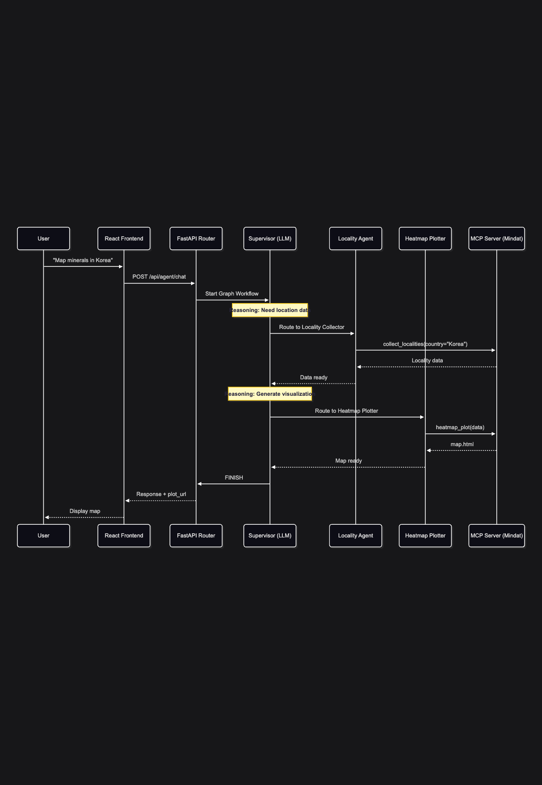
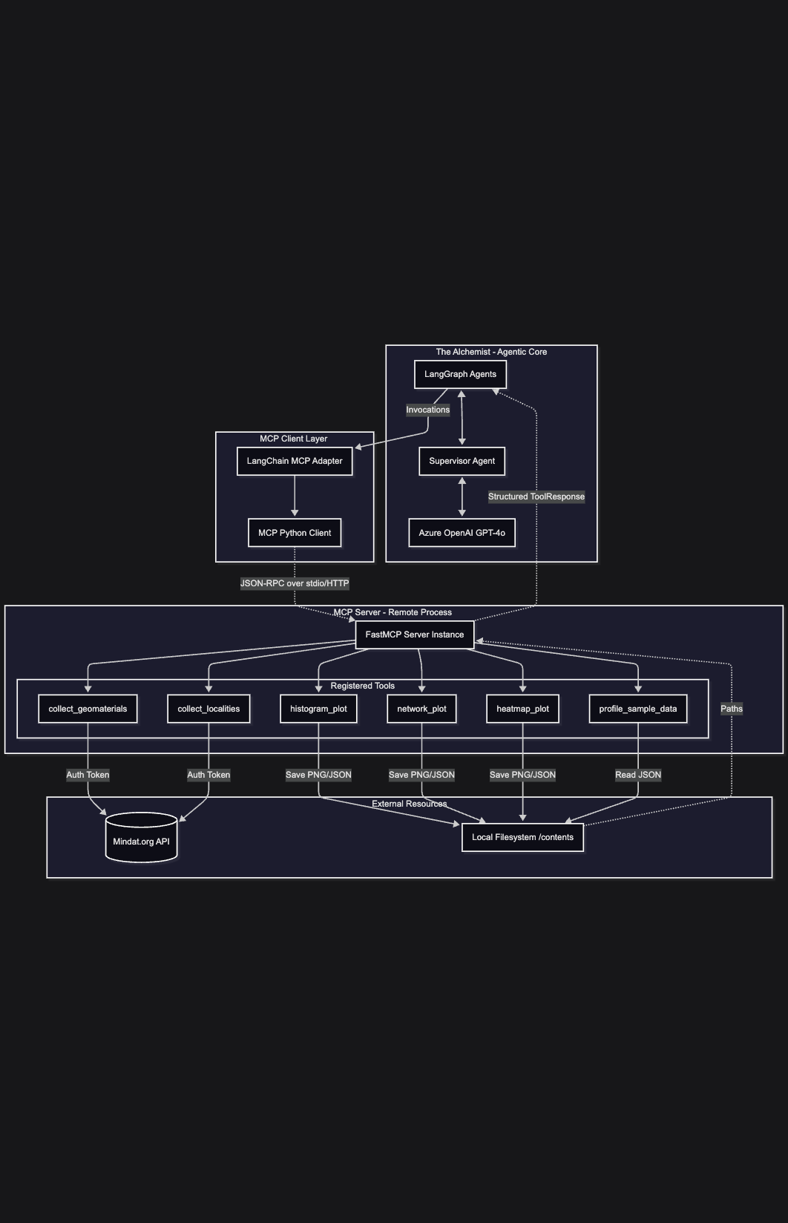
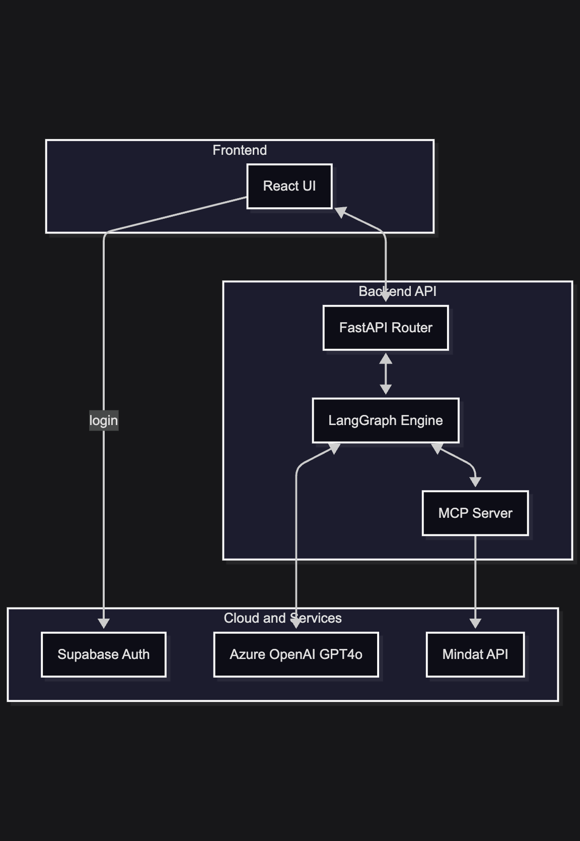
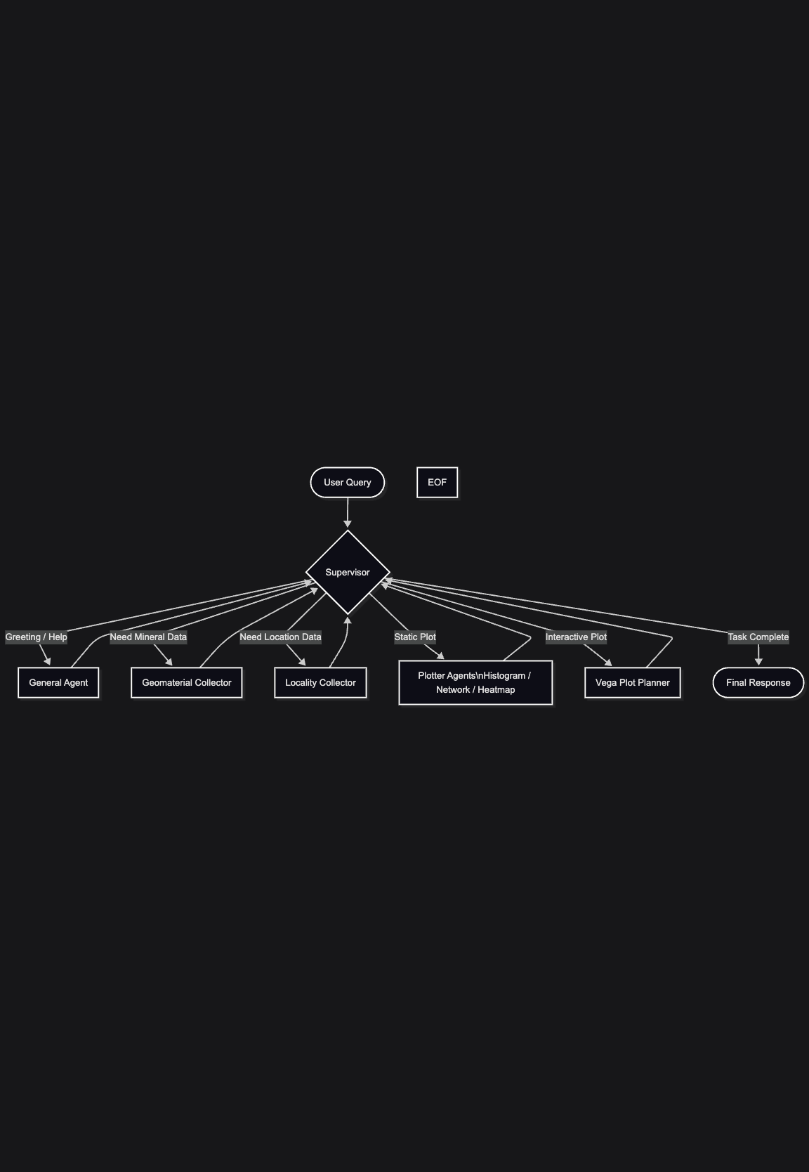
THE ALCHEMIST
LLM-driven smart agents for user-friendly access to Mindat mineral data
Team: Safal Sth, Prateek Rauniyar, and collaborators
Objective
Concept Development
Validation
- Make open mineral data usable through natural language.
- Reduce the need to know Mindat API parameters before exploring data.
- Return data tables and visualizations that support fast geological insight.
- Early prototypes explored direct API calls, hardcoded visualizations, and single-agent prompting.
- The selected concept uses a LangGraph supervisor to route requests to specialized agents.
- Validation is kept before the LLM workflow so unsafe input never reaches tool execution.
- Tested representative demo prompts across histogram, heatmap, and network categories.
- Verified hardness filters accept Mohs values from 0-10 while ignoring unrelated years such as discovered before 1990.
- Verified malicious/system-prompt requests are blocked before agent execution.
- Verified conversational greetings route to the general agent instead of being rejected as off-topic.
- Build checks: backend Python compile checks for validation/router modules and frontend Vite build when dependencies are available.
Background and Value Proposition
- Mindat is a rich public mineral database, but API exploration can be difficult for non-developers.
- The Alchemist provides a conversational layer over Mindat queries, filters, and visualization workflows.
- Multi-agent routing chooses when to collect geomaterial data, collect locality data, or generate charts.
- Users can ask questions such as hardness histograms, locality heatmaps, and mineral co-occurrence networks.
- Value: faster access, fewer query-format errors, reusable outputs, and a clearer path from question to evidence.
The Final Design
- React frontend sends chat requests and renders returned tables, plots, and Vega-Lite charts.
- FastAPI backend validates input, stores chat history, and invokes the LangGraph agent workflow.
- Collector agents call Mindat-oriented tools; visualization agents generate chart specifications.
- Recent improvement: validation failures now receive LLM-written explanations that redirect users toward Mindat tasks.
Summary, Conclusions, and Recommendations
- The Alchemist demonstrates a practical AI layer for exploring open mineral data.
- Pre-agent validation improves safety while LLM-guided feedback keeps responses useful.
- Next steps: broaden evaluation prompts, add richer chart comparisons, and improve deployed observability.
Key Requirements
- Natural-language chat interface for Mindat-related tasks.
- Input validation for malicious, off-topic, and invalid parameter requests.
- Secure backend API with session-based chat history.
- Agent workflow for geomaterial, locality, and Vega-Lite chart generation.
- Deployment-ready frontend/backend with documented Vercel and Render setup.
Architecture and sequence views show the chat request path from frontend to validation, agent routing, Mindat tools, and returned visual output.
Acknowledgements
University of Idaho College of Engineering, EXPO 2026 reviewers, project advisors, Mindat.org, and open-source contributors to FastAPI, React, LangChain, LangGraph, and Vega-Lite.

