Slide 1

STOCK MINING USING GENETIC ALGORITHM BASED
NEURAL NETWORKS
Presented by:
Sweta Rout
Prateek Roy
Pratishruti Nayak
Guided by:
Mrs. Pushpanjali Mohapatra

Slide 2


Introduction To Stock Market

Slide 3
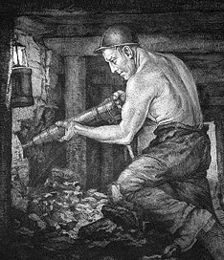
Data Mining
What is Data Mining?
Why do we need/use it?

Slide 4
Process
PROBLEM DEFINITION
DATA EXPLORATION
DATA PREPARATION
DATA
DATA
DEPLOYMENT
DATA
MODELING
EVALUATION

Slide 5
Data Mining Tools
Decision Trees
Regression
Neural Networks

Slide 6
Why Neural Network??
Neural networks take a different approach to problem solving than that of conventional computers. Conventional computers use an algorithmic approach i.e. the computer follows a set of instructions in order to solve a problem. Unless the specific steps that the computer needs to follow are known the computer cannot solve the problem.
Neural networks process information in a similar way the human brain does. The network is composed of a large number of highly interconnected processing elements(neurons) working in parallel to solve a specific problem. Neural networks learn by example. They cannot be programmed to perform a specific task.

Slide 7
Advantages
Disadvantages
High Accuracy
Able to approx. complex non-linear mapping
Noise Tolerance
Flexible with respect to missing and noisy data
Ease of maintenance
Can be implemented in parallel hardware
Can be updated with new data, making them dynamic
Poor Transparency
Operate as “black boxes” with little/no knowledge of the algorithms used
Trial-and-Error Design
The selection of hidden nodes and training parameters are heuristic
Data Hungry
Requires large amounts of data to be accurate which also means more computing power

Slide 8
Important terminology
Weights : In architecture of ANN, each neuron is connected to other neurons by means of directed communication links, and each communication link is associated with weights. The weights contain information about the input signal. This information is used by the network to solve the problem. The weight can be represented in terms of matrix.
Bias : the bias included in the network has its impact in calculating the net input. The bias is included by adding a component x_{o} = 1 to the input vector X. Thus the input vector becomes X=(1,X₁ ………,X_{i} ……….,X_{n} )
Learning Rate : The learning rate is denoted by ‘µ’. It is used to control the amount of weight adjustment at each step of training. The learning rate, ranging from 0 to 1, determines the rate of learning at each time step.
Activation Functions : The activation function is applied over the net input to calculate the output of an ANN. It is used to ensure that a neuron’s response is bounded – that is, the actual response of the neuron is conditioned or dampened as a result of large or small activating stimuli and is thus controllable.

Slide 9
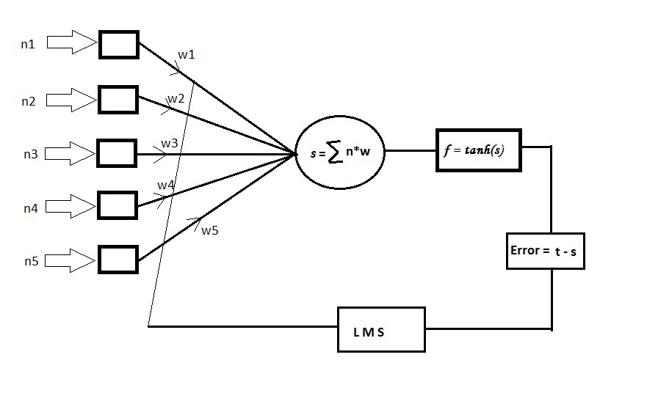
Basic Perceptron Model
I
N
P
U
T

Slide 10

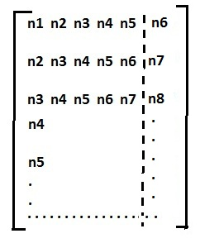
Implementation
t
Input matrix(n) =
Weight
matrix(w) =
Normalized value = n-max(n) /max(n) – min(n)
-Weight matrix is taken as random values.
Implementation is done through back propagation and LMS(Least Mean Square) Algorithm.

Slide 11
Back Propagation
The basic back propagation algorithm consists of three steps.
The input pattern is presented to the input layer of the network. These inputs are propagated through the network until they reach the output units. This forward pass produces the actual or predicted output pattern.
Because back propagation is a supervised learning algorithm, the desired outputs are given as part of the training vector. The actual network outputs are subtracted from the desired outputs and an error signal is produced.
This error signal is then the basis for the back propagation step, whereby the errors are passed back through the neural network by computing the contribution of each hidden processing unit and deriving the corresponding adjustment needed to produce the correct output. The connection weights are then adjusted and the neural network has just “learned” from an experience.

Slide 12
Derivation by LMS Algorithm
Summed output(s) = ∑ n_{k} * w_{k}
Activation function output(f) = tanh (s)
Error(e) = t - f
Mean square error(J) = 1/2 e ²
W_{k}(i+1) = W_{k}(i) - µ (d J(i)/dw_{k} )
W_{k}(i+1) = W_{k}(i) - µ ( ½ * 2 * e * d e/dw_{k} )
W_{k}(i+1) = W_{k}(i) - µ ( e * d (t – f)/dw_{k} )
W(i+1)= w(i) + (µ * e * d/dw_{i} (tanh (s(i)))
W(i+1)= w(i) + (µ * e * sech² (s(i)) * n(i) )
Learning Rate
Constant

Slide 13
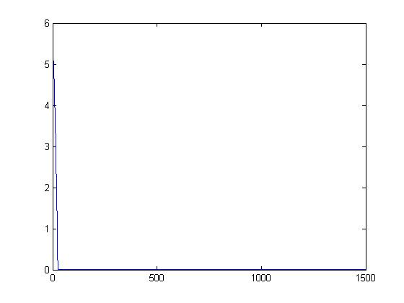
Results and Observation
In training phase : The optimum value of weight matrix is calculated so that the error is minimized.
MSE = 0.0528

Slide 14
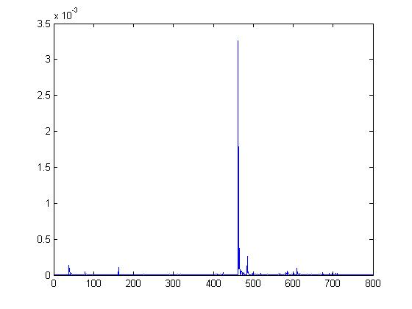
In testing phase : The error is almost zero as we have freezed the optimum weight matrix values and used them as inputs for out neural network model.
MSE = 9.9013e-006

Slide 15

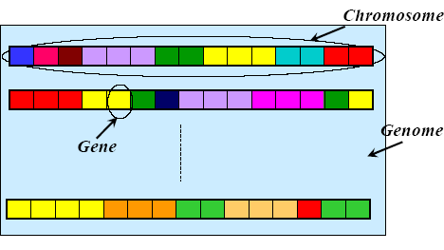
What Is Genetic Algorithm??

Slide 16
INITIALIZE POPULATION
DATA FOR TRAINING
CALCULATE FITNESS
PROBLEM REPRESENT
SELECTION
CROSSOVER AND MUTATION
CHECK CONVERGENCE
APPLY TRADING RULES

Slide 17
POPULATION(chromosomes)
Phenotype
Fitness
Selection
OBJECTIVE FUNCTION
PARENTS
Replacement
Fitness
Genetic Operation
Phenotype
OFFSPRING

Slide 18
Genetic Algorithm For GA
OUTLINE
START
FITNESS
NEW POPULATION
SELECTION
CROSSOVER
MUTATION
ACCEPTING
REPLACEMENT
TEST
Go To STEP 2

Slide 19
Why GA??
The first and most important point is that genetic algorithms are intrinsically parallel.
Another notable strength of genetic algorithms is that they perform well in problems for which the fitness landscape is complex - ones where the fitness function is discontinuous, noisy, changes over time, or has many local optima.
Another area in which genetic algorithms excel is their ability to manipulate many parameters simultaneously.

Slide 20
Conclusion
To make the Genetic Algorithm applicable for generating rules for large data sets it should be made scalable and for this purpose an incremental Genetic Algorithm is discussed in this paper which builds the model in a fine granular way.
The application of GA in NN for reinforcement learning can also prove to be a worth-while area for future work. Combination of GA and NN are likely to also continue to impact the field of artificial life.
To make genetic algorithm more effective and efficient it can be incorporated with other techniques within its framework to produce a hybrid genetic algorithm that can reap best from its combination.

Slide 21
THANK YOU

