Slide 1
Project: COVID death rate and World Health Statistics
By Jyothi Samudrala

Slide 2
Project Purpose:
Is covid death rate higher in countries where alcohol consumption is higher?
Is covid death rate higher in countries that have a high probability of death from non-communicable diseases (cancer, heart disease etc.)?
Is covid death rate higher in countries that have high tobacco consumption?
Current news and studies may answer with a general “yes” to the above questions. However, my intent is to understand the true relation between death rate and some of the world health statistics; perhaps there are surprises that go against conventional understanding.

Slide 3
Data Sets
Latest Covid 19 Data containing Death and Recovery numbers, based on country
World Health Statistics data, based on country
Probability of dying between the age of 30 and 70 because of non-communicable diseases like cancer, cardiovascular disease, cancer, diabetes or chronic respiratory disease.
Alcohol Substance abuse indicated by alcohol consumption per capita.
Prevalence of current tobacco use among persons aged 15 years and older

Slide 4
Variable Choice
Country/Location. Example Value: United States. Categorical.
Death rate (result of total covid deaths divided by total covid cases). Example Value: 4.15 percent
Recovery rate (result of total covid recoveries divided by total covid cases). Example Value: 67.33 percent
Alcohol substance abuse numeric per capita, indicating alcohol consumption. 2018 Data. Example Value: 18.8
Numeric value indicating probability of dying between the age of 30 and exact age of 70 from any of the cardiovascular disease, cancer, diabetes, or chronic respiratory disease. 2016 Data. Example Value: 14.2
Prevalence of current tobacco use among persons aged 15 years and older. Numeric value. 2018 Data. Example Value: 26.7

Slide 5
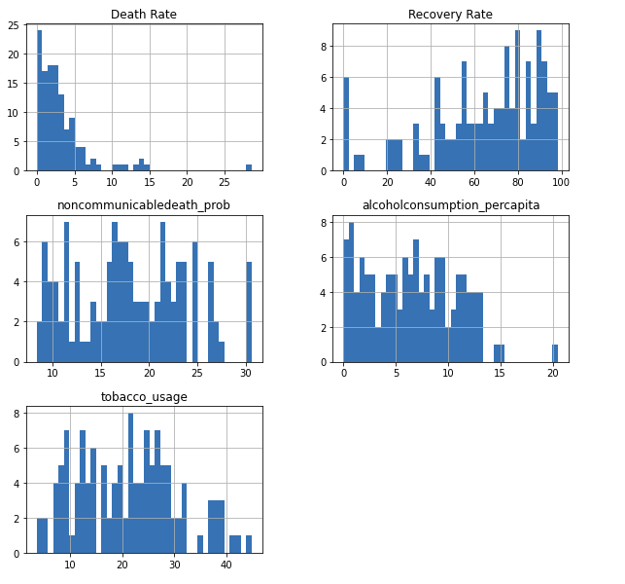
Histograms of Chosen Variables

Slide 6
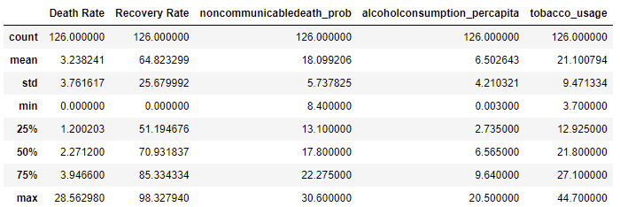
Missing values, Duplicates, Outliers, and Descriptive Statistics
Rows with missing values were removed to avoid unnecessary bias
There were no Duplicates
Based on histograms and Descriptive statistics, there are no outliers

Slide 7
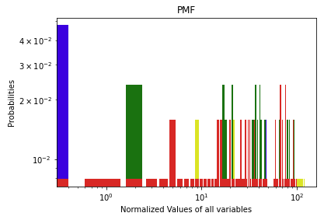
PMF
Data is not discrete, and continuous. So, PMF is not a good representation for answering project questions.
Blue – Death Rate
Red - tobacco_usage
Green - noncommunicabledeath_prob
Yellow - alcoholconsumption_percapita

Slide 8
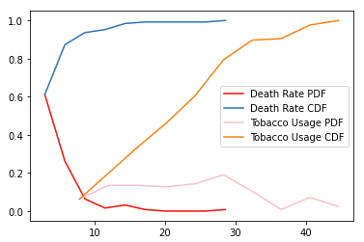
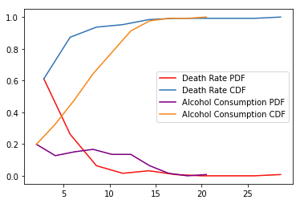
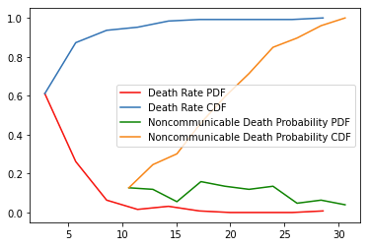
PDF and CDF
Based on PDF and CDF, except for alcohol consumption – to a certain extent – none of the other health related variables seem to vary together with covid death rate. At least within the current sample set .

Slide 9
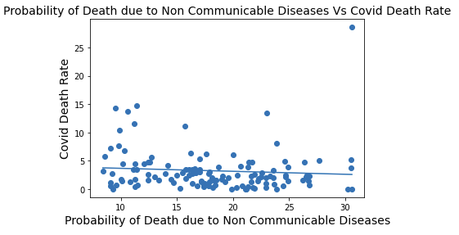
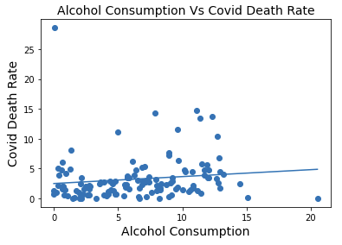
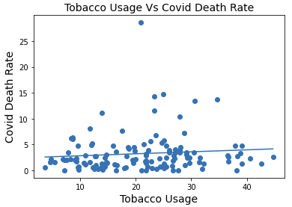
Scatter plots and fitted line
Based on the scatter plots, Tobacco and alcohol consumption seems to have a positive linear relation with covid death rate. Data on non-communicable diseases with respect to covid death rate seems inconclusive

Slide 10
Covariance, Pearsonr and Spearmanr
Covariance for alcoholconsumption_percapita: 2.05870018
Pearsonr for alcoholconsumption_percapita: 0.12998802336952864
Spearmanr for alcoholconsumption_percapita: 0.26418232845296885
Covariance for noncommunicabledeath_prob: -1.72755122
Pearsonr for noncommunicabledeath_prob: -0.08004036301776227
Spearmanr for noncommunicabledeath_prob: -0.18269253846709124
Covariance for tobacco_usage: 3.43526956
Pearsonr for tobacco_usage: 0.09642177636969855
Spearmanr for tobacco_usage: 0.13157515794838082

Slide 11
Inference from covariance and correlation
Alcohol consumption and tobacco consumption seem to have a slightly positive correlation with covid death rate. Meaning, higher the consumption, higher the death rate
Prevalence of non communicable diseases seems to have a negative correlation with covid death rate, however, I am inclined to say non communicable disease relation to covid death rate is inconclusive as the dataset is not large enough.

Slide 12
Hypothesis Testing - One Sample T test and Z test
I chose to do a simple t test and z test as my distributions are not categorical (ruling out chisquare test), we are not comparing two groups (ruling out anova f-test).
Reason for choosing the above tests: The distributions are selected from a population, where each item has an equal chance of being selected. And the distributions are somewhat close to normal.
Based on the tests, One Sample T Test and a Z Test, for independent variables (world health statistics), with p values lower than 0.05, we are rejecting null hypothesis. The effect between covid death rate and world health statistics (alcohol consumption, tobacco consumption and probability of dying from non-communicable diseases) is statistically significant.

Slide 13
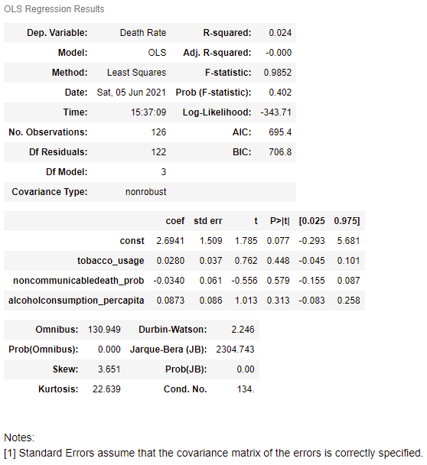
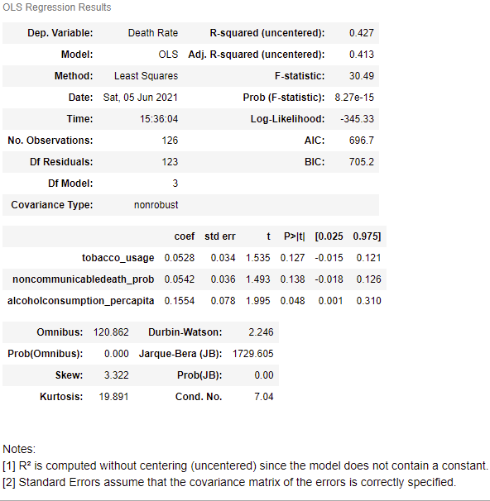
Multiple Regression Analysis

Slide 14
Inference from Multiple Regression Analysis
R-squared is low – the selected independent variables don’t explain covid death rate to a large extent
Coefficients indicate similar results as mentioned in the “covariance and correlation” slides
In general, I would not rely on this model for predicting covid death rate

Slide 15
Answers to my project questions
Is covid death rate higher in countries where alcohol consumption is higher?
Yes – slightly
Is covid death rate higher in countries that have a high probability of death from non-communicable diseases?
No – data is not conclusive. This was surprising as I saw a negative relation based on the available data.
Is covid death rate higher in countries that have high tobacco consumption?
Yes – slightly

