Slide 1
Heart Disease Analysis
Prateek Sarangi

Slide 2
Import dataset and view it as a dataframe

Slide 3
Feature enginerring and data analysis done for the dataset.
## age sex cp trestbps chol fbs restecg thalach exang oldpeak slope ca thal
## 1 0.6 0.9 0.01 0.6 0.3 0.1 0.3 0.6030534 0.9 2.3 0.01 0.9 0.1
## 2 0.1 0.9 0.90 0.6 0.3 0.9 0.9 0.8854962 0.9 3.5 0.01 0.9 0.1
## 3 0.1 0.1 0.60 0.6 0.1 0.9 0.3 0.7709924 0.9 1.4 0.90 0.9 0.1
## 4 0.4 0.9 0.60 0.2 0.3 0.9 0.9 0.8167939 0.9 0.8 0.90 0.9 0.1
## 5 0.4 0.1 0.10 0.2 0.5 0.9 0.9 0.7022901 0.1 0.6 0.90 0.9 0.1
## 6 0.4 0.9 0.10 0.6 0.1 0.9 0.9 0.5877863 0.9 0.4 0.20 0.9 0.1
## target
## 1 1
## 2 1
## 3 1
## 4 1
## 5 1
## 6 1

Slide 4
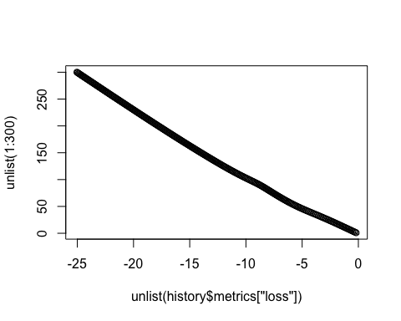

Slide 5
## $loss
## [1] -26.44949
##
## $accuracy
## [1] 0.05940594

