Slide 1
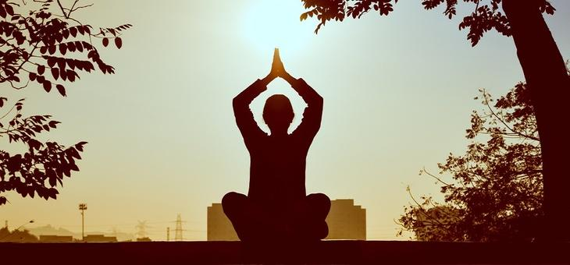
















Healthy lifestyle not only changes your body, It changes your mind, your attitude and mood
Towards the Healthier Tomorrow
Let’s Navigate ….Inside

