Slide 1
Machine Failure Prediction
Classification for imbalanced dataset by class balancing techniques using the date time analysis and evaluating the failure condition correctly with machine learning algorithm
BUSINESS PROBLEM
Imbalanced Dataset
Observed Failure(Yes) – 81
Non-Failures(No)-8073
Date and Time parameters are important for predicting machine failure as machine’s efficiency decreases with time and can be related to no. of days or any particular day of the week
Logistic Regression
Radial basis SVM
Polynomial SVM
Logistic Regression
accuracy - 0.88
F1_score – 0.52
Radial basis SVM
accuracy - 0.99
F1_score – 0.49
Polynomial SVM
accuracy - 0.98
F1_score – 0.52
PHASE 1: UNDERSTAND
PHASE 2: MODEL
PHASE 3: APPLY
Predicting the machine failure with the help of one or more features available in dataset
SOLUTION
BENEFIT
Predicting the failure analysis will help us in pre-maintenance of the machines
FTE: < >
FTE: < >
FTE: < >
BUSINESS BENEFIT
TECHNOLOGY STACK
In general, model predicts nonfailure due to its imbalancedness. But we try to tune model to predict failures. So that, we could give maintenance to machines which are about to fail. This way we could intelligently spend on maintenance and save expenses when failure happens
Langauge – Python
Libraries – ScikitLearn, Pandas, Seaborn, MatplotLib

Slide 2
Data analysis
Observed the Failure features learning about the nature of dataset as an Imbalanced Dataset
Observed Failure(Yes) – 81
Non-Failures(No)-8073
Temperature is highly correlated with the failure. As temperature increased, there were more machine failures
Particular date-time-month or day of the week giving insight for the failure prediction. Not dropping those features because may be some specific month or specific weekday leads to more failures.

Slide 3
Data Preprocessing for Training
Data splitting has to be done for the training purpose
Data is imbalanced so it can result in imbalanced splitting of the dataset i.e. we can have all the failure points in training set or zero failure points
Dataset Stratification
It will help us quite a lot if we could split the data accordingly to the present ratio of negatives and positives
Splitting of dataset having failure and non-failure points in same ratio in training set as well as test set
This will help in better training of models, keeping the ratio of dataset same for training and test dataset

Slide 4
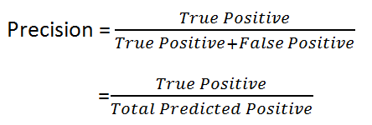
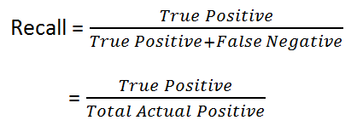

Metrics
Accuracy may not always be the metric to select the best model
Accuracy can be largely contributed by a large number of True Negatives, whereas False Negative and False Positive usually has business costs (tangible & intangible)
Thus, F1 Score might be a better measure to use if we need to seek a balance between Precision and Recall, if there is an uneven class distribution (large number of Actual Negatives)

Slide 5
Models
Logistic Regression - Logistic regression is used to describe data and to explain the relationship between one dependent binary variable and one or more nominal, ordinal, interval or ratio-level independent variables. Accuracy of the model was good but giving a bad f1_score
Radial basis function - In machine learning, the radial basis function kernel, or RBF kernel, is a popular kernel function used in various kernelized learning algorithms. In particular, it is commonly used in support vector machine classification model and it was overfitting, such that it was saying zeros at every instance and giving a bad f1_score
Polynomial SVM - It represents the similarity of vectors (training samples) in a feature space over polynomials of the original variables, allowing learning of non-linear models. Accuracy and f1_score of the model was good

Slide 6
Future methods which could have been tried:-
Random Oversampling of minority class, but in our case, since minority class was so low; it could have lead to overfitting to data points in minority class
Random Undersampling of majority class – but this could have led to randomly missing some important data for predicting non-failures
Using Synthetic Minority oversampling (SMOTE) for equal representations of both the classes
Training of models for different ratios of negatives and positives and taking the majority vote from these ensemble of models

