Slide 1
Understanding Basic SQL Commands with Examples

Slide 2
Database
Definition:
A database is a collection of logically organized data.
It stores Data in a structured way so it can be easily accessed, managed, and updated.
Real-world analogy:
Think of a database as a cabinet and tables as drawers within the cabinet, each containing related files.

Slide 3
How to Create a Database
CREATE DATABASE database_name;
The command creates a new database on your SQL server.
Database names should be unique and follow naming rules (no spaces, no special characters).
Use IF NOT EXISTS to avoid errors:
CREATE DATABASE IF NOT EXISTS database_name;

Slide 4
How to Show Databases
SHOW DATABASES;
Llists all databases currently present in the MySQL server.

Slide 5
Selecting a Database to Use
USE database_name;
You must “select” a database before creating tables or inserting data into it.

Slide 6
How to Drop (Delete) a Database
DROP DATABASE database_name;
This command permanently deletes the database and all of its contents.
DROP DATABASE IF EXISTS CollegeDB;

Slide 7
Creating a Table with Syntax and Example
CREATE TABLE table_name (
column1 datatype constraints,
column2 datatype constraints,
...
);

Slide 8
CREATE TABLE Students
(
StudentID INT
Name VARCHAR(100),
Age INT,
Email VARCHAR(100)
);

Slide 9
Display Table Structure
DESCRIBE table_name;
DESCRIBE Students;
Shows column names, data types, nullability, keys, and default values.

Slide 10
Rename a Table
RENAME TABLE old_name TO new_name;
RENAME TABLE Students TO Learners;
Keeps data intact, just changes the table's name.

Slide 11
Modify Table Structure
ALTER TABLE is used to change the table after creation.
Add a New Column
ALTER TABLE Students ADD Gender VARCHAR(10);
Drop a Column
ALTER TABLE Students DROP COLUMN Email;
Rename a Column
ALTER TABLE Students CHANGE Name FullName VARCHAR(100);
Modify Data Type
ALTER TABLE Students MODIFY Age TINYINT;

Slide 12
Drop a Table
DROP TABLE table_name;
DROP TABLE Students;
Deletes the entire table and all records within it.

Slide 13
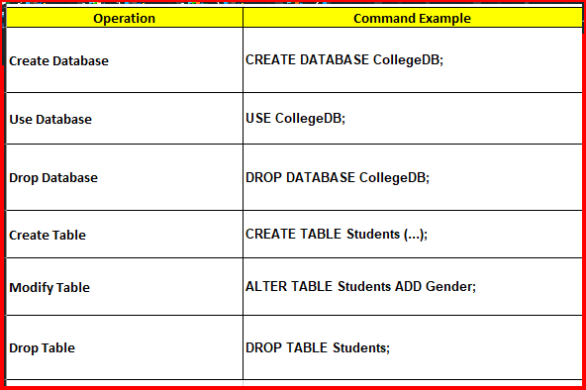
Summary with example: database : CollegeDB table name: Students

Slide 14
Question
Create a table named Courses with columns: CourseID, CourseName, Duration.
How do you remove a column Email from the Students table?
What is the difference between DROP TABLE and DELETE FROM?
Rename the table Courses to Subjects.
Add a new column Department to the table Teachers.

