Slide 1
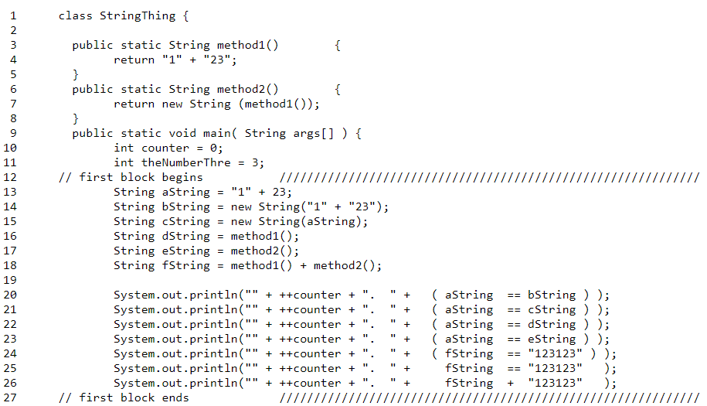
BLOCK - 1
i
“123“
“123“
“123“
“123”
“123123”
i
ii
iii
i
iv
v
ii
iii
iv
v
aString
bString
cString
OUTPUT
dString
1. false
2. false
3. true
4. false
5. false
false
7. 123123123123
eString
fString
EXPLANATION
Line 13 is executed, “123” is assigned a memory location (i) which is provided to aString.
In line 14, a new memory block (ii) is allocated to bString as it is created using new keyword.
In line 15, a new memory block (iii) is allocated to cString as it is created using new keyword.
Line 16 calls method1() that returns a literal “123”, created during compile time and points to the same memory location (i) as aString.
Line 17 calls method2() that uses new keyword and thus eString is allocated a new memory location (iv) .
Line 18 adds method1() that returns a literal and method2() that returns a string object. Thus, fString is assigned a new memory location (v).

Slide 2
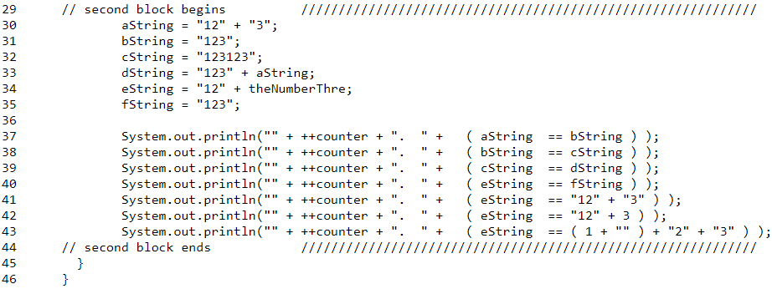
BLOCK - 2
i
“123“
“123123“
“123123“
“123”
i
i
ii
iii
iv
i
ii
iii
iv
aString
bString
OUTPUT
cString
8. true
9. false
10. false
11. false
12. false
13. false
14. false
dString
eString
fString
EXPLANATION
1. In line 30, string literal “123” is allocated a memory location (i).
2. In line 31, a literal is created at compile time and is allocated same memory location (i) as aString.
3. In line 32, a literal is created “123123” and allocated a new memory location (ii).
4. In line 33, a new literal is created using a variable during runtime. Thus, a new memory location is allocated (iii).
5. In line 34, a new literal is created using a variable during runtime. Thus, a new memory location is allocated (iv).
6. In line 35, a literal is created at compile time and is allocated same memory location (i) as aString.

