Slide 1
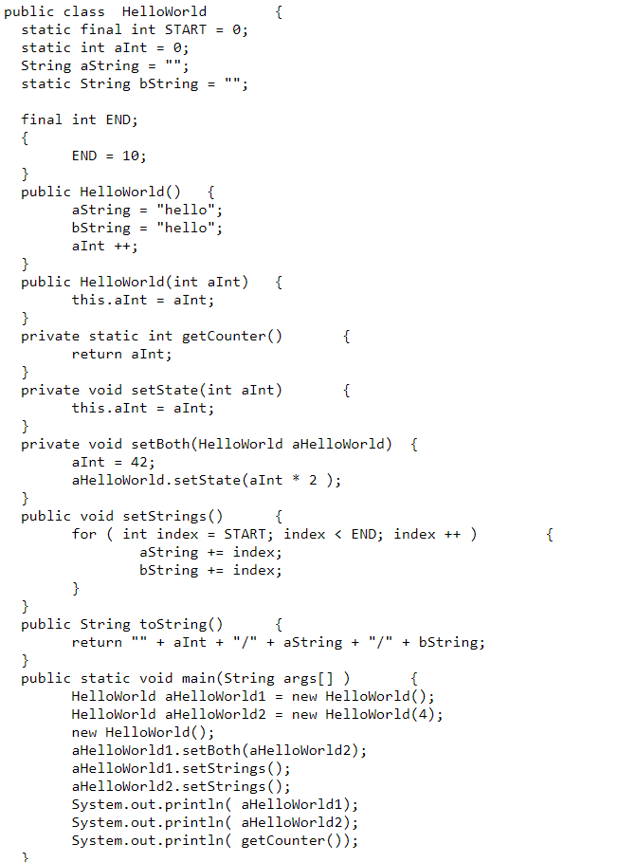
Static fields
HelloWorld.Start = 0
HelloWorld.aInt = 0
HelloWorld.bString = “ “
Prateek Sharma
Kirti Sharma
HelloWorld aHelloWorld1 = new HelloWorld();
Static fields
HelloWorld.Start = 0
HelloWorld.aInt = 1
HelloWorld.bString = “hello “
HelloWorld Instance
aString = “hello”
END = 10

Slide 2
HelloWorld aHelloWorld2 = new HelloWorld(4);
Static fields
HelloWorld.Start = 0
HelloWorld.aInt = 4
HelloWorld.bString = “hello “
HelloWorld Instance
aString = “hello”
END = 10
new HelloWorld();
Static fields
HelloWorld.Start = 0
HelloWorld.aInt = 5
HelloWorld.bString = “hello “
HelloWorld Instance
aString = “hello”
END = 10

Slide 3
aHelloWorld1.setBoth(aHelloWorld2);
Static fields
HelloWorld.Start = 0
HelloWorld.aInt = 84
HelloWorld.bString = “hello “
HelloWorld Instance
aString = “hello”
END = 10
aHelloWorld1.setStrings();
Static fields
HelloWorld.Start = 0
HelloWorld.aInt = 84
HelloWorld.bString = “hello01234567890 “
HelloWorld Instance
aString = “hello01234567890”
END = 10

Slide 4
Static fields
HelloWorld.Start = 0
HelloWorld.aInt = 84
HelloWorld.bString = “hello01234567890123456789 “
HelloWorld Instance
aString = “0123456789”
END = 10
OUTPUT:
84/hello0123456789/hello01234567890123456789
84/0123456789/hello01234567890123456789
84
How many class variables do exist, for how long? 3
They exist for the entire duration of the program
How many instance variables do exist, for how long? 12
Exists for the lifetime of each individual “HelloWorld” object.
Is it possible to change all public methods to private?
Yes we can change the methods to private, but we won’t be able to use them from outside the program.

