Slide 1
Capstone Project

Slide 2
Bank Note Authentication

Slide 3

Acknowledgement
This Capstone Project was completed under the supervision of Mr. Arun Upadhyay, a lecturer.

Slide 4
Components
Gathered Data
EDA(Exploratory Data Analysis)
Training And Testing Data
Report
Feature Engineering

Slide 5
Gathered Data
This dataset was obtained from the UCI Dataset Repository.
This website is for educational purposes, and it contains numerous datasets.
The dataset "Bank Note Authentication" is a classification problem dataset.

Slide 6
Generic Libraries
import numpy as np
import pandas as pd
import matplotlib.pyplot as plt
%matplotlib inline
import seaborn as sns
import warnings
warnings.filterwarnings('ignore')

Slide 7
Exploratory Data Analysis
Pairplot
Histogram with (Kernel Density Estimator)
HeatMap
Boxplot
Plotted Confusion Matrix
Plotted ROC Curve

Slide 8
EDA(Continued)

Slide 9
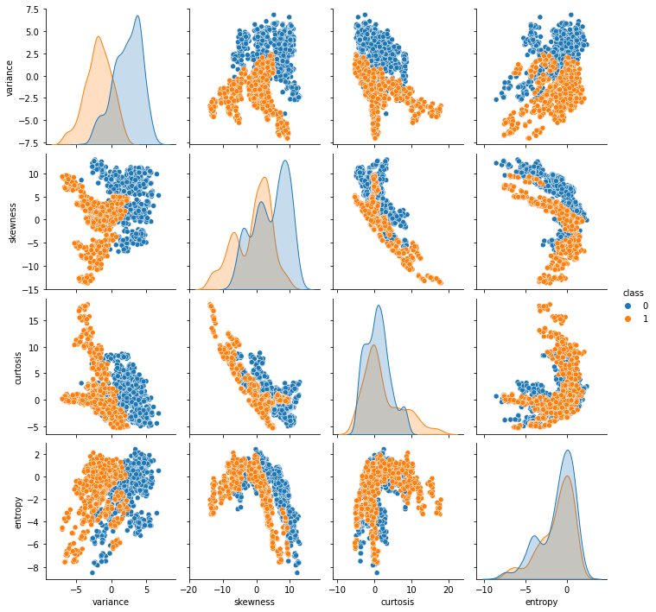
Pair Plot

Slide 10
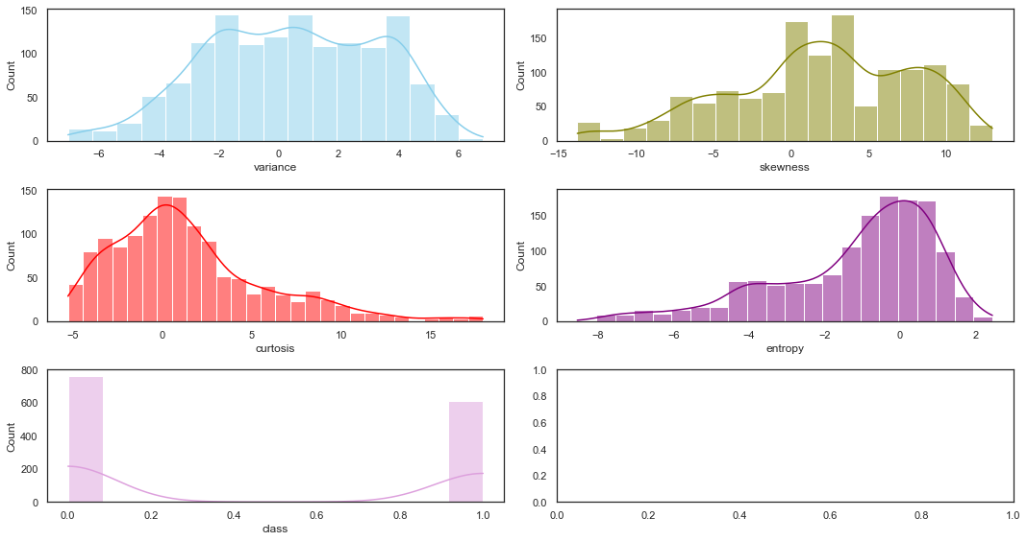
Histogram

Slide 11
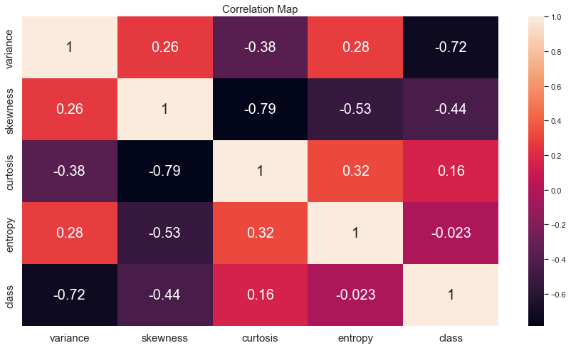
HeatMap

Slide 12
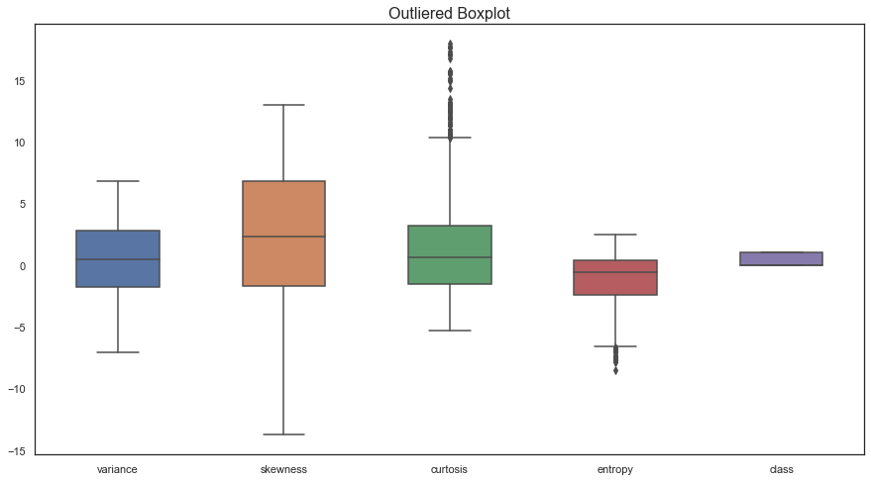
Boxplot

Slide 13
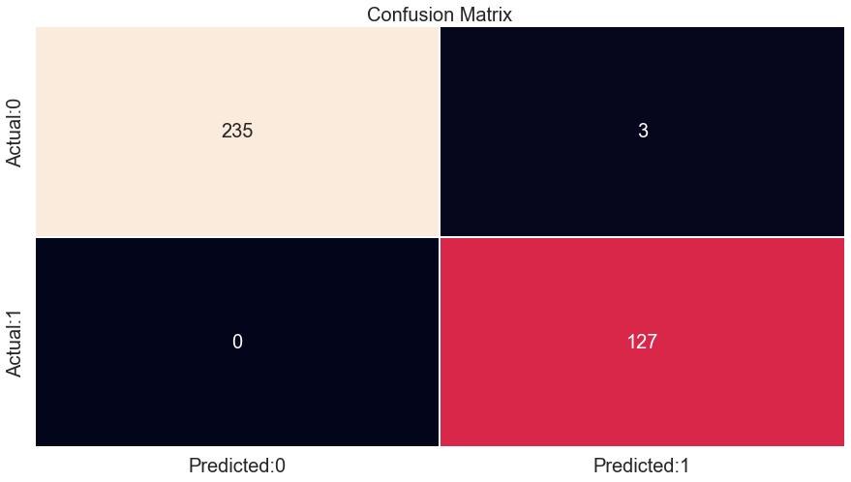
Confusion Matrix

Slide 14
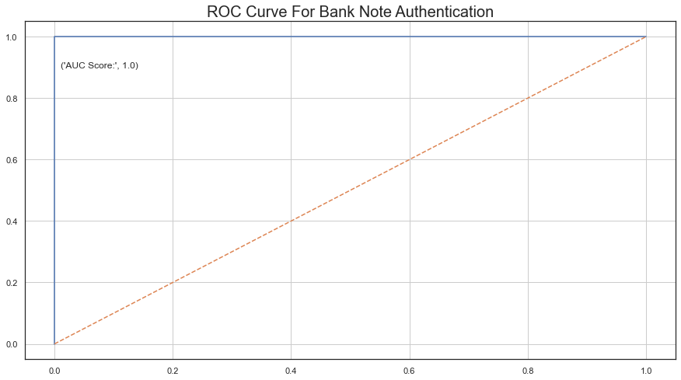
ROC Curve

Slide 15
Feature Engineering
Outliers Removal
PreProcessing
Normalisation
Splitting Dataset

Slide 16
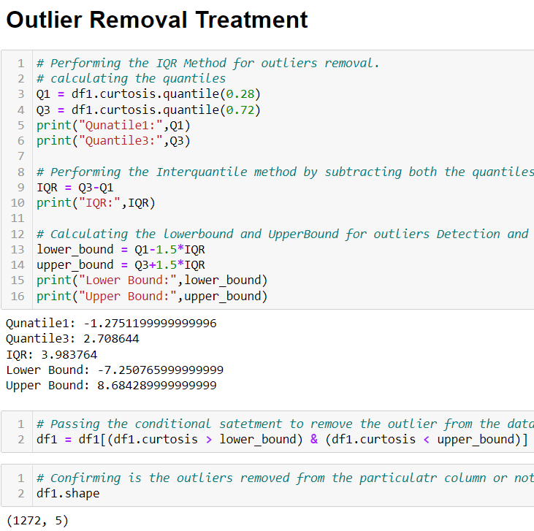
Outliers Removing
Used IQR Method
Then passed the conditional Statement
Rechecked by using boxplot and .shape function

Slide 17
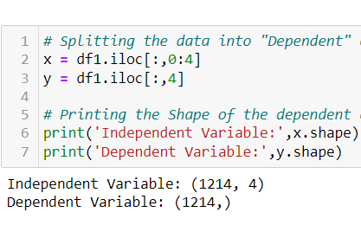
Splitting Dataset
Independent Features
Dependent Feature

Slide 18
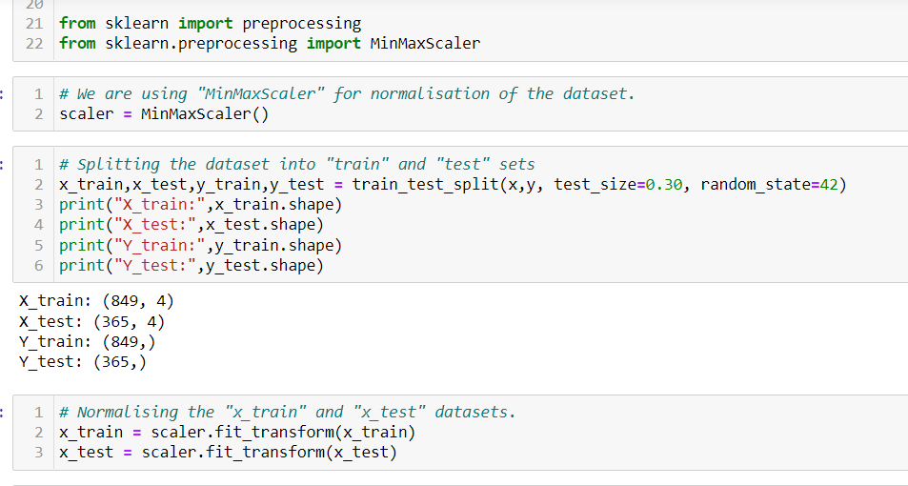
Splitting the Data into Train and Test Dataset and Performed Normalisation
Used MinMaxScale()
Performed on X_train, X_test dataset

Slide 19
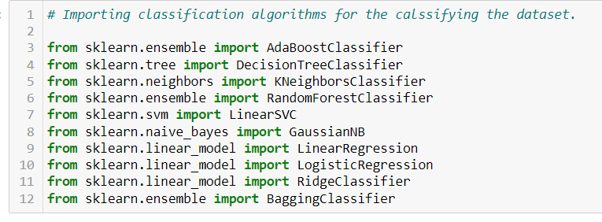
Importing Libraries for Model Building
Adaboost
Decision Tree
Random Forest
K Nearest Neighbor
Many More

Slide 20
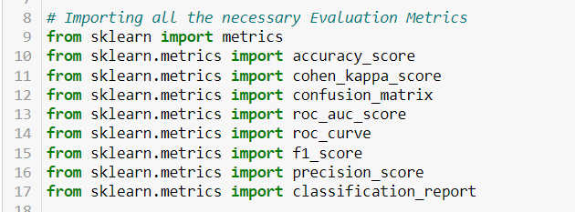
Importing Metrics Evaluation Libraries
Accuracy_Score
ROC_AUC_Score
Cohen_Kappa_Score
F1-Score
Precision Score
Classification Report

Slide 21
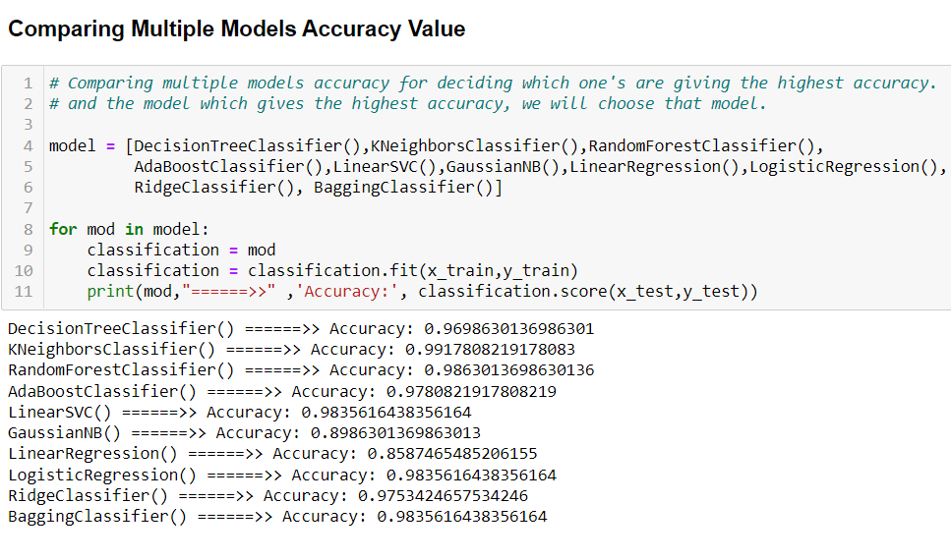
Comparing Models
I compared many classification algorithms using a "for loop" statement; by running the models through a loop, I can compare many models in less time and spend less time deciding which model to use.

Slide 22
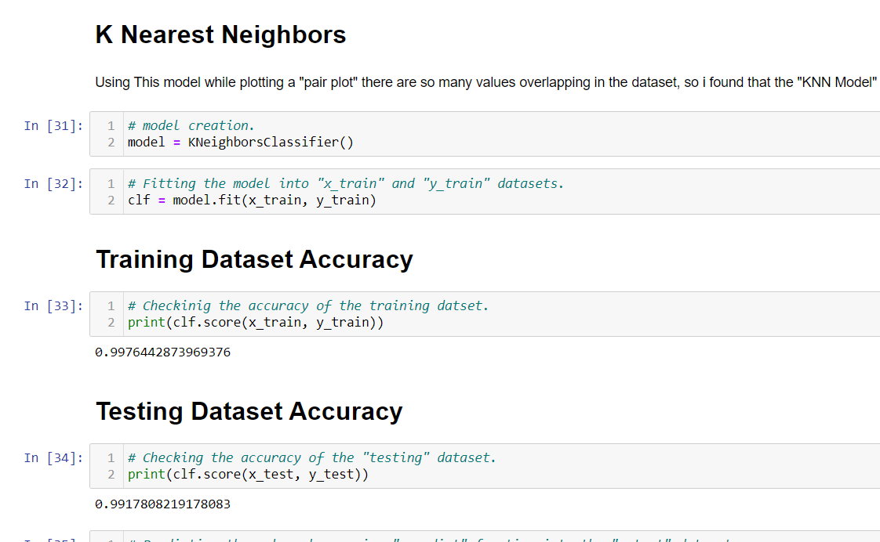
K Nearest Neighbor
When I plotted the PairPlot by passing the target variable in the hue class, I noticed that many values of the target variable were overlapping on the independent variables, whereas we know that the k Nearest Neighbor algorithm finds the likelihood points and then creates a hyperplane to separate them.

Slide 23
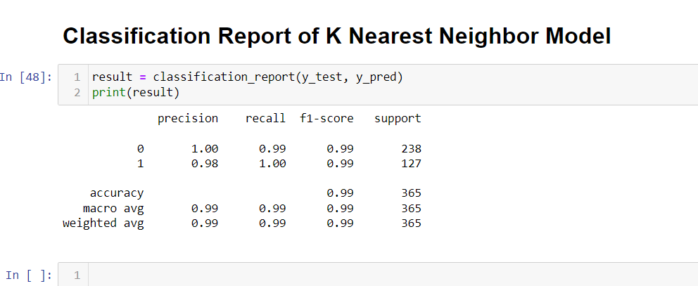
Summary Report
By following these steps for model building, my model achieves 99 percent accuracy, despite the fact that in K Nearest Neighbor algorithms, the distance is calculated, so when using this model, we must perform feature scaling to avoid any type of underfitting or overfitting, as well as to avoid data leakage problems and to reach global minima as quickly as possible after training and testing.

