Slide 1

Capstone Project 2

Slide 2

Credit Amount Prediction

Slide 3

Acknowledgement
This Capstone Project was completed under the supervision of Mr. Arun Upadhyay.

Slide 4

Components
Gathered Data
EDA(Exploratory Data Analysis)
Training And Testing Data
Report
Feature Engineering

Slide 5
Gathered Data
This dataset was obtained from the Hackathon
The website name is skillenza partnered with Imarticus Learning
The dataset “Credit Amount Prediction" is a Regression problem dataset.

Slide 6
Generic Libraries
import numpy as np
import pandas as pd
import matplotlib.pyplot as plt
%matplotlib inline
import seaborn as sns
import warnings
warnings.filterwarnings('ignore')

Slide 7
Exploratory Data Analysis
Pairplot
Histogram with (Kernel Density Estimator)
HeatMap
Boxplot
Displot

Slide 8

EDA Visualisations

Slide 9
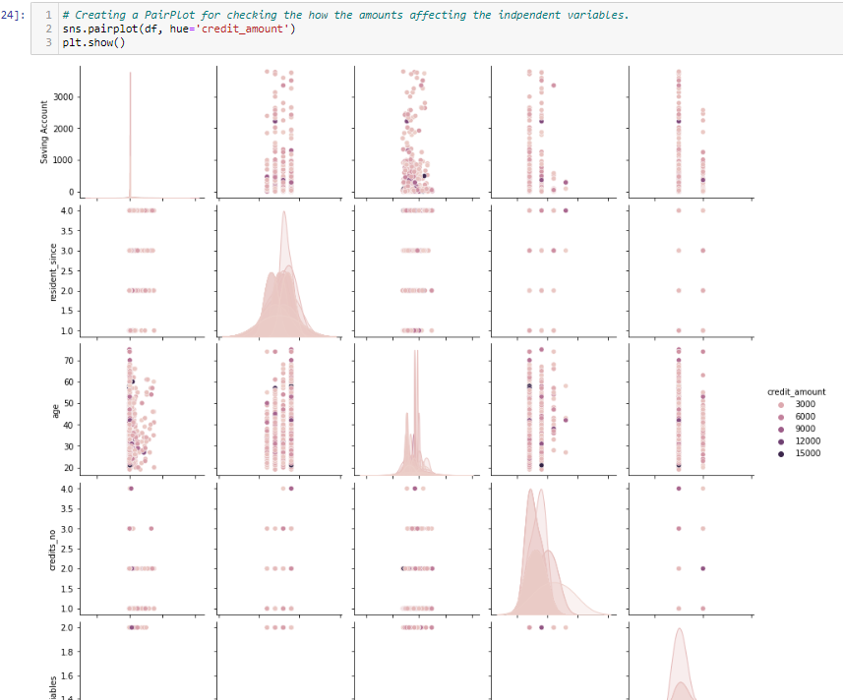
Pair Plot
We can clearly see in the pairplot that there are many outliers in our target variable, but because this is our Credit Amount Column, we won't consider it an outlier.

Slide 10
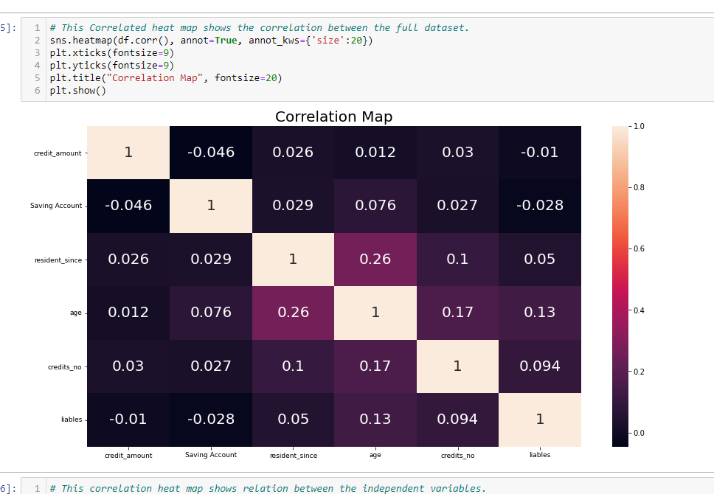
HeatMap
In the correlation heatmap, we can see that there are two columns that have no correlation with our target variable and our "Savings Account" column of our independent variables.

Slide 11
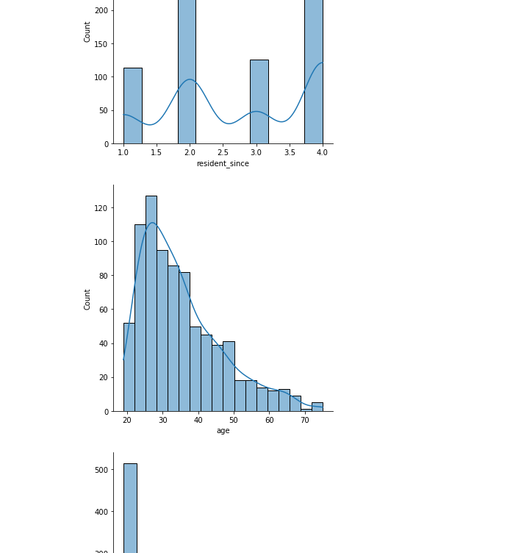
Displot
In this plot, we can see that the data is not normally distributed; as we know, while training a model, a parabola curve is created, and the dataset needs to be distributed normally, or the data should be gaussian distributed.

Slide 12
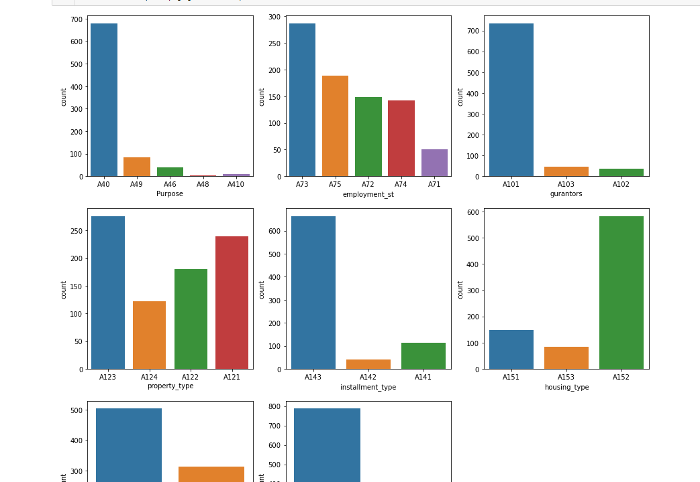
CountPlot
Because these are all Categorical variables in our dataset, I created a loop to generate these countplots.

Slide 13
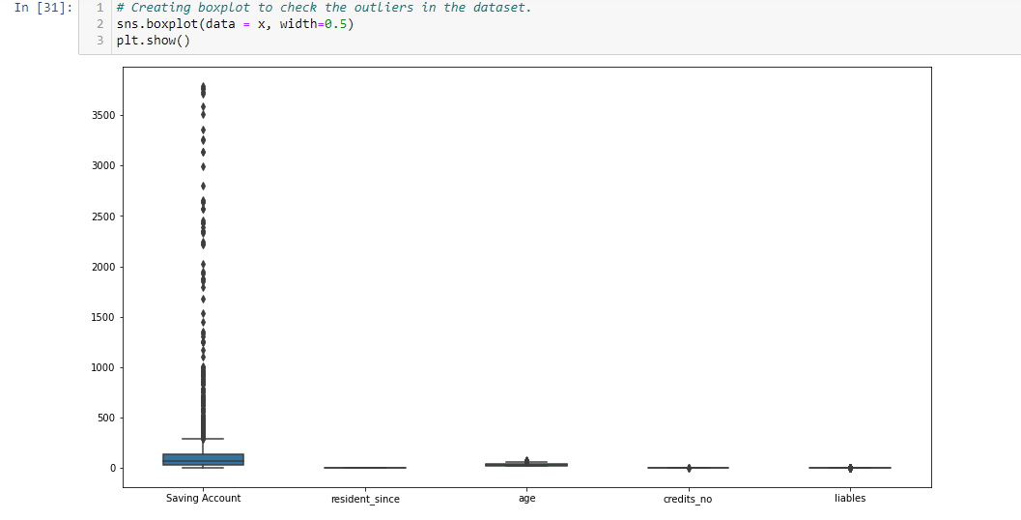
Boxplot
In this boxplot, we can see that there are many outliers in the "Saving Account" column, but the Saving Account column is a continuous range value, so it cannot be considered an outlier.

Slide 14
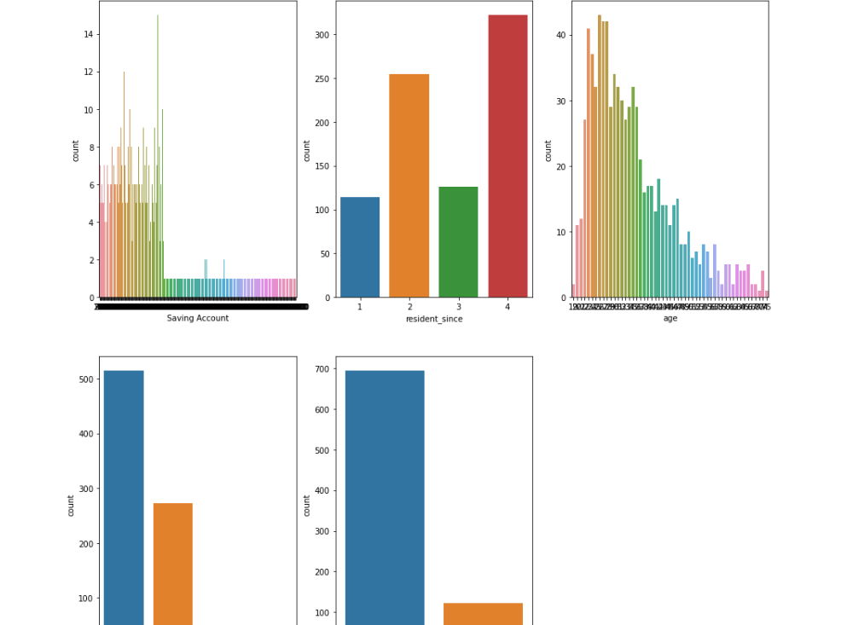
Numeric variables CountPlot
This is a countplot of numerical variables. The countplot also shows that the variables are not normally distributed, so we must perform Standard Scaling to scale down the data and reach the global minima faster.

Slide 15

Feature Engineering
Outliers Removal
Pre-Processing
Normalisation and Standardising Data
Splitting Dataset

Slide 16
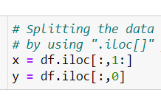
Splitting Dataset
Independent Features
Dependent Feature

Slide 17
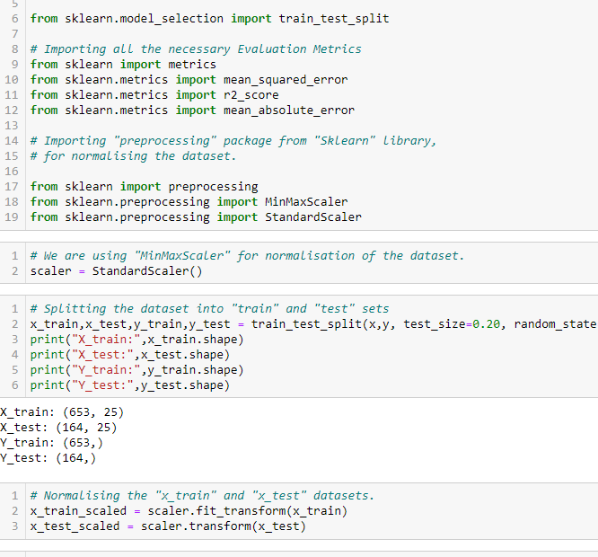
Splitting the Data into Train and Test Dataset and Performed Standardisation
Used StandarScaler()
Performed on X_train, X_test dataset

Slide 18
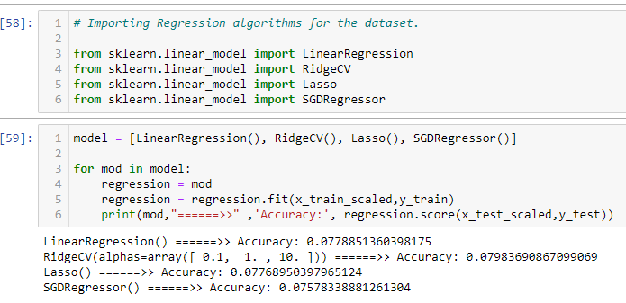
Importing Libraries for Model Building
LinearRegression
RidgeCV
Lasso
SGDRegressor

Slide 19

Importing Metrics Evaluation Libraries
RMSE
R-Squared
Adjusted-R-Squared
MSE
MAE

Slide 20
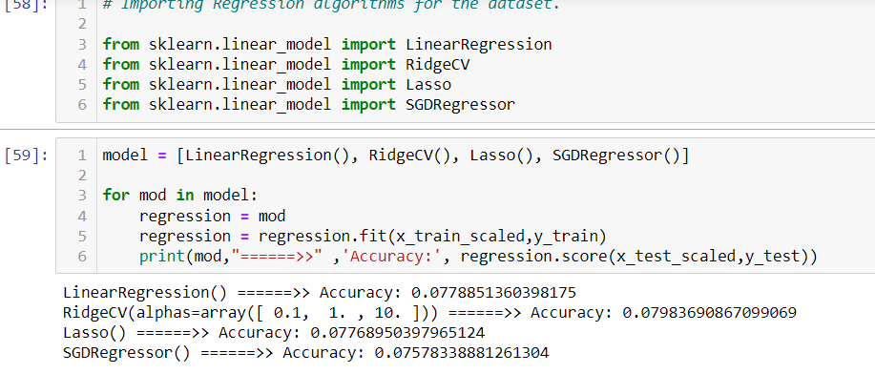
Comparing Models
I compared multiple Rgression algorithms using a "for loop" statement, by running the models through a loop, I can compare multiple models in less time and spend less time deciding which model to use, and which model is giving me the highest accuracy.

Slide 21
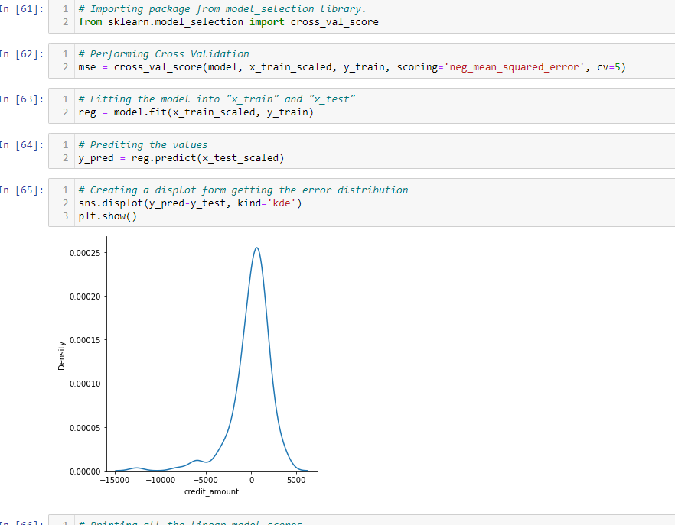
LinearRegression()
As we know, it's a regression problem statement, and while we know that in regression, there is no such thing as accuracy, there is only model efficiency, which is how our model works after deployment and how much error rate the model stat analysis shows, and then we decide whether to use the model or not.

Slide 22
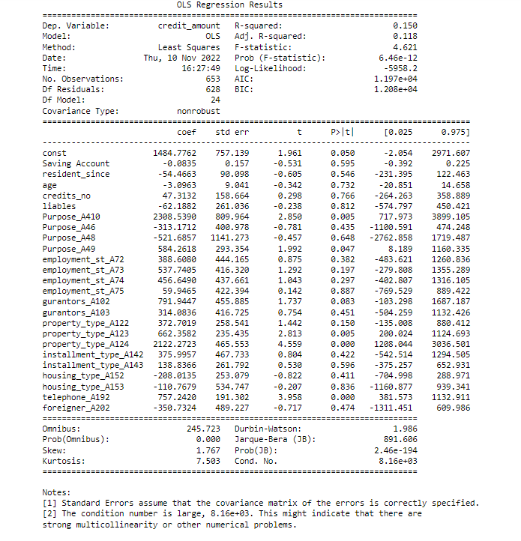
Summary Report
The conclusion of this OLS Summary is that my model has a very low error rate, and we can use it in real-world banking problems, and after deployment, this model will not cause data leakage.

